Slide 1
Relay Operation Follow-up
Date: 2023-12-08
Authors:

Slide 2
Introduction
A potential relay architecture is proposed in [1], i.e. the relay AP is advertised as an affiliated AP of the AP MLD.
Under this relay architecture, the non-AP MLD can use the link reconfiguration to flexibly add or remove the relay link with its mobility.
In this presentation, we shows some updates since the last presentation.
  Support the legacy client’s association
  Addressing scheme

Slide 3
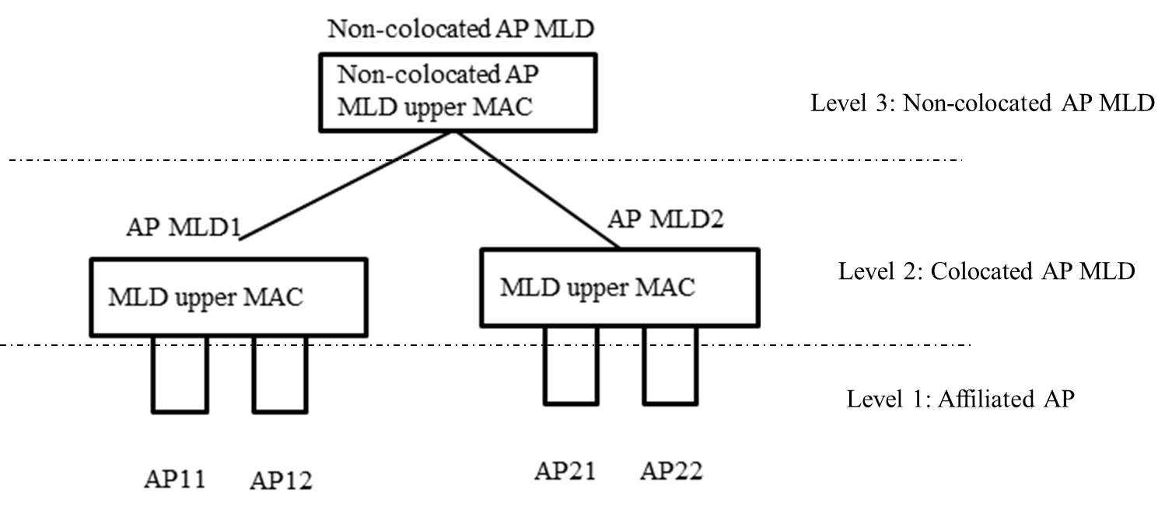
Recap Non-colocated AP MLD for seamless roaming
Considering the Link ID space (4 bits in length) is not enough, the following non-colocated AP MLD architecture for the seamless roaming is proposed.
  Each link can be identified with colocated MLD MAC address (or a newly defined colocated ID) plus link ID.
    The EHT non-AP MLD only can associate with the colocated AP MLD.
    The UHR non-AP MLD can associate with either the colocated AP MLD or the non-colocated AP MLD, which depends on whether the UHR non-AP MLD has the need of roaming.

Slide 4
Relay architecture
Each relay device consists of a relay STA (or named backhaul STA) and a relay AP.
  Case 1. The relay AP can share a common radio with the relay STA and operates on the same channel.
    In this case, the TXS mechanism may be used to improve the channel access.
    Note. Based on the current 11be draft, the non-AP MLD is not allowed to simultaneously establish link 1 and link 2.
  Case 2. The relay AP and the relay STA may use different radios and are deployed on different channels.
architecture
AP MLD
MLD upper MAC
AP 0
(2.4 GHz)
AP 1
(5 GHz)
Backhaul link
Relay STA
(Direct) link 0
(Direct) link 1
Relay function
Relay device
Relay AP
(AP 2)
(Relay) link 2
STA 0
STA 1
STA 2
architecture
MLD upper MAC
Non-AP MLD

Slide 5
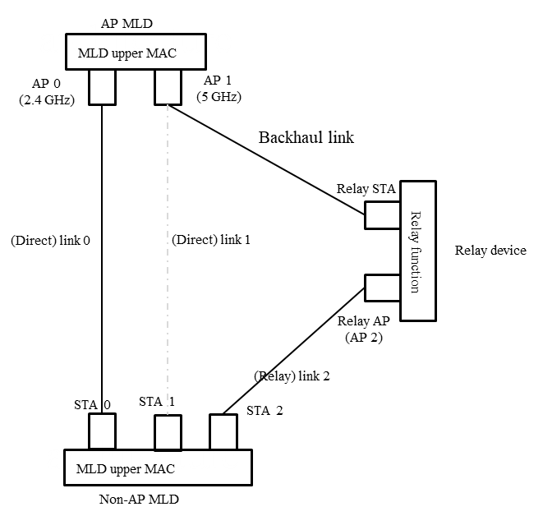
Relay architecture (Cont.)
In this scenario, the relay AP is advertised as an affiliated AP. From this point of view, the architecture is also a kind of non-colocated AP MLD.
Compared with the previous non-colocated AP MLD architecture (for the enterprise scenario), there are two following main differences
  No need to advertise the existence of another (non-collocated) AP MLD which is build on the top of the current colocated AP MLD. Because 15 links are enough for this relay scenario.
  The interface between the MLD upper MAC sublayer and the MLD lower MAC sublayer is wireless.

Slide 6
Relay architecture (Cont.)
The benefit of this proposed two-level non-colocated AP MLD architecture is it may be transparent to the EHT non-AP MLD. Thus the EHT non-AP MLD can associate with this (non-colocated) AP MLD.
  At most support 15 links.
AP MLD
MLD upper MAC
Level 2: (non-colocated) AP MLD
AP 0
(2.4 GHz)
AP 1
(5 GHz)
Relay/Backhaul STA
Relay/Backhaul STA
Level 1: Affiliated AP
AP 2
(2.4 GHz)
AP 3
(5 GHz)
AP 4
(2.4 GHz)
AP 5
(5 GHz)
Note. The pre-EHT STA still associates with the affiliated AP. So the affiliated AP has the full legacy AP function which is not in shown in this figure.

Slide 7
Discovery of relay AP
First, the relay STA initiates the association with the AP MLD.
  Meanwhile, the profile of the relay AP is included within a newly defined element of the Association Request frame, e.g.
    Operating class, channel number
    BSSID, Beacon interval, TSF, DTIM info
    Indicates whether the STA is power constrained or not
    …
After the relay STA successfully associates with AP MLD, then the AP MLD will start advertising the existence of AP 2 (i.e. relay AP) affiliated with the AP MLD through the RNR element in the Beacon frame and the Basic Multi-link element in the Probe Response frame.
  Which exactly follows the current 11be draft.

Slide 8
Relay link setup procedure
Non-colocated AP MLD
Non-AP MLD
AP MLD
Relay AP
Assuming that the non-AP MLD has established link 0 and/or link 1 with the AP MLD, the relay link setup procedure is shown as the right figure.
  Step 0. The AP MLD sends a Beacon Request to inform the non-AP MLD to do the measurement on the RSSI of the relay AP.
  Step 1. The AP MLD sends a Link Reconfiguration Notify frame to recommend the non-AP MLD to establish the relay link based on the received Beacon Report.
  Step 2. The non-AP MLD exchanges Link Reconfiguration Request/Response frames with the AP MLD through one of direct links to establish the relay link.
Beacon Request
Beacon Report
Link Reconfiguration Notify
Link Reconfiguration Request
Link Reconfiguration
Link Reconfiguration Response
UL transmission
(switch to awake state)

Slide 9
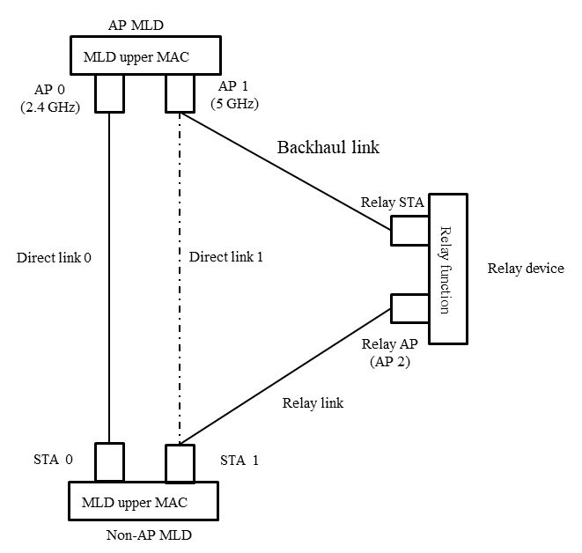
Addressing scheme
The queued individually addressed MPDU is tunneled between the MLD upper MAC sublayer of the AP MLD and the MLD lower MAC sublayer of the relay AP through the wireless backhaul link (i.e. AP 1 ↔ relay STA).
  The non-AP MLD associates with the AP MLD and derives the corresponding PTK, denotes as PTK.
  The relay STA associates with one AP affiliated with the AP MLD and derives the corresponding PTK, denotes as PTK`.
MPDU protected by PTK`:
RA=Relay STA
TA= AP 1
DA=Non-AP MLD
SA=AP MLD
Encapsulated MPDU protected by PTK:
RA=STA 1
TA= Relay AP
SA
MPDU protected by PTK`:
RA=AP 1
TA= Relay STA
DA=AP MLD
SA=Non-AP MLD
PTK`
Encapsulated MPDU protected by PTK:
RA=Relay AP 1
TA= STA 1
DA
Encapsulated MPDU protected by PTK:
RA=STA 1
TA= Relay AP
SA
Encapsulated MPDU protected by PTK:
RA=Relay AP 1
TA= STA 1
DA
Downlink
Uplink

Slide 10
Summary
The proposed relay architecture can be used for the coverage expansion and the seamless roaming for the home scenario.
  Which can be transparent to the EHT non-AP MLD.
For this proposed relay architecture, we have discussed the following operation details, including
  Discovery of relay AP
  Relay link setup procedure
  Addressing scheme

Slide 11
References
[1] Guogang Huang et al., IEEE 802.11-23/1899r0 Relay operation for 11bn
[2] Guogang Huang et al., IEEE 802.11-23/231r0 Thoughts on Seamless Roaming Under the Non-collocated AP MLD Architecture
[3] Duncan et al., IEEE 802.11-23/1910r3 Seamless Roaming for UHR
[4] Liwen et al., IEEE 802.11-23/1937r0 Seamless Roaming Follow-up: Procedure and Signalling

