Slide 1
Thoughts on Proxy SCS
Date: 2024-01-12
Authors:
Name | Affiliations | Address | Phone | email
Guogang Huang | Huawei |  |  | huangguogang1@huawei.com
Yuchen Guo
Yunbo Li
Yue Zhao
Maolin Zhang
Ming Gan

Slide 2
Introduction
An interesting XR use case is considered in [1-2].
And a proxy SCS mechanism is proposed to improve the end-to-end QoS for the above XR use case.
In this submission, we will share our thoughts on this use case and the necessary signaling indication.

Slide 3
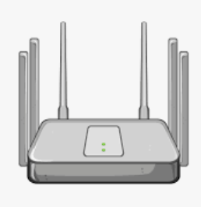
Recap on proposal [1]
Due to size, thermal, cost and power constraint, XR devices may leverage a different device for computation
This is termed Remote Rendering, see the figure below
As data is exchanged between the remote computer device and XR device through AP, both Wi-Fi links have great impact on the overall XR user experience
However, the compute device may not have the latest Wi-Fi technology and cannot exercise advanced Wi-Fi features
For example, AP lacks necessary info to optimize its OFDMA scheduling for the remote device and the Wi-Fi performance at the XR device may not be satisfactory
Therefore, we need a mechanism to improve a legacy device’s WiFi performance via TGbn device
AP
(TGbn capable)
Remote computer device
(e.g., Wi-Fi 6)
XR device
(TGbn capable)

Slide 4
Recap on proposal [1]
Propose to define mechanism(s) to allow a TGbn device to help improve the Wi-Fi performance of a legacy device in the same Wi-Fi network
Proxy SCS
Specifically, the MAC address of the remote computer device is needed for AP’s scheduling algorithm and should be included in the proposed proxy SCS mechanism.
Proxy SCS
AP
(TGbn capable)
Remote computer device
(e.g., Wi-Fi 6)
XR device
(TGbn capable)

Slide 5
Proxy SCS
Considering the following facts, the XR device which supports the proposed proxy SCS mechanism can extra request the AP to schedule the transmission of the other end of the SCS stream (i.e. remote computer device) with the same QoS requirement, e.g. the Min/Max Service Interval.
The QoS requirement of the DL transmission of the XR device is exactly the same as the one of the UL transmission of the remote computer device.
The QoS requirement of the UL transmission of the XR device is exactly the same as the one of the DL transmission of the remote computer device.
In other words, no need to include another set of QoS Parameters for the other end of the SCS stream.

Slide 6
Proxy SCS (Cont.)
Furthermore, one or more TCLAS elements are included within the SCS Descriptor element to tell the AP MLD how to identify the SCS stream in this XR use case.
For example, a TCLAS element with Classifier Type 0 (as shown in the below figure) is included to identify both ends of the SCS stream.
Based on the TCLAS element with Classifier Type 0, the AP MLD shall check whether both ends of the SCS stream are associated with itself or the other end is associated with the AP affiliated with the AP MLD. If no, the AP MLD shall reject this SCS request.
Fig. TCLAS element with Classifier Type 0

Slide 7
Proxy SCS (Cont.)
Note that based on the current spec., the TCLAS element(s) is only provided for the downlink SCS request.
But the TCLAS element(s) should be also provided for the uplink in an SCS Request when a QoS Characteristics element is included. [3]
It is important for the AP MLD to know the UL TCLAS information for flows corresponding to SCS request with QoS Characteristics and make the decision on whether it should accept this SCS stream or not based on its QoS policy configuration.

Slide 8
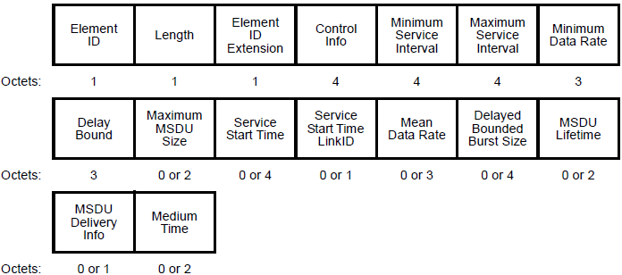
Proxy SCS (Cont.)
Based on the above analysis, a simple 1-bit subfield (e.g. Proxy QoS Enable subfield) in the Control Info field of the QoS Characteristics element may be enough to indicate whether the AP MLD needs to schedule the other end of the SCS stream with the same QoS requirement.
Fig. QoS Characteristics element

Slide 9
Conclusions
In this contribution, the proxy SCS mechanism is discussed.
Based on the analysis of the proxy SCS mechanism, a simple 1-bit within the Control Info field of the QoS Characteristics element may be enough to indicate whether the AP MLD needs to schedule the other end of the SCS stream with the same QoS requirement.

Slide 10
References
[1] Guoqing Li, et al. Proxy QoS Management for XR Use Cases, DCN 11-23/1958r0
[2] Duncan, et al. End-to-end QoS with SCS, DCN 11-23/1885r0
[3] Binita, et al. 11-23-1540-05-00be-lb275-cr-for-scs-tclas-counter-proposal

Slide 11
Appendix SCS Request frame

Slide 12
SCS Response frame
Fig. SCS Response frame

