Slide 1
Range Expansion via Repeated Transmission
Date: 2024-01-11
Authors:

Slide 2
Introduction
UHR aims to attain exceptional reliability concerning throughput, latency, packet loss, and power consumption as described in the UHR proposed PAR [1].
In pursuit of advancing Range v.s. Rate (RvR), a pivotal KPI within UHR, several potential technologies have been introduced, as detailed in [2-5].
In this document, we propose repeated transmission across time/freq. domains coupled with coherent combining to improve the 11bn range in both DL and UL directions.

Slide 3
Repeated Transmission
The concept of repeated transmission offers a straightforward yet immensely effective approach to improved the SNR and range.
  A simple version of repeated transmission was introduced in 802.11ax (DCM and ER PPDU).
Leveraging Signal Repetition for Range Expansion:
    This strategy entails the deliberate transmission of identical or slightly modified copies of the same signal across the wireless medium.
    The aim is to counteract the adverse impact of channel impairments – such as path loss, fading, noise, and interference – that often curtail the coverage distance and reliability of wireless links.
    The repetition can be employed over time, frequency, and space dimensions or any combination thereof (e.g., time and freq.).
    The receiver must employ coherent combination of the received replicas to improve the observed SNR.

Slide 4
Signal Processing at the receiver
The receiver should be aware of the repetition scheme employed by the transmitter.
  The required signaling for this purpose is discussed in the following slides.
Utilizing Coherent Combining for improved SNR
  Different Coherent Combining methods can be implemented.
  In particular, MRC yields the maximum possible SNR gain.
  For instance, when the AP employs MRC and N independent signal replicas are dispatched through the channel, the resultant increase in received SNR in dB can be approximated by 10*log(N).
Illustrative example:
  Transmitting 2 signal replicas in the UL could yield an anticipated 3dB enhancement in received SNR. As another example, the receiver can observe 9.53 dB gain in SNR when N=9, i.e., replicating the original signal over 8 other branches.

Slide 5
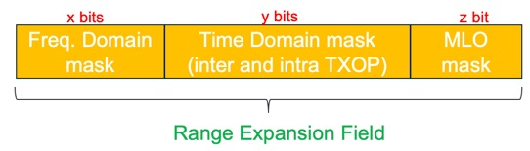
Proposed Mechanism
As pointed out, the transmitter needs to inform the receiver about the repetition scheme it is employing to enable coherent combining upon the reception of signal replicas.
We propose a new "Range Expansion" Field to be included in the U-SIG
  The new Repetition Field carries all the necessary information about the time/freq./link domain repetition that is employed by the transmitter.
The proposed " Range Expansion " Field is composed of 3 subfields:
  Freq.-domain Mask (x bits): carries information about the repetition scheme over RUs
  Time-domain Mask (y bits): carries information about inter and intra TXOP repetition schemes
  MLO Activation (z bits): carries information about repetition over multiple links in MLO-capable device

Slide 6
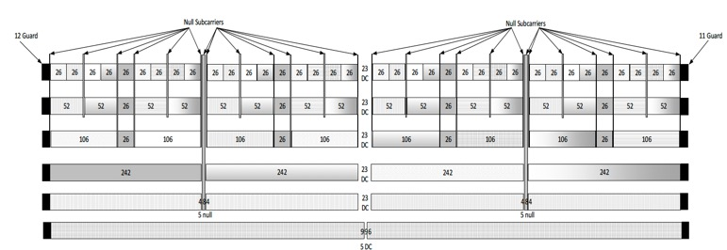
Freq. Domain Mask
Proposed structure:
  Consecutive RU treatment
  Duplication happens in RUs following original data
  4-bit value to indicate the desired duplication
Illustrative Example assuming 4-bit freq. domain mask:
80 MHz RU106 {1,2,3,4,5,6,7}
  0001 = duplicate once {1,2,3} {4,5,6}
  0010 = duplicate twice {1,2} {3,4} and {5,6}
  0011 = duplicate thrice {1} {2,3,4}
  0100 = duplicate 4 times {1} {2,3,4,5}
  0110 = duplicate 6 times {1} {2,3,4,5,6,7}

Slide 7
Time Domain Mask
Proposed structure:
  It is composed of two subfields corresponding to intra-TXOP and inter-TXOP repetitions, respectively.
  Intra-TXOP subfield indicates PPDU repetition across consecutive OFDMA symbols within a single TXOP
  Inter-TXOP subfield indicates PPDU repetition over consecutive TXOPs
Illustrative Example assuming 8-bit time domain mask:
  0000 0000: no time domain repetition
  0011 0000: three times repetition over the OFDMA symbols
  within a single TXOP.
  0000 0001: one repetition over the immediately next available TXOP

Slide 8
Usage example for “Range Expansion” Field
We consider two illustrative examples to show how the proposed repetition field in the U-SIG carries the necessary information about the transmitter's adopted repetition scheme.
Example 1:
  If only freq. domain is active, and repetition occurs across 3 RU sets
Example 2:
  If freq. domain is active and 2 intra-TXOP repetitions on all the available links

Slide 9
References
[1] 11-23-0480-03-0uhr-uhr-proposed-par
[2] 11-23-0042-00-0uhr-thought-for-range-extension-in-uhr
[3] 11-23-1100-00-0uhr-low-power-and-long-range-preamble
[4] 11-22-1908-01-0uhr-uhr-rate-vs-range-enhancement-with-Relay
[5] 11-22-1928-01-0uhr-enhanced-long-range-usage-scenarios-design-target-and-feasibility

Slide 10
SP1
Do you support to define a “range expansion” mode for the AP and non-AP STA where the transmitter may invoke a repetition scheme over time/freq. to improve the SNR at the receiver when the coverage is poor?

Slide 11
SP2
Do you agree to define a new “range expansion” field in the U-SIG to determine/signal the employed repetition scheme across time/freq.?

