Slide 1
Channelization to include Optical Bands
Date: 2024-01-15
Authors:

Slide 2
Abstract
This contribution considers channelization to include optical bands into the IMMW scope. It is proposed to harmonize the channelization used for integrated LC with the one to be defined for mm-wave in IMMW.

Slide 3
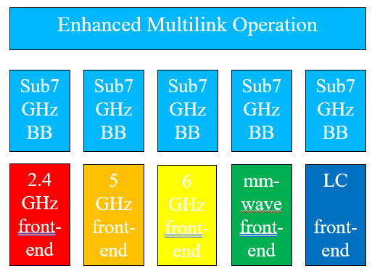
Previous work and this contribution
Recent contributions in IMMW SG show significant interest in use of higher bands
  [1-4] proposed to reuse existing Sub-7GHz baseband waveforms
  [2] discussed ideas about channelization for mm-wave
  [5, 6] proposed a limited scope in general
  [7] discussed beacon issues
  [8] proposed to include optical bands
  [9, 10] provide background on 11bb in optical bands
  this approach can only work if parts of the standard are reused
Channelization is one critical issue
  definitions should be similar to mm-wave
Source: Extend IMMW scope to include optical bands, 11-23/2016r2 [8]

Slide 4
11bb already reuses 5 or 6 GHz baseband [9, 10]
Idea was to reuse existing chipsets
  RF frontends up-convert BB signals to sub-7 GHz
  LC frontend up-converts baseband onto LC IF
  e.g. lowest LC IF is 26 MHz for 20 MHz channel
11bb enables
  same data rates, same interfaces, same capabilities like 11n, 11ac, 11ax PHY+MAC
RF up-conversion
Freq
Freq
0
0
5 or 6 GHz
LC IF up-conversion
20 MHz
Freq
Freq
0
0
26 MHz

Slide 5
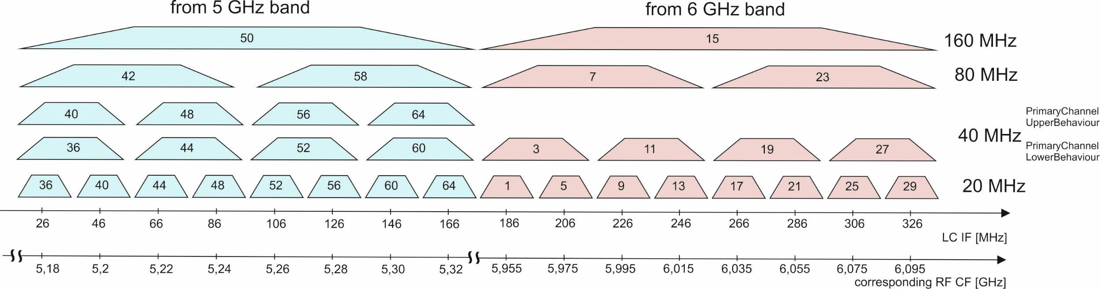
11bb Channelization [9, 10]
11bb uses block up/down-conversion, similar to satellite radios
  subset of consecutive channels is taken from 5 GHz or 6 GHz bands
Optical frontends have limited bandwidth
  LEDs: ~ 100 MHz, VCSEL arrays: substantially more BW

Slide 6
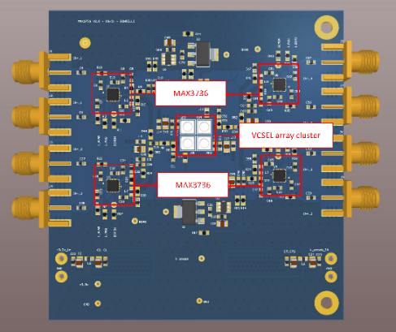
What optical bandwidth is feasible?
High-power LEDs: mobile applications, up to 100 MHz BW
  11bb channelization is enough, 11bb channels corresponding to 5 GHz band are useful
  Recent research results on vertical cavity surface-emitting laser (VCSEL) arrays
Small VCSEL array and OFDM → higher capacity
  17 Gbps with 14 mW and OFDM/bitloading [11]
  1.5 GHz BW limitation due to optical RX
  collimated beam → few cm² TX coverage → fixed wireless use cases
High-power VCSEL arrays and OOK → wider coverage
  4 Gbps with 350 mW and OOK [12]
  subarrays with parallel drivers, concept is scalable to higher power
  1.5 GHz BW limitation due to optical RX
  several m² TX coverage → multiple Gbps for mobile use cases
Summary: Several GHz bandwidth are possible, even with high-power VCSEL arrays.

Slide 7
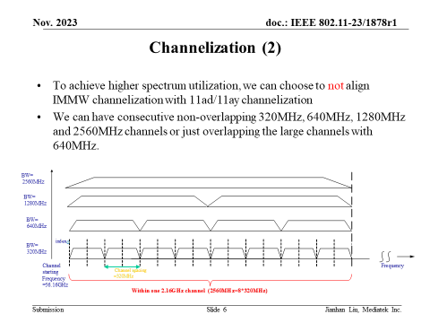
Proposed IMMW Channelization [2]
11ad/11ay channelization
  hardly used, spectrally very ineffective
  320 MHz blocks in 11be suggest new channelization
2.56 GHz bands, each split into
  1 x 2.56 GHz
  2 x 1.28 GHz
  4 x 640 GHz
  8 x 320 MHz

Slide 8
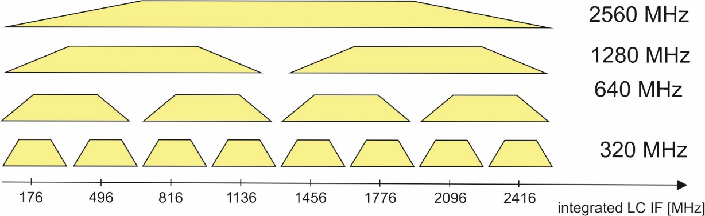
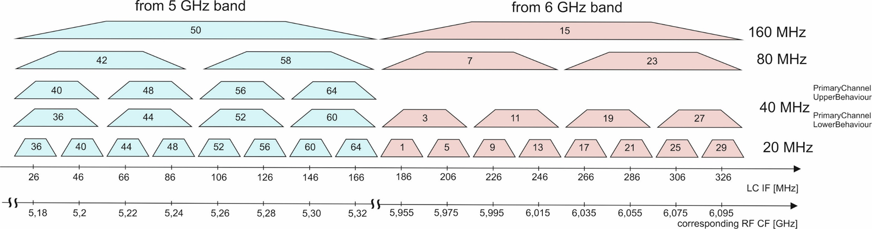
Proposed channelization to include optical bands
docs. [13, 14, 9] proposed to continue work on LC in new 802.11 projects
assuming 2.56 GHz optical modulation bandwidth maybe realistic in 5 years
  the lowest 320 MHz super-channel overlaps with entire 11bb modulation spectrum
  the proposed scheme is generic, i.e., lower bandwidth (e.g. 160 MHz) are possible, likewise
entire BW covered by 11bb

Slide 9
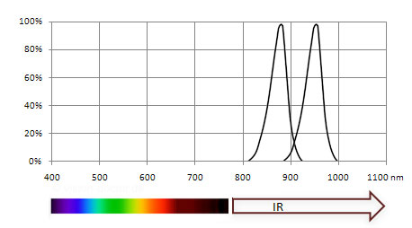
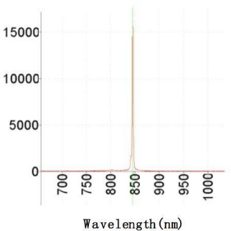
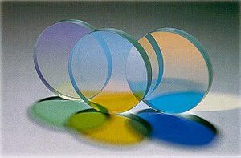
WDM to define further optical bands
LEDs
11bb defines wavelength-division multiplexing [9]
  colorless LC TX operates in 800 nm to 1000 nm band (near IR)
  splitting the optical band into two sub-bands
    TX₁: 800 nm to 900 nm, TX₂: 900 nm to 1000 nm
    summation of both bands at RX: Compatibility with colorless LC TX
  optical spectra of LED are relatively wide
    remove crosstalk needs additional MIMO processing
VCSELs do have much narrower optical spectra
  no more MIMO processing needed to isolate WDM LC TXs
    lower complexity: use a bench of optical filters
  denser WDM with more optical sub-bands are possible
    4 optical sub-bands: TX₁: 800 nm to 850 nm, TX₂: 850 nm to 900 nm, TX₃: 900 nm to 950 n, TX₄: 950 nm to 1000 nm
    summation of sub-bands at RX: Compatibility with colorless and 2-optical sub-bands
Source: https://www.vision-doctor.com/en/ir-illumination.html
Source: https://www.box-laser.com/850nm-10mw-to-can-vcsel-laser-diode.html
VCSEL
Source: https://en.wikipedia.org/wiki/Interference_filter

Slide 10
Summary
Channelization should be harmonized when including optical bands.
  GHz bandwidth maybe achievable using VCSEL arrays instead of LEDs.
Same channelization like for IMMW should be adopted also for use in optical bands.
  Multiple optical bands should map onto different wavelengths using WDM.
  Simple multiplexing/demultiplexing of optical bands by using optical filters

Slide 11
References
[1] Integrated mmWave Design Considerations, doc. 11-23/1819r1 https://mentor.ieee.org/802.11/dcn/23/11-23-1819-01-immw-integrated-mmwave-design-considerations.pptx
[2] High-Level Design Considerations of IMMW, 11-23/1878r1, https://mentor.ieee.org/802.11/dcn/23/11-23-1878-01-immw-high-level-design-considerations-of-immw.pptx
[3] Requirements Analysis for IMMW Use Cases, 11-23/1977r1, https://mentor.ieee.org/802.11/dcn/23/11-23-1977-01-immw-requirements-analysis-for-immw-use-cases.pptx
[4] Discussion on Enabling MIMO in IMMW, 11-23/1991r, https://mentor.ieee.org/802.11/dcn/23/11-23-1991-00-immw-discussion-on-enabling-mimo-in-immw.pptx
[5] Technical scope proposal, 11-23/2004r0, https://mentor.ieee.org/802.11/dcn/23/11-23-2004-00-immw-technical-scope-proposal.pptx
[6] High-level thoughts on IMMW, 11-23/1905r0, https://mentor.ieee.org/802.11/dcn/23/11-23-1905-00-immw-high-level-thoughts-on-immw.pptx
[7] mmWave operation without mmWave Beacon, 11-23/2152r0, https://mentor.ieee.org/802.11/dcn/23/11-23-2052-00-immw-mmwave-operation-without-mmwave-beacon.pptx
[8] Extend IMMW scope to include optical bands, 11-23/2016r2, https://mentor.ieee.org/802.11/dcn/23/11-23-2016-02-immw-extend-immw-scope-to-include-optical-bands.pptx
[9] IEEE Std 802.11bb-2023, https://standards.ieee.org/ieee/802.11bb/10823/
[10] IEEE 802 Tutorial “IEEE 802 Standards on Light Communication” at March 2023 Plenary Meeting https://mentor.ieee.org/802.11/dcn/23/11-23-0277-01-0000-ieee-802-standards-on-light-communication.pdf
[11] H. Kazemi et al., “Experimental Demonstration of 17 Gb/s Transmission Over Indoor Optical Wireless Communication Links Using A Low-Power Single-Mode VCSEL” , Optical Wireless Communication Conference, Eindhoven, Dec. 2023
[12] M. Hinrichs et al., “4 Gbit/s Optical Wireless Communication with High-Power Transmitter,” ECOC Glasgow, Sept. 2023
[13] 11-23/0091 “New Light Communication Features” https://mentor.ieee.org/802.11/dcn/23/11-23-0091-00-0wng-light-communication-for-uhr.pptx
[14] 11-23/0221r1 “Hybrid LC and RF in UHR” https://mentor.ieee.org/802.11/dcn/23/11-23-0221-01-0uhr-hybrid-lc-and-rf-in-uhr.pptx

