Slide 1
ML-aided Channel Classification and Its Application to WLAN
Date: 2024-01-11
Authors:

Slide 2
Introduction
The IEEE channel model is classified into A, B, C, D, and E in the order of high frequency selectivity.
In [1], we showed that the neural network based machine learning (ML) can achieve close to perfect classification result by using the multi-dimensional (i.e., time & frequency domain) channel measurements as preprocessors of the neural network.
We also showed that the classification result can provide a beamformee to select an appropriate subcarrier grouping (N_{g}) value to reduce overhead required for CSI feedback.
Following [1], this contribution presents additional use-cases of how the channel classification can be used for the improvement of WLANs.

Slide 3
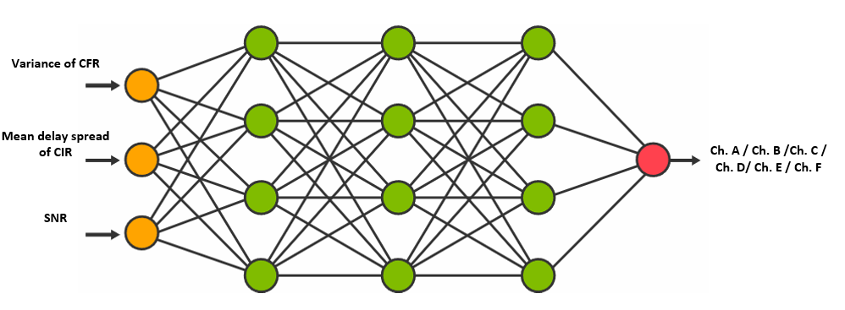
Recap: Neural Network based Channel Classification [1]
The neural network is trained in advance by using the three-dimensional channel measurements as its inputs.
  Variance of CFR (channel frequency response)
  Delay spread of CIR (channel impulse response)
  SNR
And then, for a new channel measurement, its channel type is identified in real-time manner by the trained neural network.

Slide 4
Recap: Neural Network based Channel Classification [1]
Simulation results
  For 1,000 channel samples, the classification performance is evaluated.
  We can see very accurate classification performance, even for low SNR.
SNR = 5dB
SNR = 15dB
SNR = 25dB
Ch. C → 2
Ch. C → Ch. D 2
Ch. D → 2
Ch. C → 505
Ch. E → 3
SNR = 35dB
SNR = 45dB
: Correct classification
: False classification
Ch. D → 1

Slide 5
Use-case 1: Beamforming
A high level design of channel type information feedback procedure is as follow.
  Beamformer that solicits channel type information transmits NDPA, where channel type information subfield may be set with three options.
  Upon the receipt of the NDP, beamformee applies an AIML technique (e.g., a Neural Network) to derive channel type information and feeds back the channel type information in a compressed beamforming report frame.
Option | Bit size | Channel Type Information
Coarse | 1 | Flat (0) | Selective (1)
Fine | 2 | Flat (00) | Selective (01) |  | Very Selective (10) |  |  | Reserved (11)
Very Fine | 3 | Ch. A (000) | Ch. B (001) | Ch. C (010) | Ch. D (011) | Ch. E (100) | Ch. F (101) | Reserved (110), (111)

Slide 6
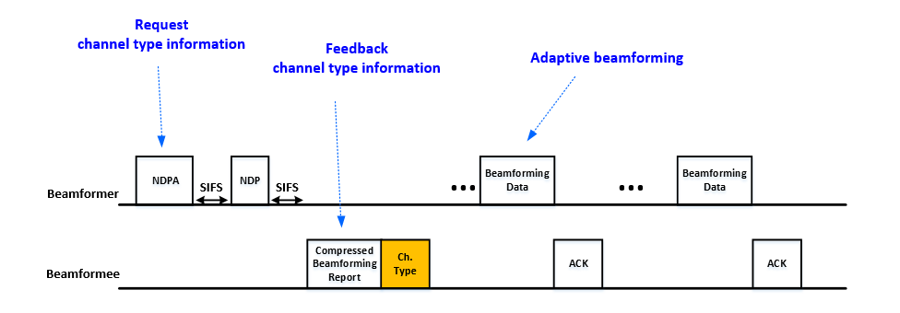
Use-case 1: Beamforming (Cont.)
Based on the channel type information, beamformer selects the subcarrier grouping value (N_{g}) or codebook size adaptively. For example,
Channel Type Information | Codebook size (bits for (ϕ, ψ)) | N_{g}
Ch. A, Ch. B, Ch. C | (2, 4) bits | N_{g} = 16
Ch. D, Ch. E, Ch. F | (4, 6) bits | N_{g} = 4

Slide 7
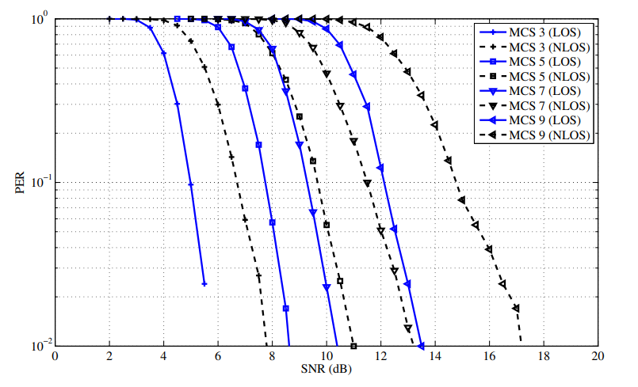
Use-case 2: mm-Wave Transmission
At 60 GHz band, the channel propagation loss is more severe than 2 GHz or 5 GHz channels [2].
  In the figure below, we can that the performance gap can reach up to 3dB between the LOS and Non-LOS (NLOS) channel.
  Without an accurate channel type identification, throughput loss will be incurred if a LOS channel is identified as a NLOS channel.
Packet error rate (PER) performance of IEEE 802.11ad [3]

Slide 8
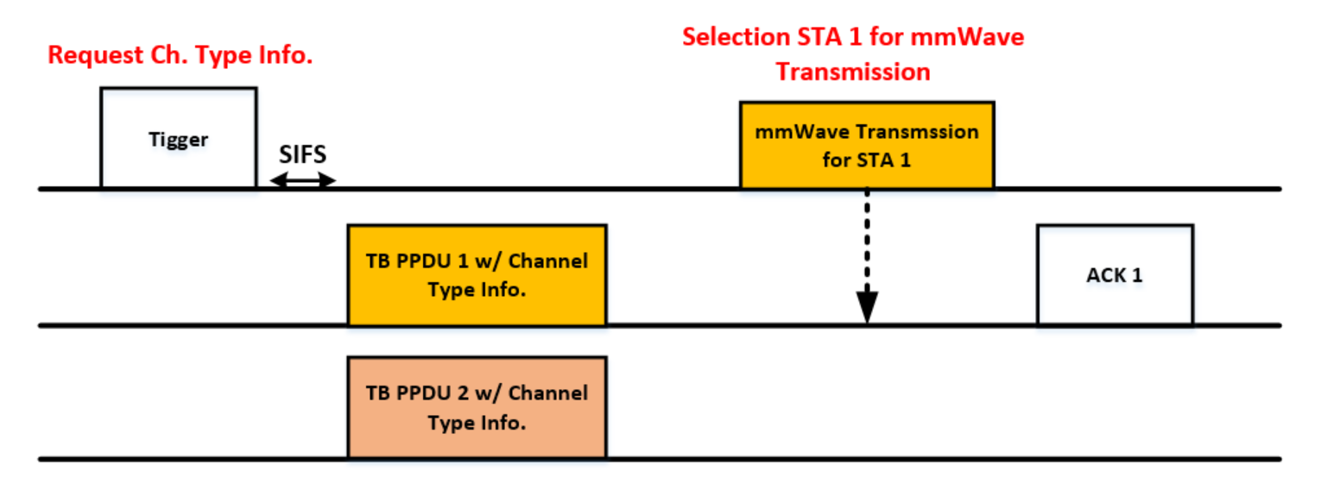
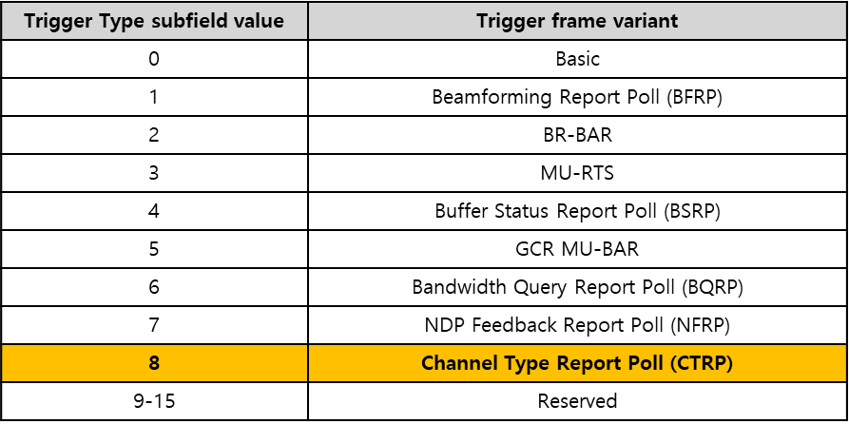
Use-case 2: mm-Wave Transmission (Cont.)
An example of high level design for channel type information feedback is as follow.
  AP transmits a new Trigger frame to solicit the channel type information.
    A new Trigger variant as shown in the table below.
  Non-AP STAs identified by the AID12 subfield of a User Info transmits a TB-PPDU carrying a channel type information.
  The availability of mm-Wave transmission is based on channel type information.

Slide 9
Use-case 3: Link Adaptation
The main goal of the link adaptation is to adjust the transmission scheme (i.e. MCS level and number of spatial streams) according to the channel condition.
Generally used link adaptation methods would be
  ARF (Auto Rate Fall-back)
    Increase the data rate if several packet transmission was successful and otherwise lower the data rate if the packet transmission failure [3].
  PHY-abstraction
    Predict PER performance based on the AWGN based link performance modeling [4].
If the channel type information is available to AP, AP can predict more accurate PER performance based on the link performance modeling of the given channel type.
  MAC header may carry the channel type information.

Slide 10
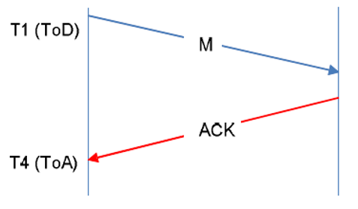
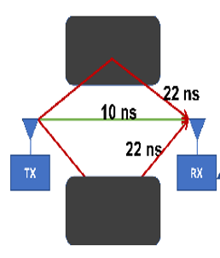
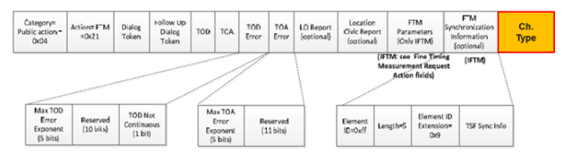
Use-case 4: FTM
FTM (Fine Timing Measurement) is a Wi-Fi based indoor positioning protocol, which relies on
  Measurement of the time from transmitting a frame (ToD) to receiving the ACK (ToA).
  In case of severe multi-path channel, fractional delay estimation and its calibration is a main issue to guarantee 1 meter-level positioning accuracy.
  The channel type information can be helpful for measurement timing calibration.
    For example, the channel type information indicates a Ch. A, there will be no calibration, and large scale calibration will be required when indicating a Ch. F.

Slide 11
Summary
We discussed a AIML aided channel classification and feedback of channel type information for the potential improvement of 802.11 WLANs in the following use-cases.
  Beamforming
  mm-Wave transmission
  Link adaptation
  FTM

Slide 12
Reference
[1] 802.11-23/0032r3, ML-based Adaptive Subcarrier Grouping for Beamforming Feedback, Samsung.
[2] E. Kurniawan, L. Zhiwei, and S. Sun, “Machine Learning-Based Channel Classification and Its Application to IEEE 802.11ad Communications,” in Proc. IEEE Global Communications Conference (GLOBECOM), Dec. 2017.
[3] A. Kamerman and L. Monteban, “WaveLAN-II: A high-performance wireless LAN for the unlicensed band,” Bell. Labs Tech. Journal, 1997.
[4] IEEE 802.16m, “Evaluation Methodology Document (EMD),” IEEE 802.16m-08/004r5, Jan. 2009.

