Slide 1
How 802.11ba Handled SNR
Date: 2024-01-10
Authors:
Name | Affiliations | email
Steve Shellhammer | Qualcomm | shellhammer@ieee.org
Bin Tian |  | btian@qti.qualcomm.com
George Cherian |  | gcherian@qti.qualcomm.com
Pooria Pakrooh |  | ppakrooh@qti.qualcomm.com

Slide 2
Introduction
Since AMP needs will utilize a WUR it is useful to review how 802.11ba handled SNR
There were two possible ways that 802.11ba could have handled SNR requirements and analysis
  Set range requirements, propagation, models, etc. to get required SNR
  Use the same models as other 802.11 standards and compare to those SNR values
In 802.11ba we used Method #2
This allows easy comparison to other 802.11 standards
  For example, the AWGN of 6 Mb/s OFDM PHY is easily available in reference documents
In this presentation we provided some background on how SNR was handled in 802.11ba, for consideration by AMP group

Slide 3
SNR Bandwidth Definition
The WUR portion of the WUR PPDU bandwidth is 4 MHz
However, to make comparison with other 802.11 standards in 802.11ba we used a 20-MHz noise bandwidth for SNR
That makes SNR comparisons to 20-MHz 802.11 standard straightforward
This of course makes the 20-MHz SNR value 7 dB lower than the 4-MHz SNR value. So, it is easy to translate between these noise bandwidths.

Slide 4
Channel Models
For comparison to 20-MHz 802.11 standard all simulations were done using the 802.11n Channel Models
The channel models used in 802.11ba were
  20-MHz AWGN Channel Model
  20-MHz Channel Model D
There are reference documents with simulations of 802.11n easily available for comparison

Slide 5
Receiver Noise Figure
It was expected that 802.11ba would have a higher receiver noise figure than a typical 802.11n receiver
This is because of the low-power requirements in 802.11ba compared to 802.11n
In 802.11ba the receiver noise figure was set as being 8 dB higher than a typical 802.11n receiver [1]
  This of course depends on implementation
This provides a straightforward way of comparing the 802.11ba SNR with the 802.11n SNR

Slide 6
Transmit Power
In some regulatory domains the allowed transmit power can depend on the transmit bandwidth
In 802.11ba this was studied to make a relative comparison to a 20-MHz bandwidth 802.11 standard [1]

Slide 7
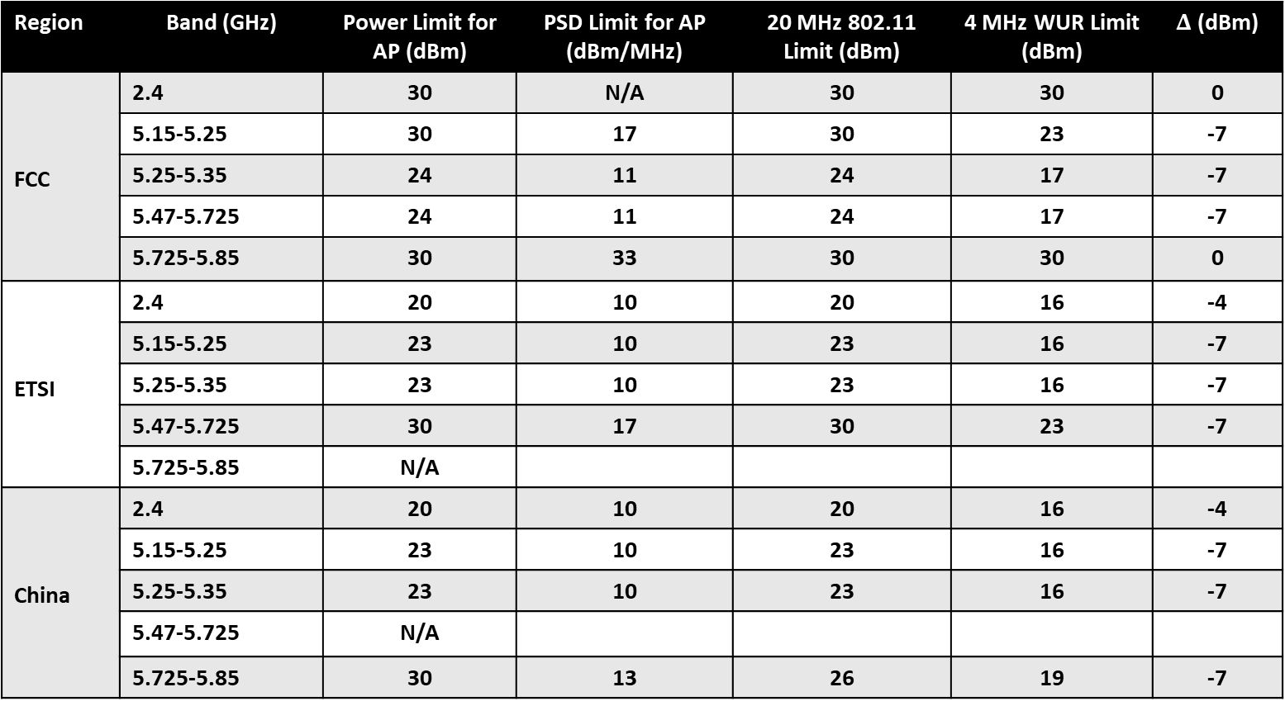
Regulated Maximum Allowed Transmit Power [1]
Region | Band (GHz) | Power Limit for AP (dBm) | PSD Limit for AP (dBm/MHz) | 20 MHz 802.11 Limit (dBm) | 4 MHz WUR Limit (dBm) | $Δ$ (dBm)
FCC | 2.4 | 30 | N/A | 30 | 30 | 0
 | 5.15-5.25 | 30 | 17 | 30 | 23 | -7
 | 5.25-5.35 | 24 | 11 | 24 | 17 | -7
 | 5.47-5.725 | 24 | 11 | 24 | 17 | -7
 | 5.725-5.85 | 30 | 33 | 30 | 30 | 0
ETSI | 2.4 | 20 | 10 | 20 | 16 | -4
 | 5.15-5.25 | 23 | 10 | 23 | 16 | -7
 | 5.25-5.35 | 23 | 10 | 23 | 16 | -7
 | 5.47-5.725 | 30 | 17 | 30 | 23 | -7
 | 5.725-5.85 | N/A
China | 2.4 | 20 | 10 | 20 | 16 | -4
 | 5.15-5.25 | 23 | 10 | 23 | 16 | -7
 | 5.25-5.35 | 23 | 10 | 23 | 16 | -7
 | 5.47-5.725 | N/A
 | 5.725-5.85 | 30 | 13 | 26 | 19 | -7

Slide 8
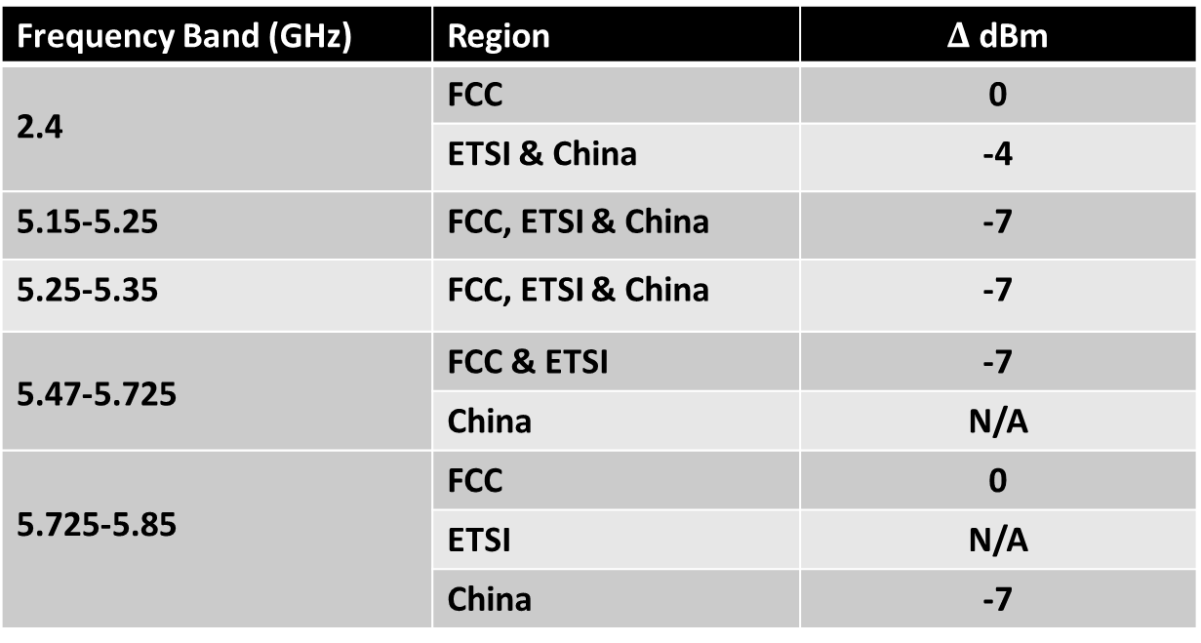
Regulatory Transmit Power Summary [1]
Frequency Band (GHz) | Region | $Δ$ dBm
2.4 | FCC | 0
 | ETSI & China | -4
5.15-5.25 | FCC, ETSI & China | -7
5.25-5.35 | FCC, ETSI & China | -7
5.47-5.725 | FCC & ETSI | -7
 | China | N/A
5.725-5.85 | FCC | 0
 | ETSI | N/A
 | China | -7
In 2.4 GHz the delta is either 0 or -4 dB, depending on region
In 5 GHz the delta is -7 dB, in almost all cases

Slide 9
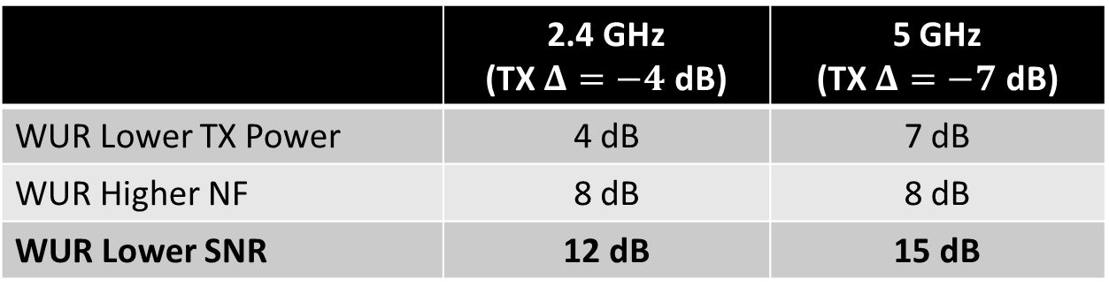
WUR Required to Operate at Lower SNR than non-WUR 802.11 [1]
Combining the effects of lower TX power and higher receiver noise figure, the WUR must operate at a lower SNR than non-WUR 802.11 to reach the same range
As shown in the table below that SNR delta is 12 dB for the 2.4 GHz frequency band and 15 dB for the 5 GHz frequency band
 | 2.4 GHz (TX $Δ=−4$ dB) | 5 GHz (TX $Δ=−7$ dB)
WUR Lower TX Power | 4 dB | 7 dB
WUR Higher NF | 8 dB | 8 dB
WUR Lower SNR | 12 dB | 15 dB

Slide 10
Summary
In 802.11ba the following approach was used for SNR
  SNR bandwidth was measured in 20 MHz
  Simulations were done using 20-MHz 802.11n channel models
    AWGN
    Channel Model D
  The WUR receiver noise figure was modeled as 8 dB higher than a typical 802.11n receiver
  The allowed regulations were considered when comparing 4 MHz and 20 MHz transmissions

Slide 11
Discussion Question to the AMP Group
Should AMP use a similar approach as was done in 802.11ba for SNR requirements and analysis?

Slide 12
References
Steve Shellhammer and Bin Tian, “Regulations and Noise Figure – Impact on SNR,” IEEE 802.11-17/365r0, March 2017

