Slide 1
Evaluation of Puncturing for Coexistence of IEEE 802.11 and Bluetooth in 6 GHz
Date: 2024-01-16
Authors:

Slide 2
Introduction
Assumption 1: Bluetooth adds Listen-Before-Talk (LBT) to the channel hopping medium access
  Several contributions show benefit to both IEEE 802.11 and Bluetooth itself
  Exact details will be developed by the Bluetooth SIG
Assumption 2: Bluetooth is using the complete available spectrum for the channel hopping
  Adaptive Frequency-Hopping (AFH) is not active / is not triggering due to low activity / has not yet converged

Slide 3
Order of Events on the Channel
IEEE 802.11 before Bluetooth
IEEE 802.11 backoff on secondary channel fails
Bluetooth LBT fails
Bluetooth before IEEE 802.11
f [MHz]
f [MHz]
160
160
Data
Data
Ack
p20
p20
t
t
Clear Channel Assessment (CCA) result is idle on all 20 MHz subchannels
IEEE 802.11 transmission starts
Bluetooth hops on channel, LBT detects transmission and defers
  Mitigation, depending on Bluetooth LBT details
Bluetooth hops on channel, LBT detects an idle channel
Bluetooth transmission starts
IEEE 802.11 CCA detects Bluetooth transmission and defers
  Bluetooth is on primary channel: anytime during backoff
  Bluetooth is on secondary channel: during the last 25 µs of the backoff
IEEE 802.11 continues to observe until the channel is idle and re-starts backoff

Slide 4
Wi-Fi Puncturing: Fully Dynamic
Dynamically puncture occupied channel(s)
Puncturing allows 20 MHz-sized “holes” in the spectrum
Primary 20 MHz must be idle
Fully dynamic in
  Time: Puncturing is instantaneously, backoff simply continues
  Frequency: Puncture arbitrary
  20 MHz-channel holes
f [MHz]
160
Data
ACK
p20
Data
ACK
t

Slide 5
Wi-Fi Puncturing: RU-based + Slow Adaptation
Backoff fails
Restart with 40 MHz PPDU
f [MHz]
Remember maximum PPDU width for next backoff
160
RU-based: Puncturing reduces transmission to valid Resource Unit (RU) containing the primary 20 MHz
  Essentially fallback from 160 MHz to
  80 MHz, 40 MHz, or 20 MHz
Slow Adaptation:
  If non-primary 20 MHz gets busy (i and ii):
    Stop backoff
    Determine which minimum puncturing would have continued the backoff
    Start new backoff with punctured PPDU
  If primary 20 MHz gets busy (iii):
    Stop backoff
    Start new backoff with full PPDU
  If backoff completes (all):
    Start transmission, and
    Determine which minimum puncturing would have completed the backoff for the next PPDU
(i)
Backoff fails
Restart with 40 MHz PPDU
p20
Data
ACK
Remember maximum PPDU width for next backoff
t
f [MHz]
160
Backoff fails with p20 busy
Restart on idle channel with full bandwidth
(ii)
p20
Data
ACK
t
f [MHz]
160
Data
ACK
(iii)
p20
t

Slide 6
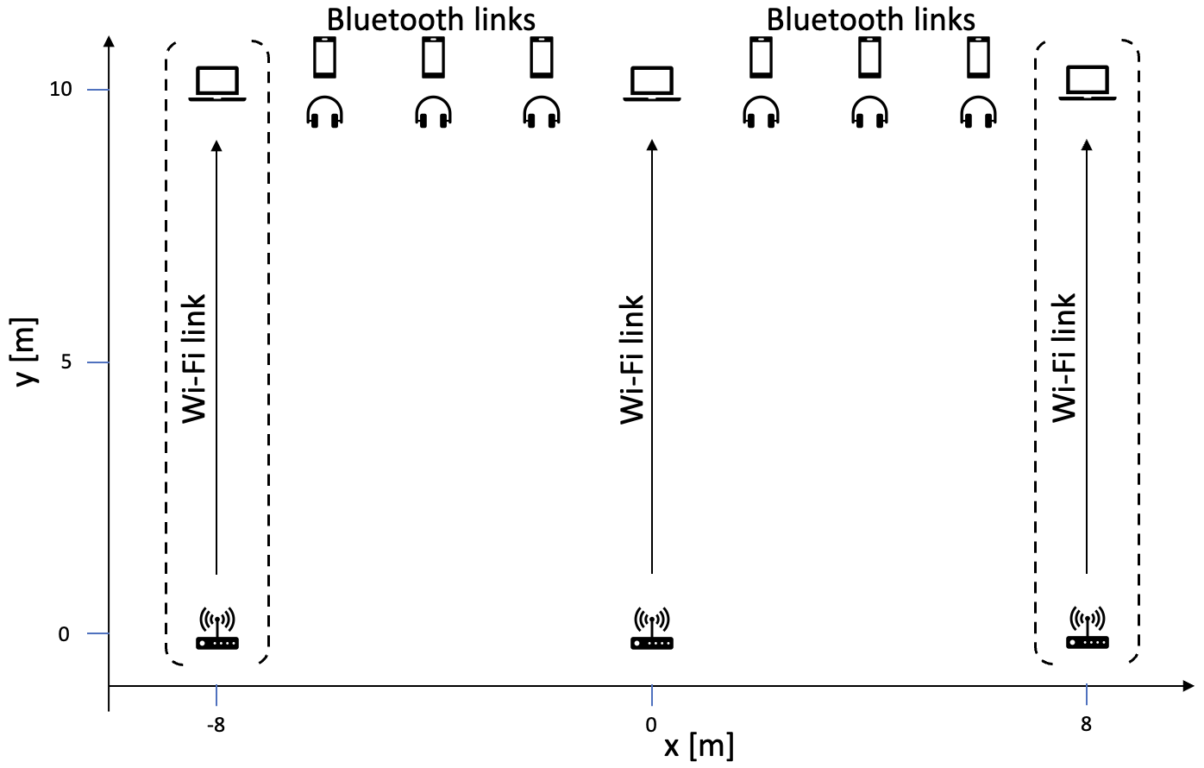
Simulation Setup (same as [1])
IEEE 802.11
Bluetooth
3⨯160 MHz channels
  Channel number 15, 47, 79
  Primary 20 MHz always the 2nd 20 MHz
Infinite number of 10 MB FTP file downloads
KPI: File download delay (mean & 95th percentile)
1MHz channels with 2 MHz spacing
  233 data channels
Frequency hopping size randomly 44 to 94
One to six links
  Constant bitrate traffic 1280 B/20 ms (57 % channel occupancy)
Async Connection-Oriented Link (ACL) with 10 ms connection interval
Performance ignored here

Slide 7
Results: FTP Download Delay median (solid) & 95-percentile (dashed)
No coexistence mechanism:
  Bluetooth blocks FTP downloads
Bluetooth introduces LBT at the Connection Event (CE-LBT)
  Coexistence becomes possible
CE-LBT + IEEE 802.11 adds fully dynamic puncturing
  Barely any impact of Bluetooth
CE-LBT + IEEE 802.11 implements RU-based + slow adaptation puncturing
  No gain over no puncturing
  KPI is even slightly worse

Slide 8



Cloud Gaming Traffic Model & KPI
4 ms
4 ms
Same scenario, but FTP traffic model replaced by
KPI:
Gaming delay = downlink 99-percentile + uplink 99-percentile
Plot shows mean and 95-percentile gaming delay of 100 simulations
Downlink: XR Video Model over RTP
  Mean load 30 Mb/s with 10 Mb/s standard deviation
  60 frames/s, every 120th frame is an I-frame (2⨯size)
  Access category video
  Measure frame delivery delay
Uplink: Control Messages over UDP
  Mean size 468 B with 90 B standard deviation
  Mean inter-frame interval 15 ms with 6 ms standard deviation
  Access category voice
  Measure frame delivery delay

Slide 9
Results: Gaming Delay median (solid) & 95-percentile (dashed)
No coexistence mechanism:
  No QoS possible
Bluetooth introduces LBT at the Connection Event (CE-LBT)
  Coexistence becomes possible, but still significant impact
CE-LBT + IEEE 802.11 adds fully dynamic puncturing
  Impact of Bluetooth is mitigated
CE-LBT + IEEE 802.11 implements RU-based + slow adaptation puncturing
  Significant gain over no puncturing (p95 reduced by 20 ms)

Slide 10
Results: Gaming Delay median (solid) & 95-percentile (dashed)
Change
  Assumption 2: Bluetooth is using the complete available spectrum for the channel hopping
  to
  Assumption 2: Bluetooth is using the complete available spectrum for the channel hopping
    With the exception of the primary 20MHz channels of the IEEE 802.11 networks
CE-LBT + RU-based + slow adaptation puncturing; Bluetooth skips primary 20 channel
  Further improvement (~10 ms)
  This only has a benefit in cooperation with puncturing

Slide 11
Conclusions
Puncturing (or adaptive channel bandwidth selection) is necessary for
low-latency QoS under Narrowband Frequency-Hopping (NBFH) interference
  Even if NBFH employs LBT
Impact depends on the puncturing scheme
  Even a simplistic RU-based, slowly adapting scheme shows gains for latency-critical traffic
Cooperation & coordination between IEEE 802.11 and Bluetooth on details can lead to further improvements
  For example, Bluetooth completely avoiding primary 20MHz channel in 6 GHz helps IEEE 802.11 if puncturing is employed

Slide 12
References
[1] Sebastian Max, “IEEE 802.11 and Bluetooth Coexistence Simulations,” IEEE 802.11 submission 11-23/1477r1
[2] Menzo Wentink, “NBFH coexistence with Wi-Fi,” IEEE 802.11 submission 11-23/1622r0

