Slide 1
Handling of Fairness Issue Caused by P2P Transmission in R-TWT SP
Date: 2024-01-15
Authors:

Slide 2
Introduction
In current specification of 11be, fairness issue occurs when the P2P transmission is enabled by the triggered TXOP sharing procedure inside R-TWT SP.
  A trigger enabled TXOP sharing with Triggered TXOP Sharing Mode subfield value equal to 2 could happen inside an R-TWT SP.
  However, the Restricted R-TWT traffic only has specification for the low latency traffic TID(s) for UL and DL inside the R-TWT SP.
  A P2P transmission enabled by the triggered TXOP sharing procedure and inside the R-TWT SP does not have any specification of the R-TWT TID(s).
How to handle the fairness issue of lack of specification of TID(s) for the P2P traffic when a trigger enabled TXOP Sharing Mode subfield value equal to 2 happens inside an R-TWT SP is not specified in the specification.

Slide 3
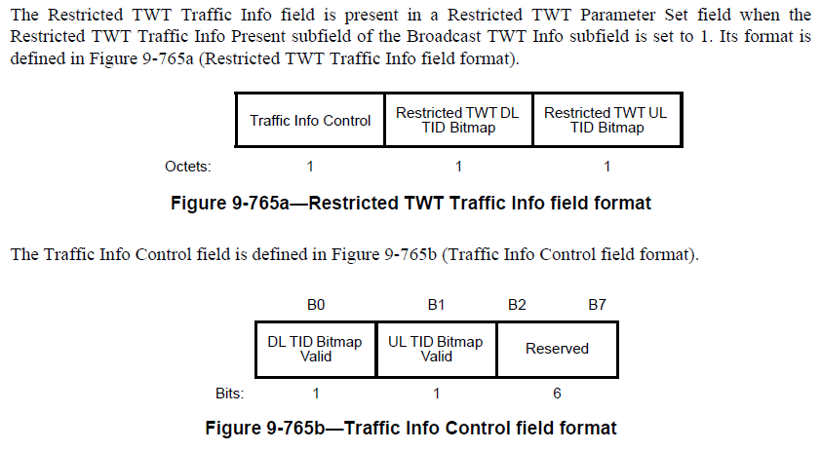
Problem Statement
In Clause 9.4.2.198 TWT element:
The TID Bitmap Valid and the corresponding Restricted TWT Bitmap subfields are only specified for UL and DL.
Example of the fairness issue:
The R-TWT UL/DL TIDs are specified as TID 8 for STA1 and STA2 in current R-TWT SP.
There is no specified R-TWT TID for the DATA to STA2 (P2P transmission in shared TXOP). Any lower prioritized TID(s) than the specified R-TWT TID could be transmitted earlier than DL DATA to STA2 w/ TID 8.
MU-RTS TXS Trigger Frame (Triggered TXOP Sharing Mode=2) to STA1
Block Ack to STA1
DATA to STA2 (R-TWT TID: 8)
AP
CTS
DATA to AP in non-TB PPDU (R-TWT TID: 8)
DATA to STA2 (unspecified R-TWT TID)
STA1
Block Ack to STA1
STA2
TXOP
R-TWT SP w/ STA1 and STA2 as the R-TWT member STAs
R-TWT UL/DL TID: 8
Time allocated in MU-RTS TXS Trigger Frame

Slide 4
Proposals
TID Bitmap Valid and the corresponding Restricted TWT Bitmap subfields for P2P direct link direction in the TWT element should be included:
  Adding P2P TID Bitmap Valid subfield into the Traffic Info Control filed to indicate whether Restricted TWT P2P TID Bitmap is valid inside the Restricted TWT Traffic Info field.
    When the Restricted TWT P2P TID Bitmap is NOT valid (Reserved), it indicates that the P2P traffic of all TIDs is identified as latency sensitive traffic.
  When the Restricted TWT P2P TID Bitmap is valid, it specifies the TID(s) that are identified as latency sensitive traffic streams in the P2P direct link direction.

Slide 5
Summary
A fairness issue occurs due to the lack of specification of TID(s) for the P2P traffic enabled by triggered TXOP Sharing that happens inside an R-TWT SP.
This contribution proposes to solve the fairness issue. Further specification of TID(s) for the P2P traffic inside an R-TWT SP should be considered.

Slide 6
References
[1] Draft P802.11be_D5.0, “Part 11: Wireless LAN Medium Access Control (MAC) and Physical Layer (PHY) Specifications - Amendment 8: Enhancements for extremely high throughput (EHT)”, November 2023.

Slide 7
Straw Poll 1
Do you agree to address the identified issue occurring when a trigger enabled TXOP Sharing Mode subfield value equal to 2 happens inside an R-TWT SP?

Slide 8
Straw Poll 2
If you agree to address the identified issue, do you agree with the potential resolution to include subfields for specify P2P TID(s) in TWT element?

