Slide 1
DPWiFi MATLAB Validation
Date: 2024-01-29
Authors:

Slide 2
Abstract
During last November’s plenary TWI proposed “Dynamic Polarization MIMO Multiplexing and Beamforming” as a candidate PHY for the nascent TGbn standard. TWI has since MATLAB-modeled “DPWiFi” for the Fixed Wireless Access application, and key findings are summarized herein.

Slide 3
Why DPWiFi for TGbn?
The P802.11bn PAR states that the defining TGbn Ultra High Reliability MAC/ PHY requires one operating mode exhibiting at least 25% higher throughput than the TGbe Extremely High Throughput MAC/PHY.
In a DLoS channel, the TGbe EHT maximum Data Rate (MCS13, 320 MHz, 800 ns GI, 1 Stream) corresponds to 2.882 Gbps, while the proposed DPWiFi peak Data Rate (MCS13, 320 MHz, 800 ns GI, 32 Streams) clocks in at 92.224 Gbps. So, DPWiFi would deliver 3200% higher throughput than TGbe.
Furthermore, DPWiFi Rate vs Range benefits even further from Ns-dependent extended range (= 10^[(10 log 32)/20] = 5.65) begat of its inherent Phased Array Beamforming gain. So, DPWiFi would deliver 18,080% higher RvR than TGbe.

Slide 4
Proposed DPWiFi PHY
32 IEEE802.11be concurrent, cochannel RF streams
  32x32 MIMO Dynamic Polarization Multiplexing (“DP-32”)
  32x32 MIMO Tx/Rx DLOS/ nLOS/ NLOS Beamforming/Beamsteering
  AP MU-MIMO Tx Multi-beaming
  AP, Client MU-MIMO Rx Interference Cancellation
  Client MU-MIMO Rx NLOS Multipath Recombination
  5-7 GHz UNII Operation
  4096 QAM 5/6
  320 MHz BW
  92.2 Gbps Peak Data Rate
  80 GbE P2P Throughput, 28 km Free-Space Range
  27 GbE PMP Throughput, 79 km² Foliage-obstructed Coverage

Slide 5
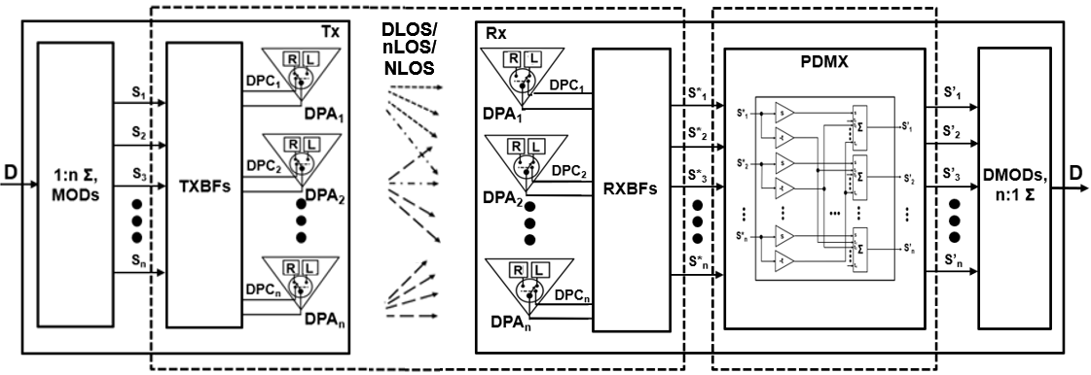



Proposed DPWiFi TRX Architecture
1
[H_{DP}] DPWiFi Propagation Channel
[H_{DP}⁻¹] DPWiFi Rx PDMX
Post-Honolulu refinements

Slide 6
DPWiFi for Fixed Wireless Access
The Fixed WiFi Access Dynamic Polarization MIMO Propagation Channel
  The FWA propagation channel [H_{DP}] is an n-dimensional “Polarization Space”, with an upper bounded n >> 32
  [H_{DP}] is non-singular, deterministic, scalar (i.e., h_{ij} = 1, i = j; h_{ij} = r_{ij} , i ≠ j) and uniform (i.e., r_{ij} = r)
  r (also the “Channel Dynamic Polarization Index” or “ChDPI”), however, varies significantly with [H_{DP}] impairments
  FWA comprises DLOS, nLOS and NLOS links, all susceptible to distinct [H_{DP}] “depolarization” impairment levels
  Channel Depolarization (“ChDp”, º) is propagation-induced angular Rx signal polarization rotation wrt the Tx-impressed baseline
    Direct Line of Sight TRXs experiencing atmospheric fog, rain, etc. encounter up to 5º [H_{DP}] depolarization
    near Line of Sight TRXs partially obstructed by foliage, landscape or structures face up to 15º [H_{DP}] depolarization
    Non Line of Sight TRX channels begat of reflection/diffraction from landscape, structures or vehicles depolarize [H_{DP}] by up to 45º
  Rising ChDp soon overwhelms the DPWiFi Rx PDMux, precluding MIMO co-channel self-interference cancellation
    PDMux pre-configured for 0º ChDp, the Rx cannot fully demultiplex RF streams subjected to even minor [H_{DP}] depolarization
    Already severe depolarization effects magnify even further with increasing DPWiFi link MCS and MIMO order
    DPWiFi MUST incorporate channel depolarization mitigation (i.e., the receiver PDMux “RxDPI” needs track the [H_{DP}] ChDPI)
Ergo, a 2-step “Adaptive DPWiFi” construct for Fixed Wireless Access:
  “ADPWiFi” (Open Loop) Channel Sounding
    DPWiFi AP transmits [H_{DP}]-characterizing “Training Sounding Packets (T)” every ~1ms to all associated DPWiFi Clients
    Each Client processes T, measures true ChDp, determines actual [H_{DP}], computes [H_{DP}⁻¹] and reconfigures its Rx PDMux to match
  ADPWiFi TRX
  DPWiFi TRX as Honolulu-proposed, but with Rx PDMux RxDPI precisely tracking the constantly sampled ChDPI

Slide 7
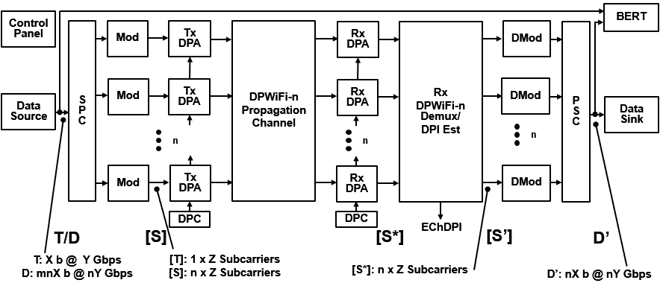
DPWiFi TRX MATLAB Model
Data Source
Generates
1x Training Packet/
1x Data Packet
SPC/Modulators
Synthesize
1x Training Stream/
32x Symbol Streams
Tx DPAs
Walsh-Polarize
1x Training Stream/
32x Symbol Streams
DPWiFi Channel
MIMO-Multiplexes
1x Training Stream/
32x Symbol Streams
Rx DPAs
De-correlate
32x M-M Training Streams/
32x M-M Symbol Streams
Rx DPDMux
Estimates Channel DPI/
Recovers 32x
Symbol Streams
Demodulators/PSC
Recover 1x
Data Packet
Data Sink
Accepts 1x
Data Packet

Slide 8
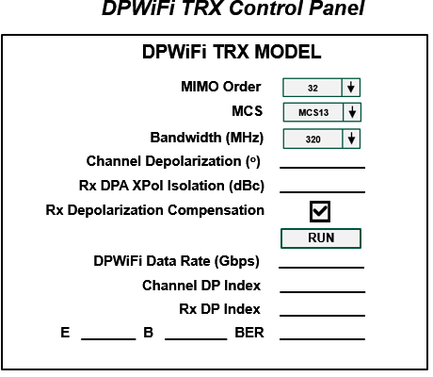
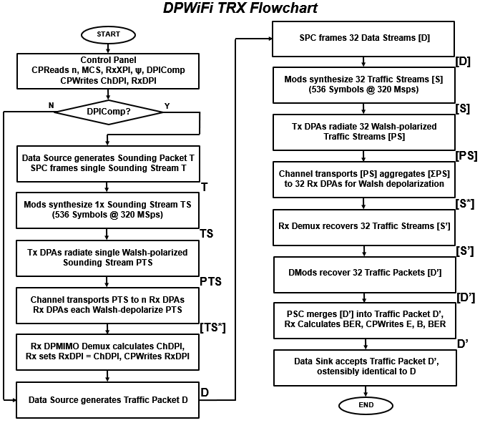
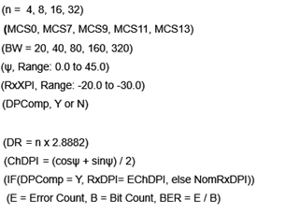
DPWiFi TRX MATLAB Model Detail

Slide 9
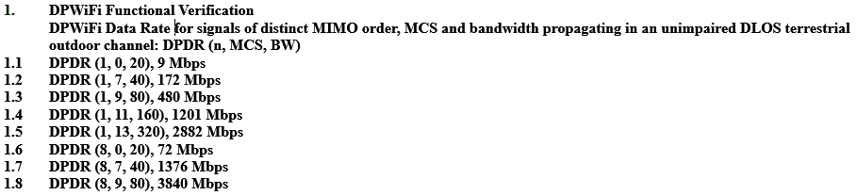
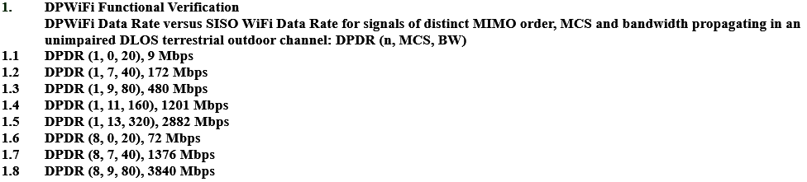
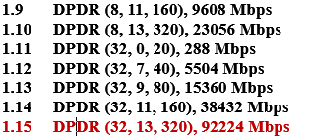
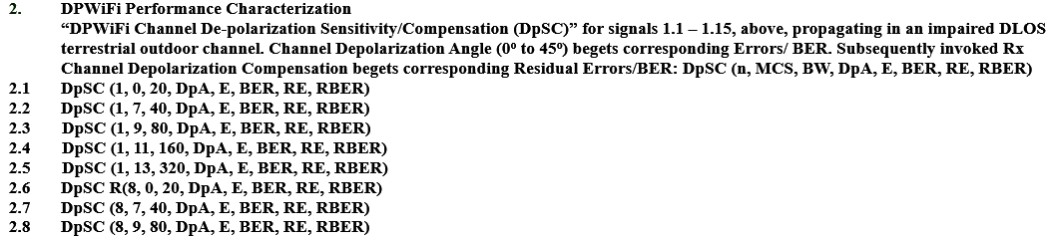
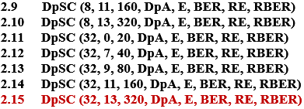
DPWiFi TRX Validation Plan
Note: See corresponding Validation Test results following

Slide 10
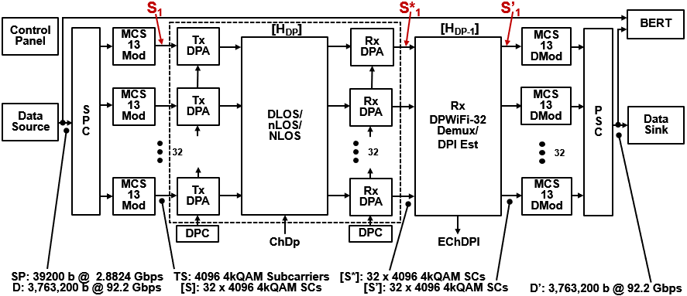
DPWiFi TRX Validation
TWI is currently executing the entire DPWiFi TRX Validation Plan of Slide 9
However, the key “Will DPWiFi work for FWA?” question has already been settled:
  Validation Plan items 1.15 and 2.15 comprise the most extreme DPWiFi-for-FWA corner case
    That is, if DPWiFi-32 320 MHz MCS13 works subjected to the full range of channel impairments, then
    ALL OTHER DPWiFi MIMO order, bandwidth and MCS combinations will ALSO work
    TWI HAS completed items 1.15/2.15 DP-32 320 MHz MCS13 MATLAB modeling, as summarized following
DPWiFi-32 320 MHz MCS13 TRX MATLAB Simulink Model

Slide 11
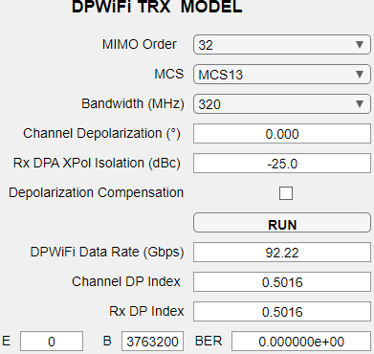
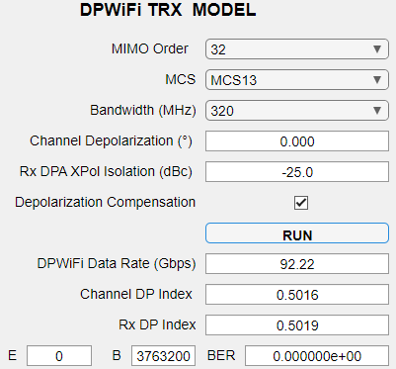
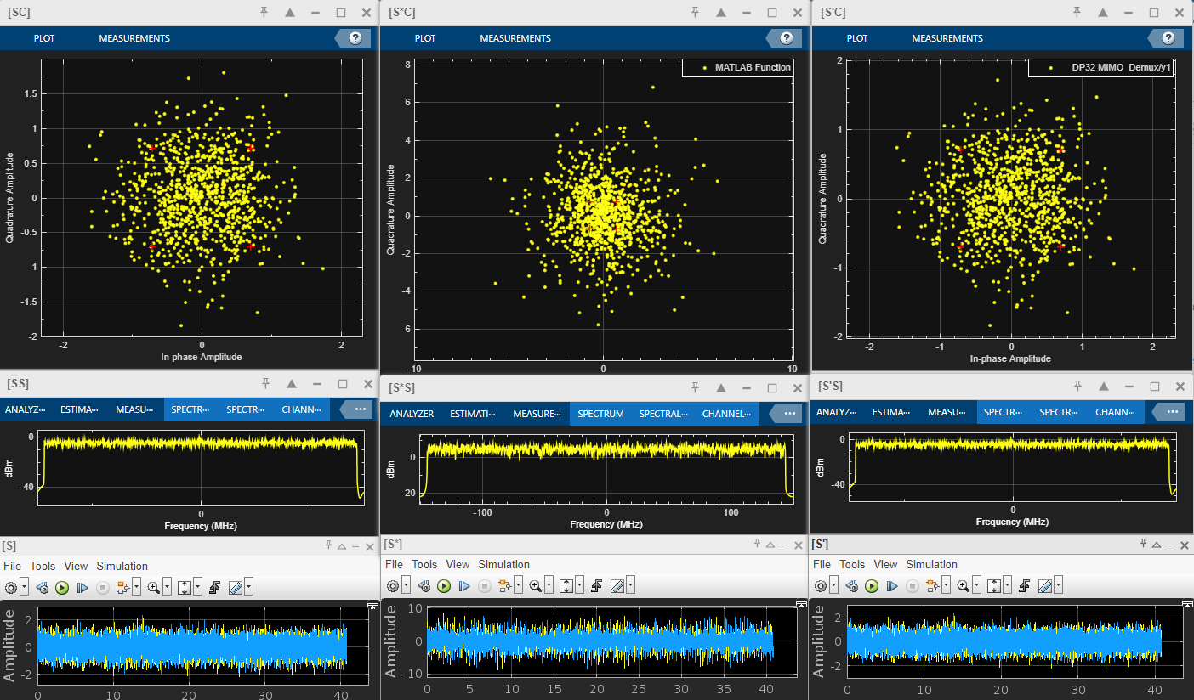
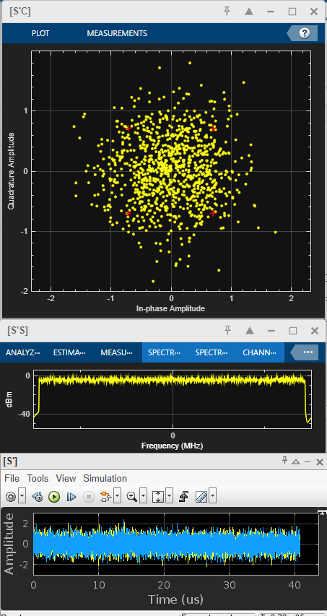
DPWiFi TRX Modeling
1. DPWiFi TRX Simulations
1.1 DPWiFi-32 320 MHz MCS13, ChDp = 0.0º
(Note 5x Scale)

Slide 12
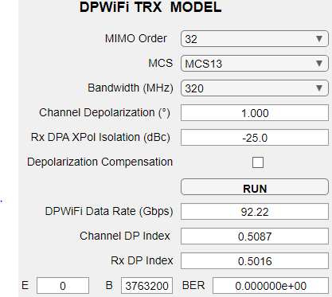
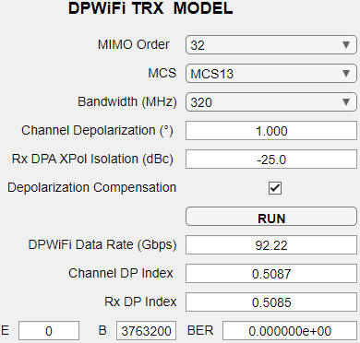
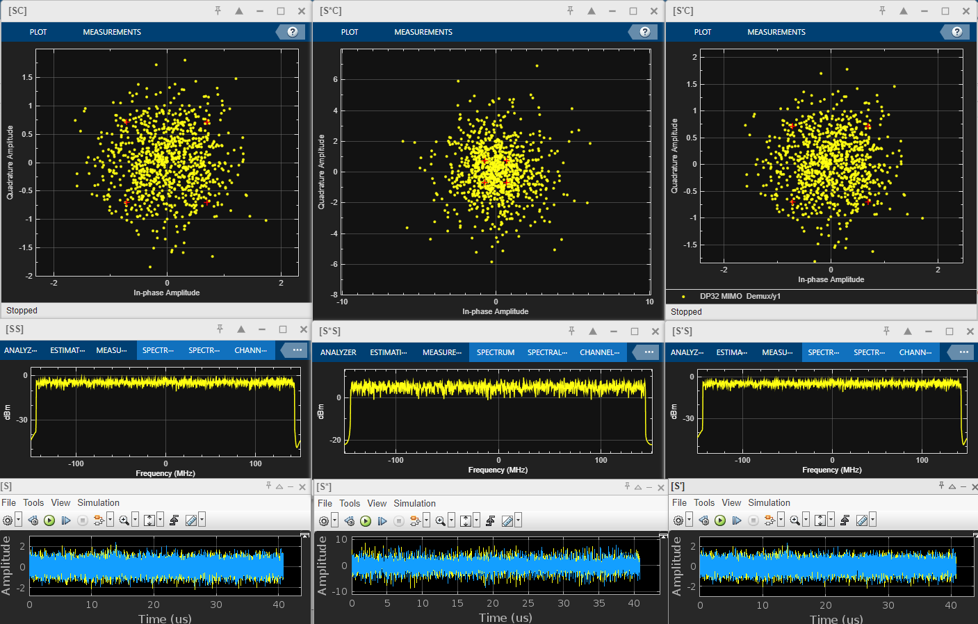
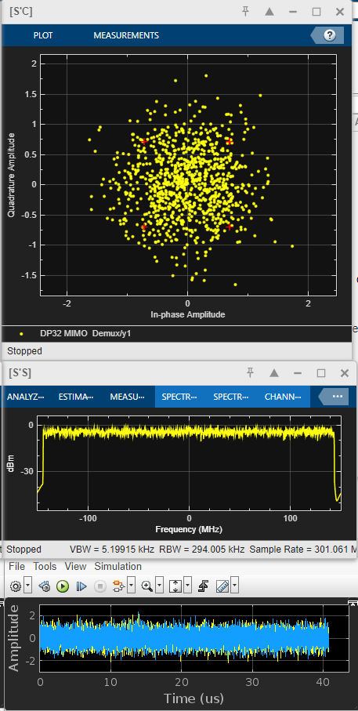
DPWiFi TRX Modeling
1.2 DPWiFi-32 320 MHz MCS13, ChDp = 1.0º
(Note 5x Scale)

Slide 13
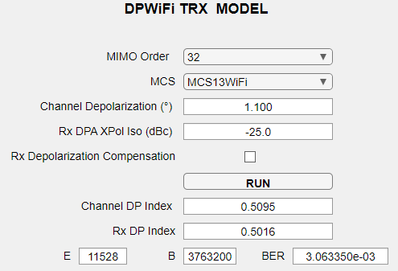
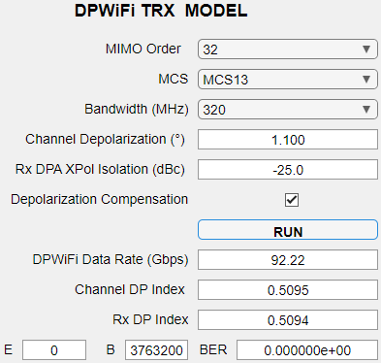
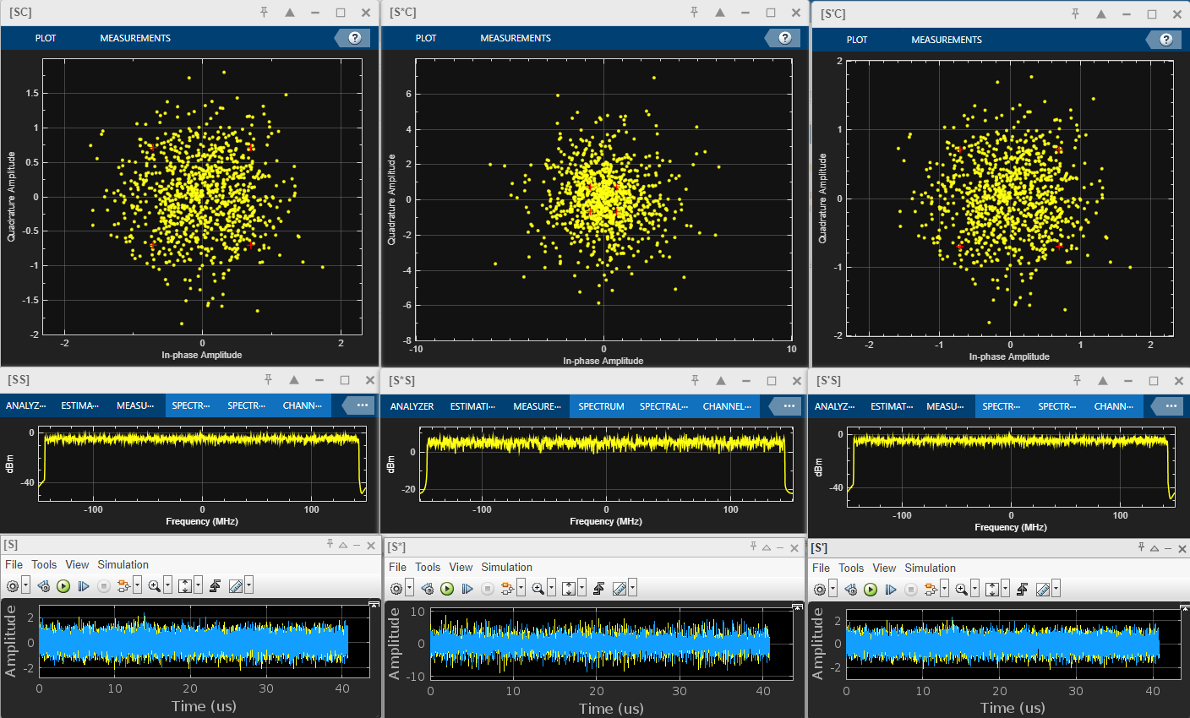
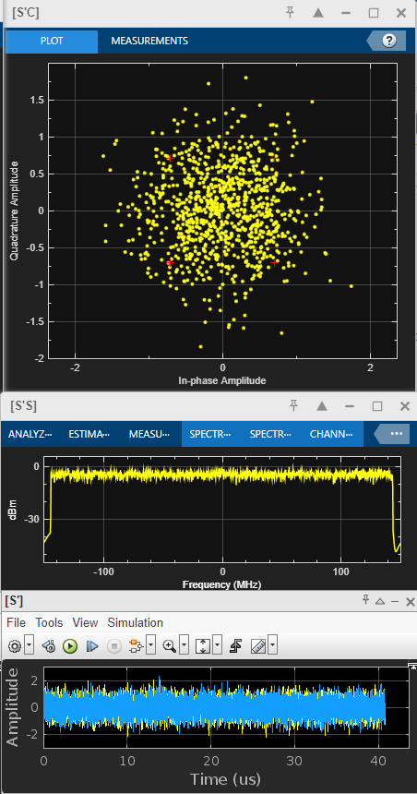
DPWiFi TRX Modeling
1.3 DPWiFi-32 320 MHz MCS13, ChDp = 1.1º
(Note 5x Scale)

Slide 14
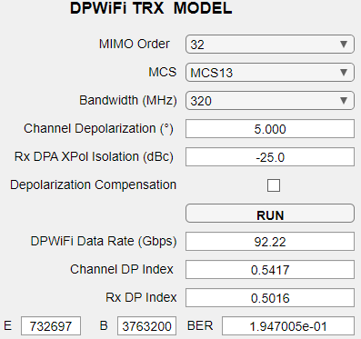
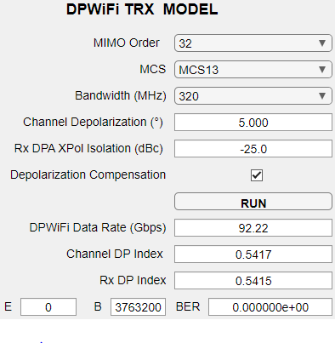
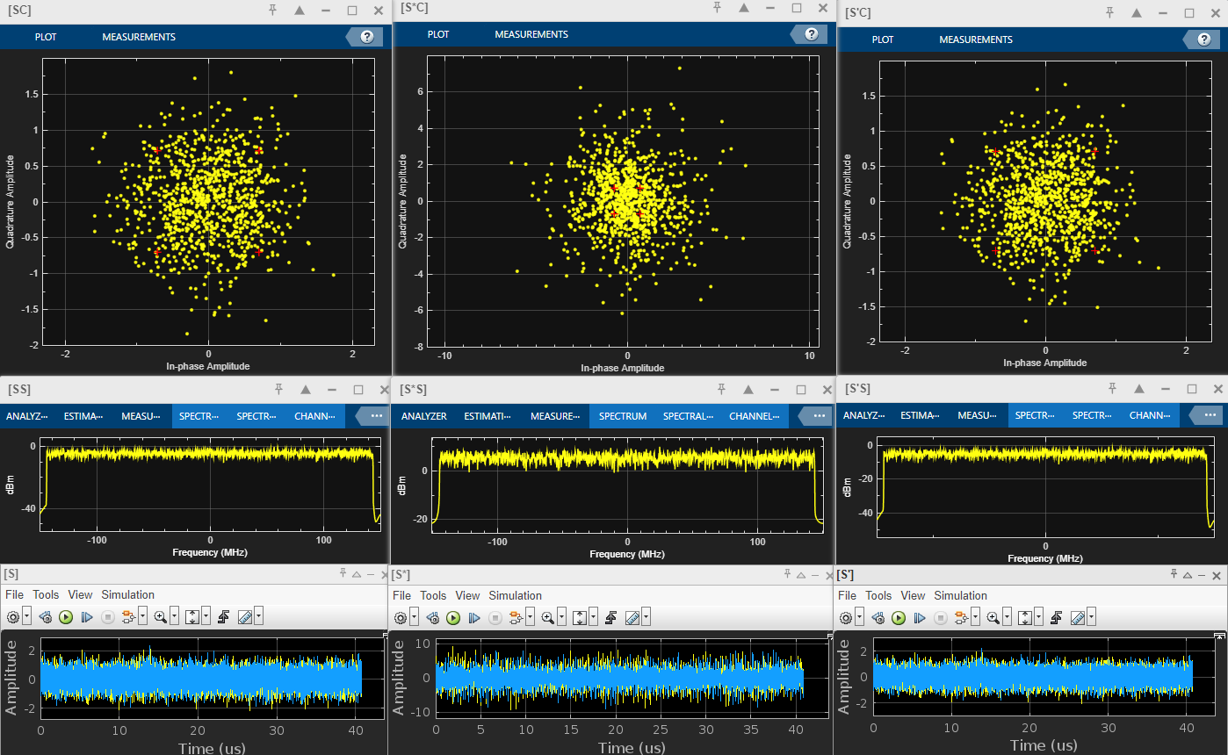
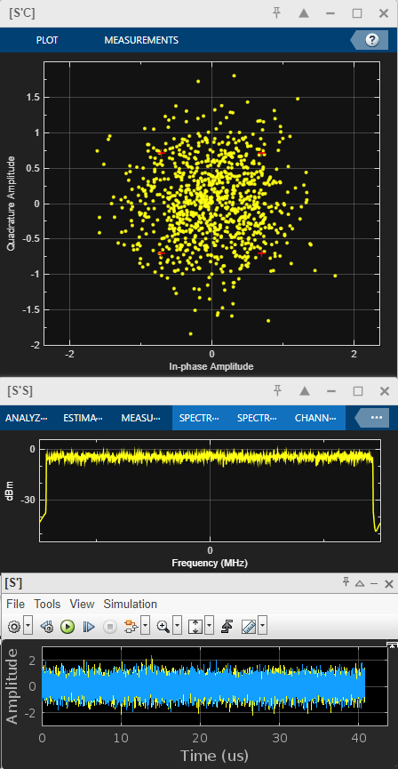
DPWiFi TRX Modeling
1.4 DPWiFi-32 320MHz MCS13, ChDp = 5.0º
(Note 5x Scale)

Slide 15
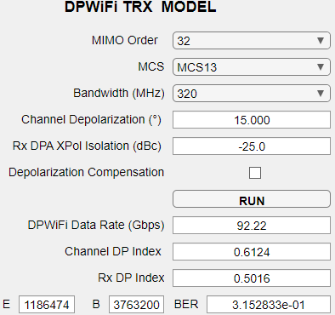
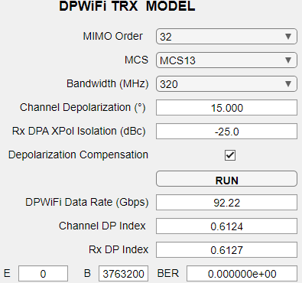
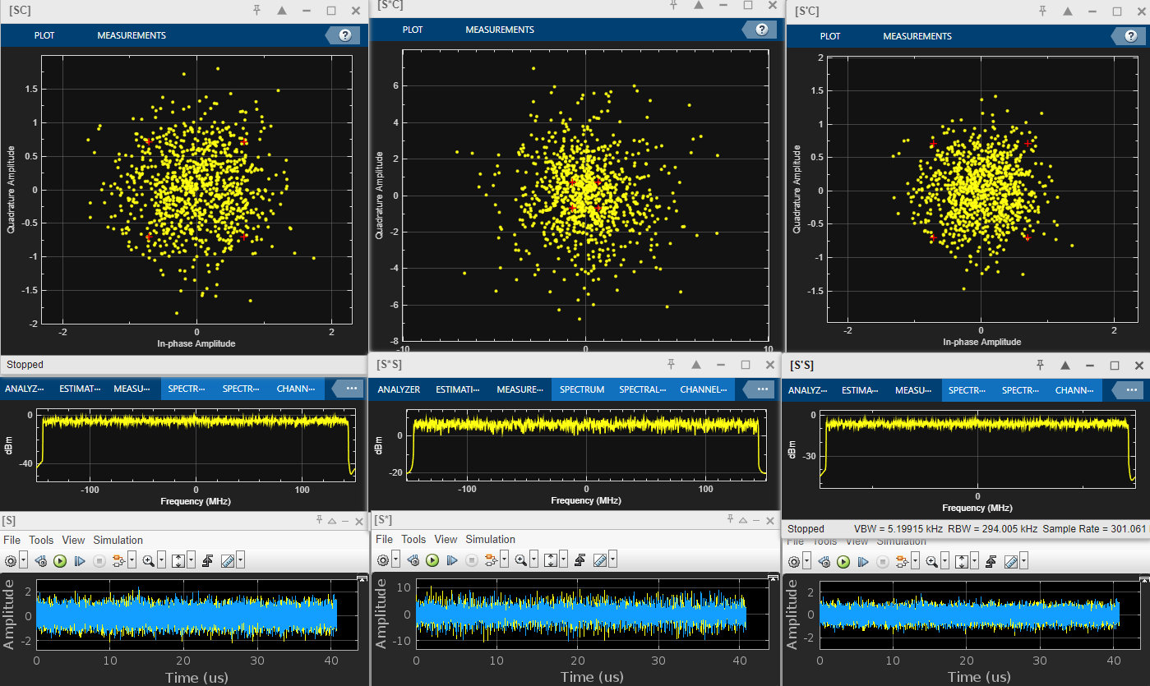
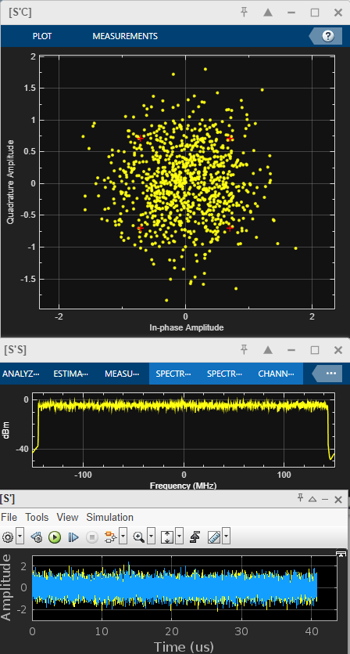
DPWiFi TRX Modeling
1.5 DPWiFi-32 320 MHz MCS13, ChDp = 15.0º
(Note 5x Scale)

Slide 16
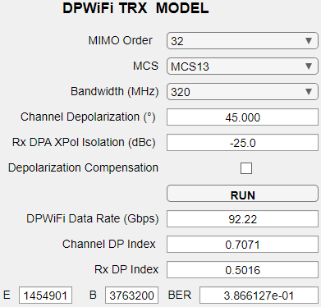
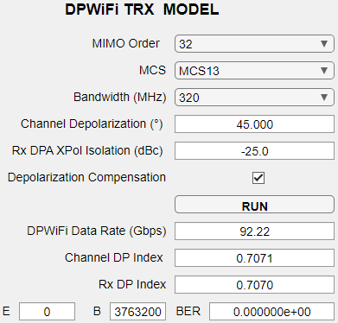
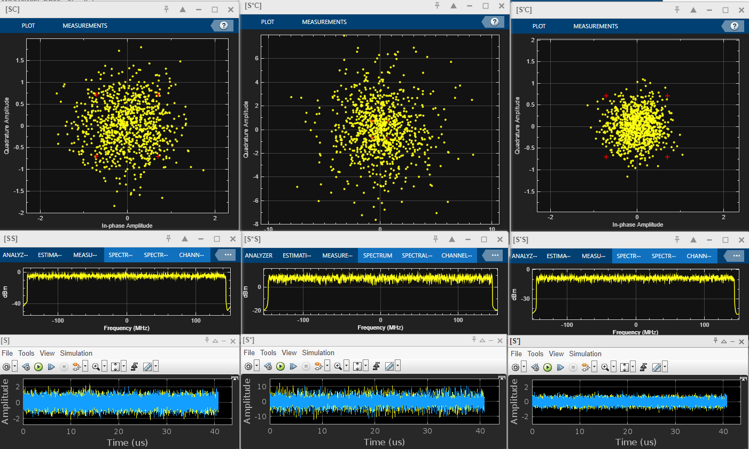
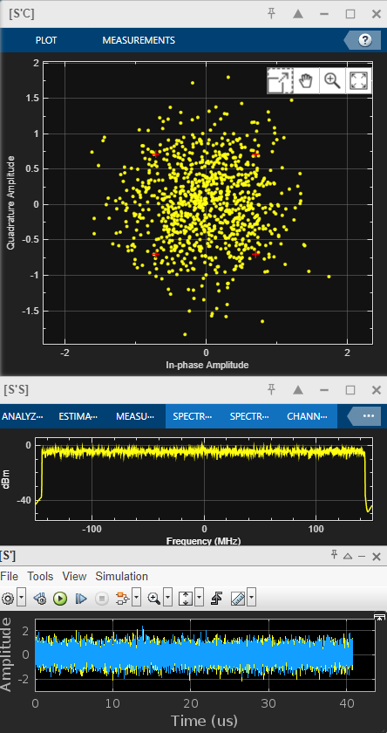
DPWiFi TRX Modeling
1.6 DPWiFi-32 320 MHz MCS13, ChDp = 45.0º
(Note 5x Scale)

Slide 17
DPWiFi TRX Modeling Observations, Analysis and Conclusions
DPWiFi TRX Modeling- Salient Observations
DPWiFi TRX Modeling- Analysis
3.1 DPWiFi is tremendously sensitive to propagation channel depolarization, as even slight fog could crash an FWA link
3.2 Adaptive DPWiFi, however, comprehensively mitigates any amount of channel depolarization
4. DPWiFi TRX Modeling- Conclusions
Adaptive DPWiFi (henceforth simply “DPWiFi”) represents both an extraordinarily powerful and robust Fixed Wireless Access waveform
DPWiFi TRX Performance in Impaired Propagation Channels DPWiFi-32 320 MHz MCS13 vs Channel Depolarization
Channel Impairment Depolarization Angle | None 0.0º | Heavy Mist 1.0º | Slight Fog 1.1º | Heavy Rain 5.0º | Rain + Foliage 15.0º | Orthogonal Reflection 45.0º
Channel DP Index | 0.5016 | 0.5087 | 0.5095 | 0.5417 | 0.6124 | 0.7071
Uncompensated TRX BER | 0.000 | 0.000 | 0.003 | 0.195 | 0.315 | 0.376
Compensated TRX BER | 0.000 | 0.000 | 0.000 | 0.000 | 0.000 | 0.000

Slide 18
DPWiFi MATLAB Validation Summary
Granted that comprehensive modeling results are still pending, the fully completed corner-case MATLAB simulations (results presented herein) nevertheless conclusively validate DPWiFi’s extraordinary, unprecedented and paradigm-shattering claimed 92 Gbps-in-320 MHz performance. Furthermore, DPWiFi appears superbly resilient to propagation channel impairments. DPWiFi thereby fully merits immediate, enthusiastic and unqualified endorsement for adoption as a TGbn PHY.

Slide 19
References
1. 23/1606r1 Dynamic Polarization Multiplexing and Beamforming WLANs
Carlos A Rios (Terabit Wireless Internet), 13-Sep-2023
23/1756r4 MIMO Dynamic Polarization and Beamforming: Proposed IEEE802.11bn PHY
Carlos A Rios (Terabit Wireless Internet), 16-Nov-2023

