Slide 1
Deterministic Backoff
Author:
Name | Affiliation | Address | Phone | Email
Menzo Wentink | Qualcomm | Utrecht, The Netherlands | +31-65-183-6231 | mwentink qti.qualcomm.com
George Cherian | Qualcomm | San Diego, CA, USA
Alfred Asterjadhi | Qualcomm | San Diego, CA, USA

Slide 2
Drawbacks of exponential backoff (EB)
Exponential backoff (EB) is fair on average, but it can be very unfair on short timescales (causing tail latency) for several reasons:
  CW is not uniform across nodes
  CW is increased exponentially when a collision occurs
  every backoff is random
Exponential backoff can also have a near/far issue when a remote node sees a collision while a nearby node does not
  if a nearby node and a remote node both transmit to the AP at the same time, the AP might still receive the transmission from the nearby node, depending on the SNR
  the nearby node might therefore see a success and reset its contention window, while the remote node sees a collision and doubles its contention window
  this may cause significant disadvantage at the remote node
  a similar effect may occur for high vs low power

Slide 3
Deterministic backoff (DB)
Deterministic Backoff (DB) is a distributed backoff algorithm that can self-organize into a round robin order
  DB is the same as EDCA, but with a different selection of the backoff value
  in the round robin order, the backoffs will have the same starting value, but the actual backoff count at each node will be different
  therefore, DB nodes access the channel at different moments, which results in a round robin ordering without collisions
  in situations where the CCA conditions are not the same at all nodes, DB will still significantly reduce the jitter relative to exponential backoff (EB), even when channel access will not be round robin or collision-free in this case (reduced tail latency)
Backoff scaling is achieved by including the number of backoff interruptions in the next backoff
  the number of backoff interruptions is referred to as interruptions per TXOP (IPT)
  an interruption of the backoff is interpreted as the presence of another node
  this allows for very quick backoff scaling, both up and down
  when repeated collisions occur, DB uses a random backoff to find an idle slot
  a deterministic backoff is determined as b + IPT, where b is the base backoff

Slide 4
Deterministic backoff rules
When selecting a new backoff
  if initial Tx (i.e. queue idle to non-idle)
    backoff = rand(0, 15) (initial backoff)
    IPT = 0
  elseif retry count mod 7 < 3
    backoff = b + IPT (deterministic backoff)
    IPT = 0
  else
    backoff = rand(0, 6) (retry backoff)
    IPT remains unchanged
For each interruption of a deterministic backoff
  IPT = IPT + 1
After a collision
  retry count = retry count + 1
After a success
  retry count = 0
retry count | 0 | 1 | 2 | 3 | 4 | 5 | 6 | 7 | 8 | 9 | 10 | 11 | 12 | 13
deterministic | d | d | d |  |  |  |  | d | d | d
random |  |  |  | r | r | r | r |  |  |  | r | r | r | r

Slide 5
Illustration of DB
IPT is the number of times the backoff was interrupted by a CCA busy condition until the occurrence of AIFS idle time. A backoff interruption is caused by a TXOP (or collision) by another node
TXOP by the node under consideration (may consist of
RTS/CTS/A-MPDU/BA)
the backoff expires
a new backoff is selected as b + 10
the backoff expires
a new backoff is selected as b + 7
...
int
3
int
10
Tx
int
1
int
2
int
3
int
4
int
5
int
6
int
7
Tx
int
1
...
IPT = 10
IPT = 7
TXOP by another node, which causes a backoff interruption at the node under consideration
Continued backoff countdown
AIFS – s – s – s – s – s
(AIFS and s are backoff slots)
A backoff interruption is a TXOP by another node (may consist of RTS/CTS/A-MPDU/BA)

Slide 6
DB round robin situation for 3 nodes
b + 2 slots total
b + 2 slots total
...
node 2
node 3
node
1
node
2
node
3
node 1
node
2
node 3
node 1
node 2
node 3
node 1
...
IPT = 2
backoff = b + 2
IPT = 2
backoff = b + 2
IPT = 2
backoff = b + 2
IPT = 2
backoff = b + 2
IPT = 2
backoff = b + 2
IPT = 2
backoff = b + 2
IPT = 2
backoff = b + 2
IPT = 2
backoff = b + 2
IPT = 2
backoff = b + 2
IPT = 2
backoff = b + 2
IPT = 2
backoff = b + 2
IPT = 2
backoff = b + 2

Slide 7
Full buffer
Latency CDF comparison, 6 nodes, full buffer
EB
DB
Access delay (CDF)
eb
db
Access delay (CDF)
very long tail
no tail
short backoffs
no short backoffs
legacy_r1_lin
cdf comparison

Slide 8
80% duty cycle (Poisson)
Latency CDF comparison, 10 nodes, Poisson arrivals
EB
DB
very long tail
short tail
short latencies due to <100% duty cycle
short backoffs
db_scw_r26_b
db_scw_r26cb

Slide 9
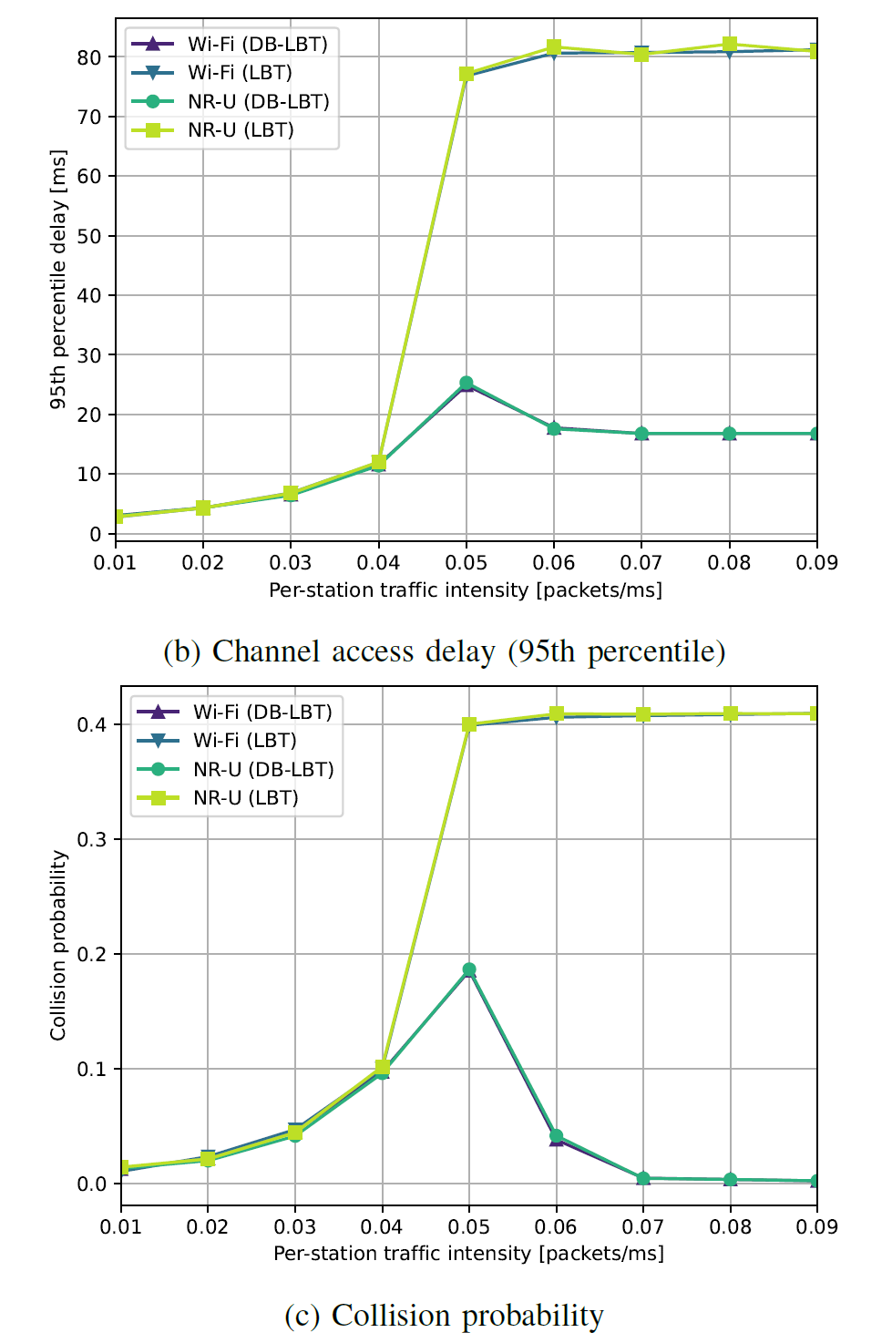
Channel access delay for different traffic intensities
Legacy EDCA
Deterministic Backoff
Source: [6] A Deterministic Backoff Approach for Wi-Fi and NR-U Coexistence in Shared Bands (unpublished), IEEE Transactions on Mobile Computing submission by Ilenia Tinnirello, Menzo Wentink, Alice Lo Valvo, Katarzyna Kosek-Szott, and Szymon Szott (University of Palermo, Qualcomm, Prysmian, AGH University of Science, AGH University of Science), potential publication date March 2023

Slide 10
Collision probability for different traffic intensities
Legacy EDCA
Deterministic Backoff
Source: [6] A Deterministic Backoff Approach for Wi-Fi and NR-U Coexistence in Shared Bands (unpublished), IEEE Transactions on Mobile Computing submission by Ilenia Tinnirello, Menzo Wentink, Alice Lo Valvo, Katarzyna Kosek-Szott, and Szymon Szott (University of Palermo, Qualcomm, Prysmian, AGH University of Science, AGH University of Science), potential publication date March 2023

Slide 11
DB parameters
An AP can tune DB channel access operation in its BSS by advertising DB parameters
  initial CW
  base backoff
  retry CW
  retry modulo
  retry threshold
  AIFSN
  TXOP limit
This is similar to EDCA, where the following values are advertised in a BSS
  CWmin
  CWmax
  AIFSN
  TXOP limit

Slide 12
DB rules – summary
At higher medium loads, DB typically selects a deterministic backoff
  the deterministic backoff is equal to b + IPT slots, where b is the base backoff
When several consecutive collisions occur, DB selects a relatively small random backoff
  the short backoffs provide randomness and increase the IPT count at other STAs that are in a deterministic backoff
  the short backoffs also help retries getting the the air sooner, curbing tail latency
  mod 7 acts like a pressure valve when consecutive collisions keep occurring
  the mod 7 does not typically come into play except in extreme cases, for example when 50 nodes start up full buffer in the same ms
  but this is better handled by operating the BSS at a higher base backoff (i.e. when the extreme cases are expected to occur regularly), for example with b = 20

Slide 13
QoS differentiation with DB
QoS differentiation with DB can be accomplished by changing the access parameters similar to EDCA
  for example, based on the current EDCA definitions:
  AIFSN for AC_VO and AC_VI depends on whether the node is an AP or a STA
  the random range is the range over which the backoff is randomly selected after consecutive collisions
When using different AIFSs, the schedule will no longer be collision-free in all cases, but jitter is still reduced significantly
 | AIFSN | base backoff | TXOP limit | random range
AC_VO | 1 or 2 | 2 | 2 ms | 3
AC_VI | 1 or 2 | 3 | 4 ms | 3
AC_BE | 3 | 12 | 6 ms | 6
AC_BK | 7 | 12 | 2 ms | 10

Slide 14
DB in a legacy environment
DB can be used when transmitting to a legacy device
  11bn AP to legacy non-AP STA
  11bn non-AP STA to legacy AP
  there is no need to switch back to legacy EDCA in this case
  a mapping should be defined between EDCA parameters and DB parameters

Slide 15
Simulations

Slide 16
Simulation settings
Tx power: 21 dBm
TXOP size: 5 ms
Traffic type
  uplink, best effort, full buffer, start time 0 s
Channel width: 80 MHz
Max bitrate: 1201 Mbps (HE MCS 11, 80 MHz, 996-tone RU, Nss = 2, 800 ns GI)
Frame exchange: RTS/CTS/AMPDU/BA
Channel model
  AWGN channel with a breakpoint at 5 m
    pathloss = 40.05 + 20log10(f/2.4) + 20log10(min(d, b)) + (d > b) * (35log10(d/b)) (dB)
    where f = 5.18 GHz, d = distance, b = breakpoint = 5 m

Slide 17
Best effort – cluster
cluster of 6 stas with full buffer uplink traffic
ap
legacy_r1_lin

Slide 18
Best effort – cluster
(ms)
eb
legacy_r1_lin
all eb

Slide 19
Best effort – cluster
(ms)
db
eb
legacy_r1_lin
1 db, 5 eb

Slide 20
Best effort – cluster
(ms)
db
eb
legacy_r1_lin
3 db, 3 eb

Slide 21
Best effort – cluster
(ms)
db
eb
legacy_r1_lin
5 db, 1 eb

Slide 22
Best effort – cluster
(ms)
db
legacy_r1_lin
all db

Slide 23
OBSS
bss 1
bss 2
n4
n5
obss_r2

Slide 24
OBSS
(ms)
n4, n5 (eb)
obss_r2
all eb

Slide 25
OBSS
(ms)
n4 (db)
n5 (eb)
obss_r2
4th sta db

Slide 26
OBSS
(ms)
n4, n5 (all db)
obss_r2
all db

Slide 27
Near/far – line
ap
stas
legacy_r2_lin_line

Slide 28
Near/far – line
(ms)
legacy_r2_lin_line
all eb

Slide 29
Near/far – line
(ms)
db
legacy_r2_lin_line
outer 3 stas db

Slide 30
Near/far – line
(ms)
db
legacy_r2_lin_line
inner 3 stas db

Slide 31
Near/far – line
(ms)
db
legacy_r2_lin_line
all db

Slide 32
Near/far – multiple links
remote node
(rn)
remote_r2_lin_multilink

Slide 33
Near/far – multiple links
(ms)
rn
all links use eb
remote_r2_lin_multilink
all use eb

Slide 34
Near/far – multiple links
(ms)
rn
nearby links use db
remote_r2_lin_multilink
nearby links use db

Slide 35
Near/far – multiple links
(ms)
rn
remote link uses db
remote_r2_lin_multilink
remote link uses db

Slide 36
Near/far – multiple links
(ms)
rn
all links use db
remote_r2_lin_multilink
all use db

Slide 37
References

Slide 38
References
[1] 11-15-1152-01-000m-moderated-backoff
  TGm contribution by Menzo Wentink (Qualcomm)
[2] 11-15-1437-00-000m-experimental-evaluation-of-moderated-edca-over-wmp
  TGm contribution by Menzo Wentink (Qualcomm)
[3] MAC Design on Real 802.11 Devices: from Exponential to Moderated Backoff
  WoWMon paper by Ilenia Tinnirello, Menzo Wentink, Domenico Garlisi, Fabrizio Giuliano, Giuseppe Bianchi (Universitá di Palermo, Qualcomm, Universitá di Roma Tor Vergata)
[4] 11-17-1428-02-coex-deterministic-backoff
  Coex SC contribution by Menzo Wentink (Qualcomm)
[5] DB-LBT: Deterministic Backoff with Listen Before Talk for Wi-Fi/NR-U Coexistence in Shared Bands
  IEEE MASCOTS 2022 conference paper by Katarzyna Kosek-Szott, Szymon Szott, Alice Lo Valvo and Ilenia Tinnirello (October 18-20, 2022, Nice, France)
  https://ieeexplore.ieee.org/document/10053817
[6] A Deterministic Backoff Approach for Wi-Fi and NR-U Coexistence in Shared Bands (unpublished)
  IEEE Transactions on Mobile Computing submission by Ilenia Tinnirello, Menzo Wentink, Alice Lo Valvo, Katarzyna Kosek-Szott, and Szymon Szott (University of Palermo, Qualcomm, Prysmian, AGH University of Science, AGH University of Science), potential publication date March 2023

