Slide 1
MIMO RvR Enhancement with Unequal Modulation
Date: 2024-01-12
Authors:

Slide 2
Introduction
Rate-vs-Range (RvR) enhancement is an important objective for UHR
In MIMO fading channels, equal modulation across spatial streams is sub-optimal, especially for ill-conditioned channels.
In this presentation, we discuss about different technologies for enhancement, and propose the unequal modulation as a candidate feature for UHR MIMO enhancement.

Slide 3

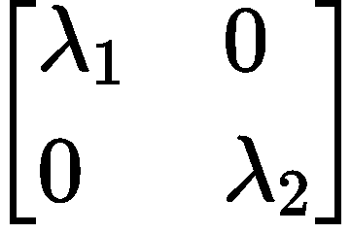
MIMO Fading Channel: DNLos 2x2
Condition number statistics:
  in the range of [7, 15]dB

Slide 4
Fading channel statistics: DNLos 4x4
Condition number statistics: SNR gap between the first spatial stream and the rest spatial streams increases from ~5dB to ~18dB @50 percentile.

Slide 5
Potential technologies
Reliability enhancement
  Enhanced beamform feedback, e.g.
    Geometric mean decomposition (GMD) [1]
    Rotated V matrix [2]
  Per-stream power scaling (PS): reverse different per-stream SNR
Capacity achieving
  Unequal modulation (UEQM) [3]: introduced in 11n HT PHY when MIMO was introduced to 802.11.
  Unequal MCS (UEQ-MCS) [4]: for layered QoS
  Bit loading: too complex to design

Slide 6
Unequal Modulation: design changes
Limited design changes:
  Update unequal stream parser: based on QAM level
  Update N_{DBPS} and N_{CBPS} for different QAM combinations and BW

Slide 7
Unequal modulation vs Unequal MCS
Complex and costly solution for SU transmission:
  Tx similar to DL MU complexity; Rx similar to UL MU complexity
    N-times more hardware for coding and scrambling
  Independent PSDU from MAC: big interface changes

Slide 8
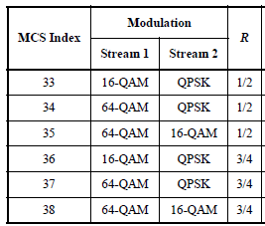
Unequal Modulation in 11n: revisit
Unequal modulation is optional in 11n
  Many unequal modulation MCS-33 to MCS-76.
  6 options for 2ss: QPSK to 64QAM, [½, ¾]
Beamforming support is also optional for 11n
  not popular on HT devices.
  Unequal modulation works with beamforming.
Full-dimension MIMO Tx is also not popular
  11n APs with 3x3 configuration and 2ss max rates

Slide 9
Unequal Modulation for UHR
More mobile/micro-APs with 2x2 configurations on the markets for P2P communications
  Full-rank transmission (2x2-2ss) is critical for high data rates.
Beamforming support is popular in 11ac/ax/be devices
  Proprietary sub-optimal solutions: e.g. per stream power scaling
It’s time to re-visit unequal modulation
  More QAM levels are introduced since 11n
    256 QAM, 1024 QAM and 4096 QAM → more combinations
  More BW are available: 80MHz/160MHz/320MHz

Slide 10
Simulations
80MHz, 2x2, DNLOS channels
4x EHT-LTF, LDPC code
Tx: SVD Tx BF
Rx: Linear receiver
Modulations:
  BPSK to 4K-QAM, Coding [1/2, 2/3, 3/4, 5/6]
Comparison:
  Equal modulation (EQM) and Unequal modulation (UEQM)
  Criteria: Average goodput of per channel RvR (optimal rate selection for each channel)
  UEQ-MCS, EQM with power scaling (EQM-SVD-PS), EQM with GMD (EQM-GMD)

Slide 11
Average Goodput: DNLos 2x2-2ss
UEQM vs EQM: up to 2.5dB gain, up to 18% ave goodput gain

Slide 12
Goodput Gain vs Condition Number

Slide 13
High vs Low Condition number
UEQM is more resilient to channels with high condition numbers, as UEQM has finer rate steps to adapt to different channels
3~4dB gain achieved for channels with higher condition numbers.

Slide 14
UEQM vs UEQ-MCS
UEQM has similar goodput as UEQ-MCS
Some benefits for UEQM observed at higher SNR points when 1st SS SNR saturates, due to joint coding

Slide 15
UEQM vs Enhanced SVD
RvR based on ensemble PER simulations
Power scaling or GMD smoothes RvR curve with some gain
UEQM shows much better gain than power scaling and GMD (ML)

Slide 16
Summary
UEQM achieves up to 2.5dB average MIMO RvR enhancement for fading channels
  More goodput gains of UEQM for channel with larger condition number.
UEQM vs UEQ-MCS and other SVD enhancements
  UEQM achieves slightly better performance gain than UEQ-MCS, and with relatively simpler implementation
  Several known SVD enhancement schemes bring limited gain
UEQM is a good candidate feature for UHR.

Slide 17
SP
Do you agree to add the following text into 11bn SFD?
11bn defines unequal modulation with the same coding rate for beamformed multi-stream transmission
Y
N
A

Slide 18
References
[1] 11-22/1869r1, uhr-txbf-based-on-the-optimal-svd
[2] 11-23/0011r0, on-the-enhanced-link-adaptation
[3] 802.11-2020
[4] 11-22/1930r0, layered-qos-and-multi-layer-transmission

Slide 19
Appendix

Slide 20
20MHz DNLos 2x2 Goodput: ML
Ensemble simulation with ML detector

Slide 21
RotV
Loss for linear receiver due to inter-stream interference
<1dB sensitivity gain at MCS>=5 for ML

Slide 22
20MHz DNLos 2x2 Goodput
EQM with new rates: straighten the RvR curves of EQM

Slide 23
Fading channel statistics: DNLOS 4x2
SNR gap between two spatial streams varies from 4.8dB to 11dB, about with about 99.9% channels fall in Unequal modulation region I.

Slide 24
Average Goodput: DNLos 4x2-2ss
EQM with new rates: straighten the RvR curves of EQM
UEQM vs EQM-new: uniform gain of ~1dB, up to 20% ave goodput gain

Slide 25
Goodput Gain (4x2-2ss)

Slide 26
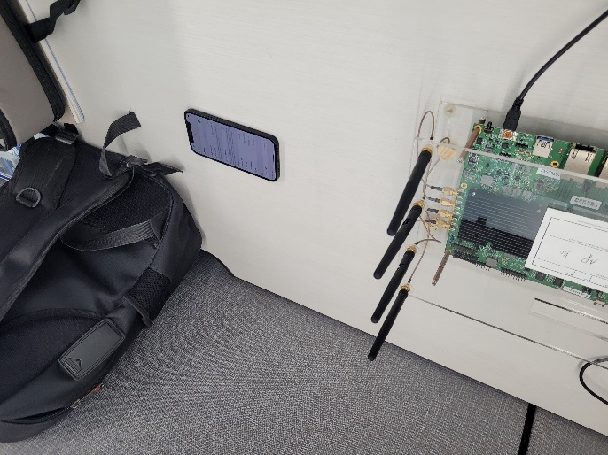
OTA channel sounding: 4x2

Slide 27
OTA channel sounding: 2x2

