Slide 1
Coordinated Spatial Nulling (C-SN) Simulations
Date: 2024-01-03

Slide 2
Introduction
The concept of coordinated spatial nulling is presented in [10], which discussed:
  Spatial nulling feedback
  Need for synchronization
  Advantages of partial nulling
  Half-coordinated vs. Fully coordinated
This contribution presents simulation results
  Performance spatial nulling in different in-home scenarios and coordination scenarios
  Comparison of different precoder computation modes

Slide 3


In-Home Scenarios
Coverage Simulation
Residential scenario based on [5]
2 AP placement options:
  Co-located APs
  10m distance between APs
  20m distance between APs
In OBSS case, STAs are assigned to APs according to position (Room 1, 2 to AP1, Room 3,4 to AP2)
In ESS case, STA assignment is optimized

Slide 4
Simulation Assumptions
For half-coordinated C-SN
  C-SN feedback (as in [10], slide 6)
  Allowed SNR degradation is 3dB
  At the secondary AP, all free spatial streams are used to create spatial nulls consistent with the max. SNR degradation
  Partial nulling is used (see [10])
Fully coordinated C-SN
  Joint MMSE precoder optimization (uplink-downlink duality) is used (see slide 11)
  Joint Sounding (as in [10], slide 8) is assumed
Synchronization
  OFDM symbol alignment for spatial nulling [9, 10]
Baseline
  TDMA with MU-MIMO (Denoted as “TDMA” in results)

Slide 5
Aggregate Throughput Comparison (1)

Slide 6
Aggregate Throughput Comparison (2)
Observations
Fully coordinated nulling always outperforms TDMA
Even half-coordinated (partial) nulling outperforms TDMA with sufficient distance between the APs
Most gain when APs are closer to each other
  Complements C-SR in scenarios where C-SR doesn’t perform well

Slide 7
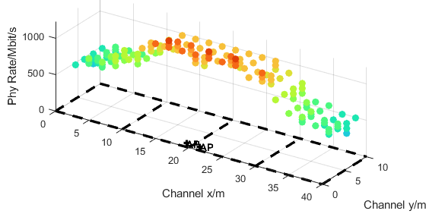
Individual STA rates (1)
Minimum distance between APs
  Fully coordinated C-SN, using joint precoder optimization, gives the highest rates
  Half-coordinated C-SN rates are lower than TDMA with access points close to each other
  The fairness issue observed with fully coordinated C-SR is not observed for C-SN
OBSS Full Coordinated

Slide 8
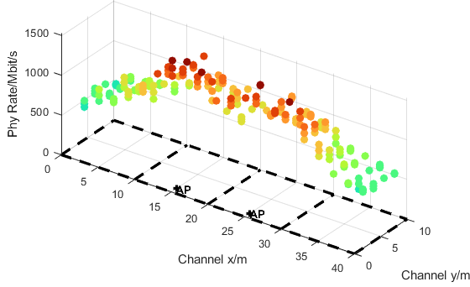
Individual STA rates (2)
10m distance between APs
  With more distance between APs, half-coordinated C-SN rates are close to TDMA rates
  Fully coordinated still performs best
OBSS Full Coordinated

Slide 9
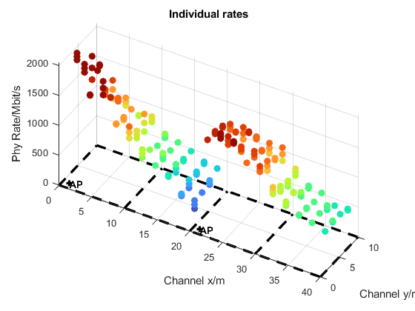
Individual STA rates (3)
20m distance between APs
  No fairness issues with fully coordinated C-SN (compared to fully coordinated C-SR)
  STAs located close to AP2, but associated with AP1 suffer (ESS will improve)
OBSS Fully Coordinated

Slide 10
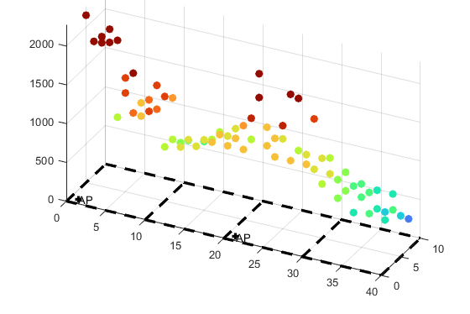
ESS vs. OBSS
OBSS vs. ESS STA Rates
  STAs are associated with the closest AP (w.r.t. attenuation)
  Issue of low rates in room 2 resolved
APs at 20m distance

Slide 11
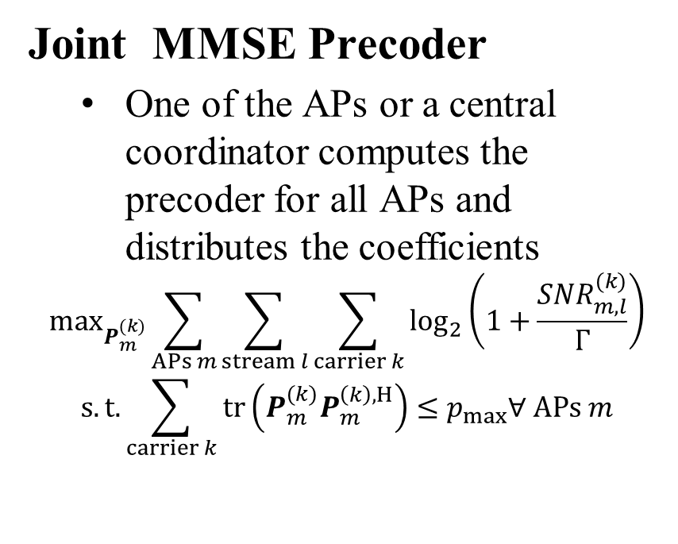
Precoder options: Mutual Nulling vs. MMSE
Mutual Nulling
  Each AP receives C-SN feedback and performs nulling to un-associated STAs
  Precoder computation is done at each AP independently (see [10], appendix)
Joint MMSE Precoder
  One of the APs or a central coordinator computes the precoder for all APs and distributes the coefficients
$$\max_{P_{m}^{(k)}}{\sum_{APs m}{\sum_{stream l}{\sum_{carrier k}{\log_{2}\left(1+\frac{{SNR}_{m,l}^{(k)}}{Γ}\right)}}}}$$
$$s.t.{\sum_{carrier k}{\operatorname{tr}\left(P_{m}^{(k)}P_{m}^{\left(k\right),H}\right)≤p_{max}∀ APs m}}$$

Slide 12
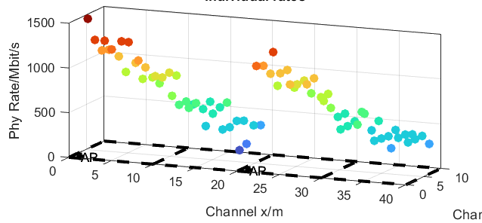
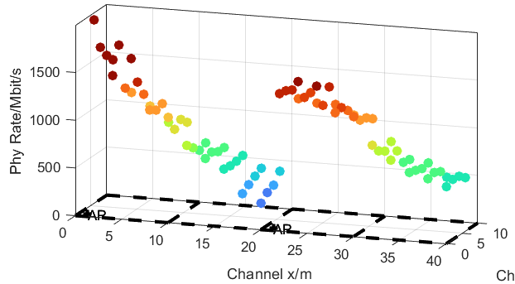
Mutual Nulling vs. MMSE Performance
Performance comparison
  20m distance between APs
  MMSE precoder reaches significantly higher rates
  Reason: MMSE works efficient with Number of spatial streams > Number of TX antennas

Slide 13
Conclusion
Spatial nulling improves throughput, compared to MU-MIMO TDMA and "regular" C-SR, for OBSS and ESS
  With small to medium distance between APs, spatial nulling gives a throughput increase around 20%, compared to collision-free TDMA
  With larger distance between APs, 30%-50% throughput increase is possible
  In addition, latency is improved over TDMA by the ability to transmit with multiple APs simultaneously
Joint precoder calculation gives an additional performance improvement

Slide 14
References
[1] “Multi-AP Simulations: framework and Joint Transmission results”, IEEE 802.11-23/1176r1
[2] “Multi-AP Simulations: follow-up”, IEEE 802.11-23/1843r0
[3] “Coordinated spatial re-use for UHR”, IEEE 802.11-23/1975r0
[3] “Spatial Reuse in Coordinated M-AP for UHR”, IEEE 802.11-23-0058r0
[4] Sigurd Schelstraete (Maxlinear), “SINR-aware Spatial Reuse”, IEEE 802.11-22/1970r0, November 2022
[5] “Performance of C-BF and C-SR”, IEEE 802.11-22/0776r1
[6] Gary Anwyl et. al“Coordinated Spatial Reuse in a 4 AP Topology”, IEEE 802.11-23-1023r2
[7] Kanke Wu et. al“Performance of Coordinated Spatial Reuse”, IEEE 802.11-23-1037r0
[8] “TGax Simulation Scenarios”, IEEE 802.11-14/0621r3, Simone Merlin, etc.
[9] Sigurd Schelstraete et.al.,“Nulling and coordinated beamforming” IEEE 802.11-19/0638
[10] Rainer Strobel et.al., “Coordinated Spatial Nulling (C-SN) Concept” IEEE 802.11-24-0011

Slide 15
APPENDIX

Slide 16
Simulation parameters
Parameter | Value
TX/RX Antennas | 4/2
APs/STAs | 2/4 (2 STAs per AP)
Spatial streams | 1 or 2 (optimized)
Bandwidth | 160 MHz
AP TX Power | 21 dBm
Channel model | D NLOS [8]
MCS | 0-13 (optimized)
Frequency | 5.25GHz
GI | 1.6µs
TX/RX SNR | 41dB/43dB
Channel aging/Doppler | 1.2km/h, 6Hz
BF quantization | ideal
Precoder type | ZF (O-BSS), MMSE (C-ESS)
Sounding interval | 100ms (SU), 10ms (MU)
Overhead | Sounding and MAC overhead not considered
MU allocation | 2 STAs served by one AP 50% time for per AP

Slide 17
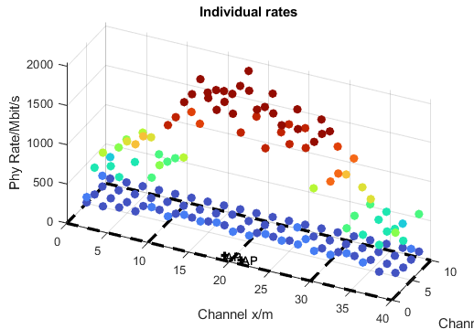
OBSS Half-Coordinated
Power control and spatial nulling
  Secondary rates are low, but 100% available (small rate improvement, but much better latency)
Co-located APs

Slide 18
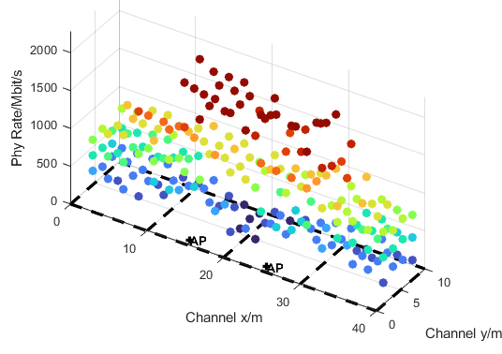
OBSS Half-Coordinated
Half Coordinated
  With more distance between APs, secondary rates improve
APs at 10m distance

Slide 19
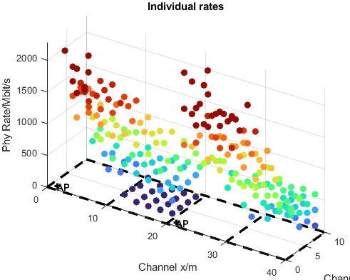
OBSS Half Coordinated
Spatial Re-Use and Spatial Nulling
  Average rates improve, compared to C-SR
APs at 20m distance

