Slide 1
Coordinated Beamforming for 802.11bn
Date: 2024-01-03
Authors:

Slide 2
Background
Multi-AP coordination (MAPC) is one of the most discussed protocol enhancements for 802.11bn.
MAPC may enable development of new features, among them Coordinated Beamforming (Co-BF).
Co-BF has been already extensively discussed in TGbe [1-5] and leverages on the applications of beamforming and null steering capabilities.

Slide 3
Objectives
Clarify Co-BF meaning, its requirements and opportunities.

Slide 4
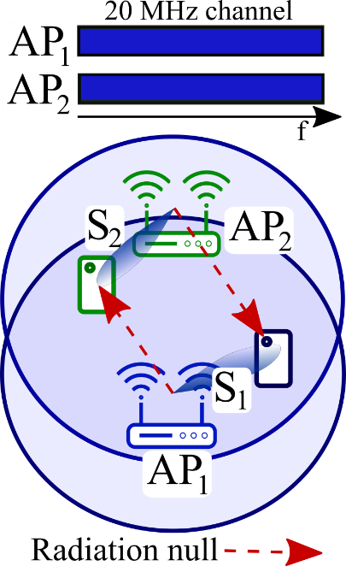
What does Co-BF mean?
Wi-Fi access points (APs) are densely deployed and equipped with multiple antennas.
Digital precoding/filtering techniques allow APs to focus radiation patterns towards users to serve, BUT also to null interference towards/from overlapping basic service set (OBSS) devices.
The application of radiation nulls requires CSI acquisition from OBSS devices.
APs equipped with Co-BF with null steering have the possibility to share channel and time resources, avoiding contentions and interference.

Slide 5
Co-BF framework for 802.11bn
Define a common MAPC framework (wireless or wired) valid for Co-BF but also for other coordination techniques:
  Coordination set establishment and maintenance with the means available in the semi-static MAPC framework
Define a specific Co-BF framework for:
  CSI acquisition from OBSS devices (CSI acquisition means for own devices reused).
  Allocation and communication of nulling capabilities in both UL and DL directions.
Data transmission with beams and nulls activated
  Relaxing channel access constraints (concurrent transmission without power reduction)

Slide 6
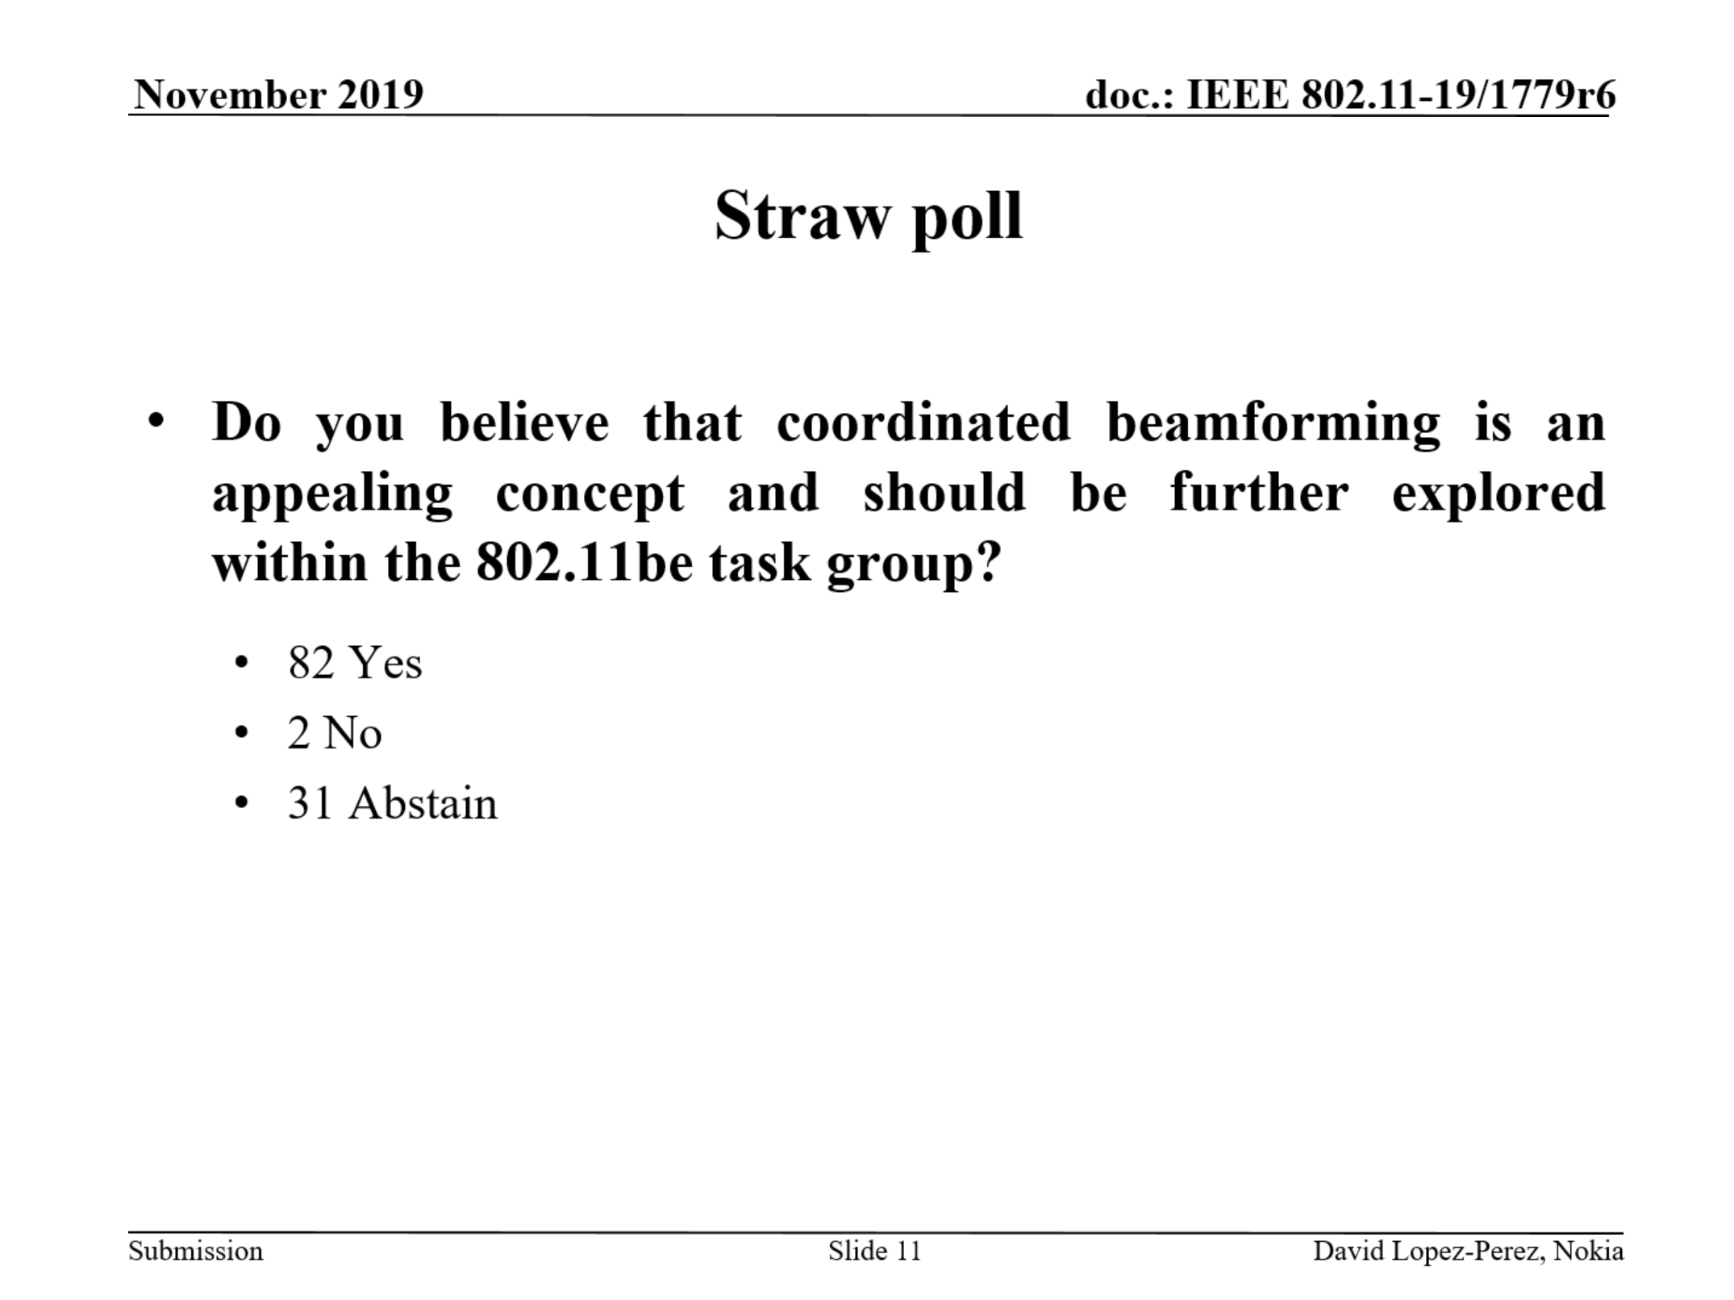
Co-BF opportunities
Through Co-BF with null steering is possible to boost spatial reuse opportunities by making media available for simultaneous transmissions, thus reducing worst-case latency [2, 5].
We aim to highlight the opportunity to build upon what has been already discussed [1-5] and straw-polled (see below) in TGbe.

Slide 7
Straw poll
Do you believe coordinated beamforming with null steering should be considered for inclusion in the 802.11 TGbn Specification Framework Document (SFD)?
  Yes
  No
  Abstain

Slide 8
References
[1] “Coordinated Null Steering for EHT”, 19/0811.
[2] “Performance of Coordinated Null Steering in 802.11be”, 19/1212.
[3] “Coordinated Beamforming/Null Steering in 802.11be”, 19/1594.
[4] “Downlink spatial reuse parameter framework with coordinated Beamforming/Null Steering for 802.11be”, 19/1779.
[5] “Performance of parameterized spatial reuse (PSR) with coordinated beamforming/null steering for 802.11be”, 20/0091.

