Slide 1
Proposal for Bluetooth and Wi-Fi Coexistence in 5 and 6GHz
Date: YYYY-MM-DD
Authors:

Slide 2
Introduction
This slide outlines a proposed framework for Wi-Fi and Bluetooth coexistence in the 5 and 6 GHz bands, viewed from the perspective of Bluetooth.

Slide 3
Key Principles of the Proposal
Establish a set of requirements and protocol improvements in the Bluetooth Higher Bands (5 and 6 GHz) specification that would facilitate a toolset for coexistence with Wi-Fi.
  Detect-And-Avoid (DAA)
  Listen-Before-Talk (LBT)
  Regulatory determination
  Improvements for Wi-Fi/BT collocated devices
Determine the conditions in which a device uses a feature available in the Higher Bands (HB) coexistence toolset, which may rely on factors such as
  Regulatory requirements
  Spectrum availability
  Channel quality
  Presence of other devices

Slide 4
Existing Toolset in Bluetooth for Coexistence
Bluetooth specification supports a form of Detect-and-Avoid (DAA) in Adaptive Frequency Hopping (AFH)
  The implementers are given the freedom to decide the most suitable way to accomplish this goal.
  Can be improved upon, as there is no constraint on the timing requirement
Impact of the narrowband transmission on Wi-Fi signal is shown to be significant without a coexistence mechanism. [2][3]
The effectiveness of AFH (as used in 2.4GHz) can be increased.

Slide 5
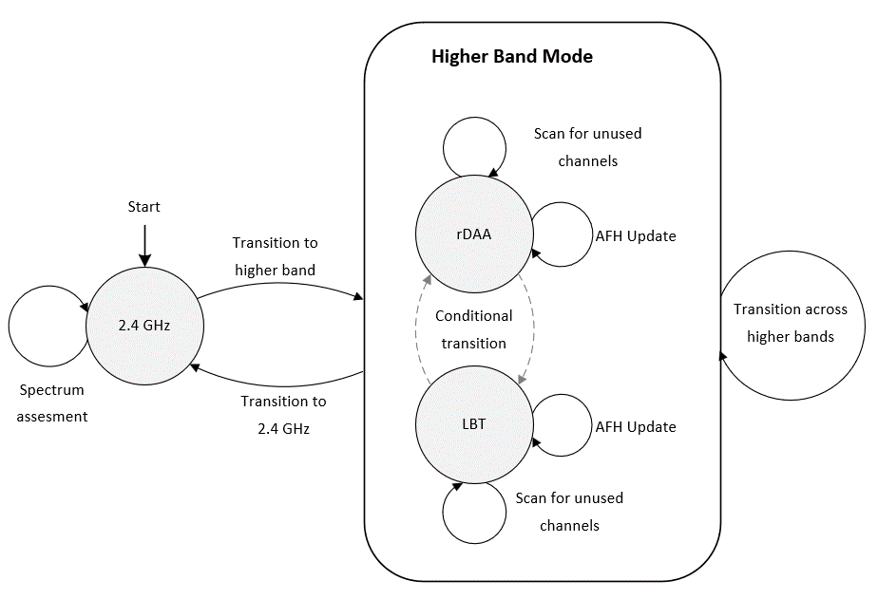
State Machine for Higher Band Operation
rDAA – regulated-DAA (details on the next slide)
LBT – Listen before Talk
Note: During transition to the higher band, If LBT is mandated by the regulatory body in the selected sub-band, the default state will be LBT, and the rDAA state will not be considered. Otherwise, the default starting state will be rDAA.

Slide 6
Regulated-Detect-and-Avoid (rDAA)
The goal is -
To establish an upper limit on the interference caused by Bluetooth device to Wi-Fi when using DAA.
To expand upon the widely used methodology currently utilized in the ETSI domain and the industry at large for 2.4GHz band (EN 300 328) [1]
Proposed rDAA Requirement
A Bluetooth device shall not do cumulative transmissions above X dBm EIRP (e.g., 0dBm) exceeding Y ms (e.g.,20ms) in a 20MHz Wi-Fi channel once an interference energy of at least Z dBm/MHz (e.g., -70dBm/MHz) starts within the same 20MHz channel.

Slide 7
Higher Band Mode
Transition from rDAA to LBT
  If there is significant spectrum overlap and Bluetooth is unable to locate an adequate number of channels to function outside the Wi-Fi occupied spectrum.
    Likely useful when Wi-Fi has low to moderate traffic load
Transition from LBT to rDAA
  If scans find unused spectrum for Bluetooth to use, it may be advantageous to switch to rDAA.
    As highlighted in our previous results, relying on LBT-based access can potentially lead to glitches for Bluetooth. [4]
Note: Compliance with regulations will take precedence over the selection of a channel access method.

Slide 8
Example using rDAA
Set of parameters
Assumptions: A Bluetooth device can obtain the channel state information using the following two methods
Active scans refer to those conducted during normal transmit and receive operations.
Passive scans refers to those carried out during periods of inactivity by specifically turning the scanner ON for scanning purposes
ISO interval | 7.5ms
Number of subevents | 2
Subevent duration | 1ms
Bluetooth channel bandwidth | 2MHz
Bluetooth hopping bandwidth | 320MHz (160 channels)
Wi-Fi bandwidth | 160MHz (overlap of 50%), Eight 20MHz channels
2MHz wide scanning capability
Different values of observations per second (sum of active and passive scans)
  [200, 500, 1000, 1500, 2000]
Bluetooth device limits transmission to ≤20ms in a 20MHz Wi-Fi channel
  Expectation is that total Bluetooth transmission time shall not exceed 8×20ms = 160ms in the Wi-Fi occupied 160MHz band.
A 20MHz band is vacated if 50% of channels in this band are found to be busy

Slide 9
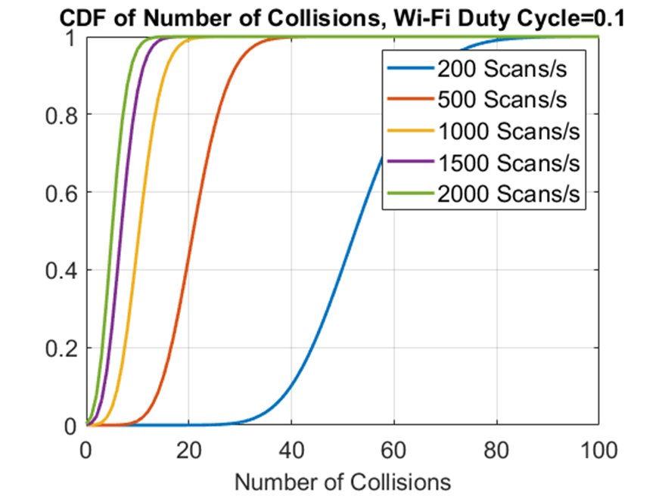
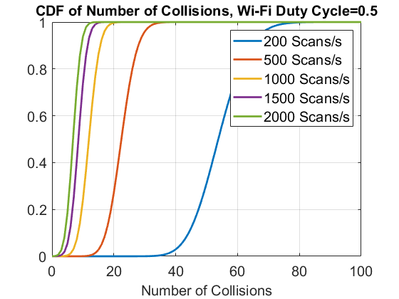
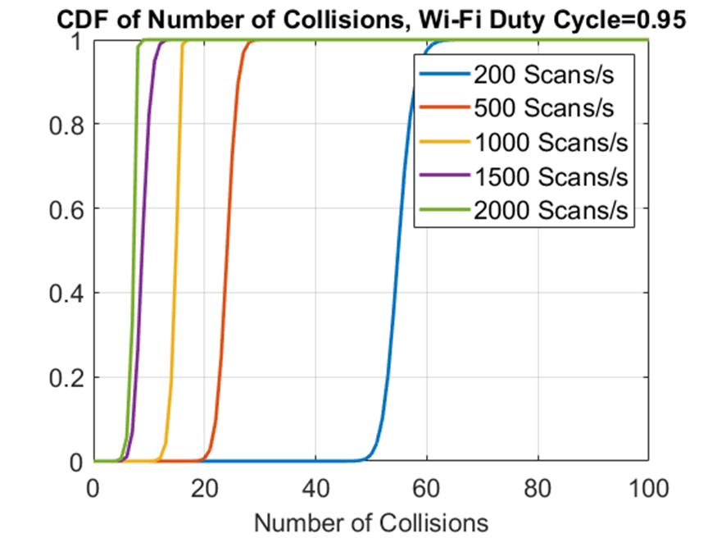
Collision with Wi-Fi
Corresponds to 20ms for this example

Slide 10
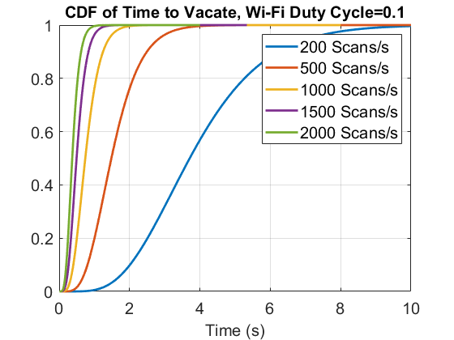
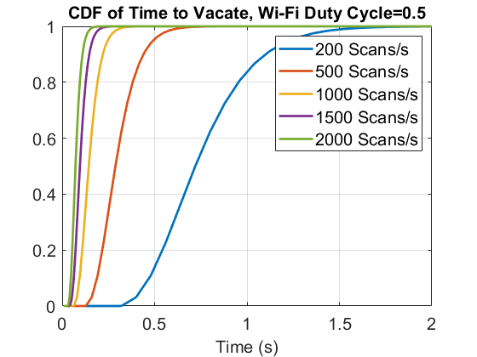
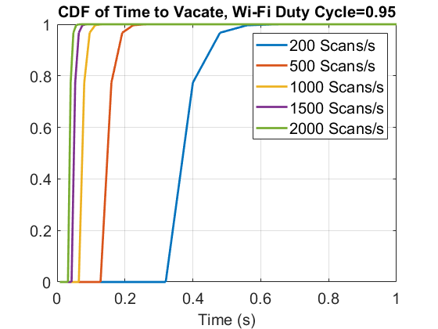
Time to Vacate Wi-Fi-occupied Band

Slide 11
Summary
To facilitate a fair coexistence of Bluetooth devices with other non-incumbent users in the higher bands, we suggest introducing a requirement for DAA, referred to as rDAA (regulated-DAA) in this document.
We propose that LBT be employed on a conditional basis or when mandated by the governing regulations.

Slide 12
References
[1] ETSI EN 300 328
[2] BRAN(21)109e008, Qualcomm
[3] 11-23-1259-01-coex-effect-of-no-lbt-nb-on-802-11-devices.pdf, Meta
[4] Coexistence study of “Bluetooth Low Energy with LBT” and Wi-Fi, Intel, Bluetooth SIG

