Slide 1
DL MU Ext PPDU
Date: 2024-01-09
Authors:

Slide 2
Abstract
This submission proposes a mechanism to support OFDMA with legacy STAs

Slide 3
Problem statement
Fact: Various transmissions have to be non-OFDMA PPDUs on the primary channel
  Beacons (typically 20M, though could be non-HT duplicate)
  Probe responses
  Broadcasts
  Transmissions to non-HE STAs (at the max width they support; could be < BSS width)
  etc.
These transmissions can consume a significant fraction of the beacon interval but utilise only a portion of the BSS available bandwidth
  Typically at low rates, worsening the issue of channel utilisation efficiency
The rest of the channel is wasted during these transmissions
Overall latency is increased as a result of these transmissions

Slide 4
Solution
Introduce a special form of DL OFDMA, a “DL MU Ext PPDU”
  Transmission on the P20 (or P40 etc.) is a legacy (non-OFDMA) waveform
  Transmission on other subchannels is an OFDMA waveform
    Can also be used for TXOP Sharing Mode 2
Use announcement frame prior to DL MU Ext PPDU, a “Non-HE-Primary Announcement”
  Short frame, as inexpensive as protection frame
  Ignored by legacy STAs, except that it may set their NAV
  UHR STAs can use this to determine where (MRU/RU) to listen for the next (DL MU Ext) PPDU
    Announcement frame indicates which UHR STAs are to ignore the primary channel and look elsewhere
    Note no HE/EHT/UHR header on primary channel for DL MU Ext PPDU

Slide 5
Example
In this example only the P20 is used for the non-HE PPDU, but can be a wider primary
In this example the HE PPDUs are shown as aligned with 20M subchannel boundaries, but can be in any RU

Slide 6
Operation – When to use
AP identifies UHR STAs in active mode that are not interested in the transmission on the primary channel
  E.g. UHR 160/320MHz capable STA not interested in the Beacon (20MHz), or
  DL PPDU to non-HE 20/40/80MHz STA
Don’t use for beacons with critical update
Don’t use for short frames
  Time cost of announcement frame outweighs the spectral benefit

Slide 7
Example Use Cases

Slide 8
Additional considerations
Q: Is it OK to not receive the Beacon?
A: Announcement frame could indicate whether broadcast frames follow
  But the UHR STAs are in active mode so will receive anyway
Q: Are all ack policy options suitable for DL MU Ext PPDU?
A: Need to ensure no acks to MPDUs in DL MU Ext PPDU while DL MU Ext PPDU still being transmitted
  Could just use ack policy No Ack or Block Ack
  Could allow just one STA to legacy ack
  Could use Trigger frames in DL MU Ext PPDU to solicit UL OFDMA acks
  Could extend announcement frame to also carry trigger information, for UL OFDMA ack after the DL MU Ext PPDU
  If allowing ack, need to pad to align to end of DL MU Ext PPDU

Slide 9
Additional considerations
Q: Do participating STAs need switch latency?
A: Not typically (same as DL OFDMA), but if they do, we can include as Padding in Announcement or/and DL MU Ext PPDU
Q: Can this feature co-exist within secondary channel access feature being proposed by a lot of people within TGbn?
A: For DL, for best results, AP can control the bandwidth use. Use of this new PPDU is optional; in many cases it can be beneficial to use.

Slide 10
Additional considerations
Q: Due to mismatch of symbol length and number of subcarriers (and pilots) in VHT and HE/EHT there would be some power leakage issues from one channel to another at the receiver side making it difficult to decode. Any idea on how to approach solving that problem?
A: Mixing non-HT with HE/EHT RU will not maintain strict orthogonality between them. The interference from HE RU to non-HE RU will be smaller; but the non-HE RU to HE RU interference will be similar to adjacent channel.
There are means to reduce the intersymbol interference on the receiver side:
  the NON-HT receiver will normally have a front end filter
  the receiver design for the new Gen can also deploy filter (as it would know its location) to reduce the experienced interference level
There are means to reduce the intersymbol interference on the AP side:
  reserve small RU to be a frequency guard band
  adjust TX PHY rate for each STA/PSDU).

Slide 11
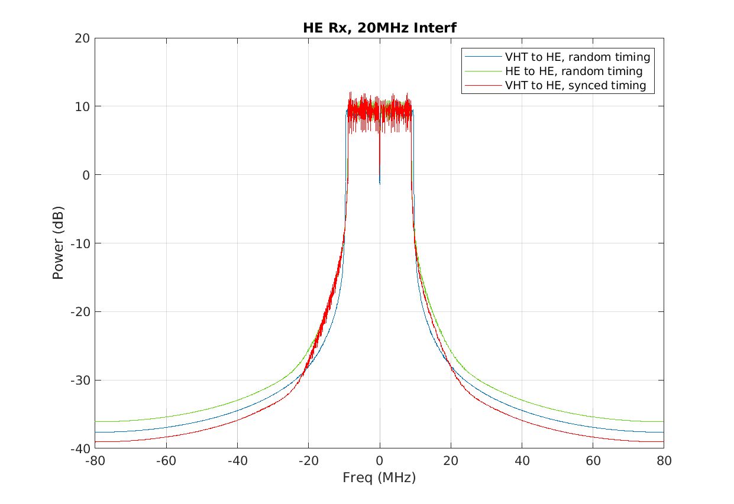
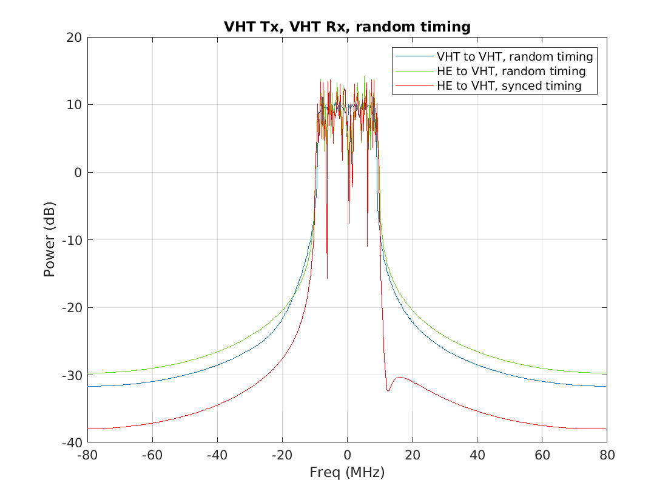
Adjacent channel interference
The frequency axis shows how far a non-P20 PSDU needs to be from the interference RU allocation (assumed on P20) to achieve a given Signal-to-Interference/leakage level

Slide 12
Summary
Improve utilisation of unused BSS bandwidth
AP can use to reduce latency for cases currently not handled; non-HE STAs/traffic (no MU-MIMO Rx, up to 80MHz channel support), MMPDUs (Beacon, Probe Response),
AP in control of
  TX PHY rate for each PSDU
  RUs used or punctured in the PPDU
so can construct a DL MU Ext PPDU for multiple STAs
or can allocate RUs for STAs to use for TXOP Sharing Mode 2

Slide 13
Straw poll
DL MU Ext PPDUs should be developed as a mechanism to make better use of the channel during transmissions to legacy STAs
Y
N
A

Slide 14
Backup

Slide 15
Non-HE Primary Announcement

Slide 16
Explanations for slide 11
Receiver performance
Per each case, there are three scenarios for comparison
HE receiver (HE_rx_interference.png)
HE interference (async, ie normal adjacent channel interference)
VHT interference (async, ie normal adjacent channel interference)
VHT interference (sync, ie our proposal)
VHT receiver (VHT_rx_interference.png)
HE interference (async)
VHT interference (async)
HE interference (sync, ie our proposal)

