Slide 1
Some thoughts on relay improvement

Slide 2
Background
UHR PAR illustration
  Achieve Ultra High reliability, with the improvement on throughput, latency, packet loss,etc.
  Improve the performance of STA in different range( improve SINR).
11bn SFD(roaming)
11bn defines a mechanism that enables a non-AP MLD to roam from one AP MLD to another AP MLD and the non-AP MLD remains in state 4 (see 11.3) during and after roaming to the other AP MLD

Slide 3
Abstract
In this contribution, we will discuss two types of network topology with relay function in residential environment, and analyze the possible UHR feature in relay communication.

Slide 4
Recap-1(easy mesh)
In residential environment, S1G-based easy mesh products are widely deployed in many countries.
In easy mesh network topology:
  one MAP Controller can access to WAN
  MAP Agents(Relay) associates with Controller via wireless
  /wired backhaul.
  one or more MAP Agents provide the data
  relay function(application level relay) for the associated STA.
  Obviously, all the STAs traffics need to go through
  MAP controller.

Slide 5
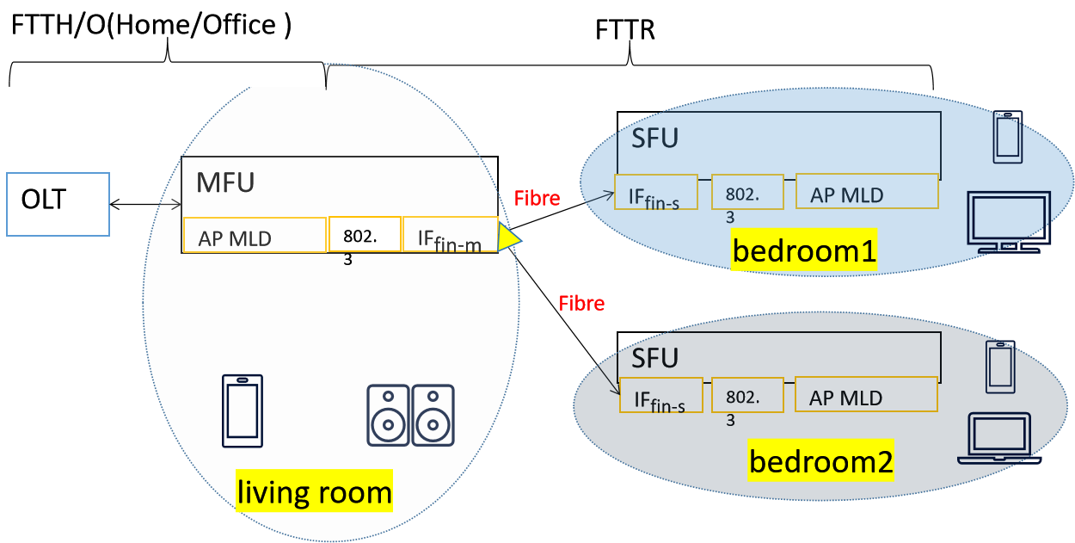


Recap(FTTR)
Based on fibre backhaul(BH) connection(Application level wired relay),the MFU provides 2.5Gbps DL and 1Gbps UL throughput for SFUs in each room, and it features low lost, low latency and high reliability. In the near future, the TP on backhaul can up to 10Gbps.
About 10 million FTTR products deployed in 2023.
The packet lost rate in the BH is about: 10⁻¹²
The delay in the BH is about 10us-400us.
The fibre is easier to be deployed in/on the wall, which address the pain point of the deployment issue in residential environment.

Slide 6
High level Relay function improvement direction
A batch of UHR relay improvement proposal well discussed last year.
  One of the direction focus on MPDU forwarding to reduce reorder delay(MAC link level relay)
      23/1175 UHR relay follow up (Kiseon Ryu)
      23/1405 Consideration on UHR Relay Architecture (Kosuke Aio)
      24/74 Relay Operation Follow-up(Guogang Huang)
  Another direction is Joint Transmission to improve the TP significantly
      - 23/1843 Multi-AP Joint Transmission Simulations with Impairments (Rainer Strobel)
      -23/243 Joint Transmission for UHR - Additional Results(Ron Porat)
      -22/1821 System Level Simulation of Co-BF and Joint Tx (Kosuke Aio)

Slide 7
Motivation
Obviously, Easy mesh, FTTR and other Relay product have the similar framework, in which all Clients traffic need to go through the root AP/MFU. Therefore, we would like to see a centralized UHR High MAC located at root AP/MFU to manage all UHR clients traffic in the new relay function.
Also we would like to see how the following features work in the D-AP MLD framework
  link level relay function(from Root AP to Relay)
  Seamless roaming(between Relay to Root AP, or between Relays)
  Joint Transmission(Specially in FTTR or other cable BH product)

Slide 8
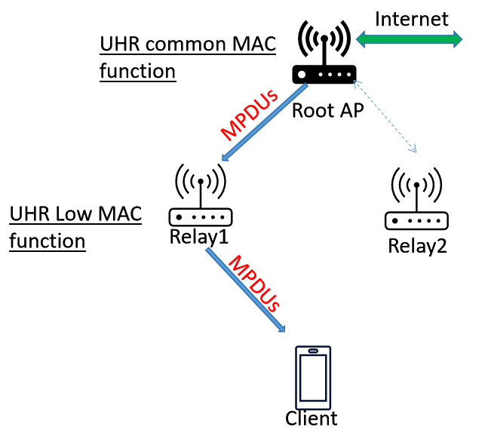
D-AP MLD framework for link level relay function
Root AP: Has additional UHR common MAC function, constructs MPDUs
Relay: Has additional UHR Low MAC and PHY function, forwards MPDUs between UHR Client and Root AP without encryption/decryption.
Note: To compatible with pre-UHR Client, Relay also has pre-UHR full MAC function.
Client: may require to decode new MPDU format or UHR signaling.

Slide 9
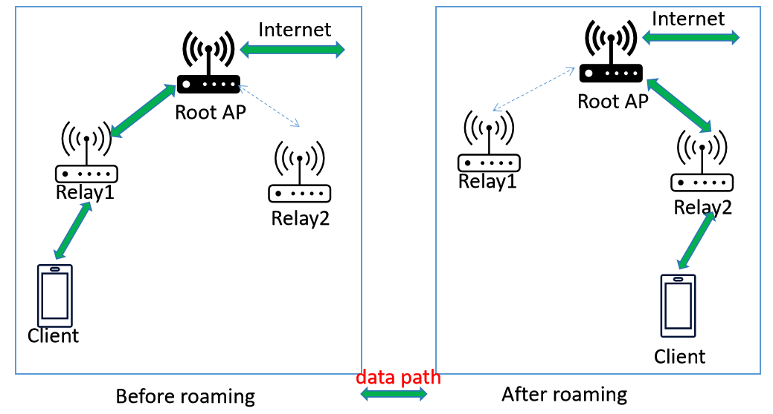
D-AP MLD framework for seamless roaming
Root AP: Before rooming, Root AP transmits the constructed DL MPDUs via Relay1. After rooming, Root AP transmits the DL MPDUs via Relay2, and buffer the undelivered MPDUs. And thus it can achieve 0 packet lost during roaming procedure.
Relay: (If assume Relay also can buffer MPDUs)drop the undelivered MPDUs directly if STA roams to another Relay.
Client: Client control the whole roaming procedure.

Slide 10
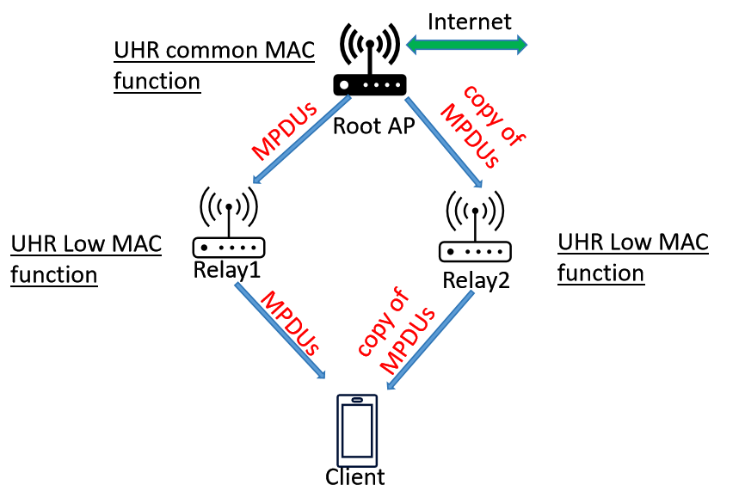
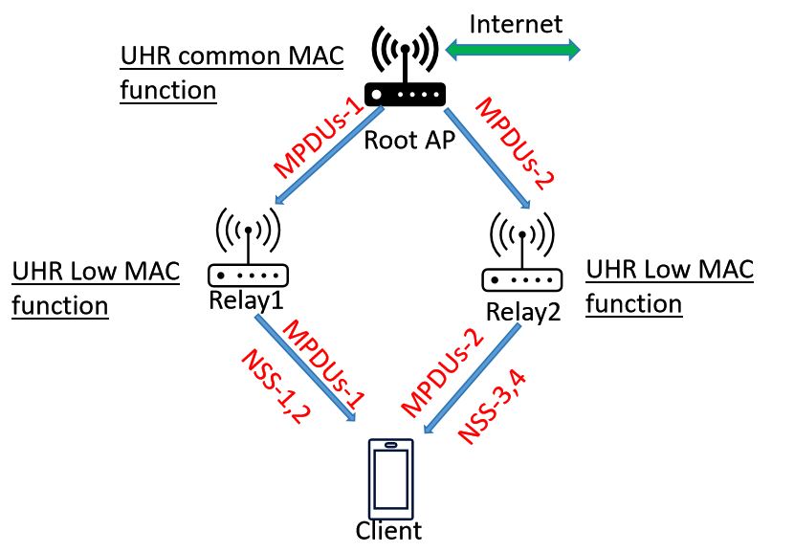
D-AP MLD framework for Joint Transmission
Root AP: Transmit the same or different MPDUs via BH.
Relays: Jointly transmit the received MPDUs to the Client at the same time.
Client: receive the same or different MPDUs from two Relays, and decode the received MPDUs together.
Case 1-same MPDUs
Case 2-Different MPDUs

Slide 11
The challenge and possible solution for JT
  The mainly challenge in JT
    Joint TX requires tight time/frequency synchronization between multiple APs.
Possible solution for time synchronization in FTTR product
  SFUs always synchronization with MFU in PON system
  PON clock can provide 10⁻¹¹ granularity（reference: ITU-T G.987.2), PON system also support IEEE 1588 for time synchronization.
  It’s naturally each AP synchronize its WIFI clock synchronized from its PON(e.g. synchronize period: 125us) system, and the time synchronization requirement can be met.

Slide 12
Summary
Recap some residential network topology (Easy Mesh and FTTR).
Analyze a high level D-AP MLD framework in residential environment.
Analyze the link level relay, seamless roaming and JT in D-AP MLD framework

Slide 13
Reference
[1]802.11bn PAR
[2] ETSI GR RIS 006 V0.0.2
[3] ITU-T G.9940(G.fin-SA) High speed fibre-based in-premises transceivers – system architecture
[4]23-1138-Features to consider for efficient Relay operation
[5]23-1146-Relaying for Low Latency Traffic in UHR
[6]23-1175-UHR relay follow up

Slide 14
SP1
Do you agree to define D-AP MLD framework in relay communication, in which root AP has the additional UHR high MAC function, and relay has the additional UHR low MAC function?
Note: the backhaul connection between root AP and relay may be wireless or wired. And the D-AP MLD framework refers to figure in slide 8.

Slide 15
SP2
Do you agree to optionally support Joint Transmission in D-AP MLD framework?

