Slide 1
Some thoughts on relay improvement

Slide 2
Background
UHR PAR illustration
  improve the reliability of the wireless network
  improve the performance of STA in different range( improve SINR).
  Reduce the power consumption on both single AP or MAP
Relay is a candidate feature to improve the Wi-Fi coverage issue based on the precondition of reliability. Meanwhile, it’s encouraged to reduce the power consumption on the relay as well.

Slide 3
Abstract
In this contribution, we will recap S1G relay framework, and analyze some proposals of S1G relay framework enhancement.
Also, provide another two types of relay framework
  FTTR(fiber-to-the-room)
  RIS(Reconfigurable Intelligent Surface)

Slide 4
Recap S1G relay
Relay framework under MLO
S1G framework relay
To enlarge Wi-Fi signal coverage, the S1G-based relay products are widely deployed in residential environment in the past several years.
Each relay has a relay STA entity that associates with a upper BSS and a relay AP entity that acts as an AP in a lower BSS. Relay STA and relay AP exchange the UL/DL MSDUs via a relay function
In MLO, each Relay has a relay non-AP MLD that associates with an upper AP MLD and a relay AP MLD entity that acts as an AP MLD to serve non-AP MLDs.
Each entity has a full MAC function, e.g. re(transmit) and receive MSDU separately.
A STA or a non-AP MLD associate with the Root AP or Relay AP/AP MLD
non-AP MLD
relay function
AP MLD

Slide 5
The shortage of S1G-based relay
Higher delay, lower reliability
  Each wireless hop may possible loss packet, assume the MSDU successful delivery rate is p%, N-hop wireless connection means the MSDU successful delivery rate may drop to (p%)^{n}
  High level application has to retransmit the missing MSDU, which will cause a significant higher delay due to the higher missing rate in L2 layer
  In the cost-sensitive market, upper MLD/BSS(let’s call backhaul) may operate on the same channel with lower MLD/BSS(let’s call front haul), which cause a serious TP drop issue when the client associates with relay AP/AP MLD.
  In some high-end market, backhaul may operate on a separate channel from front haul to void the collision issue,but the reliability issue is still here

Slide 6
The analyze against S1G-based relay proposal
S1G-based relay may enjoy the benefit of several MAP coordination schemes
  leverage the general MAP features like C-TDMA,C-OFDMA to mitigate the collision issue between backhaul and front haul
The proposal for MPDU delivery in rSTA is interesting
  Such framework may reduce the reorder delay
  But reorder delay is NOT main factors
  Enhanced S1G-based network is a still unreliability network
Conclusion
S1G-based relay can be deemed to an implementation that can enjoy the benefit with the general MAP coordination schemes.

Slide 7
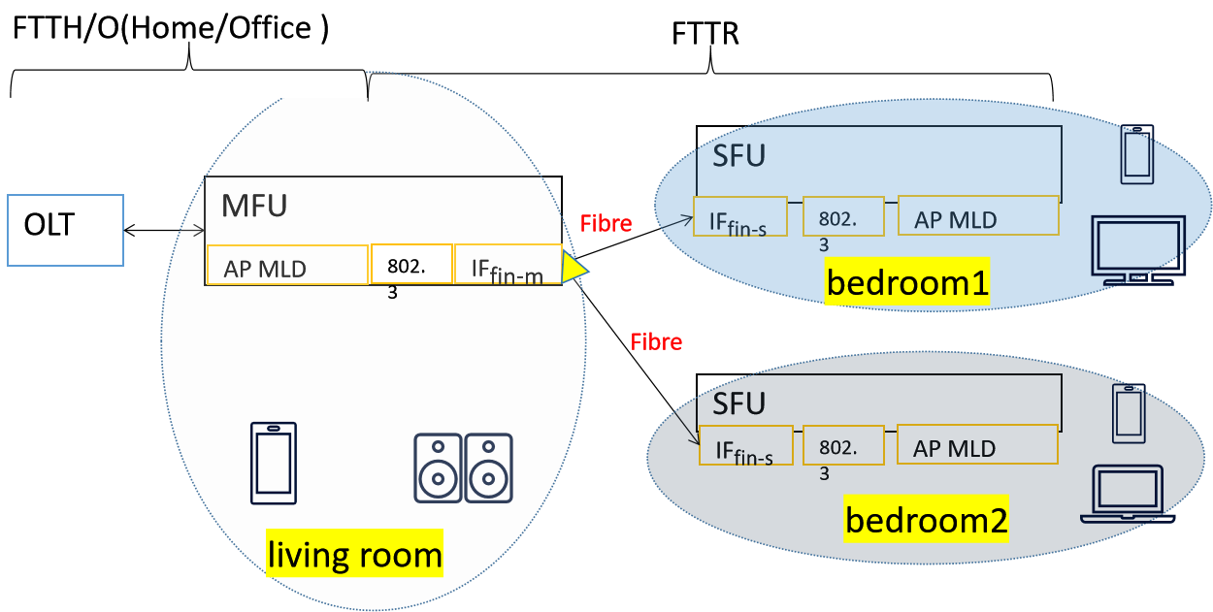


FTTR Overview
Based on fibre backhaul(BH) connection,the MFU provides 2.5Gbps DL and 1Gbps UL throughput for SFUs in each room, and features low lost, low latency and high reliability.
The packet lost rate in the BH is about: 10⁻¹²
The delay in the BH is about 10us-400us.
The backhaul fibre is easier to deploy in/on the wall, which address the pain point of the deployment issue in residential environment.

Slide 8
RIS Overview
Based on wave reflection and refraction mechanism, RIS features Low lost, Low latency, Low Power cost, Zero delay in seamless roaming and compatible with legacy STA.
Low latency: wave propagation level latency delay
Low lost: like extra virtual antennas to improve SNR
Low Power cost: no power cost in “operating” mode, less
power consumption when root AP exchanges control signaling with RIS
Zero delay in seamless roaming: dynamically adopt the wave reflection and refraction when STA moves from one place to another
Compatible with any legacy STA: no signaling design between STA and RIS.
STAR:Simultaneously Transmitting and Reflecting
RIS demo variety

Slide 9
Comparison on different Relay products
 | SIG-based Relay | FTTR | RIS
Packet lost rate | High | No Packet lost | No Packet lost
Reliability | Low | High | High
Relay delay | ms-second | 10-400us | 0
Power consumption | High | High | Extremely Low
Seamless roaming | NO | only 11bn STA | all legacy STA
market intelligence(2023, China) | On sell in retail market, but no order from ISP | 10 million sets deployed in residential environment | Not commercialization

Slide 10
Summary
Recap S1G-based framework
Analyze several proposals of S1G-based framework
Introduce the current relay framework(FTTR) in residential environment
Introduce the next generation of wireless relay framework(RIS)

Slide 11
THANK YOU ☺

Slide 12
Reference
[1]802.11bn PAR
[2] ETSI GR RIS 006 V0.0.2
[3] ITU-T G.9940(G.fin-SA) High speed fibre-based in-premises transceivers – system architecture
[4]23-1138-Features to consider for efficient Relay operation
[5]23-1146-Relaying for Low Latency Traffic in UHR
[6]23-1175-UHR relay follow up

