Slide 1
Comparison of Waveforms with PA Non-linearity
Date: 2024-03-11
Authors:

Slide 2
Abstract
Technical input regarding different waveform options for a new mmWave PHY.

Slide 3
Background
The IMMW Study Group Creation Motion [1] specifies operation between 42.5 and 71 GHz and a new amendment that “leverages MAC/PHY specifications in the Sub 7 GHz bands”
Contributions to the UHR and IMMW Study groups ([2], [3]) have suggested that simple changes to existing OFDM physical layer designs, such as increasing the clock rate and/or changing the DFT length would be sufficient to transform a PHY designed for bands below 7 GHz into a useful PHY for mmWave bands.
Previous work in IEEE standards– including 802.11ad, 802.11ay, 802.15.3c provides helpful guidance for the direction of this new effort

Slide 4
Outline
Review previous IEEE 802.15 and 802.11 standards efforts
Review Evaluation Methodology from previous standards efforts
Review the Rapp Model for power amplifier non-linearities
Present Simulation Results for HE SU and DMG waveforms applied to the Rapp Model according to Evaluation Methodologies from previous
Suggest Future Work

Slide 5
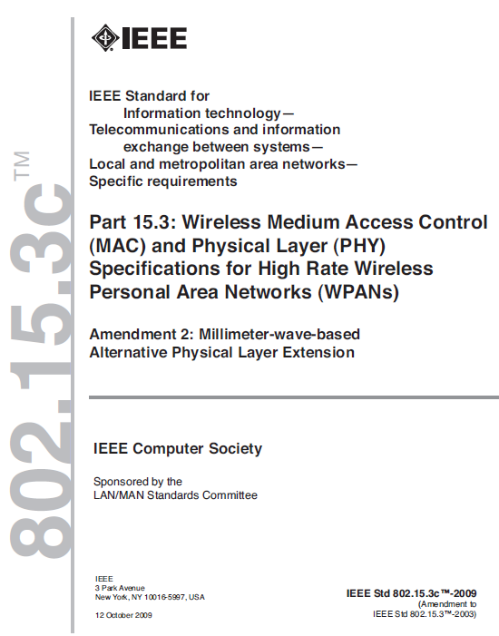
IEEE 802.15c Review
Published in 2009
Included 3 Alternate PHY specifications for 802.15.3
  Single Carrier Mode
  High Speed Interface Mode (OFDM PHY)
  Audio / Visual Mode (OFDM Low and High Rate PHY)
2160 MHz channel bandwidths
Not implemented in products

Slide 6
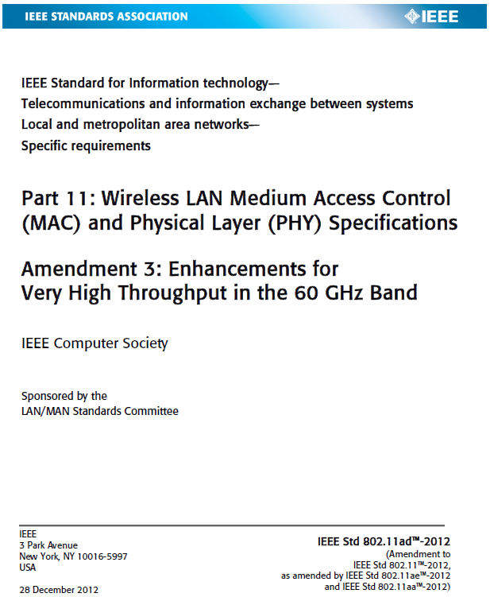
IEEE 802.11ad Review
Published in 2012
4 Physical Layers Defined
  Single Carrier Control PHY
  OFDM PHY
  SC PHY
  Low power SC PHY
Control PHY and SC PHY are implemented in products that are on the market today
OFDM PHY was deprecated and removed

Slide 7
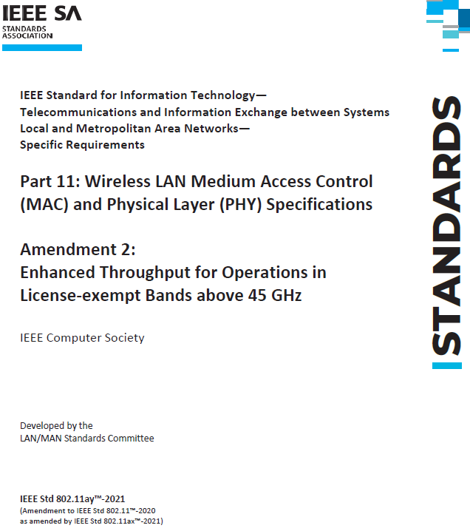
IEEE 802.11ay Review
Published in 2021
2 Physical Layers Defined
  EDMG SC PHY
  EDMG OFDM PHY
EDMG SC PHY has been implemented in products

Slide 8
OFDM vs Single Carrier (1)
For linear, time invariant channels, the two techniques can provide identical performance [4]: “Indeed, the MMSE-DFE (single carrier) achieves the signal-to-noise radio and corresponding data rates of a multitone (OFDM) system, which is known to be able to achieve capacity.
Practical implementations differ

Slide 9
OFDM vs. Single Carrier (2)
OFDM
Simpler to combine with channel coding
High peak-to-average ratio creates distortion in amplifiers
More sensitive to phase noise
Single Carrier
DFE (Decision Feedback Equalizer) can be difficult to combine with channel coding
Low peak-to-average ratio minimizes distortion
Less sensitive to phase noise

Slide 10
802.11ad SC PHY Design
For the 802.11ad PHY design, there were three key observations
  The impulse response of indoor mmWave channels would tend to be short compared to 2.4 and 5 GHz channels
    High speed omni-directional mmWave communication in not possible
    Large antenna gains means narrow beamwidths, which reduces the number of strong reflected paths and reduces the resulting channel impulse response length
    MMSE-DFE is not necessary; a linear equalizer would work well
  Power amplifiers are less efficient at 60 GHz and would need to operate closer to saturation than 2.4 and 5 GHz systems
  Phase noise will be much higher at 60 GHz
All these factors favor Single Carrier over OFDM

Slide 11
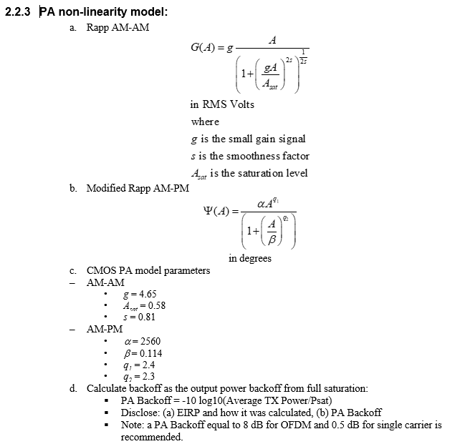
TGad and TGay Evaluation Methodology
Both task groups used the same power amplifier non-linearity model
Model acknowledges that a greater backoff is required for OFDM compared to single carrier

Slide 12
Comparing Waveforms with the Rapp Model
IEEE 802.11ax HE SU PPDU
  MCS 4 (16 QAM rate ¾ LDPC code)
  2x996 tone RU - 160 MHz mode
  1 Spatial stream
  3.2 us GI
  Target EVM -19 dB (See 802.11ax-2021 p.636)
IEEE 802.11ad DMG SC PPDU
  MCS 12 (16 QAM rate ¾ LDPC code)
  Target EVM -21 (See 802.11-2020 p.2992)
Results computed with Matlab WLAN Toolbox

Slide 13
PSD Comparison
Even with a more relaxed EVM specification, the OFDM waveform power level is 2.5 dB lower

Slide 14
Gain Compression Impact
Peak and average power levels are shown on top of the Rapp Model amplitude response
DMG Single carrier waveform can transmit 2.5 dB more power at a lower EVM

Slide 15
PER Performance
4096 byte PSDU comparison in AWGN between the HE SU Waveform
At 1% PER, the DMG SC PHY requires 1.6 dB lower SNR
DMG SC has a net 4.1 dB improvement over the 802.11ax PHY

Slide 16
Summary
Power amplifier nonlinearity will limit the usefulness of any OFDM PHY in the mmWave bands
Results here show a gap of more than 4 dB using existing IEEE 802.11 PHY specifications and evaluation criteria
The gap is most likely even greater when realistic phase noise models are added
The option to develop a single carrier PHY is a necessary part of any task group for IMMW

Slide 17
References
Integrated mmWave Study Group Creation, IEEE 802.11-23/0481r2
Considerations on PHY Designs for mmWave Band, IEEE 802.11-22/1872r0
Integrated mmWave Design Considerations, IEEE 802.11-23/1819r1
“MMSE Decision-Feedback Equalizers and Coding – Part II: Coding Results”, J. Cioffi et al, IEEE Trans. Comm, Vol 43, No. 10, Oct. 1995, p. 2595-2604
TGay Evaluation Methodology, IEEE 802.11-15/0866r2

