Slide 1
1st Vice Chair Report – 2024 Jan – Interim - Panama
Date: 2024-01-15
Authors:
Notes:
.

Slide 2
Abstract
Agenda Items for 1st Vice Chair –
Monday January 15:
M3.3 II Session Information
M3.4 II Meeting room locations
M3.5 II Meeting registration
M3.6 II Recording attendance
M3.7 II Local File Server Access
M3.8 II Breakfast, breaks, Social logistics
Friday November 19:
  F3.1.2 DT WG Straw Poll
  F3.1.3 DT Future venues Insight

Slide 3
Monday, January 15, 2024
802.11 WG Opening Plenary
M3.3 II Session Information
M3.4 II Meeting room locations
M3.5 II Meeting registration
M3.6 II Recording attendance
M3.7 II Local File Server Access
M3.8 II Breakfast, breaks, Social logistics

Slide 4
Successful Mixed-mode Meeting Protocol
In-room Attendees:
  In Webex choose connect without audio before you join
  Use the Webex queue to indicate you want to speak
  Wait to be called on while standing/holding a microphone to make a comment
  Repeat any questions that are inadvertently asked away from the microphone
Remote Attendees:
  Join Webex and set Webex audio as ‘music’
  Use the Webex chat window to indicate you want to speak (“q”)
  Wait to be called on to speak

Slide 5

IMPORTANT INFORMATION
IEEE 802 Wireless Interim Meeting
January 14 – 19, 2024
Hilton Panama
See 802 EC-24/0011r0

Slide 6
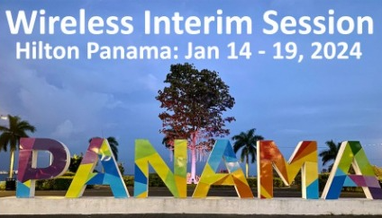

INTERIM MEETING SUPPORTER
We would like to thank Visit Panama, the Panama Convention Bureau, for all their help and support in the planning and preparation of the Interim Meeting and especially for providing funding to further support the meeting.

Slide 7
AUDIO VISUAL:
The Audio Visual is being supplied by INGENTRONICS.
There will be floating AV technicians between the rooms during the meetings.
For any issues, please see a contact a technician from INGENTRONICS.
AUDIO IN MEETING ROOM
If you are a local participant, PLEASE, select “Don’t connect to audio” when joining the WebEx session. Connecting to the audio, may cause an audio feedback loop that prevents the meeting from proceeding

Slide 8
IEEE 802 WIRELESS INTERIM – 802.11 NEWCOMER TRAINING
IN PERSON: 1030am – 1230am Monday 15 January Venetian Room
REMOTE: IEEE 802 Calendar https://ieee802.org/802tele_calendar.html
REGISTRATION FEE: Registration for the IEEE 802 Interim Session (with fee) is required, whether attending in-person or remotely.

Slide 9
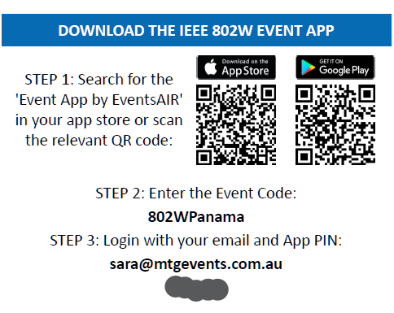
PROGRAM APP
- The IEEE 802 Wireless Interim Meeting App information is available on the back of your name badge

Slide 10
COMBINED SCHEDULE
IN PERSON Room Assignments: Schedule QR codes posted outside each meeting room and on the back of your name badge.
REMOTE Participation: https://ieee802.org/802tele_calendar.html
ATTENDANCE TOOL (IMAT) : https://imat.ieee.org/

Slide 11
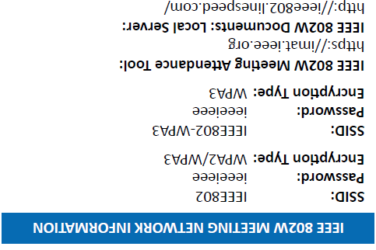
NETWORK ACCESS INFORMATION:
Local Document Server for IEEE 802W Documents:
http://ieee802.linespeed.com/
The network provider for the IEEE 802 Wireless Interim is Linespeed Events. Linespeed are located in the Mystic Room during the meeting.
Details on how to log into the network are printed on the back of your badge.

Slide 12
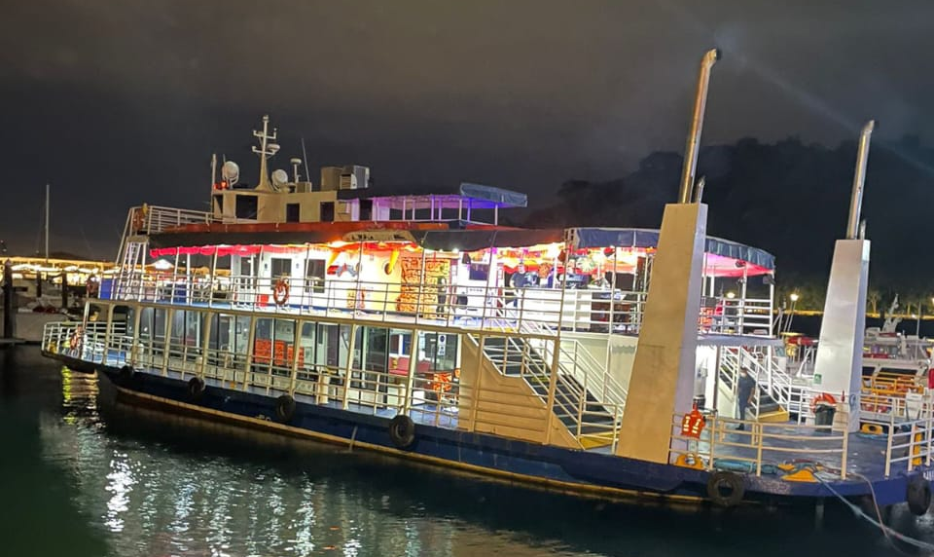
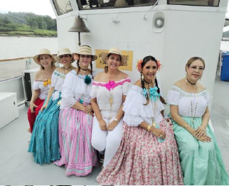
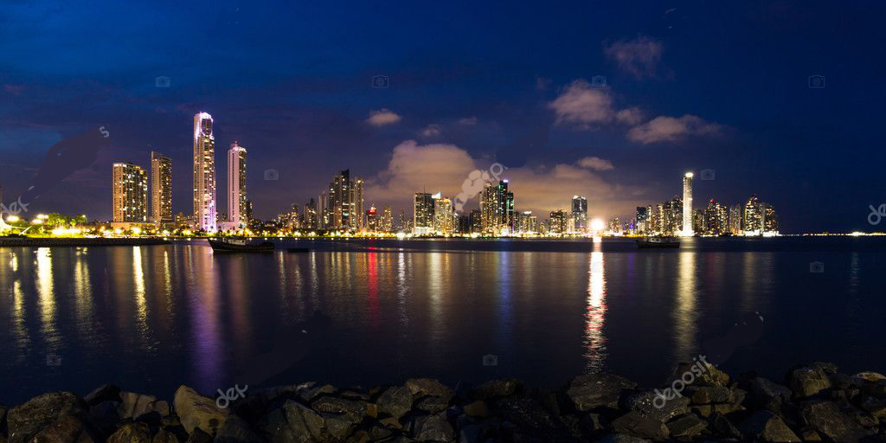
WEDNESDAY SOCIAL
AN EVENING ON PANAMA BAY
Wednesday September 17, 2024
Time: 6:20pm - 6:45pm: Buses depart Hilton
Please meet from 6:20pm – 6:45pm on the street level of the Hilton (L1) for Coach transfer to the Wharf
7:15pm – 9:00pm: Boat cruise on Panama Bay
Entertainment: Local Panamanian Entertainment
Dress code: Casual
Food: Buffet of Local Panama Food & Drinks
We look forward to a fun evening and seeing you there.

Slide 13
CATERING:
  Breakfast: is included in your room rate if you booked at the Hilton. Breakfast is served in the Society Café.
  Morning & Afternoon teas will be served from the foyer areas on both floors, Level B and M.
  Lunch: will be held in Society Café, Level: L2, available from 12:00pm – 2:00pm

Slide 14
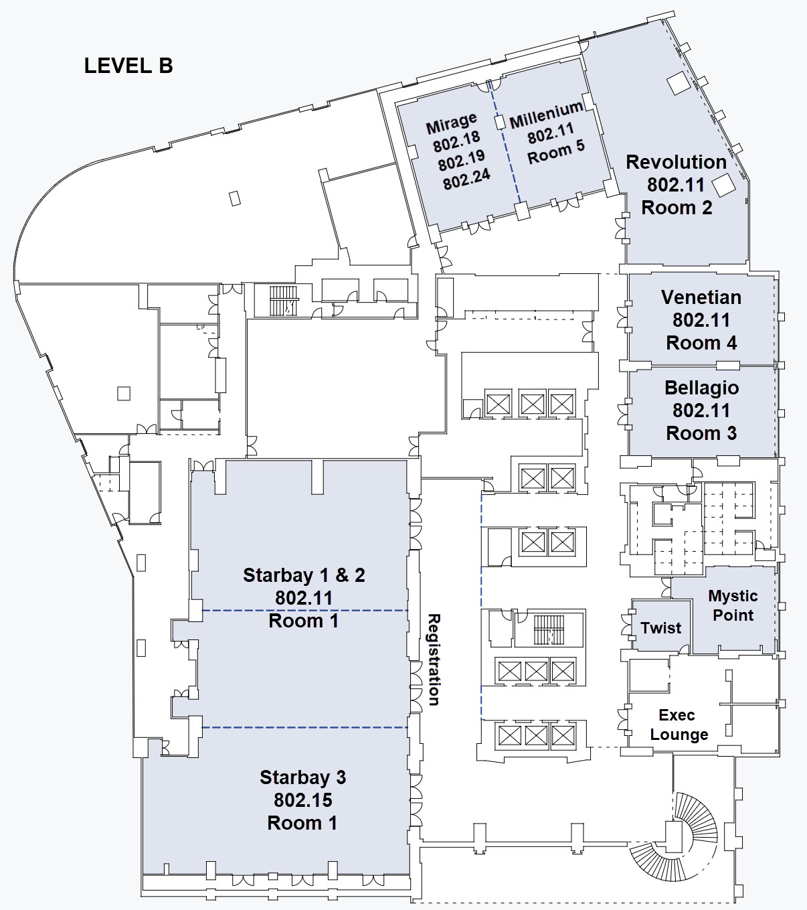
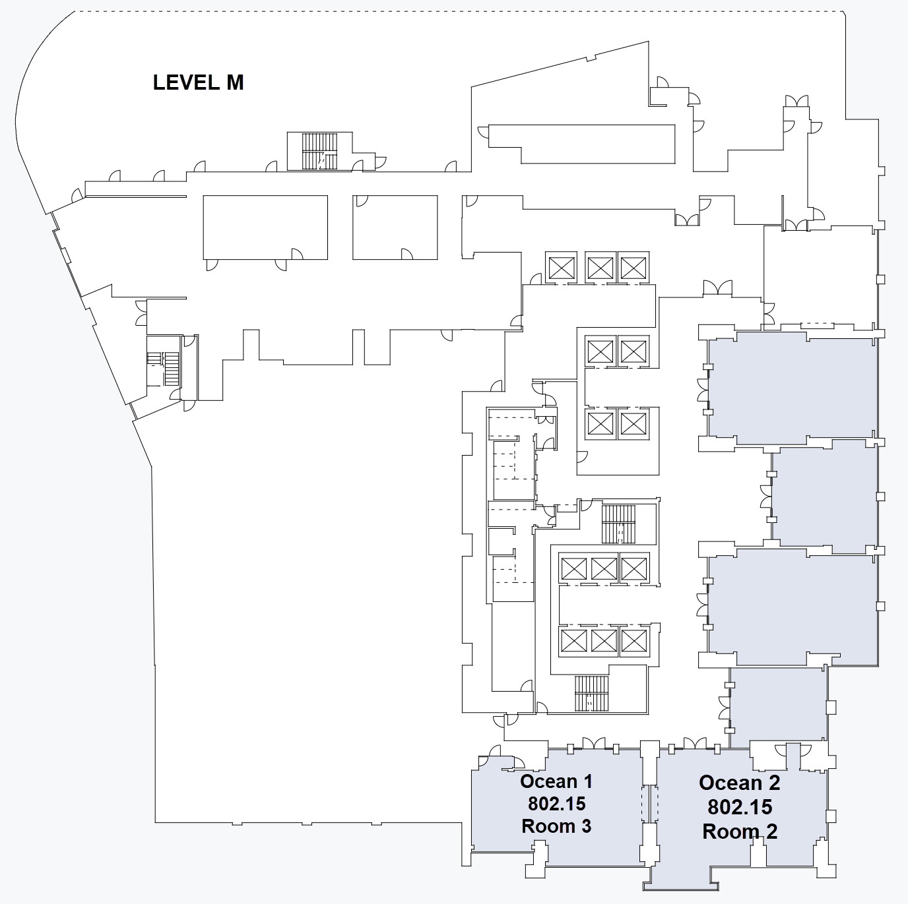
FLOOR PLANS:

Slide 15
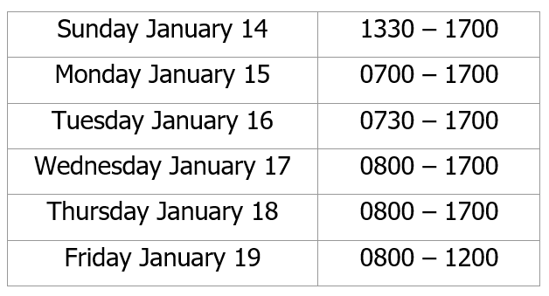
The REGISTRATION DESK will be located in the Hotel Foyer, outside of Starbay 1-2, during the following times:

Slide 16
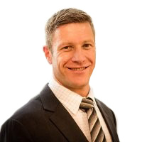
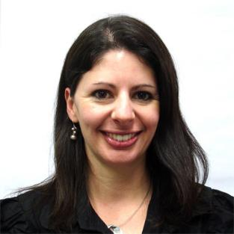

Any Questions
Please see Daniel or Sara on the registration desk!
ieee802@mtgevents.com.au

Slide 17
M3.6 Recording attendance
It is a requirement that attendees record their participation at an 802.11 session and declare their affiliation. This record is usually made using the IMAT attendance system.
  If you wish to participate without recording attendance, send an email per session to the WG 2nd vice chair declaring your participation and affiliation. You cannot gain or maintain 802.11 voting membership using this method.
You must record 75% attendance of required 802.11 slots in a session for that session to count towards gaining or maintaining 802.11 voting membership
  You need a single IEEE-SA web account
    The IEEE SA web account requires a working email address
    do not remove your email address from the account
  Use the email address associated with that web account when registering attendance
    If you change email addresses, update the web account, don’t create a new web account, or your membership status may not be calculated properly
  Record attendance using this URL: IMAT.IEEE.ORG/

Slide 18
2024 January 802 Wireless Interim
Panama Hilton, Panama

Slide 19
Friday, January 19, 2024
802.11 WG Closing Plenary
Agenda Items:
3.1.2 DT Straw Poll regarding meetings
3.1.3 DT Future venues status and discussion

Slide 20
Straw Poll: Return to This Venue:
(Hilton Panama, Panama City, Panama)
1. How many people would like to come back to this venue?
  Yes –
  No –
2. Did you go to the social?
  Yes –
  No –
3. If you attended the Social, did you like the social?
  Yes –
  No –
Notes:
Show of Hands of those in the room.

Slide 21
Future Interim Venue Status
As of Nov 12, 2023
2024-01 (14-19) Hilton Panama, Panama, Panama (Rebooked from Jan 2022)
2024-05 (12-17) Marriott Warsaw, Warsaw, Poland – (Rebook from May 2022)
2024-09 (8-13) Hilton Waikoloa, Waikoloa, HI, USA
2025-01 (12-17) Kobe, Japan – TBC (Moved from May 2023)
2025-05 (11-16) – Hilton Prague, Prague, Czech Republic (Contract TBC)
2025-09 (14-19) Hilton Waikoloa, Waikoloa, HI, USA
2026-01 (11-16) – RFP - Americas
2026-05 (10-15) – RFP - Europe
2026-09 (13-18) Hilton Waikoloa, Waikoloa, HI, USA
2027-01 (10-15) – RFP - Americas (could rotate J-M)
2027-05 (9-14) – RFP - Asia (could rotate J-M)
2027-09 (12-17) – Grand Hyatt Atlanta, Buckhead, GA, USA (Contract TBC)
Meeting Planner:
Dotted Venues: Face to Face Events
Starred Venues :MTG Events
Notes:
Future Wireless Interim Meetings: review and status Sept 1, 2023
In General, Each year one Session must be Non-NA/US – Odd years Asia – Even Years Europe
2023 September 10-15 – Grand Hyatt, Atlanta Buckhead – Contract executed (802WFIN-21/1r0)
2024 January 14-19 – Hilton Panama, Panama – Contract executed (802WFIN-21/31r0)
2024 May 12-17 - Warsaw Marriott, Warsaw, Poland– Contract executed (802WFin-23/59r0)
2024 Sept 8-13 - Hilton Waikoloa Village – Contract executed (802WFIN-20/12r0)
2025 Jan 12-17 – Kobe, Japan – in negotiations
2025 May 11-16 – Hilton Prague, Prague, Czech Republic Contract TBC
2025 Sept 9-14 - Hilton Waikoloa Village, Waikoloa, HI – Contract executed (802WFIN-22-0007r0)
2026 Jan 11-16 – RFP – Open (NA/Asia)
2026 May 10-15– RFP – Open (Asia/NA)
2026 Sept 13-18 Hilton Waikoloa Village, Waikoloa, HI – Contract executed (802WFIN-22-0008r0)
2027 Jan 10-15 – RFP – Open (NA/Asia)
2027 May 9-14 – RFP – Open (Asia/NA)
2027 Sept 12-17 – Grand Hyatt Atlanta, Buckhead, GA, USA – Contract TBC

Slide 22
Future 802 Plenary Venue Contract Status
2024 March 10-15 – Hyatt Regency Denver at Colorado Convention Center, Denver, CO, (March 2021)
2024 July 14-19 – Sheraton Le Centre Montreal, Montreal, Quebec, Canada (July 2020)
2024 November 10-15 –Hyatt Regency Vancouver, Vancouver, Canada (Nov 2021)
2025 March 9-14 –Hilton Atlanta, Atlanta, GA, United States (2 of 2 – March 2020).
2025 July 27-August 1 –Melia Castilla Madrid, Madrid, Spain (Changing Week to July 27)
2025 November 9-14 – Marriott Marquis Queen’s Park, Bangkok, Thailand
2026 March 8-13 - Hyatt Regency Vancouver, Vancouver, Canada (Change from Chicago)
2026 July 13-18 – Le Centre Sheraton Montreal, Montreal (July 2022 attrition offset)
2026 November 8-13 - Marriott Marquis Queen’s Park, Bangkok, Thailand
2027 March 14-19 – Hilton Atlanta, Atlanta, GA, United States ( offset potential shortfall 2023/2025)
2027 July 11-16 - Gothia Towers, Gothenburg, Sweden
2027 November 14-19 – Hawaiian Village, Oahu, Hawaii, United States
802 EC Approved – Contract is being Negotiated.
Contracts Executed
As of Dec 13, 2023

Slide 23
References
1. Plenary Meeting Status File: 802 EC-22/0003r0
  https://mentor.ieee.org/802-ec/dcn/22/ec-22-0003-00-00EC-future-802-plenary-venue-contract-status.xlsx
2. IEEE 802WCSC Meeting Venue Manager Report: 802 EC-23/0001r05
  https://mentor.ieee.org/802-ec/dcn/23/ec-23-0001-05-WCSG-ieee-802wcsc-meeting-venue-manager-report-2023.pptx

