Slide 1
LCI in Beacons and Probe Responses
Date: 2023-12-07
Authors:

Slide 2
Abstract
This document presents a proposal to include Location Configuration Information (LCI) data in a standard information element (IE) that can be broadcast in Beacons and included in Probe Responses.
Background and purpose of the proposal is provided.

Slide 3
Why LCI in Beacons and Probe Responses?
Non-AP STAs and their applications would like to determine their location from the WLAN infrastructure, particularly indoors where WLAN is the dominant and preferred network.
When desired to be shared by the infrastructure provider, including the LCI in Beacons and Probe Responses will make the infrastructure location available to the greatest number of 802.11 capable non-AP STAs.
Current available methods (next slide) are limited in devices that support them and/or cumbersome with additional conditions required for non-AP STAs to obtain LCI from the infrastructure – it can all be made MUCH simpler and much more accessible.

Slide 4
Background on Existing LCI Methods
Type of Exchange/ Reference (REVme D4.1) | Advantages | Limitations | Procedure
FTM Exchange (4.3.21.19, table 9-136 measurement type 8) | Provides Ranging and LCI information | Newest generation hardware only (802.11-2020). [Also applicable to 802.11az capable hardware]. Does not scale beyond a few non-AP STAs. | Active exchange
GAS/ANQP (9.4.5.12 Geo element, 9.4.5.13 Civic element) | Many elements available in addition to LCI via ANQP | Limited query interval. Does not scale beyond a few non-AP STAs. Low complexity devices cannot get LCI information.
Neighbor Report (9.4.2.35, subelement 39 measurement report of type LCI) | Can include multiple neighboring BSSs | Associated non-AP STAs only. Does not scale beyond a few non-AP STAs.
Request Element (9.4.2.8/9.4.2.9) | Can be used to directly request LCI in a response frame | Initiated by non-AP STA only, not infrastructure. Does not scale beyond a few non-AP STAs. | Active exchange
DSE (9.4.2.50) | Includes LCI in Beacon along with dependent station enablement (DSE) | Previously limited purpose (DSE) 3.6 GHz Frequency Band, (licensed) Altitude in meters only, no civic support | Broadcast in beacons

Slide 5
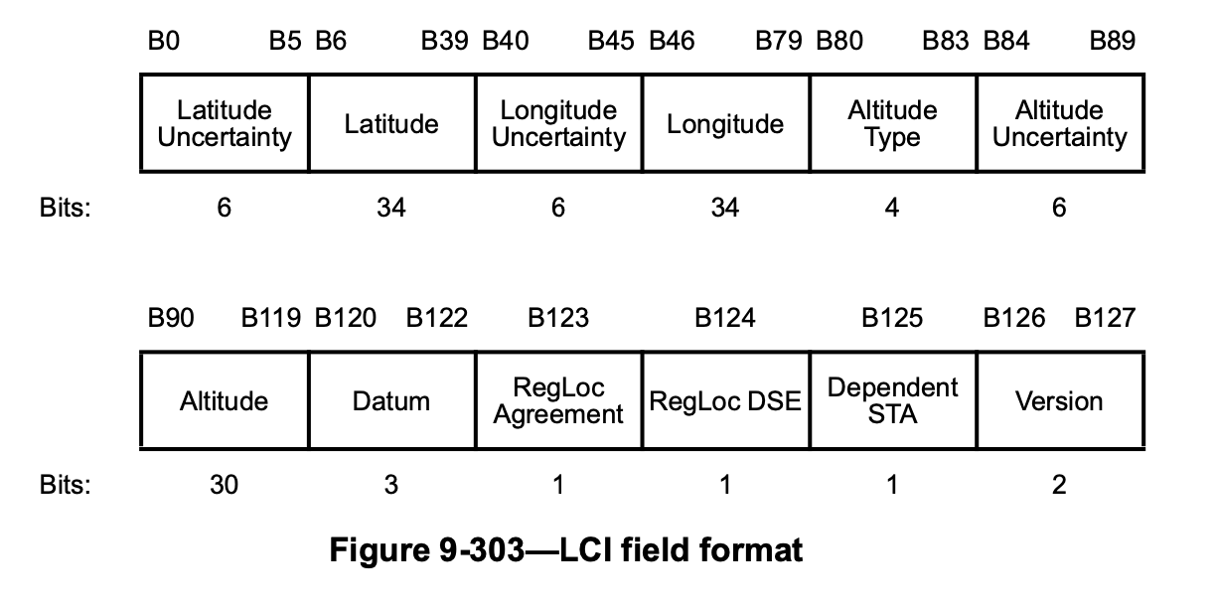
Proposal
APs
  Provide a standardized method for APs to include LCI in Beacons and Probe Responses. Simply create a new information element, using already defined LCI Field Format [9.4.2.20.10 LCI Report.]
Non-AP STAs
  Non-AP STAs can optionally decode the LCI or forward Beacon and Probe Response frames elsewhere for processing.
Notes:
The definitions of fields within beacons and probe responses shall be as specified in Table 9-134 LCI Field Format (IEEE 802.11me draft 4.1, 9.4.2.20.10 and Section 2.2 of IETF RFC 6225, July 2011)

