Slide 1
802.15 Liaison Report – Jan. 2024
Date: 2024-01-17
Authors:

Slide 2
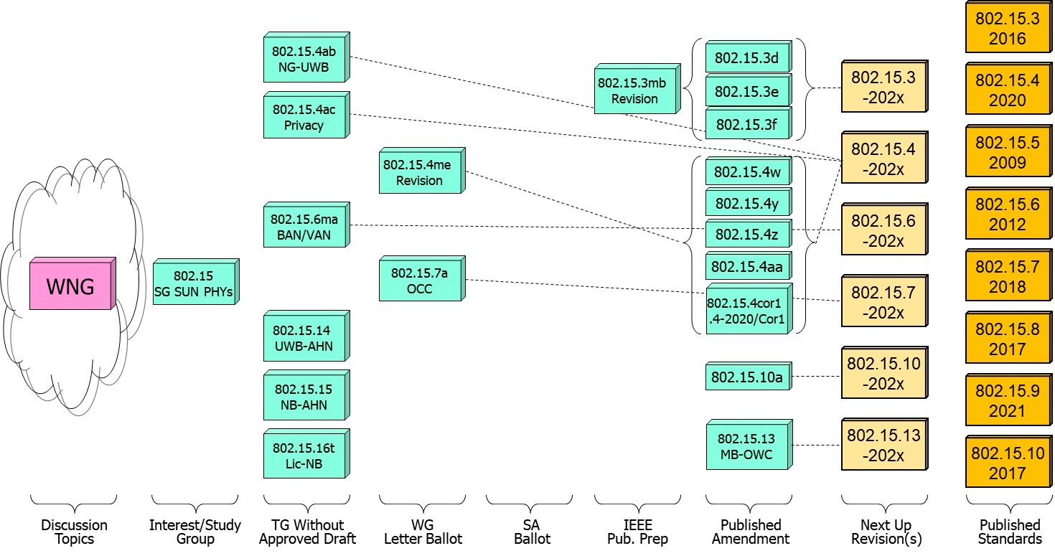
802.15 WG Standards Pipeline

Slide 3
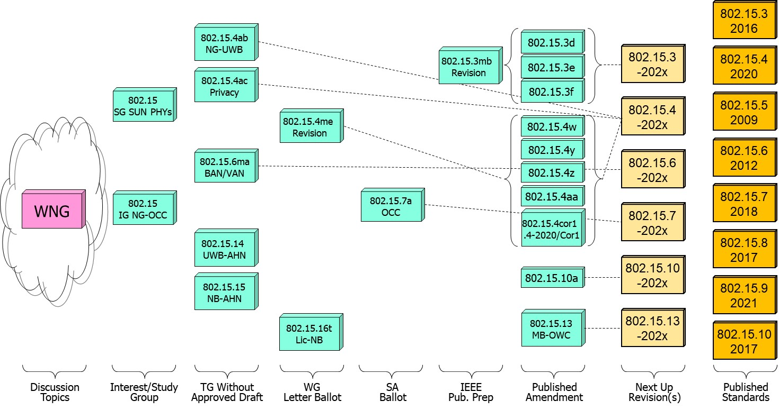
802.15 WG Standards Pipeline (updated)

Slide 4
SG Next Generation SUN PHYs
What is it?
  Next Gen SUN/Smart Utility Network OFDM
  Long range PHY to enable city wide simple star networks, dense networks with >10K nodes, Power efficient for battery operated end node.
  Enhancing OFDM with Long Range extension with improved link budget and higher reliability while remaining compliant with existing worldwide regulatory requirements.
  Target PHY is the existing SUN-OFDM PHY .
Status:
  Continue PAR and CSD development for extending the SUN PHYs.

Slide 5
802.15.4ab Next Generation UWB
What is it:
  Builds on 802.15.4z increasing footprint and usefulness to additional usages beyond range measurement and improve IR signal limitations.
  Main areas of enhancements relates to ranging resiliency (NB assisted operation), sensing, data rates, support for additional spectrum.
Status:
  Preparations towards going into Initial WG ballot: identify/complete missing std. pieces, and complete comment collection resolution.

Slide 6
802.15.4ab Next Generation UWB
Major areas of discussion:
  Continued discussion of co-existence and LBT of NB operation.

Slide 7
802.15.4ac Privacy
What is it:
  Modifications to the IEEE Std 802.15.4 medium access control
  Improved user privacy to protect from user tracking and profiling attack.
  Amongst the mechanisms MAC address randomization and rolling MAC address.
Status:
  In draft development.
  Progress on the identified issues of current standard: static MAC address , MAC address set across multiple radios in a single physical device, MAC address refresh, security context refresh for group and unicast, network discover and more.

Slide 8
802.15.16t Narrow Band Licensed Operation (NB-Lic)
What is it:
  Licensed Narrow Band (NB) Operation in channels bandwidth between 5 – 100KHz in the VHF/UHF bands such as 160MHz, 450MHz, 700MHz and 900MHz, taking advantage of the superior channel propagation properties. Targeted usages mission critical operation.
Status and main discussion topics:
  Group completed the informal comment resolution and draft now starting initial WG ballot phase.

Slide 9
802.15.6ma - Enhanced Dependability Body Area Network (ED-BAN)
What is it:
  Enhancements to the BAN (Body Area NW) Ultra Wideband (UWB) physical layer (PHY) and media access control (MAC) to support enhanced dependability to a human BAN (HBAN) and support for vehicle body area networks (VBAN).
  This revision focuses on international operation.
Status:
  Continue resolution of (informal) comment collection and assess readiness to go to initial WG ballot.

Slide 10
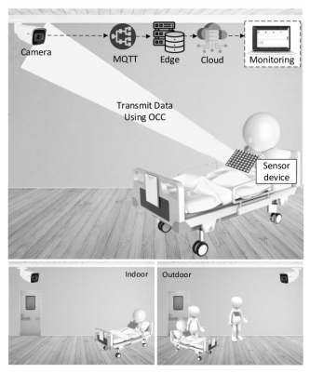
Next Generation Optical Camera Communication (OCC)
What is it:
  Interest group to evaluate the interest of a new OCC standard.
  Future applications include indoor/outdoor and submerged applications.
Status:
  Formation meeting for the IG, reviewed submissions on applications and usages.

Slide 11
