Slide 1
Low latency channel access
Date: 2023-11-12
Authors:

Slide 2
Recap from 11-23/1065r0: problem
UHR PAR aim to reduce tail of the latency and allow high-priority access
EDCA remains the main channel access method in 802.11
  On average make everyone suffer equally
    lead to long latency tail due to failed TX and exponential backoff
  Has limits on # of STAs that can efficiently use AC without leading to too high number of collisions (worst for AC_VO)
    Not possible to define more aggressive parameters using same concept (AIFSN, CWmin/max) as used today without creating more collisions
  Even higher AC may lose contention to a lower AC
    AIFSN and CW values does not provide sufficient traffic separation.
  Hard to provide bounded latency
Improvements needed in deployments:
  With large number of contenders using the same AC and where the goal would be mainly to cut the latency tail and bound worst-case latency
  where we want to ensure even more predictability of channel access than AC_VO without the risk of collisions

Slide 3
Recap from 11-23/1065r0: solution
Proposal would be to isolate STAs with prioritized access from the rest of the STAs at the beginning of a contention period
  Achieve this by allowing these STAs to transmit a Defer Signal at the beginning of a contention period to force all STAs that are not sending the Defer Signal to have CCA busy and not participate in the contention period
  If multiple of these STAs have prioritized access, they will transmit the same Defer Signal at the same time with the same result on other STAs (CCA busy)
And then to allow for a contention only between the STAs with prioritized access
  Only STAs that have sent a Defer Signal can participate in this immediately following contention
  More degrees of freedom for the contention parameters setting to avoid collisions without loosing priority
    don’t necessarily need to be too aggressive in order to scale to a larger number of STAs while ensuring low collision rates (contrary to AC_VO)

Slide 4
Illustration
Previous TxOP
From STA1
EDCA contention period
TxOP gained by STA3
SIFS
DIFS
STA1
Legacy
AIFSN
Idle
Busy
EIFS mode
Busy
STA2
Legacy
AIFSN
Busy
Idle
Busy
EIFS mode
Busy
Defer signal
STA3
i.e. STF/LTF/SIG
PPDU transmission
or CTS
BO: rand(0,7)=4
Busy
Idle
Idle
Defer signal
STA4
i.e. STF/LTF/SIG
BO: rand(0,7)=5
or CTS
Busy
Idle
Idle
Busy

Slide 5
Recap from 11-23/1065r0: results
1 AP, variable number of STAs, all within ED range
  EDCA
  EDCA with CwMax limit ==127
  HIPEDCA case 1, cutting the AC_BE tail:
    A STA that suffer from 4 consecutive failures allowed to send DS signal to announce high priority (HiP) EDCA
  HIPEDCA case 2, :
    A STA that shall send LL traffic send DS signal to announce high priority (HiP) EDCA
Statistic of interest: channel access time
Results
  Case 1: Substantial (2x-3x-5x-10x) reduction of 90th channel access time
  Case 2: bounded latency for LL applications
This presentation address some comments received from July IEEE meeting
  How DS behave if hidden nodes are present?
  How DS behave in multi-BSS setup

Slide 6
New material
Hidden nodes aspect. Is it a problem?
  In isolated BSS or in a multi-BSS setup
    Can DS repetition help with hidden nodes situation?
      AP respond back with another DS to provide sync for hidden nodes
Multi-BSS aspect
  What happens when DSes from multiple BSSes are sent?
    Should DS be “common” or “unique”
      A unique DS can carry BSS color/BSS ID for identification purpose
Possible “Rules of engagement” for DS
  There should be a limit on a number of DS attempts both
    consecutive (i.e. one after another)
    quantitative (how frequent DS can be sent)
  AP regulate the purpose of DS:
    for access improvement (i.e. too many reties)
    for latency improvements, i.e. high priority channel access to “bound the latency”

Slide 7
Simulation configuration
Isolated BSS with hidden nodes
1 AP and variable number of STAs: 5, 10, 15, 20, 30, 50, 75 and 100
Full buffer traffic in DL and UL direction
2x2x20Mhz @ MCS0
  in fact, the BW, NSS and MCS does not matter here, they only define PPDU duration on air
TXOP limit = uniform (1.5ms; 5ms)
  New TXOP limit is selected each time when STA/AP won contention
  Randomization is only to introduce “burstiness” and extra randomness into channel occupancy time
Case 1: Everyone can hear everyone, no hidden nodes
  STAs randomly dropped inside 12.5x12.5x3m box; AP is in the middle
Case 2: Hidden nodes
  STAs randomly dropped inside 50x50x3m; AP is in the middle
Simulation time 100seconds
  Every 3 seconds STAs randomly re-dropped inside the box
Repetition/No Repetition
  AP repeat DS signal sifs after reception of DS from a STA side. This should improve hidden node detection/protection

Slide 8
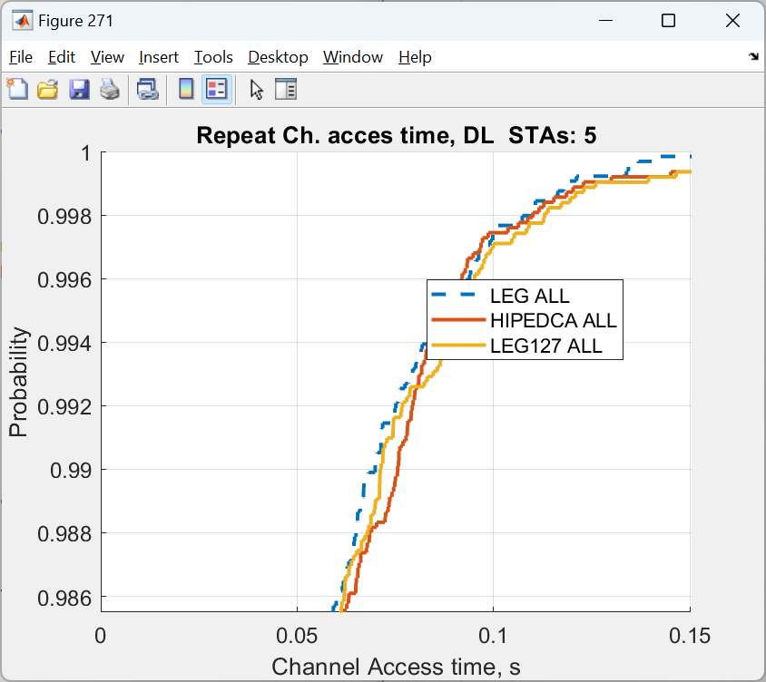
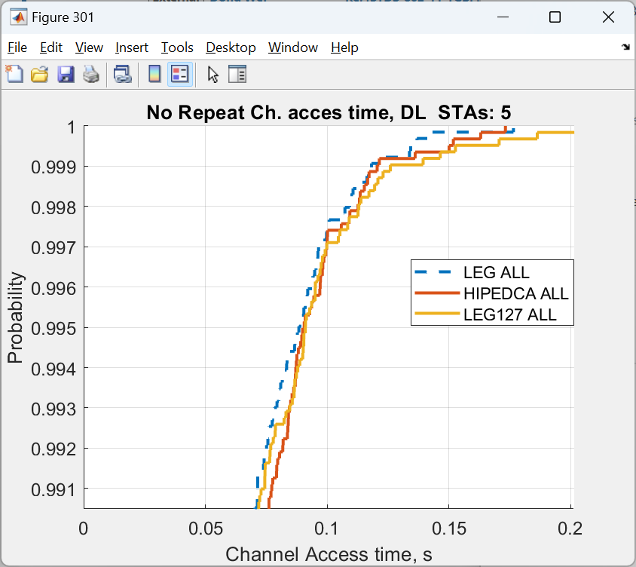
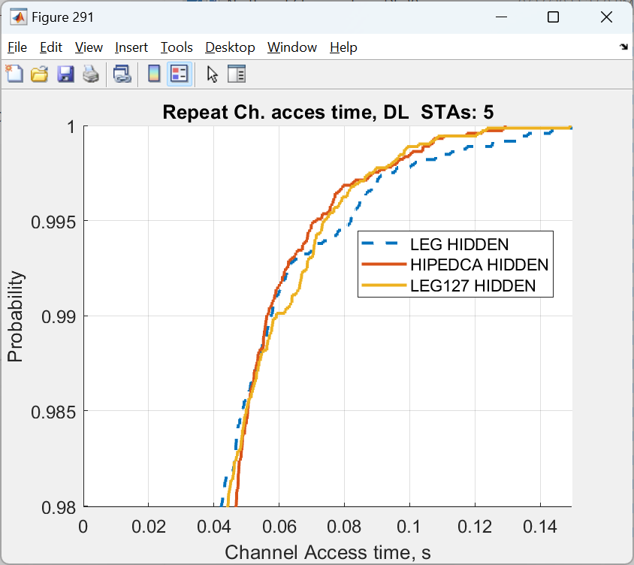
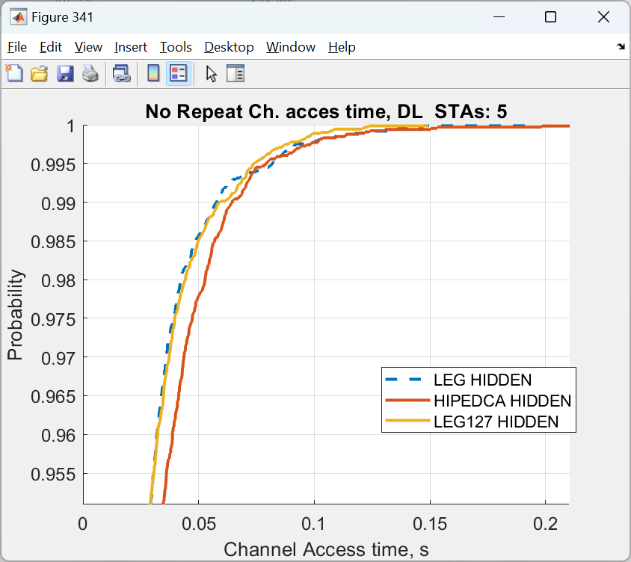
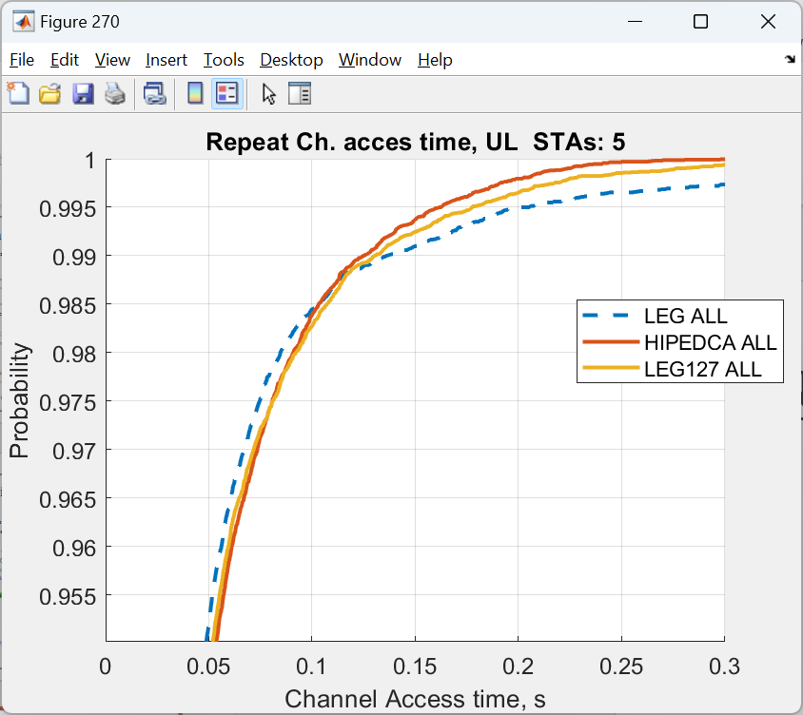
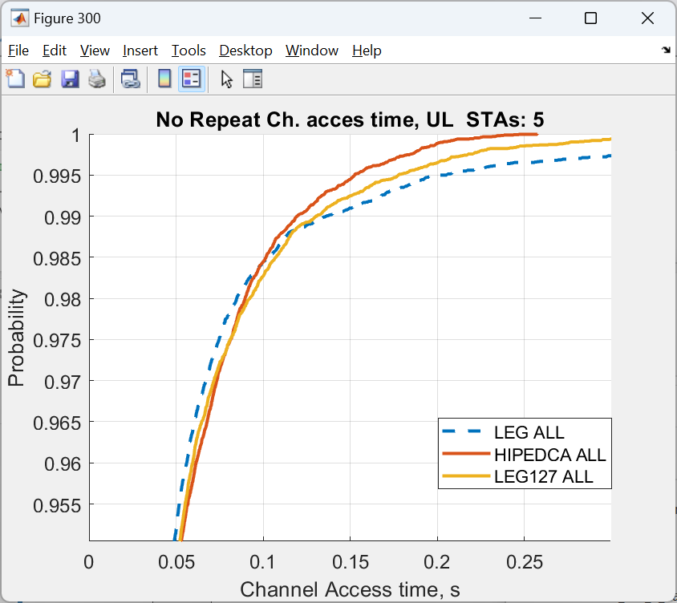
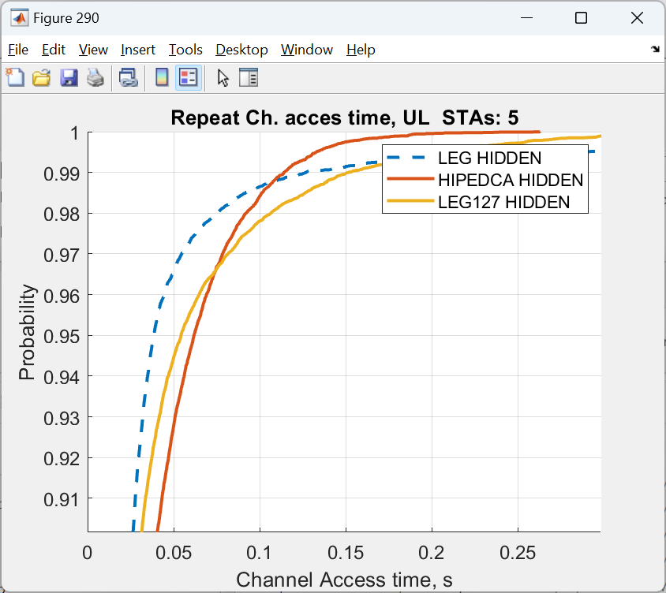
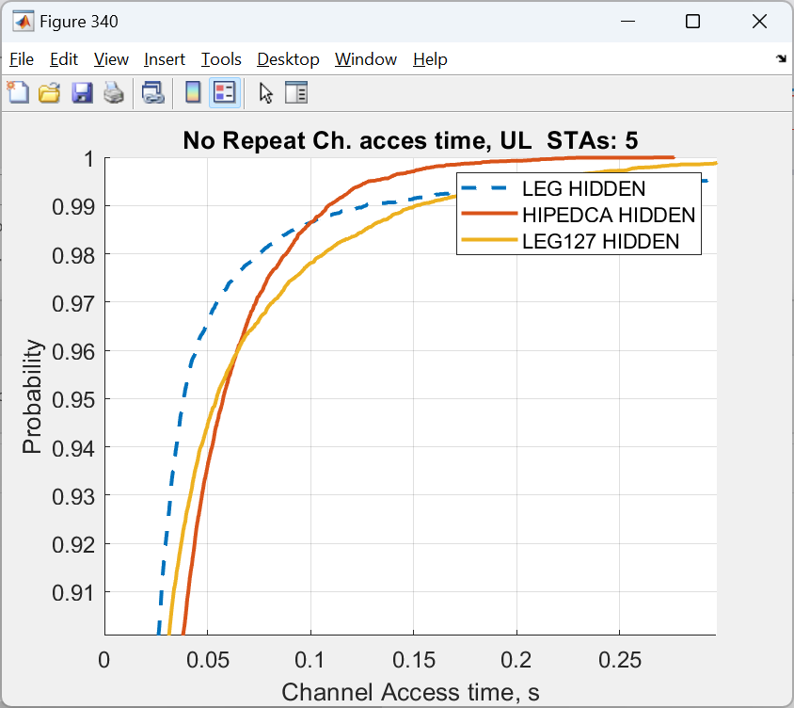
5 STAs
Upper row – DL; lower row – UL
Light color (light green and light beige) – case with DS repletion
Darker colors – case w/o repetition
Green color – with hidden nodes; Beige colors – with hidden nodes

Slide 9
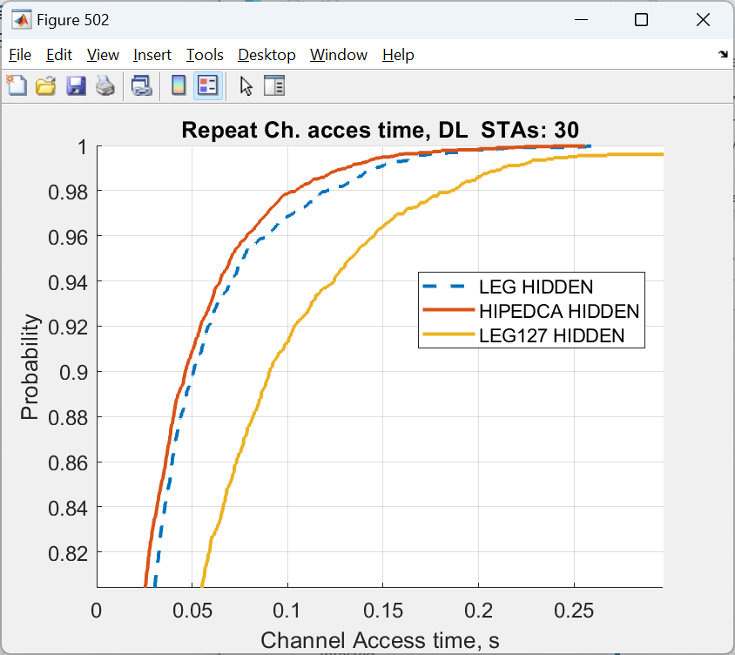
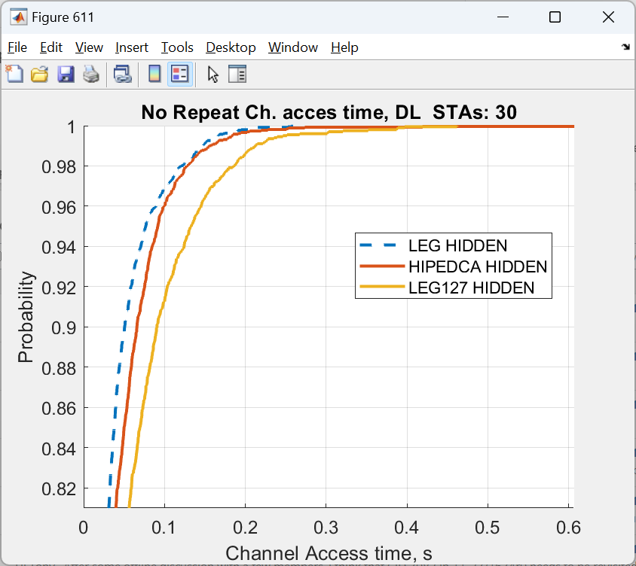
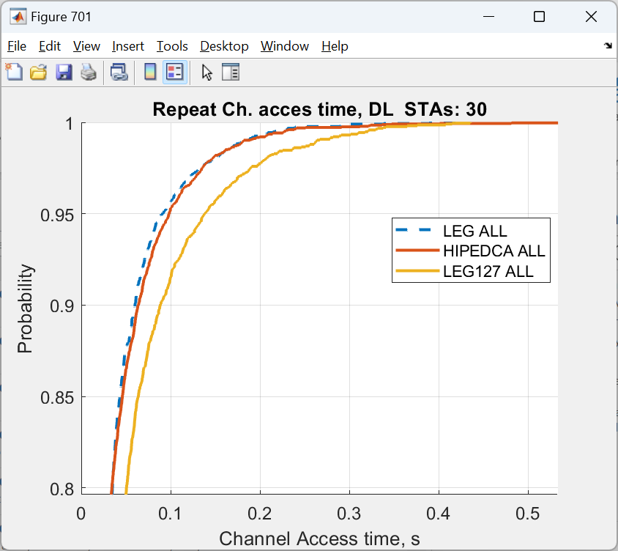
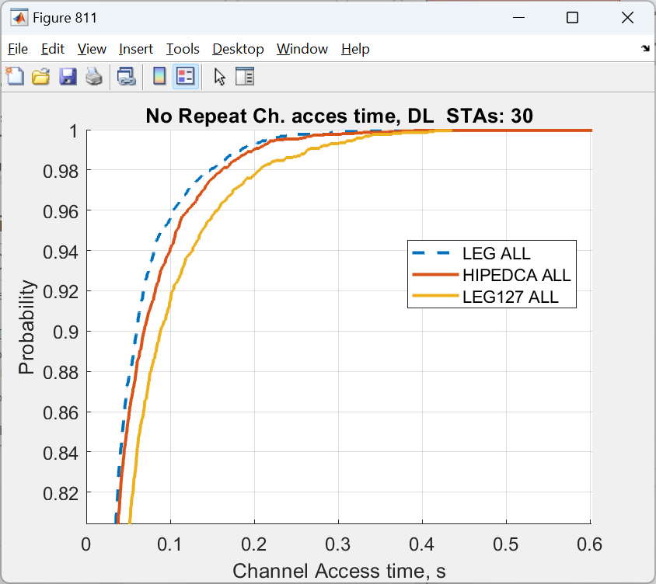
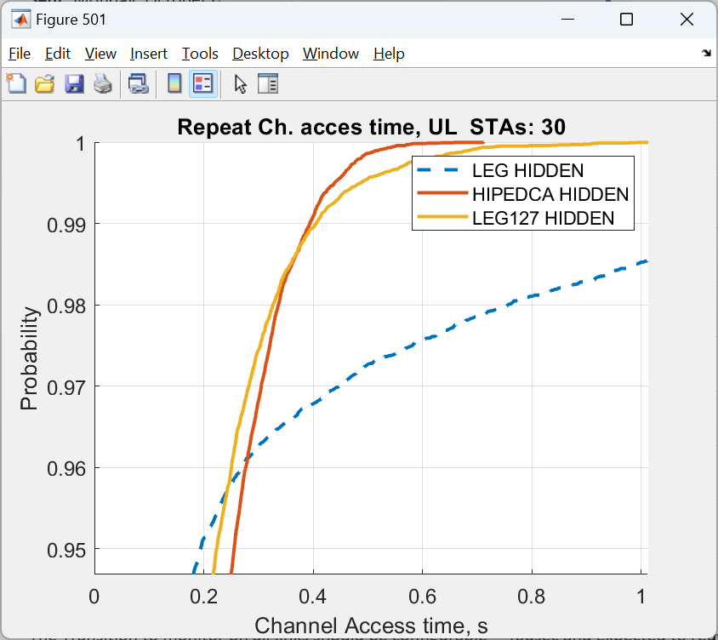
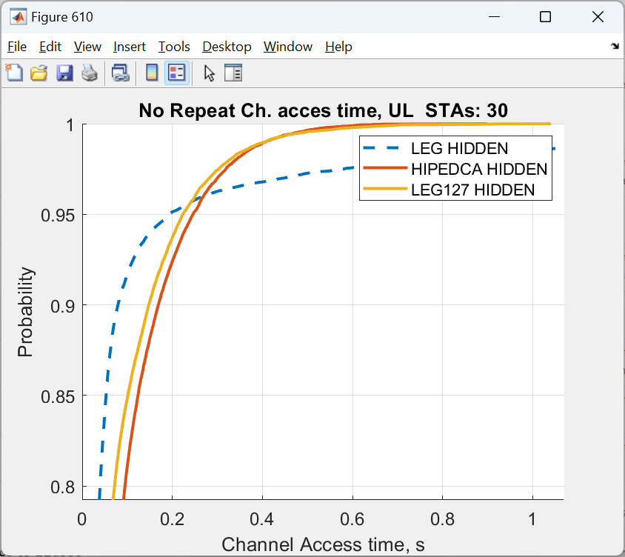
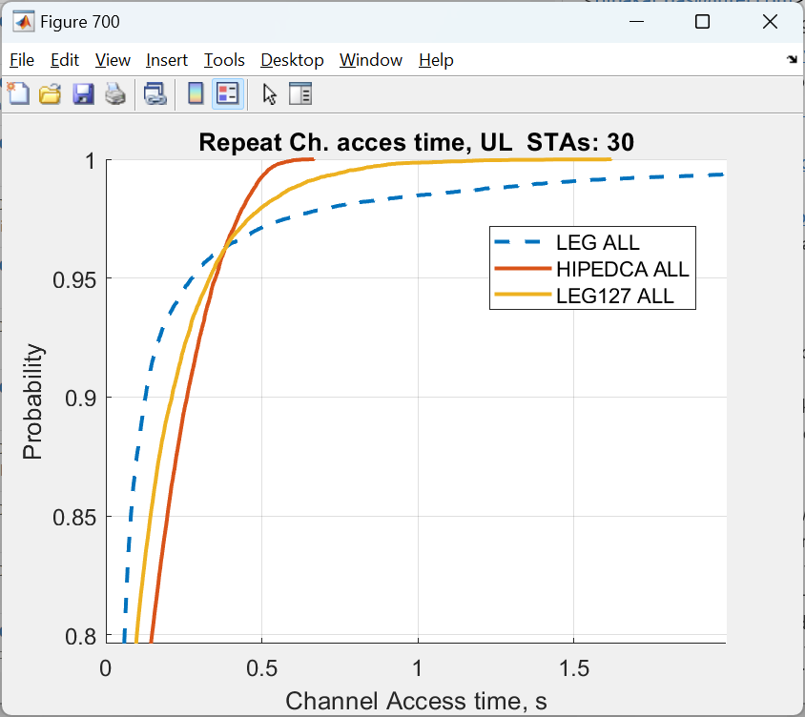
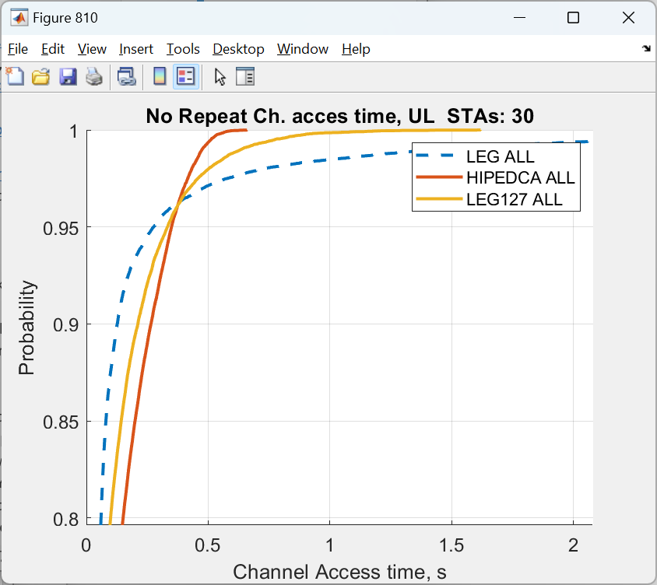
30 STAs
Upper row – DL; lower row – UL
Light color (light green and light beige) – case with DS repletion
Darker colors – case w/o repetition
Green color – with hidden nodes; Beige colors – with hidden nodes

Slide 10
Observations for an isolated BSS case
The HiP EDCA clearly capable of improving tail latency in UL direction
  The larger the number of contenders, the more significant the improvement : from 99th percentile (5 STAs) to 85th (50 STAs)
  This is true for both cases with and without hidden nodes
The DS repetition has very limited effect on tail latency improvement
  Marginal difference between repetition and no repetition case in one BSS case

Slide 11
Simulation configuration
Scenario 2
80meters
8
D=9
7
28m
6
Enterprise-like layout
  Up to 8 APs with variable number of STAs: 1, 2, 4, 6, 8 and 16
Full buffer traffic in DL and UL direction
2x2x20Mhz @ MCS0
TXOP limit = uniform (1.5ms; 5ms)
  New TXOP limit is selected each time when STA/AP won contention
  Randomization is only to introduce “burstiness” and extra randomness into channel occupancy time
  STA Cw = 15/1023; AP Cw=15/63
  TxPower: STA = 17dBm; AP=23dBm
Case 1: Some hidden nodes
  STAs assigned on a grid across four 4x4 cube islands, AP in the middle of the island
  Overall area size is 80x80meters
Case 2: All hear all
  STAs assigned on a grid across four 4x4 cube islands, AP in the middle of the island
  Overall area size is 20x20 meters
50m
5
80meters
31m
4
3
2
1

Slide 12
Multi-BSS test
Repeat with Unique DS
Unique DS = variant of DS which carry BssId
Only AP with Matching BssId respond back with DS
Only AP with matching BssId participate in the HiP EDCA
All devices that receive unique DS set EIFS
This is somewhat similar to RTS/CTS but w/o contention

Slide 13
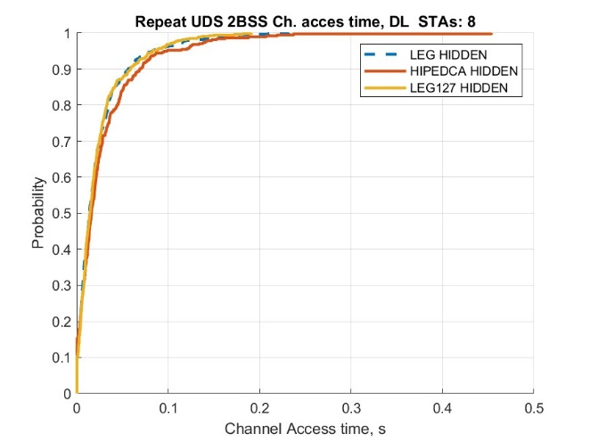
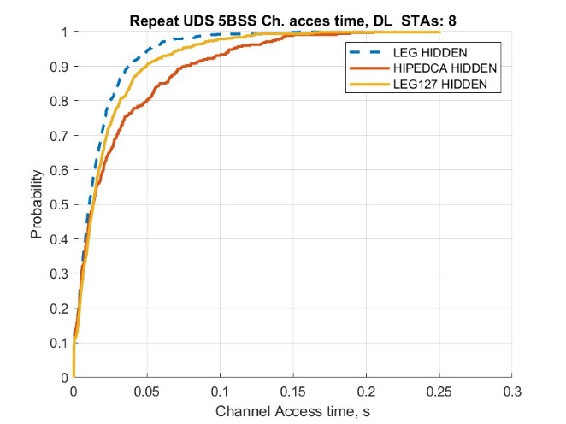
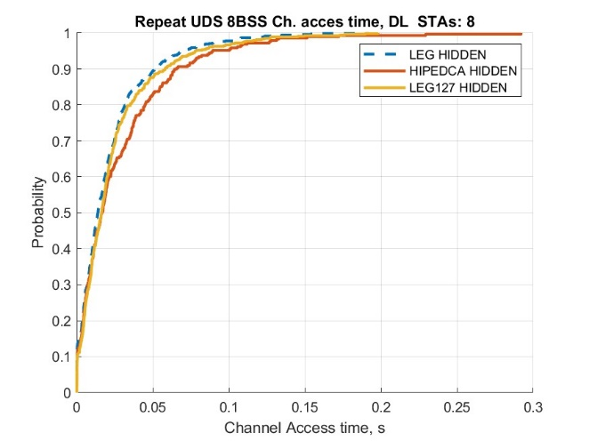
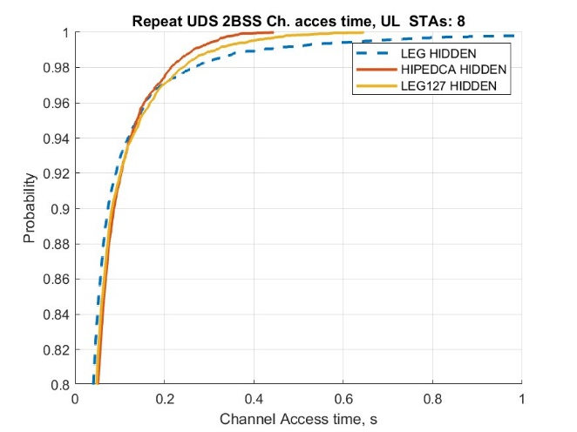
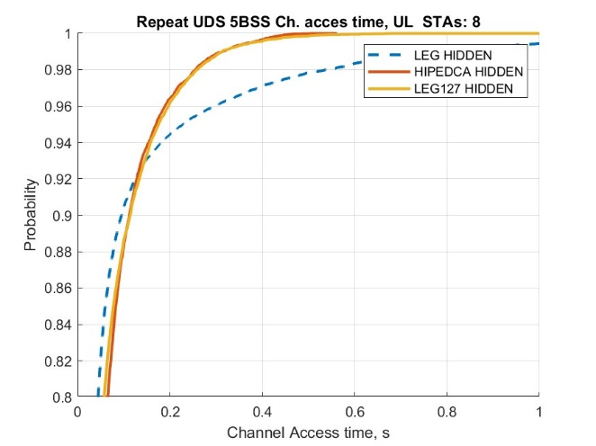
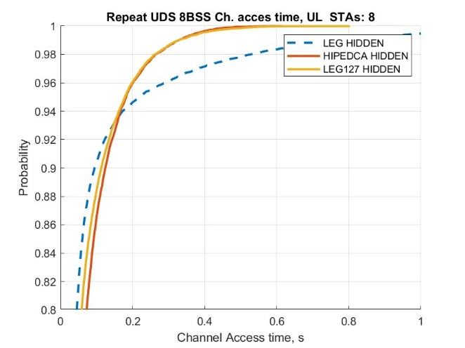
CDFs for 2, 5, and 8 BSSes, each with 8 STAs, rest in Backup section
Clear performance improvement for 2-3 BSSes case vs Legacy and vs Legacy 127
Substantially improves channel access time in UL for 95%th+ percentile

Slide 14
Multi-BSS test
No Repeat with Unique DS
Unique DS = variant of DS which carry BssId
Only own AP participate in the HipEDCA
AP does not respond back
All devices that receive unique DS set EIFS
This is somewhat similar CTS-to-self but w/o contention

Slide 15
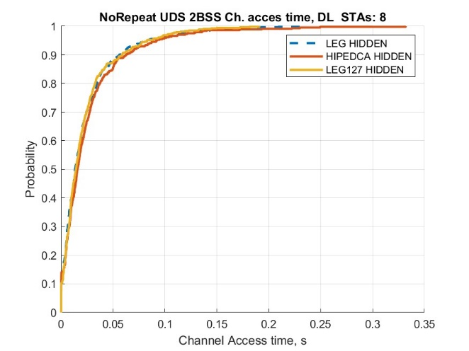
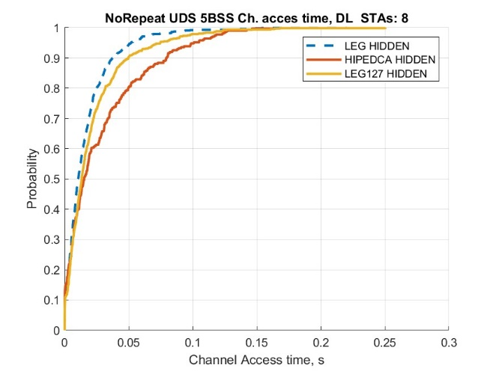
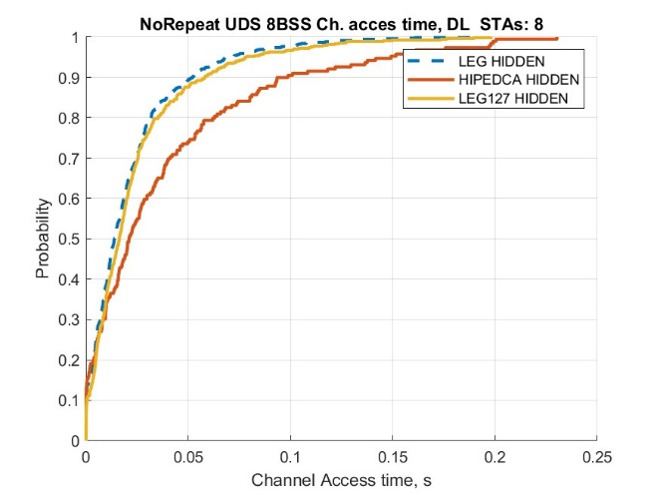
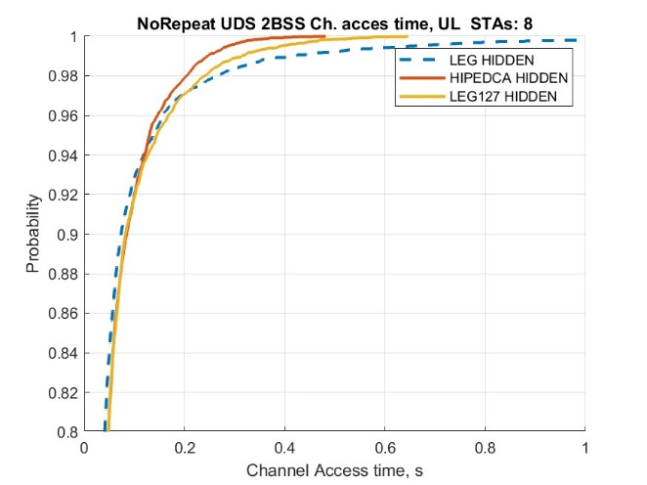
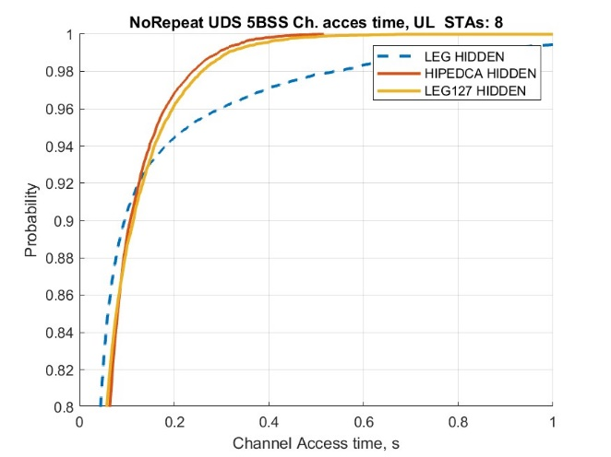
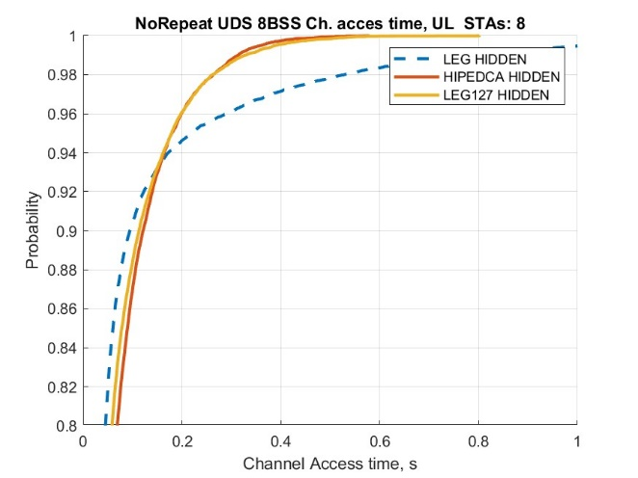
CDFs for 2, 5, and 8 BSSes, each with 8 STAs, rest in Backup section
Clear performance improvement for < 5 BSSes case vs Legacy and vs Legacy 127
Substantially improves channel access time in UL for 92%th+ percentile

Slide 16
Multi-BSS test
No Repeat with Common DS
Common DS. All DSes are the same
All APs participate in the HiP EDCA contention
No DS repetition
All devices that receive common DS set EIFS except APs

Slide 17
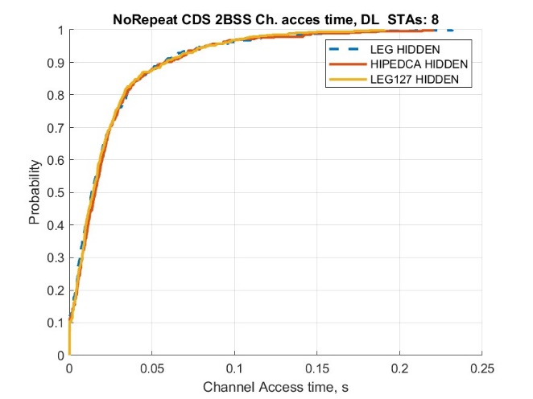
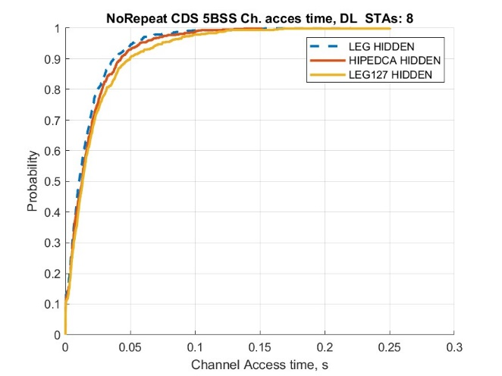
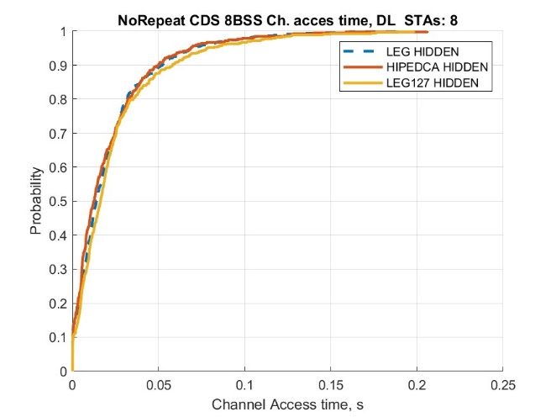

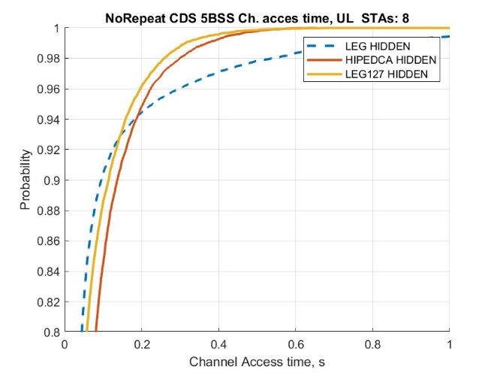
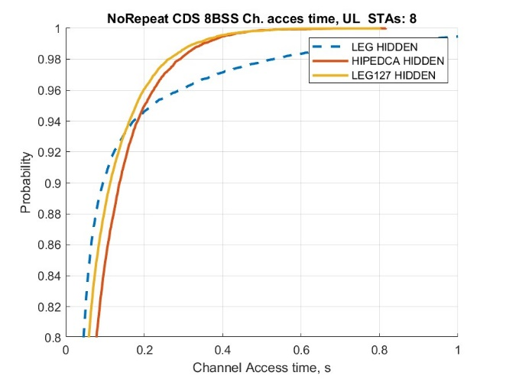
CDFs for 2, 5, and 8 BSSes, each with 8 STAs, rest in Backup section
Clear performance improvement for 2-3 BSSes case vs Legacy and vs Legacy 127
Substantially improves channel access time in UL for 95%th+ percentile

Slide 18
Multi-BSS test(s)
Repeat with Common DS only
Generally not working with 2+ BSSes when STA that is sending initial DS in BSS1 is hidden from AP of BSS2, but AP of BSS1 is not.
Example : 4 BSS case
  STA of BSS1 send DS
    AP1, AP2 and AP4 hear it
      AP1, AP2 and AP4 respond
        AP3 get repeat DS
          AP3 send DS back
            AP1, AP2, AP4 hear DS
              1, 2 and 4 send DS
                AP3 get DS… etc.

Slide 19
Channel access delay @
95th percentile omparison
X-axis: # of BSSes and # of STAs per BSS.
Interval between major ticks contain data for 1, 2, 4, 6, 8 and 16 STAs per BSS
All methods of HiP EDCA announcement substantially improve 95%th percentile for channel access time
  With UDS (Unique DS) + nR (no repetition) being the best

Slide 20
99th percentile Comparison
X-axis: # of BSSes and # of STAs per BSS.
Interval between major ticks contain data for 1, 2, 4, 6, 8 and 16 STAs per BSS
All methods of HiP EDCA announcement substantially improve 99%th percentile for channel access time
  With UDS (Unique DS) + nR (no repetition) being the best

Slide 21
99th percentile Comparison
X-axis: # of BSSes and # of STAs per BSS.
Interval between major ticks contain data for 1, 2, 4, 6, 8 and 16 STAs per BSS
All methods of HiP EDCA announcement substantially improve 99%th percentile for channel access time
  With UDS (Unique DS) + nR (no repetition) being the best

Slide 22
Observations from Multi-BSS setup
The HiP EDCA is capable of reducing tail latency in UL direction
The DS signal is better be limited to one BSS only to avoid chain reaction of DSes in neighboring BSSes,
  i.e. “UNIQUE”, not “COMMON”
  This observation is relevant to any other techniques that use any “common” signal/frame TGbn going to define
With multi BSS layout, capping CW to some value (127 in this set of experiments) has similar effect.

Slide 23
HiP EDCA for AC VO
Multi-BSS setup in 80x80 and 20x20 area
Compare Regular EDCA AC_VO channel access vs HiP EDCA for AC_VO
  A STA / AP use HiP EDCA to send frames enqueued to AC_VO;
    Alternative: use DS after first failure in AC_VO category
  A STA / AP send DS signal to have isolated HiP contention it is has frame enqueued into AC_VO
1 to 8 BSSes with # STAs:
  VO traffic is bi-directional 160 bytes every average 16ms =uniform (10ms, 22ms)
  BE are legacy with bi-directional full buffer traffic, TXOP = uniform (1.5ms, 5ms)
Statistic of interest:
    ETE delay
# STAs | 2 | 3 | 4 | 5 | 6 | 7 | 8 | 9 | 10 | 11 | 12 | 13 | 14 | 15 | 16
VO STAs case 1 | 1 | 1 | 1 | 2 | 2 | 2 | 2 | 3 | 3 | 3 | 3 | 4 | 4 | 4 | 4
VO STAs case 2 | 1 | 1 | 1 | 1 | 1 | 1 | 1 | 2 | 2 | 2 | 2 | 2 | 2 | 2 | 2
% of VO | 50 | 33 | 25 | 40 | 33 | 29 | 25 | 33 | 30 | 27 | 25 | 31 | 29 | 27 | 25

Slide 24
Case 1 –hidden nodes with large number of LL streams
# STAs | 2 | 3 | 4 | 5 | 6 | 7 | 8 | 9 | 10 | 11 | 12 | 13 | 14 | 15 | 16
VO STAs case 1 | 1 | 1 | 1 | 2 | 2 | 2 | 2 | 3 | 3 | 3 | 3 | 4 | 4 | 4 | 4
% of VO | 50 | 33 | 25 | 40 | 33 | 29 | 25 | 33 | 30 | 27 | 25 | 31 | 29 | 27 | 25

Slide 25
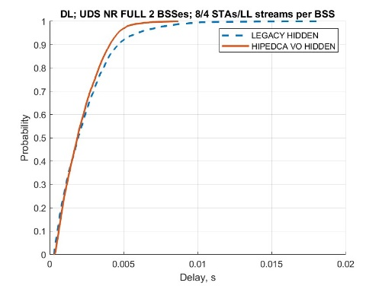
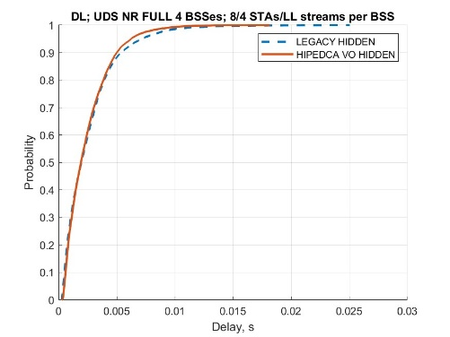
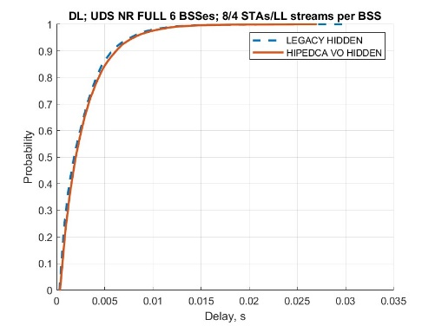
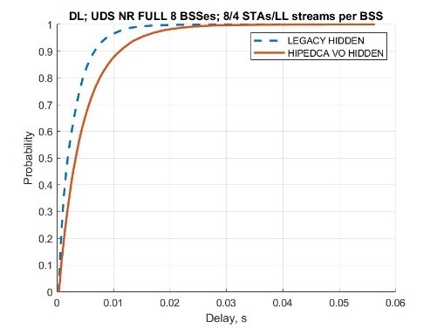
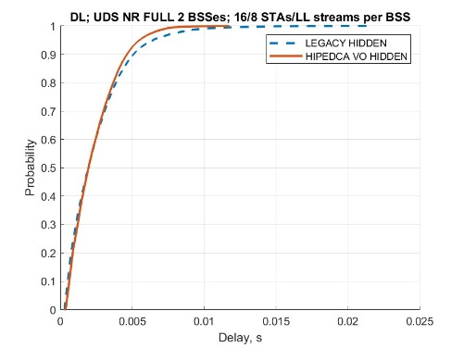
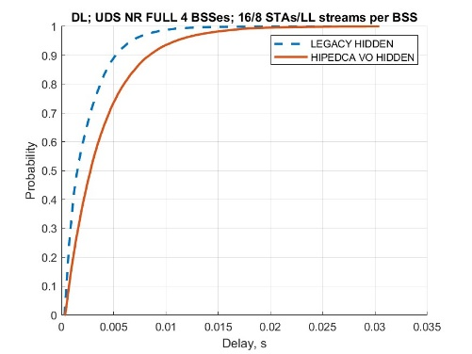
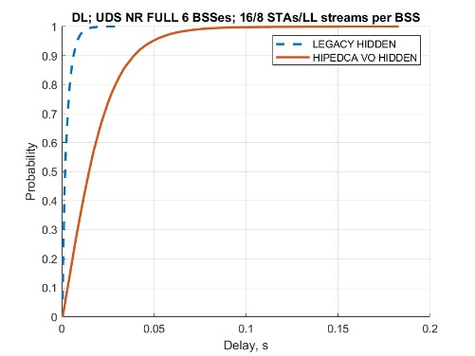
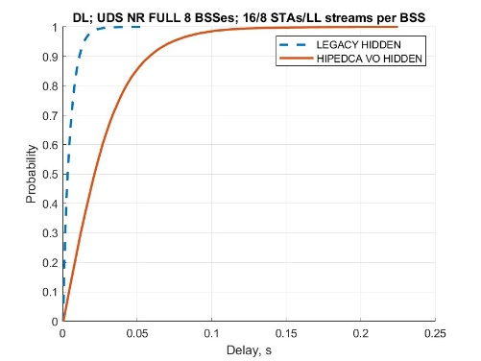
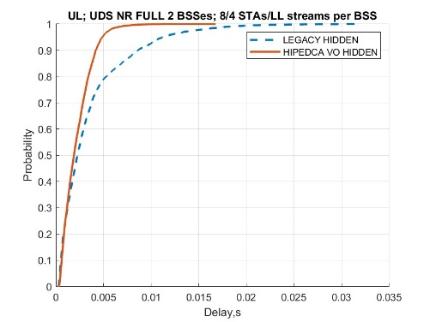
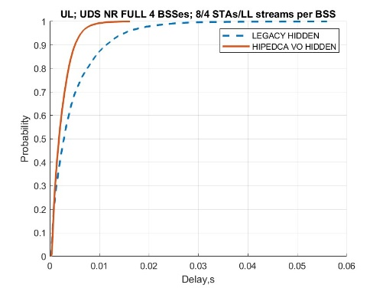
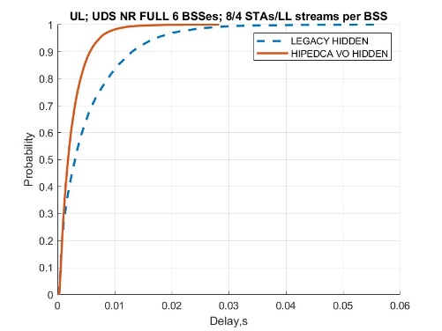
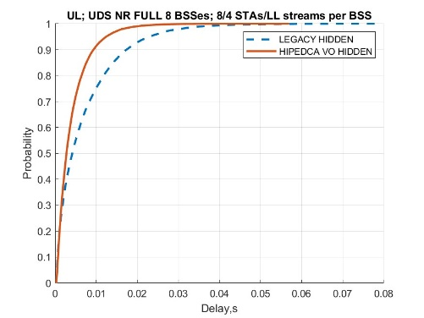
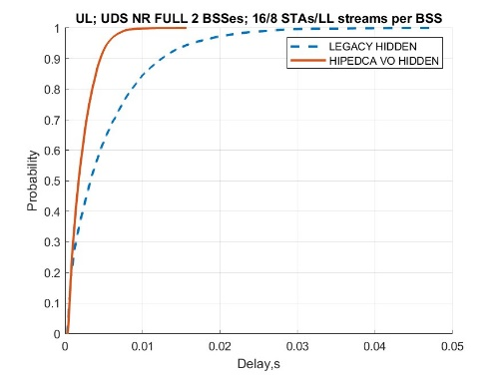
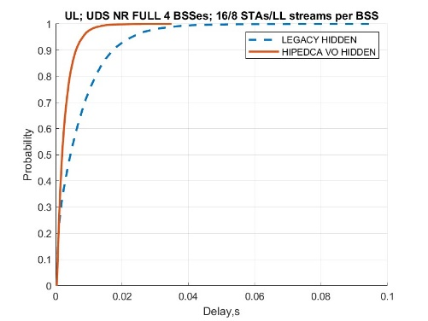
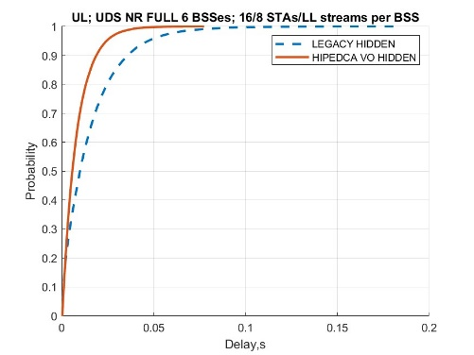
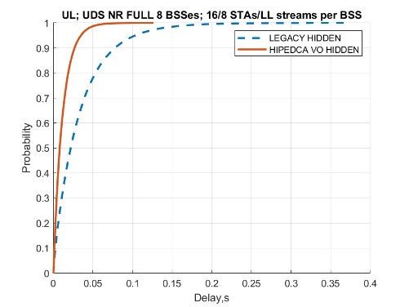
DL, 8 STAs
DL, 16 STAs
UL, 8 STAs
UL, 16 STAs

Slide 26
Case 1 –hidden nodes with small number of LL streams
# STAs | 2 | 3 | 4 | 5 | 6 | 7 | 8 | 9 | 10 | 11 | 12 | 13 | 14 | 15 | 16
VO STAs case 1 | 1 | 1 | 1 | 2 | 2 | 2 | 2 | 3 | 3 | 3 | 3 | 4 | 4 | 4 | 4
% of VO | 50 | 33 | 25 | 40 | 33 | 29 | 25 | 33 | 30 | 27 | 25 | 31 | 29 | 27 | 25

Slide 27
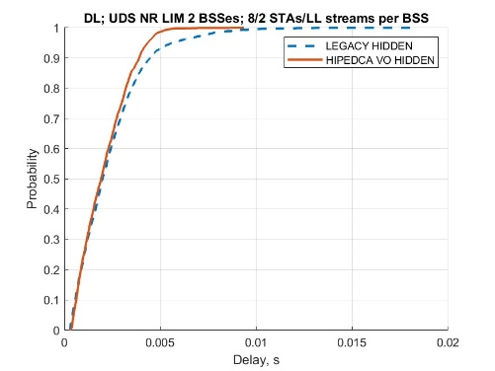















DL, 8 STAs
DL, 16 STAs
UL, 8 STAs
UL, 16 STAs

Slide 28
Observation
DS performance is LL load dependent
  # of BSSes and # of LL streams
    With “small” # of streams it provide similar or better performance (~1.3x latency improvements) in DL direction up to 5 BSSes in the area
    With “large” # of streams DS performance in DL is comparable with legacy mode of operation
    In provides overall 2x-3x delay improvement in UL direction across all number of STAs and BSSes
  Frequency of LL frames arrival is a key factor
    The amount of HiP contentions is LL traffic dependent. Same statement is correct for any other _preemption_ techniques
What is LL and what is LL use case is important
Similar performance observed when DS used to deal with AC_VO failures (not plotted)
  DS is sent when a frame from AC_VO experience single failure
  ETE delay CDF behavior is similar , only shifted by fixed amount which is a result of time spent for unsuccessful TX attempt

Slide 29
Observations
The DS approach has its own limits
  Frequency of use needs to be controlled.
  Large number of LL streams saturate HiP interval quickly
    If DS signal is a regular WiFi frame, it can carry duration to control HiP interval duration
DS signal transmission boundary is in conflict with AIFSN values which simply does not provide sufficient traffic priorities separation
  PIFS and DIFS are essentially AIFSN = 1 and AIFSN=2.
  If Legacy VO traffic is present, it will/may collide with DS that is sent @ AIFSN=2
  AIFSN values may be tweaked from AP side
    STAs shall be compliant
AIFSN values is a bottleneck for traffic separation
  AIFSN for DS are TBD and a topic for discussion
Contributions 467r0 and 470r0 provide additional thoughts and analysis for latency improvements
  467 provide additional simulation results on impact to the latency devices
  470 provide some thoughts on potential directions for low latency improvements

Slide 30
Conclusion
  Based on current evaluating, HIP EDCA allows to get 3x/4x latency improvements (cutting the tail) in a vast number of scenarios/conditions, while preserving legacy STAs performance

Slide 31
Backup

Slide 32
Case 1 – no hidden nodes with large number of LL streams
# STAs | 2 | 3 | 4 | 5 | 6 | 7 | 8 | 9 | 10 | 11 | 12 | 13 | 14 | 15 | 16
VO STAs case 1 | 1 | 1 | 1 | 2 | 2 | 2 | 2 | 3 | 3 | 3 | 3 | 4 | 4 | 4 | 4
% of VO | 50 | 33 | 25 | 40 | 33 | 29 | 25 | 33 | 30 | 27 | 25 | 31 | 29 | 27 | 25

Slide 33
















DL, 8 STAs
DL, 16 STAs
UL, 8 STAs
UL, 16 STAs

Slide 34
Case 1 – no hidden nodes with small number of LL streams
# STAs | 2 | 3 | 4 | 5 | 6 | 7 | 8 | 9 | 10 | 11 | 12 | 13 | 14 | 15 | 16
VO STAs case 1 | 1 | 1 | 1 | 2 | 2 | 2 | 2 | 3 | 3 | 3 | 3 | 4 | 4 | 4 | 4
% of VO | 50 | 33 | 25 | 40 | 33 | 29 | 25 | 33 | 30 | 27 | 25 | 31 | 29 | 27 | 25

Slide 35
















DL, 8 STAs
DL, 16 STAs
UL, 8 STAs
UL, 16 STAs

