Slide 1
802.15 Liaison Report – Nov. 2023
Date: 2023-11-15
Authors:

Slide 2
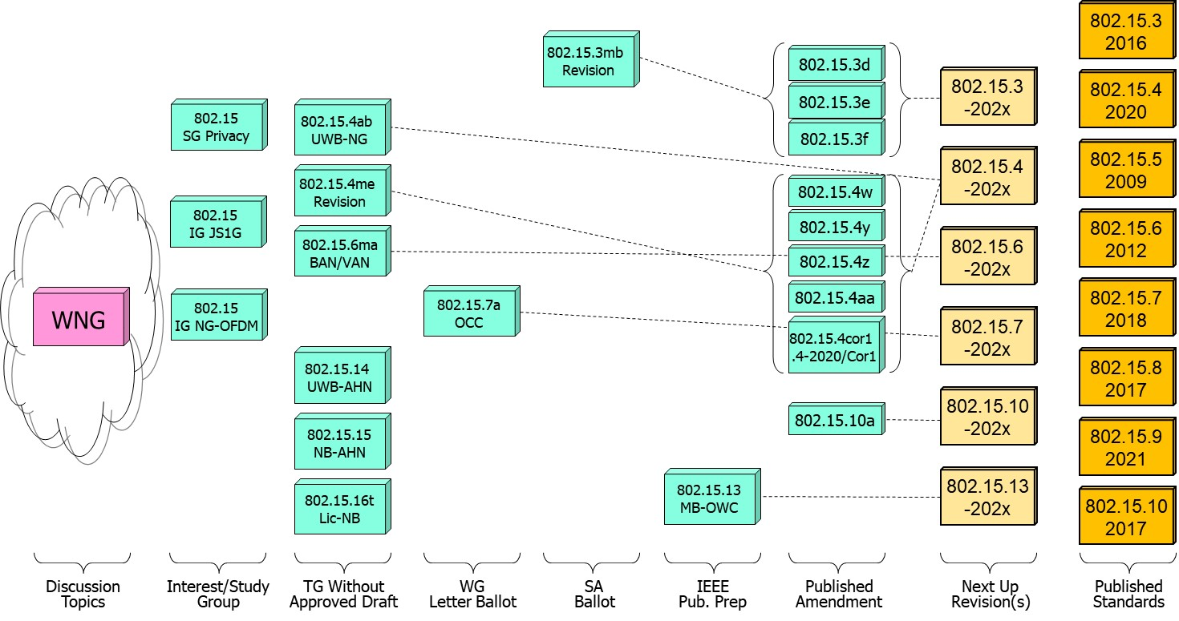
802.15 WG Standards Pipeline (previous)

Slide 3
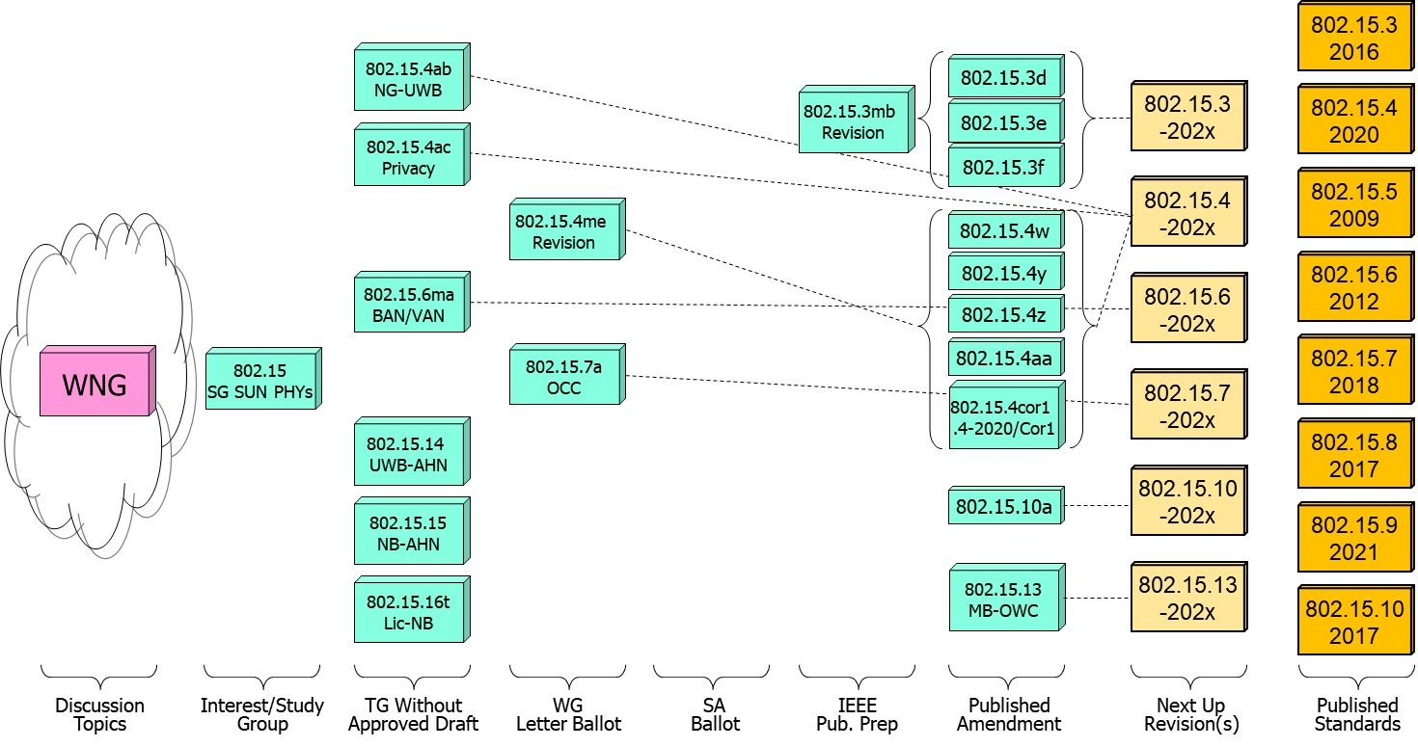
802.15 WG Standards Pipeline (updated)

Slide 4
SG Next Generation SUN PHYs
What is it?
  Next Gen SUN/Smart Utility Network OFDM
  Long range PHY to enable city wide simple star networks, dense networks with >10K nodes, Power efficient for battery operated end node.
  Enhancing OFDM with Long Range extension with improved link budget and higher reliability while remaining compliant with existing worldwide regulatory requirements.
  Target PHY is the existing SUN-OFDM PHY .
Status:
  Recently transitioned from IG NG OFDM to SG to Develop a PAR & CSD for extending the SUN PHYs.

Slide 5
802.15.4ab Next Generation UWB
What is it:
  Builds on 802.15.4z increasing footprint and usefulness to additional usages beyond range measurement and improve IR signal limitations.
  Main areas of enhancements relates to ranging resiliency (NB assisted operation), sensing, data rates, support for additional spectrum.
Status:
  In comment collection (informal CR) stage, draft is maturing, with ~250 comments resolved during the Sep. and Nov. meeting.
  Expected to initiate a 2nd informal comment collection/recirculation out of Nov. meeting.

Slide 6
802.15.4ab Next Generation UWB
Major areas of discussion:
  Continued discussion of co-existence with Wi-Fi specifically NB in UNI 3 and 5 – no conclusion on LBT or other CCA mechanism.

Slide 7
802.15.4ac Privacy
What is it:
  Improved security and privacy to protect from user tracking and profiling attack.
  Amongst the mechanisms MAC address randomization and rolling MAC address.
Status:
  Transitioned from SG to TG (May) and is in draft development.
  Progress on the identified issues of current standard: static MAC address , MAC address set across multiple radios in a single physical device, MAC address refresh, security context refresh for group and unicast, network discover and more.

Slide 8
802.15.16t Narrow Band Licensed Operation (NB-Lic)
What is it:
  Licensed Narrow Band (NB) Operation in channels bandwidth between 5 – 100KHz in the VHF/UHF bands such as 160MHz, 450MHz, 700MHz and 900MHz, taking advantage of the superior channel propagation properties. Targeted usages mission critical operation.
Status and main discussion topics:
  Group completed the informal comment resolution and draft now starting initial WG ballot phase.

Slide 9
802.15.6ma - Enhanced Dependability Body Area Network (ED-BAN)
What is it:
  Enhancements to the BAN (Body Area NW) Ultra Wideband (UWB) physical layer (PHY) and media access control (MAC) to support enhanced dependability to a human BAN (HBAN) and support for vehicle body area networks (VBAN).
  This revision focuses on international operation.
Status:
  Completed the propagation simulation, channel model and coding as well as development of Technical Requirements and initial draft.
  Conducted (informal) comment collection and comment resolution, and is performing ongoing resolution.

Slide 10
TG4me
Cor1 15.4 2020 Revision 1
TG4ab
Next Generation UWB
TG6ma
Body Area Networks
Revision
TG7a
Optical Camera Communications
TG13
Multi Gigabit/sec
Optical Wireless Communication
TG15
Ultra Wide-Band Ad-Hoc Networks
TG16t
Ultra Wide-Band Ad-Hoc Networks
TG3mb
TG HDR
High Data Rate
Revision
SCmaint
Maintenance Group
SCTHz
_{Standing Committee THz}
SCWNG
Wireless Next Generation
SCIETF
IETF liaison

