Slide 1
Multiple Channel Access in Preemption Sequence
Date: 2023-11-16
Authors:

Slide 2
Abstract
The tail of latency reduction is one of 11bn’s objectives.
To improve latency performance, preemption methods were discussed.
The preemption methods, in which an AP coordinates preemption, were discussed[1, 2].
  STAs transmit pre-emption request frames within an inter-PPDU spacing.
  Contention resolution phase follows pre-emption request phase.
The preemption methods with random access between STAs were also discussed [3].
  STAs contend for medium for latency sensitive frame within an inter-PPDU spacing.
  Once a STA succeed in channel contention, the STA transmits the latency sensitive frame immediately.

Slide 3
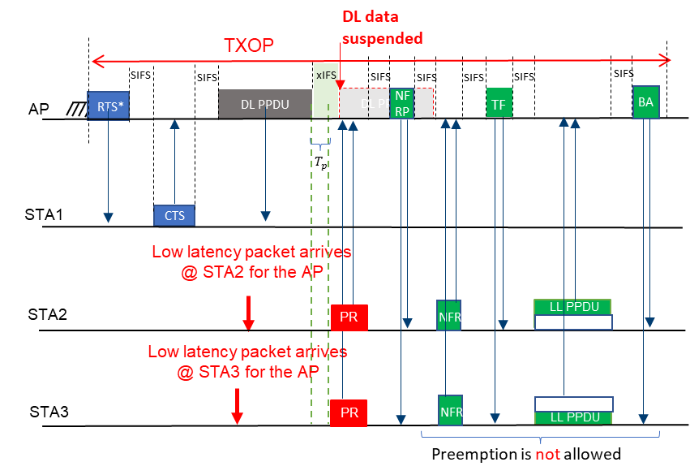
Recap: Coordinated preemption method
(Coordination method)
[1]: 23/1229r1, Juan Fang
Coordination
The discussed preemption method uses AP’s coordination
  This method can reserve transmit slots for STAs
    Collision probability can be decresed
  However, coordination overhead may occur.

Slide 4
Recap: Random Channel Access for Preemption (Random Access method)
[3] discussed the necessity of random channel access within an inter-frame spacing
There are some candidates of random channel access schemes:
  E.g., DCF-like operation

Slide 5
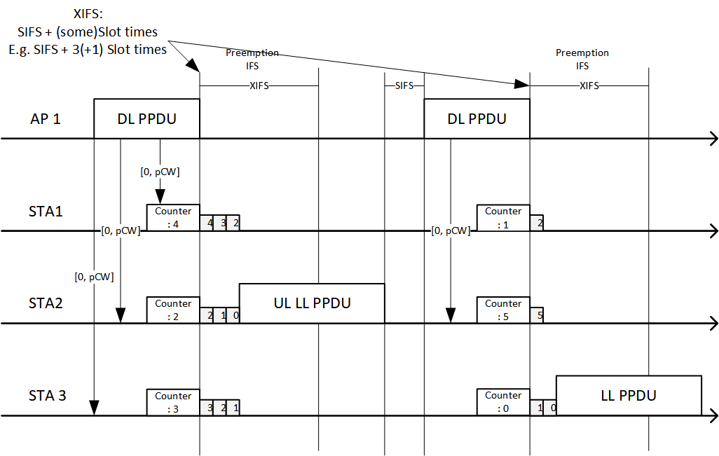
Example: DCF-like Backoff Scheme
This example is showing one of the random access method for preemption.
STAs perform short-term backoff within inter-PPDU spacing (XIFS)
  XIFS should be long enough to perform backoff operations.

Slide 6
Comparison between
Coordination and Random Access Methods
1. Small number of STAs which perform preemption:
  When only a small number of STAs perform preemption, the random access method is advantageous for quick transmission as it does not require separate coordination.
  However, an overhead of the coordination method may occur inefficiency when only a small number of STAs perform preemption.
2. Large number of STAs which perform preemption:
  When a large number of STAs perform preemption, the coordination method has the advantage of a lower probability of collision and better resource management.
  However, as the number of STAs performing preemption increases, the probability of collision also rises in the random access method. Therefore, inefficiency can occur when using the random access method.

Slide 7
Summary
In this submission, the two channel access methods for UL SU preemption was discussed
  1. Coordination Method
  2. Random Access Method
In the coordination method,
  STAs can access channel without collisions
  Overheads for coordinating STAs will be occurred
In the random access method,
  STAs can access channel without coordination overheads
  Collisions may occur between STAs

Slide 8
References
[1] 11-23/1229r1: Juan Fang et al., Preemption for low latency application (Follow up), https://mentor.ieee.org/802.11/dcn/23/11-23-1229-01-0uhr-preemption-for-low-latency-application-follow-up.pptx
[2] 11-23/1174r0: Kiseon Ryu et al., TXOP preemption follow up, https://mentor.ieee.org/802.11/dcn/23/11-23-1174-00-0uhr-txop-preemption-follow-up.pptx
[3] 11-23/1242r1: Juseong Moon et al., Considerations on Inter-PPDU based Preemption Scheme, https://mentor.ieee.org/802.11/dcn/23/11-23-1242-01-0uhr-considerations-on-inter-ppdu-based-preemption-scheme.pptx

Slide 9
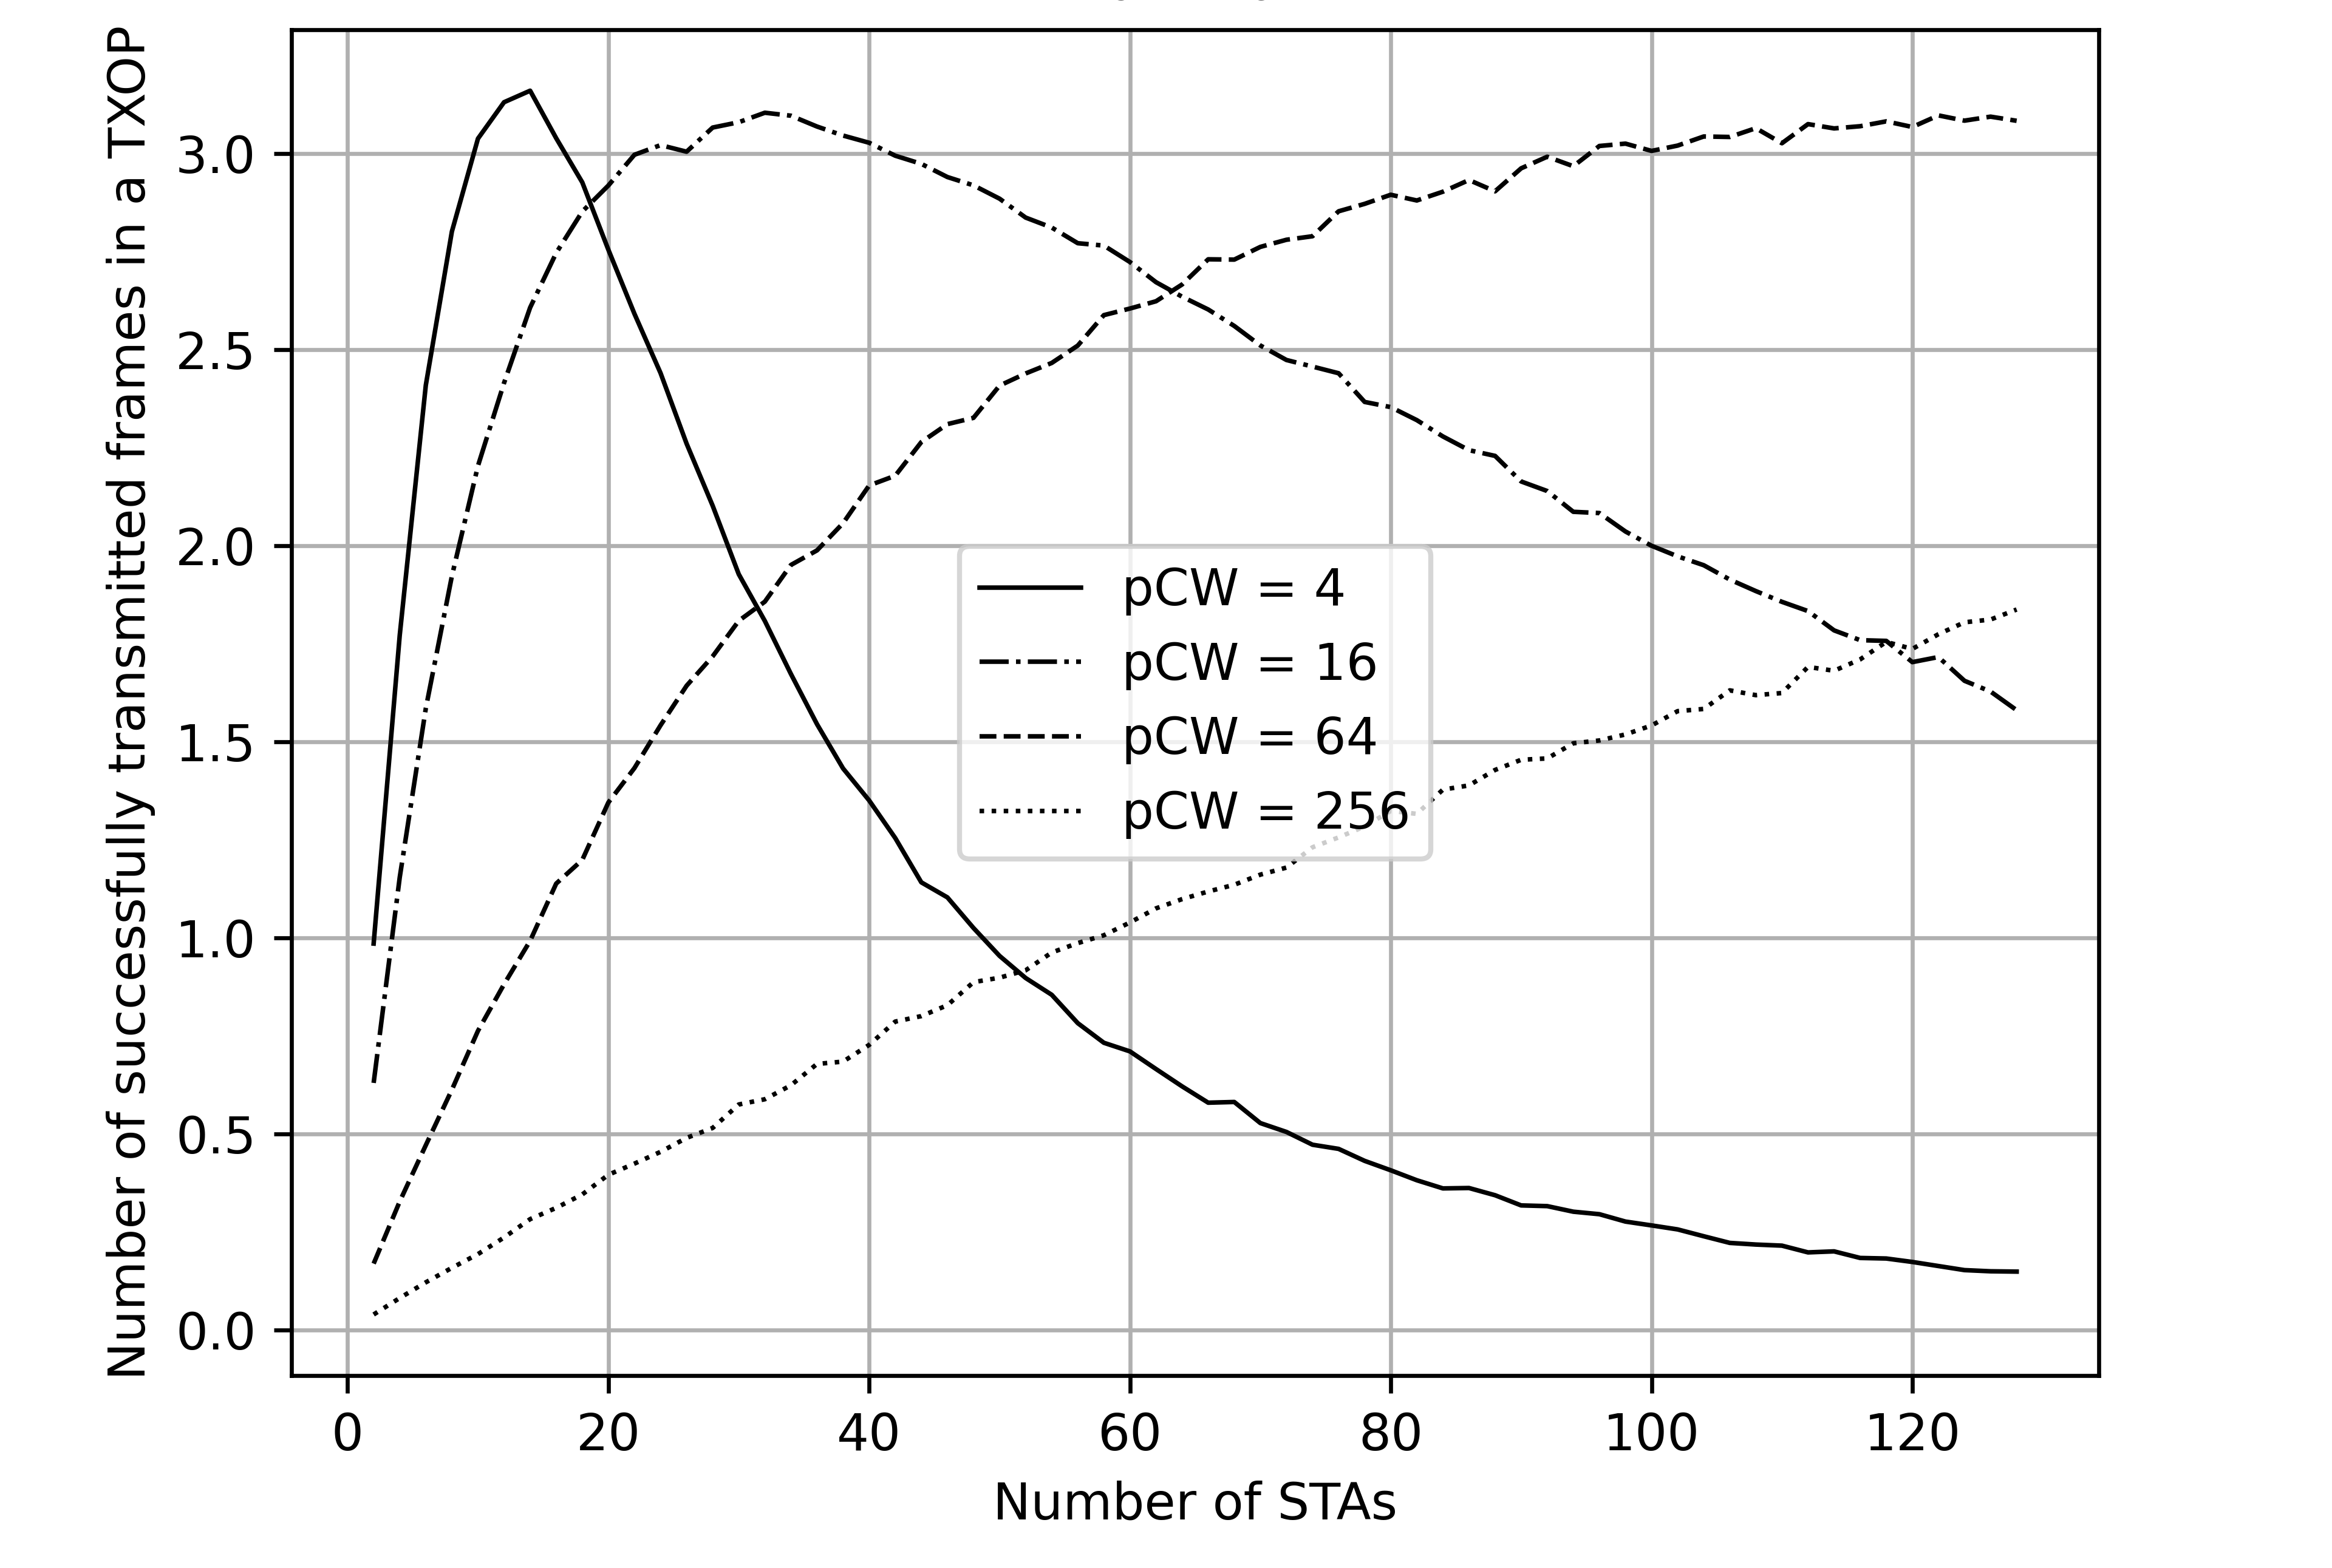
Appendix 1:
Experiments for DCF-like Random access method
- 4 Preemption slots per TXOP / 10% enqueue probability for each STAs
- Maximum 3 slots can be decreased at each STAs
- STAs access channel in each slots, based on a short contention slots/
- The contention slots are selected from [0, pCW]
- Maximum 3.13 frame can be transmitted when pCW = 4 and 12 STAs are contenting

Slide 10
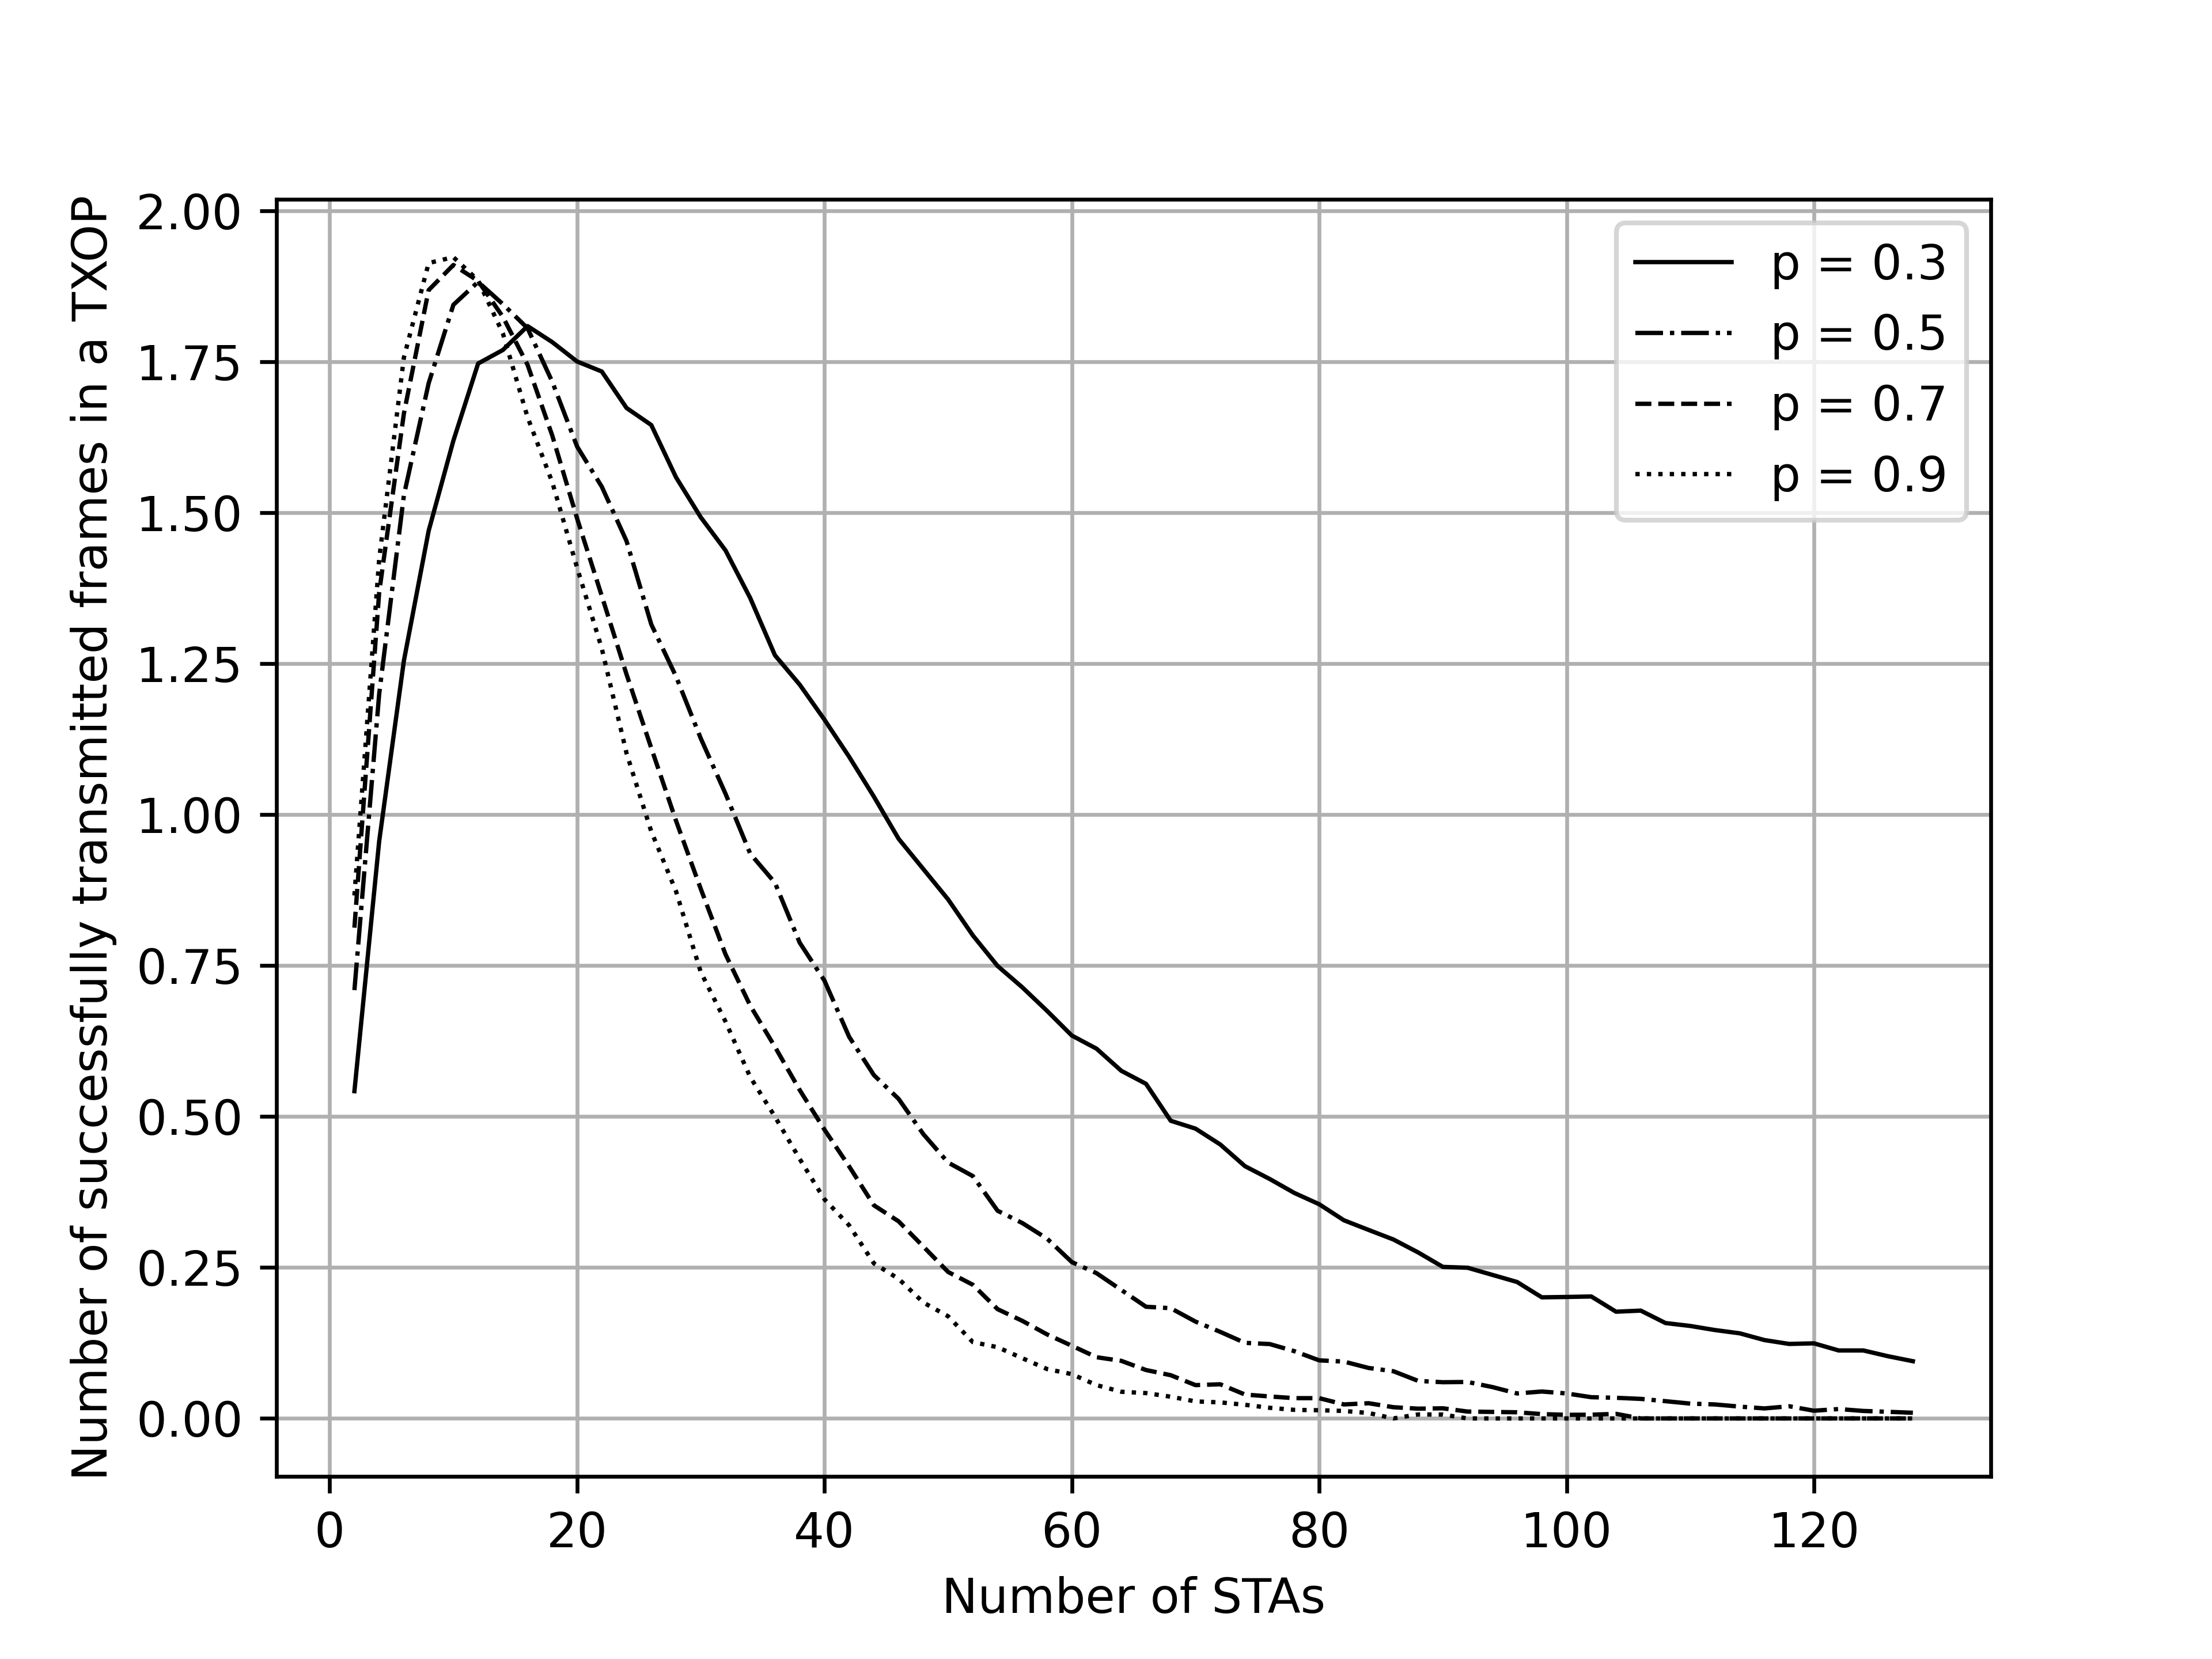
Appendix 2:
Experiments for Probability based access method
- 4 Preemption slots per TXOP / 10% enqueue probability for each STAs
- STAs access channel in each slots, based on channel access probability
- Maximum 1.92 frame can be transmitted when p = 0.9 and 10 STAs are contenting

