Slide 1
Considerations for DSO Sub-band switch delay
Date: 2023-11-10
Authors:

Slide 2
Abstract
This document identifies two issues related to the sub-band switch delay associated with Dynamic Sub-band Operation (DSO). To address the issues, it proposes:
making the sub-band switch initial control frame a no-ACK frame,
the use of a follow-up frame to sub-band switch initial frame, for reserving the channel for the delay necessary for DSO sub-band switch.

Slide 3
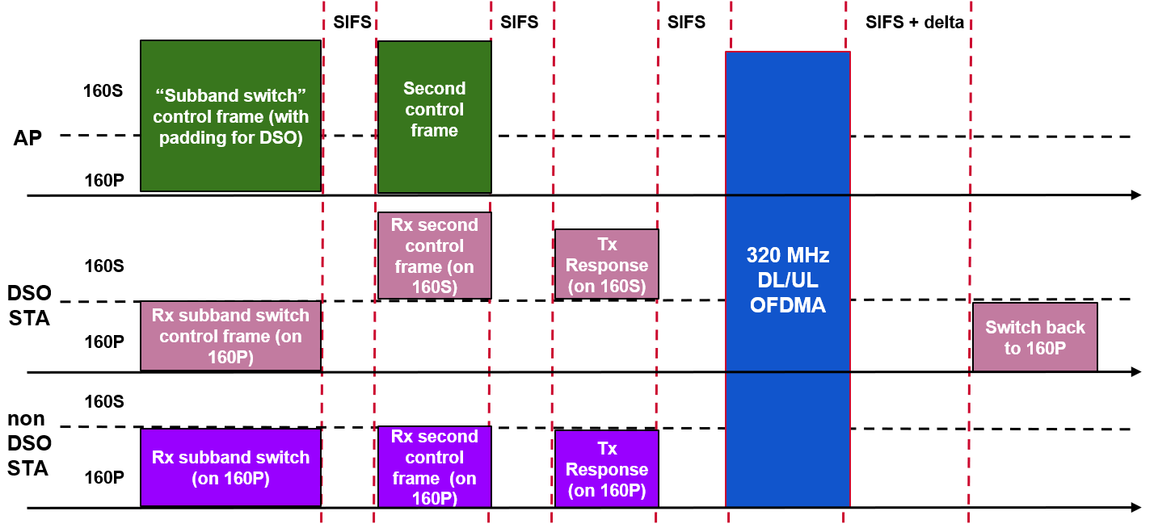
Dynamic Sub-band Operation - Recap
As the maximum supported bandwidth by WiFi rises, non-AP STAs may operate with a smaller supported bandwidth than the AP.
To exploit the full bandwidth supported by an AP efficiently, Dynamic Sub-band Operation (DSO) was proposed in 11-22-2204r0.
  In a TXOP, an AP can indicate to DSO-capable clients the sub-band on which they will be served within the TXOP.
  The AP initiates transmission to the DSO STAs after sufficient delay to allow the DSO devices to perform the channel switch. The AP also ensures protection of the TXOP for the duration of this switch.
  At the end of the TXOP the DSO STAs switch back to the primary channel.

Slide 4
Existing proposals in UHR
11-22-2204r0
  Proposed the high-level idea of DSO.
  Proposes that AP send a sub-band switch control frame as a special initial control frame (can be modification of MU-RTS or BSRP) to indicate a DSO non-AP STA its allocated sub-band.
  The frame can have sufficient padding to cover the sub-band switch latency.
  The frame may/may not require ACK.
11-23-1496r0
  Proposes to perform DSO (similar to 2204r0) but using EMLSR operation. Suggests merging the EMLSR initial control frame with the Sub-band switch control frame.

Slide 5
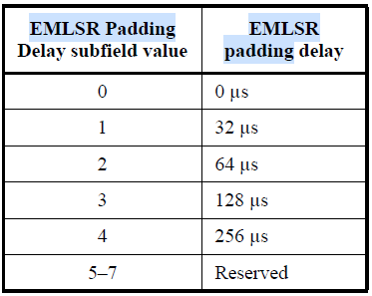
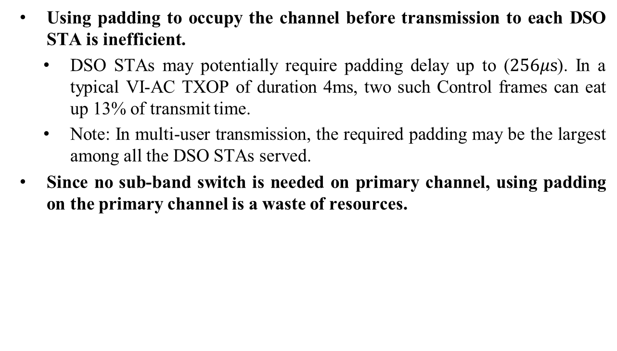
Problem 1: Padding overhead
Using padding to occupy the channel before transmission to each DSO STA is inefficient.
  DSO STAs may potentially require padding delay up to ($256μs$). In a typical VI-AC TXOP of duration 4ms, two such Control frames can eat up 13% of transmit time.
  Note: In multi-user transmission, the required padding may be the largest among all the DSO STAs served.
Since no sub-band switch is needed on primary channel, using padding on the primary channel is a waste of resources.

Slide 6
Proposed solution 1
The sub-band switch initial control (SBS IC) frame should not solicit an ACK response from the DSO STAs.
  During the time required for DSO STAs to switch, the AP can serve other STAs which do not require sub-band switching.
  This time can also be useful for transmission of low-latency traffic.
  Note: Padding can be also be used, if no other STAs are expected to be served within the TXOP.
TXOP Duration
BA
BA
BA
BA
MPDUs for DSO STA4
MPDUs for DSO STA3
MPDUs for DSO STA2
MPDUs for STA1
BA
BA
BA
BA
Frequency
SBS IC for DSO STAs
Serve other STAs
SIFS
SIFS
SIFS
Primary
Time
Transmission Start Time for DSO STAs 2-4
STAs 2-4 switch back to primary channel

Slide 7
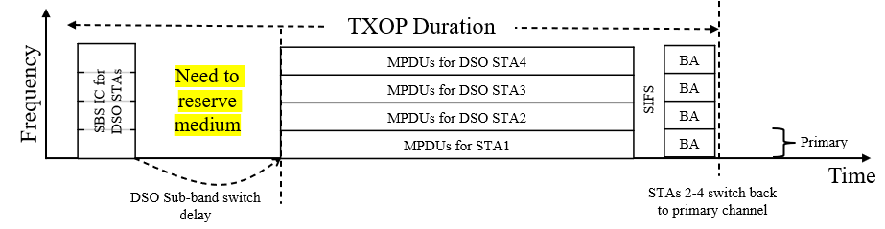
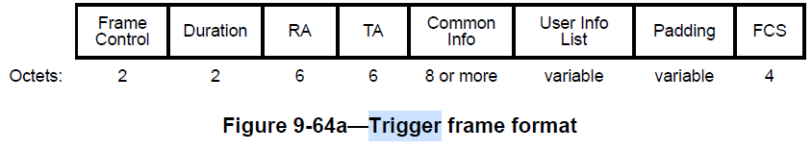

Problem 2: Performing FCS check
At least in some cases, padding may be needed to reserve the medium till the duration of sub-band switch of DSO STAs.
In any control frame, the padding field comes before the Frame Check Sequence (FCS). If a receiving STA performs the switch during the padding, it will not be able to perform FCS-check to detect packet errors.
  If FCS check is ignored, DSO STA may perform switch to a wrong sub-channel.
  Although PHY padding (such as Packet Extension) can be used to reserve medium, they are limited in their maximum duration ($16μ$s).
  Note: This issue is not encountered in EMLSR since it has a weak radio continuously listening to the ICF during link switch.

Slide 8
Proposed solution 2
The medium can be reserved for the sub-band switch delay by transmitting a follow-up frame after the SBS IC frame.
  The follow-up frame can be aggregated in same PPDU or can be in another PPDU.
  The follow-up frame can carry data or control signaling to other STAs.
  The follow-up frame can carry MAC padding if necessary.
  This mechanism doesn’t require any major spec changes.
TXOP Duration
Follow-up frame with necessary padding
MPDUs for DSO STA4
MPDUs for DSO STA3
MPDUs for DSO STA2
MPDUs for STA1
BA
BA
BA
BA
Frequency
SBS IC for DSO STAs
SIFS
Primary
Time
DSO Sub-band switch delay
STAs 2-4 switch back to primary channel

Slide 9
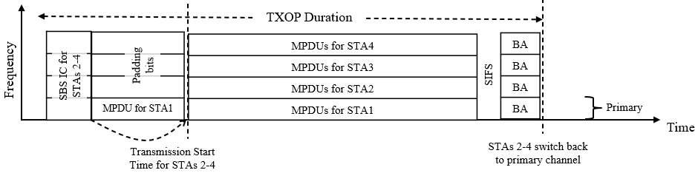
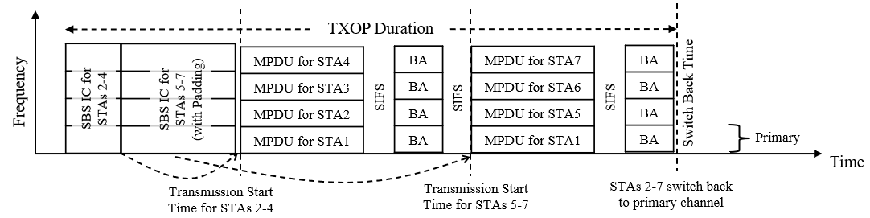
Examples of follow-up frame
It can be a frame containing data to STAs that don’t need sub-band switching in MU-PPDU format. On a sub-band with no recipient STAs, the RUs may not be assigned to any STA, and padding bits can be transmitted.
It can be an SBS IC frame meant for the STAs to be served later within the TXOP/SP. These frames may include the pre-FCS padding (if necessary) for covering the sub-band switch of the first set of indicated STAs.

Slide 10
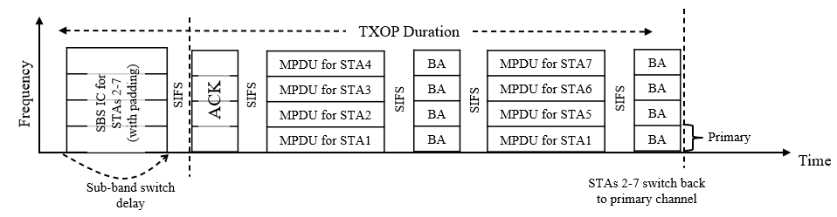
Alternative solutions
All DSO STAs served in a TXOP are provided indication in the same SBS IC frame.
Medium is reserved (for the maximum of the sub-band switching delays) by using a new PHY padding or a new post-FCS padding field. [Needs spec changes]
SBS IC frame solicits an ACK from all the DSO STAs.

Slide 11

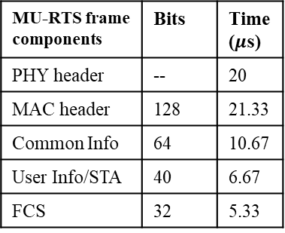
Overhead comparison in an example scenario
Consider AP wins a TXOP of duration 2.5ms with the TXOP bandwidth being 160MHz.
Let us assume the AP intends to serve 6 DSO-capable 80MHz STAs within the TXOP in the secondary 80MHz channel as illustrated below. The primary 80MHz may be used to serve non-DSO devices within the TXOP.
We assume the STAs have Channel Switch Times of $\{0, 16, 128, 32, 64, 32\}μ$s, respectively.
We assume the SBS IC frame is transmitted with a data rate of 6Mbps. We assume the fields of SBS IC can be comparable in size to MU-RTS frame.
MU-RTS frame components | Bits | Time ($μ$s)
PHY header | -- | 20
MAC header | 128 | 21.33
Common Info | 64 | 10.67
User Info/STA | 40 | 6.67
FCS | 32 | 5.33
Secondary 80MHz
Tx to STA1
Tx to STA3
Tx to STA5
Tx to STA2
Tx to STA4
Tx to STA6
Primary 80MHz
Non-DSO STAs
TXOP duration

Slide 12
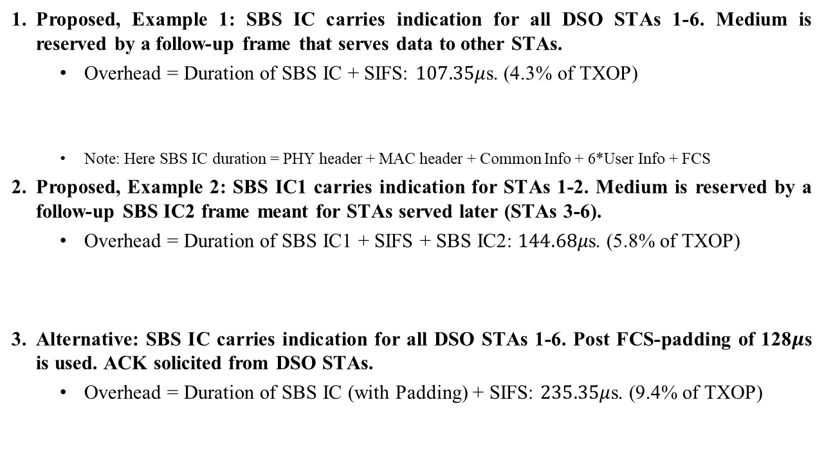
Overhead comparison results
Proposed, Example 1: SBS IC carries indication for all DSO STAs 1-6. Medium is reserved by a follow-up frame that serves data to other STAs.
  Overhead = Duration of SBS IC + SIFS: $107.35μ$s. (4.3% of TXOP)
  Note: Here SBS IC duration = PHY header + MAC header + Common Info + 6*User Info + FCS
Proposed, Example 2: SBS IC1 carries indication for STAs 1-2. Medium is reserved by a follow-up SBS IC2 frame meant for STAs served later (STAs 3-6).
  Overhead = Duration of SBS IC1 + SIFS + SBS IC2: $144.68μ$s. (5.8% of TXOP)
Alternative: SBS IC carries indication for all DSO STAs 1-6. Post FCS-padding of 128$μ$s is used. ACK solicited from DSO STAs.
  Overhead = Duration of SBS IC (with Padding) + SIFS: $235.35μ$s. (9.4% of TXOP)
SBS IC
Data to non-DSO
Data to DSO
SBS IC1
SBS IC2
Data to DSO
SBS IC (padding)
Data to DSO
ACK

Slide 13
Conclusion
Using padding to reserve medium for the time required for DSO sub-band switch can be inefficient.
Using a no-ACK SBS IC obviates the need to wait till the DSO switch is completed (by performing padding).
FCS check is not possible if existing mechanisms for padding are used for reserving the medium during DSO sub-band switch.
A follow-up frame can be used to reserve the medium during the DSO-sub-band switch and can be a more judicious use of the resources.

Slide 14
References
11-22-2204-00-0uhr-dynamic-subband-operation.pptx
11-23-1496-00-0uhr-emlsr-dynamic-subband-operation.pptx

