Slide 1
Principle and Methodology for dRU Tone Plan Design
Date: 2023-11-02
Authors:
Name | Affiliations | Address | Phone | Email
Shengquan Hu | Mediatek | 2840 Junction Ave. San Jose, CA, 95134 |  | Shengquan.hu@mediatek.com
Jianhan Liu |  |  |  | jianhan.liu@mediatek.com
Gary Anwyl
Thomas Pare

Slide 2
Introduction
Distributed tone RU (dRU) has been discussed and proposed as one of the potential UHR PHY features to overcome the strict PSD limitation issues for 6GHz LPI and improve Rate vs Range (RvR) performance
We have shared the high-level views on the dRU in [1] in term of distribution BW, optimal distribution gains, dRU sizes and different dRU operation modes
dRU tone plan is the fundamental for dRU design in 11bn. In this contribution, we will share our thoughts on the general design principles and methodologies for dRU tone plan such as
  dRU design criteria and target
  different dRU design approaches
  Pros & cons analysis and comparisons
  Example illustrations of dRU tone plan
  Preliminary performance simulations such as dRU with channel smoothing, CFO impact & ICI cancellations on dRU, etc
Our studies show that 26-tone RU based dRU design method is the best choice to meet all of the design criteria and targets

Slide 3
Design principles & methodologies of dRU Tone Plan
Minimize the number of tones per 1MHz to achieve the optimal power boost gain.
Preserve dRU hierarchical structure as regular RU (rRU) to allow simple signaling of dRUs
  The key for simplified signaling of dRU is to have a one-to-one mapping between the rRU and the dRU
  Can reuse the existing RU Allocation table
Allow scheduling and distributing different size dRUs without overlapped tones.
Do not introduce new RU sizes to avoid extra different data rates and extra parsing, interleaving and encoding.
Achieve uniform or near-uniform tone distribution pattern for simpler smoothing algorithms, easier phase tracking, ICI cancellation and improved diversity
Reserve enough edge tones (e.g. left-12 & right-11 tone for dRU on BW40/80, left-6 & right-5 for BW20)
Reserve enough DC tones (e.g. >= 5 DC tone for dRU on BW40/80, >=3dB for BW20)
Tones distributed over non-OFDMA tone plan range
dRU subcarrier indices generation with PAPR reduction
Slide 3
Shengquan Hu, Mediatek Inc.

Slide 4
Considerations of dRU Tone Plan Design
Several approaches/design options have been studied for tone distribution over 20/40/80MHz such as
  “Global Dtm” method
  “Tone Group Based” method
  “Perfect Uniformly Distribution” method
  “26-tone RU Based” method
Method | Pros | Cons
Global Dtm method | • Achieve optimal power boost gain • Equation based dRU distribution | • Wrap around issue to cause un-evenly data & pilot tone distributions • Challenging to perform cannel smoothing • Each dRU has different distribution pattern → varying PAPR
Tone Group Based method | • Near-evenly distributed in “grouped tone” fashion • Design friendly for channel smoothing | • Suboptimal power boost gain. Up to 1.25dB gain loss for 4 cases (dRU52/106 on BW20, dRU106/242 on BW40) • Only support 8 dRU26 on BW20, 16 dRU26 on BW40 • Repeating with period of 16 tones will cause PD false detection issues
Perfect Uniformly Distribution method | • Perfect evenly tone distributions for all dRUs on BW20/40/80 • Design friendly for channel smoothing | Same as above
26-tone RU based method meets all the design criteria, achieve optimal power boost gains for all size dRU, preserve hierarchical structure, uniformly/near-uniformly distributed tone patterns make channel smoothing much easier
We will focus on 26-tone RU based method in this contribution, the other methods can be found in the appendix
Slide 4
Shengquan Hu, Mediatek Inc.

Slide 5
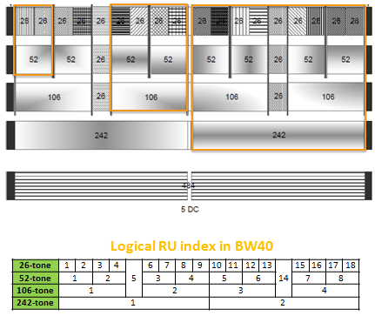
26-tone RU Based dRU Design Method
rRU has the hierarchical structure, i.e. each each larger size RU consists of corresponding smaller size RU tones
For an example, one rRU52 consists of tones from two rRU26s, one rRU106 consists of tones from two rRU52 or four rRU26 with two extra tones
This hierarchical structure makes RU assignment & scheduling much simpler
It would be desired for dRU to maintain the similar hierarchical structure to make dRU implementation more friendly, scheduling easier and signaling simpler
dRU will maintain the similar hierarchical structure as rRU
Slide 5
Shengquan Hu, Mediatek Inc.

Slide 6
26-tone RU Based dRU Design Method
Using dRU26 as a basic building block, all other sized dRUs are built on dRU26 tone plan
  dRU52 is built from two dRU26
  dRU106 is built from four dRU26 or two dRU52 with 2 extra padding tones
  dRU242 is built from nine dRU26 with 8 extra padding tones, or two dRU106 & one dRU26 with 4 padding tones
  dRU484 is built from two dRU242
Not change the number of RUs for each BW, keep the same ordering of RUs
Reuse the existing RU allocation table
The detailed indices will be discussed & filled up later
Example of 26-tone RU Based dRU Tone Plan Structure for BW20
Data and pilot subcarrier indices for distributed tone RUs (dRU) in a 20 MHz UHR TB PPDU for 6GHz LPI
dRU type | dRU index and subcarrier range
26-tone dRU i=1:9 | dRU1 | dRU2 | dRU3 | dRU4 | dRU5
 | dRU6 | dRU7 | dRU8 | dRU9
52-tone dRU i=1:4 | dRU1 26-tone [dRU1, dRU2] |  | dRU2 26-tone [dRU3, dRU4]
 | dRU3 26-tone [dRU6, dRU7] |  | dRU4 26-tone [dRU8, dRU9]
106-tone dRU i=1:2 | dRU1 26-tone [dRU1~4], 2 padding tones |  | dRU2 26-tone [dRU6~9], 2 padding tones
Slide 6
Shengquan Hu, Mediatek Inc.

Slide 7
26-tone RU Based dRU Tone Plan Structure for BW40
The detailed indices will be discussed & filled up later
Data and pilot subcarrier indices for distributed tone RUs (dRU) in a 40 MHz UHR TB PPDU for 6GHz LPI
dRU type | dRU index and subcarrier range
26-tone dRU i=1:18 | dRU1 | dRU2 | dRU3 | dRU4 | dRU5 | dRU6
 | dRU7 | dRU8 | dRU9 | dRU10 | dRU11 | dRU12
 | dRU13 | dRU14 | dRU15 | dRU16 | dRU17 | dRU18
52-tone dRU i=1:8 | dRU1 26-tone [dRU1, dRU2] |  | dRU2 26-tone [dRU3, dRU4] |  | dRU3 26-tone [dRU6, dRU7]
 | dRU4 26-tone [dRU8, dRU9] |  | dRU5 26-tone [dRU10, dRU11] |  | dRU6 26-tone [dRU12, dRU13]
 | dRU7 26-tone [dRU15, dRU16] |  | dRU8 26-tone [dRU17, dRU18]
106-tone dRU i=1:4 | dRU1 26-tone [dRU1~4], 2 extra tones |  | dRU2 26-tone [dRU6~9], 2 extra tones |  | dRU3 26-tone [dRU10~13], 2 extra tones
 | dRU4 26-tone [dRU15~18], 2 extra tones
242-tone dRU i=1:2 | dRU1 106-tone [dRU1~2],26-tone dRU5, 4 extra tones |  | dRU2 106-tone [dRU3~4],26-tone dRU14, 4 extra tones
Slide 7
Shengquan Hu, Mediatek Inc.

Slide 8
26-tone RU Based dRU Tone Plan Structure for BW80
The detailed indices will be discussed & filled up later
Data and pilot subcarrier indices for distributed tone RUs (dRU) in a 80 MHz UHR TB PPDU for 6GHz LPI
52-tone dRU i=1:16 | dRU1 26-tone [dRU1, dRU2] | dRU2 26-tone [dRU3, dRU4] | dRU3 26-tone [dRU6, dRU7] | dRU4 26-tone [dRU8, dRU9]
 | dRU5 26-tone [dRU10, dRU11] | dRU6 26-tone [dRU12, dRU13] | dRU7 26-tone [dRU15, dRU16] | dRU8 26-tone [dRU17, dRU18]
 | dRU9 26-tone [dRU20, dRU21] | dRU10 26-tone [dRU22, dRU23] | dRU11 26-tone [dRU25, dRU26] | dRU12 26-tone [dRU27, dRU28]
 | dRU13 26-tone [dRU29, dRU30] | dRU14 26-tone [dRU31, dRU32] | dRU15 26-tone [dRU34, dRU35] | dRU16 26-tone [dRU36, dRU37]
106-tone dRU i=1:8 | dRU1 52-tone [dRU1~2], 2 extra tones | dRU2 52-tone [dRU3~4], 2 extra tones | dRU3 52-tone [dRU5~6], 2 extra tones | dRU4 52-tone [dRU7~8], 2 extra tones
 | dRU5 52-tone [dRU9~10], 2 extra tones | dRU6 52-tone [dRU11~12], 2 extra tones | dRU7 52-tone [dRU13~14], 2 extra tones | dRU8 52-tone [dRU15~16], 2 extra tones
242-tone dRU i=1:4 | dRU1 106-tone [dRU1~2],26-tone dRU5, 4 extra tones |  | dRU2 106-tone [dRU3~4],26-tone dRU14, 4 extra tones
 | dRU3 106-tone [dRU5~6],26-tone dRU24, 4 extra tones |  | dRU4 106-tone [dRU7~8],26-tone dRU33, 4 extra tones
484-tone dRU i=1:2 | dRU1 242-tone [dRU1~2] |  | dRU2 242-tone [dRU3~4]
NOTE: same as rRU, the 19th dRU26 is left as “Not defined”
Slide 8
Shengquan Hu, Mediatek Inc.

Slide 9
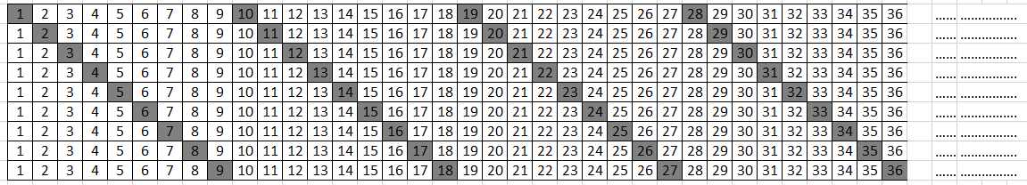
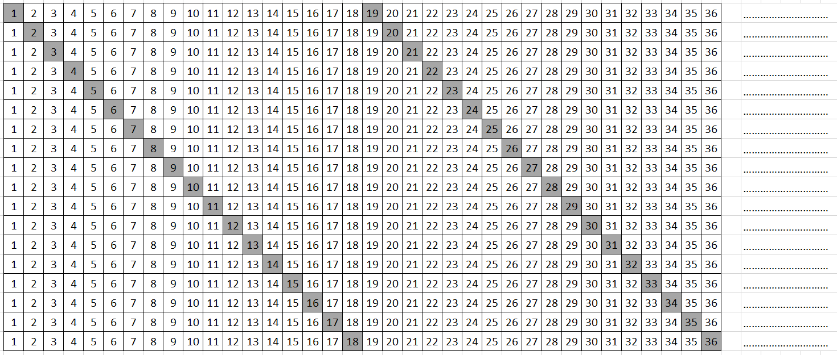
26-tone RU Based dRU Design Method
The key for design 26-tone RU based dRU design method is to generate 26-tone dRU
To achieve the optimal gains and better distribution patterns, the following tone separation distance/or repetition period for dRU26 on different distribution BW can be considered:
  Np = 9 for BW20
  Np = 18 for BW40
  Np = 36 for BW80
Np=9
dRU26 distribution pattern on BW20
Np=18
dRU26 distribution pattern on BW40
Slide 9
Shengquan Hu, Mediatek Inc.

Slide 10
Example Illustration of dRU Distribution Pattern: dRU on BW40
26-tone dRUs are perfect uniformly distributed over 40MHz
52-tone dRUs are perfect uniformly distributed over 40MHz
Slide 10
Shengquan Hu, Mediatek Inc.

Slide 11
Example Illustration of dRU Distribution Pattern: dRU on BW40
106-tone dRUs are near-uniformly distributed over 40MHz
Slide 11
Shengquan Hu, Mediatek Inc.

Slide 12
dRU With vs Without Channel Smoothing
dRU with evenly or near-evenly distributed patterns make channel smoothing & optimization much easier
Our studies show that channel smoothing can provide more than 2dB smoothing gain beyond the power boost gain
The following table shows the performance comparison of channel estimation with vs without smoothing:
dRU26 and dRU52 on BW40
D-NLOS, 1T2R, MCS1
LSCE: Least-Squared Channel Estimation without channel smoothing
SMCE: Channel estimation with smoothing
Logical RU26 index | LSCE | SMCE | Delta (dB) (LSCE-SMCE)
1 | 6.85 | 5.52 | 1.33
2 | 6.95 | 5.56 | 1.39
3 | 6.89 | 5.61 | 1.28
4 | 6.94 | 5.64 | 1.3
5
6 | 6.93 | 5.62 | 1.31
7 | 6.87 | 5.69 | 1.18
8 | 6.82 | 5.58 | 1.24
9 | 6.86 | 5.62 | 1.24
10 | 6.81 | 5.52 | 1.29
11 | 6.84 | 5.49 | 1.35
12 | 6.94 | 5.54 | 1.4
 |  | average(dB) | 1.3
Logical RU52 index | LSCE | SMCE | Delta (dB) (LSCE-SMCE)
1 | 6.59 | 4.46 | 2.13
2 | 6.59 | 4.43 | 2.16
3 | 6.68 | 4.55 | 2.13
4 | 6.67 | 4.50 | 2.17
5 | 6.59 | 4.46 | 2.13
6 | 6.66 | 4.49 | 2.17
7 | 6.73 | 4.48 | 2.25
8 | 6.62 | 4.48 | 2.14
 |  | Average (dB) | 2.16
The numbers in these two column are the sensitivity SNR (dB) @10% PER
Slide 12
Shengquan Hu, Mediatek Inc.

Slide 13
Impact of CFO on dRU
Impact of CFO becomes concerns for dRU due to the ICI introduced from neighbor users’ tones
Our studies show that
  Less impact for low to medium MCS (e.g. MCS0~7) even for up to 1KHz CFO (assume after pre-correction for UL TB OFDMA)
  Higher MCS (>=9) become more sensitive to CFO>500Hz
  Simple ICI cancellation can improve the performance for medium to higher MCS (e.g. >= MCS7) with larger CFO
  Better dRU tone distribution pattern makes ICI canceller implementation simpler
The following table shows sensitivity requirements of MCS-4/7/9/11 @10% PER when UL TB OFDMA transmission using dRU with different CFO
  4 UL TB users, each with dRU242 on BW80
  D-NLOS, LDPC, channel estimation with smoothing
  1T2R, assume ideal FOE for ICI
 | No ICI Cancellation - Required SNR (dB)
 | FOE Error (Hz) |  |  |  |  |  | Delta vs 0 Hz
MCS | 0 | 175 | 350 | 500 | 1k | 3k | 175 | 350 | 500 | 1k | 3k
4 | 9.5 | 9.5 | 9.5 | 9.5 | 9.6 | 10.0 | 0.0 | 0.1 | 0.1 | 0.1 | 0.5
7 | 16.9 | 16.9 | 16.9 | 16.9 | 17.2 | 20.5 | 0.0 | 0.0 | 0.0 | 0.3 | 3.6
9 | 22.3 | 22.4 | 22.6 | 22.7 | 23.4 | Inf | 0.1 | 0.2 | 0.4 | 1.1 | #VALUE!
11 | 28.1 | 28.2 | 28.6 | 29.0 | 38.9 | Inf | 0.0 | 0.5 | 0.8 | 10.8 | #VALUE!
 | With simple ICI Cancellation - Required SNR (dB)
 | FOE Error (Hz) |  |  |  |  |  | Delta vs 0 Hz
MCS | 0 | 175 | 350 | 500 | 1k | 3k | 175 | 350 | 500 | 1k | 3k
4 | 9.5 | 9.5 | 9.6 | 9.5 | 9.5 | 9.8 | 0.1 | 0.1 | 0.1 | 0.1 | 0.3
7 | 16.9 | 16.9 | 16.9 | 16.9 | 17.1 | 18.3 | 0.0 | 0.1 | 0.0 | 0.2 | 1.4
9 | 22.3 | 22.6 | 22.7 | 22.7 | 23.1 | Inf | 0.3 | 0.4 | 0.4 | 0.8 | #VALUE!
11 | 28.1 | 28.2 | 28.4 | 28.8 | 31.0 | Inf | 0.0 | 0.3 | 0.6 | 2.9 | #VALUE!
dRU still benefits from the power boost gains even though with some ICI loss (e.g. 5.1dB power gain vs 1.4dB ICI loss after cancellation for this example)
Slide 13
Shengquan Hu, Mediatek Inc.

Slide 14
Summary
We share our thoughts on dRU tone plan design which includes
  dRU design criteria, methodology and design target
  Several different approaches for dRU tone plan design
Our studies show that 26-tone RU based dRU tone plan would be the best choice
  Meets all the design target and achieve optimal power boost gain
  Preserve hierarchical structure as rRU
  Better tone distribution pattern with either uniformly or near-uniformly distributed
  Easier for channel smoothing and simpler for scheduling/signaling

Slide 15
Straw Poll #1
Do you support that dRUs tone plan design scheme for 11bn is 26-tone RU based dRU method (using 26-tone dRUs as basic building blocks)?
Slide 15
Shengquan Hu, Mediatek Inc.

Slide 16
Reference
  [1]. 11-23-2020-00-00bn-high-level-perspective-on-distributed-tone-ru-for-11bn
Slide 16
Shengquan Hu, Mediatek Inc.

Slide 17
Appendix
Slide 17
Shengquan Hu, Mediatek Inc.

Slide 18



Option-1: Global Dtm Method
  Global Dtm like tone mapping over entire distribution BW
  Simple equation based dRU tone generation
  Parameter Dtd depends on dRU size
Resulted Distributed RU tones
DTM
DTD
Local Tone Mapper on Small-size RUs
Large-Size Distributed Tone Distributor
may be by-passed
RU 2
52-tone RU
RU 1
26-tone RU
Parameter Dtd determines the distance between dRU tones and dRU tone distribution pattern. Dtd can be any integer number but should be chosen to achieve optimal power boost gains. E.g. Dtd could be 8/9/or 13 for dRU on BW20 or 13/16 etc for dRU on BW40/80 etc
$$N_{st}=242, 484, 996 for distribution BW20MHz, 40MHz, 80MHz$$
Slide 18
Shengquan Hu, Mediatek Inc.

Slide 19
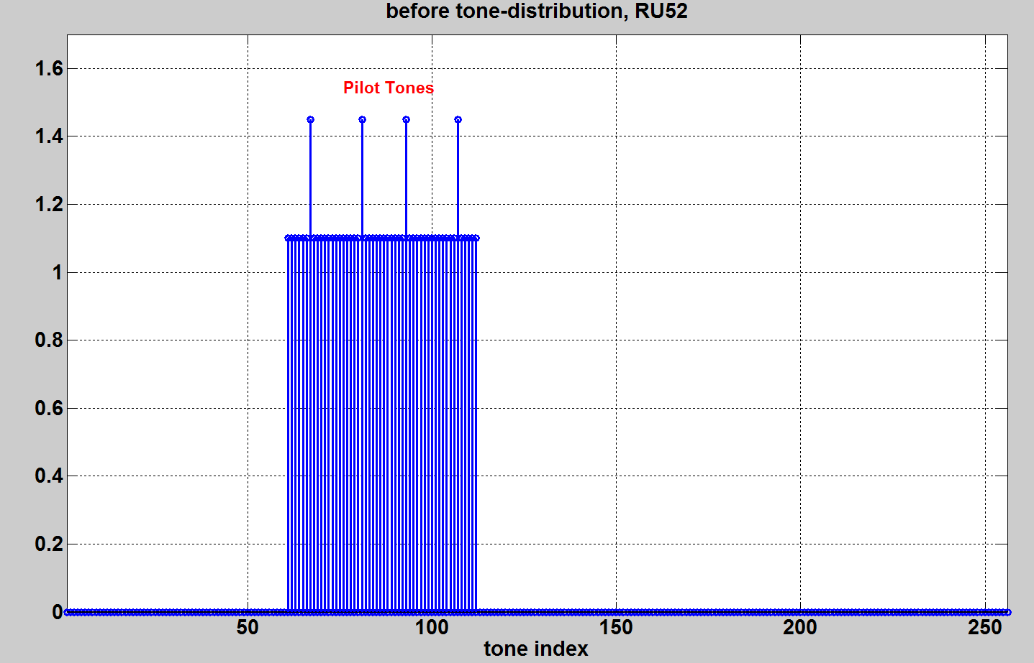
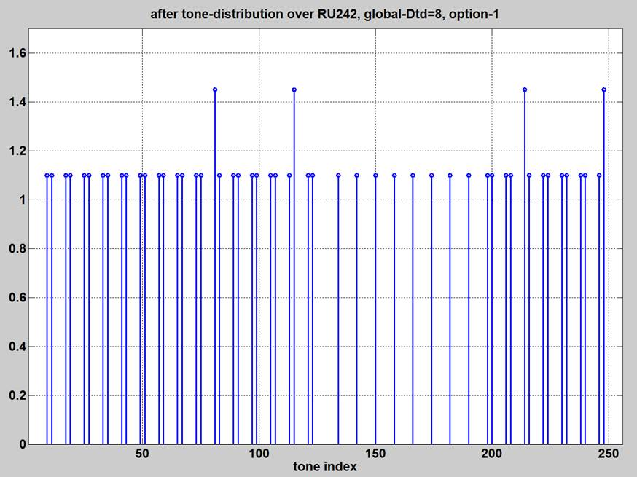
Option-1: Global Dtm Method
Pros:
  Achieve optimal power boost gain
  Simple equation based dRU distribution
Cons:
  Wrap around issue to cause un-evenly data & pilot tone distributions
  Challenging to perform cannel smoothing
  Each dRU has different distribution pattern → varying PAPR
rRU52
dRU52
Slide 19
Shengquan Hu, Mediatek Inc.

Slide 20

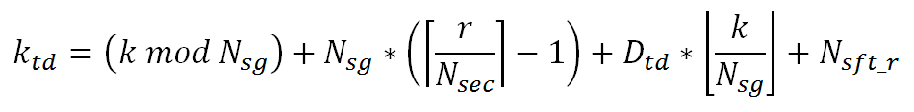
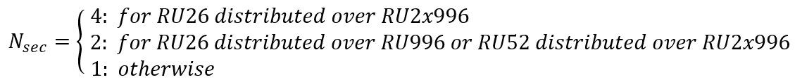
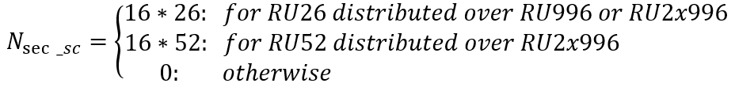

Option-2: Tone-Group Based Method
“Grouped-tones” as one virtual tone distributed over entire BW
Equation based dRU distribution with parameters of Dtd and Nsg (# of tones in a group)
DTM
Grouped-tone Global Dtd
Local Tone Mapper on Small-size RUs
Large-Size Distributed Tone Distributor
Distribution BW20
RU 2
52-tone RU
RU 1
26-tone RU
Dtd
20MHz | 40MHz | 80MHz
8 | 16 | 16
 | Nsg
 | 20MHz | 40MHz | 80MHz
RU26 | 1 | 1 | 1
RU52 | 2 | 2 | 1
RU106 | 4 | 4 | 2
RU242 | na | 8 | 4
Slide 20
Shengquan Hu, Mediatek Inc.

Slide 21
Option-2: Tone-Group Based Method
Pros:
  Near-evenly distributed in “grouped tone” fashion
  Design friendly for channel smoothing
Cons:
  Suboptimal power boost gain. Up to 1.25dB gain loss for 4 cases (dRU52/106 on BW20, dRU106/242 on BW40)
  Only support 8 dRU26 on BW20, 16 dRU26 on BW40
  Repeating with period of 16 tones will cause PD false detection issues
26-tone | 1 | 2 | 3 | 4 | 5 | 6 | 7 | 8 | 9 | 10 | 11 | 12 | 13 | 14 | 15 | 16
52-tone | 1 |  | 2 |  | 3 |  | 4 |  | 5 |  | 6 |  | 7 |  | 8
106-tone | 1 |  |  |  | 2 |  |  |  | 3 |  |  |  | 4
242-tone | 1 |  |  |  |  |  |  |  | 2
“4-tones grouped” for dRU106 on BW20
Nsg=4
dRU over BW20
Dtd=16
dRU over BW40
dRU over BW80
Slide 21
Shengquan Hu, Mediatek Inc.

Slide 22
Option-3: Perfect Uniformly Distribution Method
Option-3 can be considered as the simplified or optimized version of Option-2
Instead of the distribution in “grouped-tone” way, Option-3 achieves perfect uniformly tone distribution pattern
Option-3 also preserves the hierarchical structure as rRU
Example of distribution pattern for dRU52 on BW20
r=1
r=3
r=2
r=4
Slide 22
Shengquan Hu, Mediatek Inc.

Slide 23
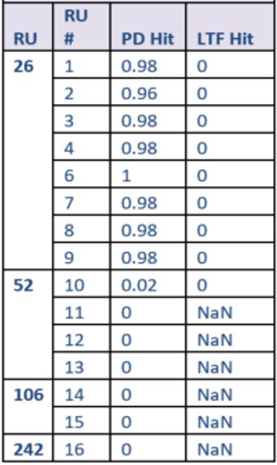
Option-3: Perfect Uniformly Distribution Method
Pros:
  Perfect evenly tone distributions for all dRUs on BW20/40/80
  Design friendly for channel smoothing
Cons:
  Suboptimal power boost gain. Up to 1.25dB gain loss for 3 cases (dRU52/106 on BW20, dRU106 on BW40)
  Only support 8 dRU26 on BW20, 16 dRU26 on BW40. No center dRU26
  Same issue as Option-2, repeating with period of 16 tones will cause PD false detection issues for dRU26 on BW40 & dRU52 on BW80
BW40 dRU26 transmission causes false PD hit
Slide 23
Shengquan Hu, Mediatek Inc.

