Slide 1
Non-collocated AP MLD framework further discussion

Slide 2
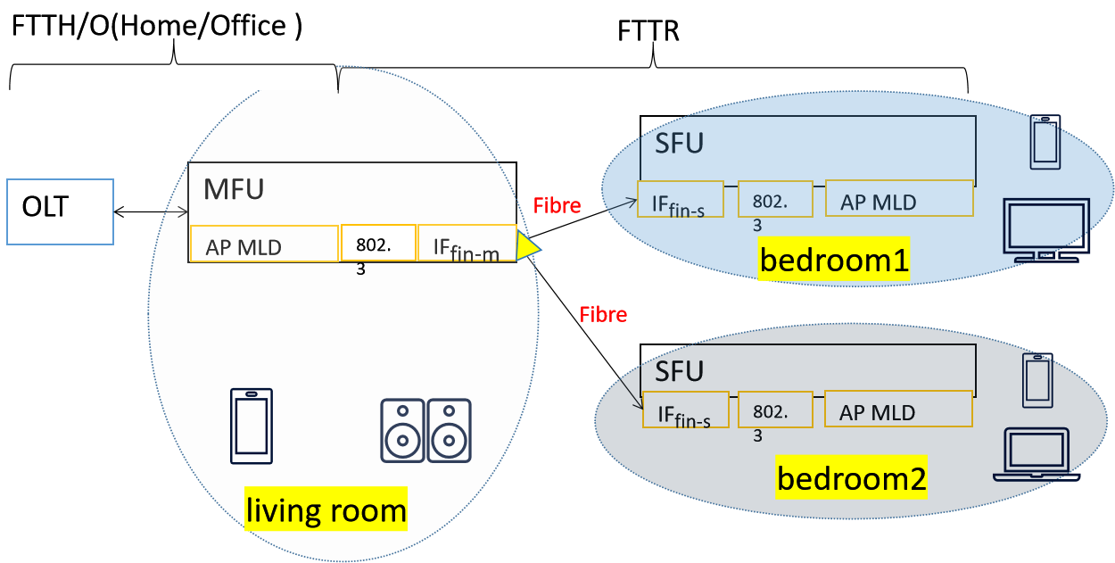
Background
FTTR/G.fin(Fibre-to-the room/Fibre based in-premises networking) products widely deployed in residential environment to improve user’s experience.
  It provides low latency and high reliability via fibre backhaul connection
  It’s composed by one MFU and several SFUs deployed in different places
  Each MFU and SFU has one AP MLD that provides wireless connection

Slide 3
Problems on 11be AP MLD
High cost concern in residential market
  In order to provide extremely throughput for high-end non-AP MLDs, each AP MLD need to integrate 3 radios operating on 2.4GHz,5GHz and 6GHz.
  IMMW development is on-going, each AP MLD may integrate 4 radios(...,60GHz) in the future, the cost of AP /FTTR products will be significantly increased.
Overhead issue for in-door location
  Besides the frame exchange with the associated AP MLD, non-AP MLD may set up extra sessions with different AP MLDs for location, and additional frame exchange required during FTM session set-up procedure
Overhead issue for Wi-Fi sensing
  LOS path will provide more accuracy sensing data than NLOS path, non-AP MLD may set up extra Wi-Fi sensing with other AP MLDs to obtain LOS path if the target object moves aside from current LOS path between non-AP MLD and the associated AP MLD.

Slide 4
Motivation
We’re looking forwards to the next generation of FTTR product that support Wi-Fi communication and sensing integration.
  Higher manageability of the whole network
  Seamless roaming for mobility device
  Seamless Wi-Fi sensing to improve accuracy
  Multiple links for in-door location
  Simplify the design of AP MLD and reduce Wi-Fi chip set cost
  Try to reuse current EHT AP MLD framework as much as possible
  Non-collocated AP MLD is the best candidate framework with the following merits

Slide 5
The merit of non-collocated AP MLD(1)
Simplify the design of AP MLD
    3 radios on one 11be chipset is already complicated, we don’t look for more radios integrated into one chipset to serve the high-ends non-AP MLD(e.g., EMLSR non-AP MLD may support more than 3 links)
    New AP MLD framework allow AP vendor to deploy multiple dual-radio AP MLDs in different places to provide a batch of links, to meet all kinds of high-ends non-AP MLD and IOT device requirements .
Seamless roaming
  Allow non-AP MLD to set up any links at any place for the seamless traffic delivery during movement
Multi-link for Wi-Fi location and seamless Wi-Fi sensing
  Possible to have multi-session for the location and Wi-Fi sensing under MLO framework

Slide 6
The merit of non-collocated AP MLD(2)
Compatible with other M-AP schemes:
  Compatible with C-OFDMA,C-SR,C-TDMA,C-TWT scheme etc. if more than two links operating on the same channel.
  No fairness issue, UHR AP MLD High MAC coordinates the media resource access
  Less overhead issue on the MAP coordination signaling, MAP coordination signaling can be delivered with wired backhaul,like Fibre backhaul in FTTR product.
Compatible with all kinds of 11be non-AP MLD and single link STA operation
  Compatible with single link STA
  Compatible with 11be STR non-AP MLD
  Compatible with 11be NSTR/EMLSR/EMLMR non-AP MLD on the non-real-time operation

Slide 7





One example between UHR non-AP MLD and non-collocated AP MLD
UHR AP MLD high MAC
backhaul
(MFU)EHT AP MLD1
AP1.1
2.4 GHz
AP1.2
6 GHz
backhaul
UHR AP MLD
(SFU)EHT AP MLD2
AP2.1
5 GHz
AP2.2
6 GHz
(SFU)EHT AP MLD3
AP3.1
5 GHz
AP3.2
6 GHz
L2
L1
L3

Slide 8
The extension in discovery procedure
UHR AP MLD assigns a unique MLD index for each EHT AP MLD
EHT AP MLD assigns the link ID for the affiliated AP as it does in 11be
UHR non-AP MLD can distinguish all the links via UHR link ID= <MLD index, link ID>
One flag should be set in the RNR to indicate whether two reported APs within different EHT AP MLDs belongs to the same UHR AP MLD or not.
All APs broadcast the same UHR AP MLD MAC address in ML element

Slide 9
One example of non-collocated AP MLD discovery
UHR AP MLD high MAC
backhaul
EHT AP MLD1(MLD index=0)
AP1.1
2.4 GHz
AP1.2
6 GHz
backhaul
UHR AP MLD
link ID=0
link ID=1
EHT AP MLD2(MLD index=1)
AP2.1
5 GHz
AP2.2
6 GHz
EHT AP MLD3(MLD index=2)
AP3.1
5 GHz
AP3.2
6 GHz
link ID=0
link ID=1
link ID=0
link ID=1
UHR link ID =(1,0)

Slide 10
The extension in MLO setup procedure
UHR non-AP MLD may set up multi-link with different EHT AP MLDs belonging to the same UHR AP MLD
  (Re)association request may carry multiple ML elements
Authentication, association, 4HS frames are transparently delivered over EHT AP MLD
  Authentication, association, 4HS shall be exchanged between UHR non-AP MLD and UHR AP MLD high MAC
  One signaling in authentication frame sent by non-AP MLD to indicate it’s a UHR non-AP MLD or EHT non-AP MLD, so that the EHT AP MLD can decide to handle it locally or forward to UHR AP MLD high MAC

Slide 11
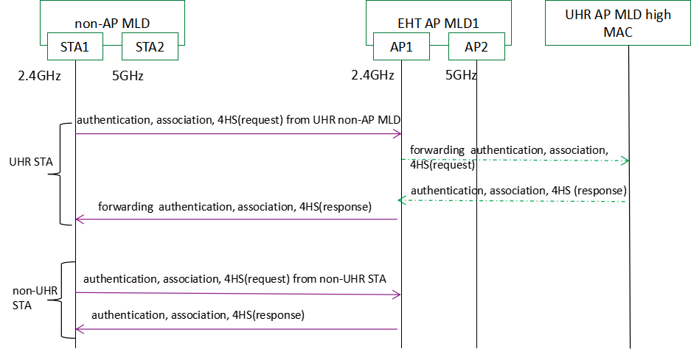
One example of setting-up procedure in non-collocated AP MLD

Slide 12
AID assignment in non-collocated AP MLD framework
There will be some challenge for 12-bit AID field in larger scale non-collocated AP MLD network
  Thousands of STAs may associate with the same non-collocated AP MLD in larger scale network
  But only allow maximum 2K STAs association at the same time according to current length of AID field
AID field needs some extension and is also compatible with legacy STA/non-AP MLD
  UHR AID =<MLD index, AID>
  UHR AP MLD high MAC assigns and recycles MLD index of each EHT AP MLD.
  Multiple EHT AP MLDs coordinate to assign a common AID to the set-up link of UHR non-AP MLD
  Non-AP MLD has the same AID on different set-up links

Slide 13
One example of the AID assignment by non-collocated AP MLD
UHR AP MLD high MAC
backhaul
EHT AP MLD1(MLD index=0)
AP1.1
2.4 GHz
AP1.2
6 GHz
backhaul
UHR AP MLD
link ID=0
link ID=1
EHT AP MLD2(MLD index=1)
AP2.1
5 GHz
AP2.2
6 GHz
EHT AP MLD3(MLD index=2)
AP3.1
5 GHz
AP3.2
6 GHz
link ID=0
link ID=1
link ID=0
link ID=1
AID=100
AID=100
UHR AID=<1,100> or <2,100>
UHR STA

Slide 14
PPDU delivery with NSTR/EMLSR/EMLMR non-AP MLD
Due to the latency in the backhaul, run-time coordination will encounter some challenge.
  Start time/end time alignment is hard to support for NSTR non-AP MLD
  Another aspect, less commercial AP MLD support ending time alignment
  Therefore, non-collocated AP MLD frame may not support ending time alignment
  Non-run time coordination in the backhaul make it possible for the non-overlap PPDU delivery on single link
  Two EHT AP MLDs coordinate a non-overlap time slot for PPDU delivery on single link when STA operates in NSTR/EMLSR/EMLMR mode
  Also,support UL traffic delivery on more than 1 link when the STA operates in NSTR mode as it is in 11be.
  TSF synchronization among different EHT AP MLDs in UHR AP MLD?
  No requirement.

Slide 15
One example of the PPDU delivery between NSTR/EMLSR/EMLMR non-AP MLD and non-collocated AP MLD
T1
T3
time slot negotiation on backhaul
UHR
non-AP MLD
STA1
UHR
AP MLD
T2
AP1(EHT AP MLD1)
STA2
AP2(EHT AP MLD2)
Fig.1 single link PPDU delivery between NSTR/EMLSR/EMLMR non-AP MLD and non-collocated AP MLD
T1
UHR
non-AP MLD
STA1
UHR
AP MLD
AP1(EHT AP MLD1)
T1
STA2
AP2(EHT AP MLD2)
Fig.2 multi-link UL traffic delivery between NSTR non-AP MLD and non-collocated AP MLD

Slide 16
Summary
Introduce the current FTTR product framework and next generation of FTTR development direction
Describe the motivation of non-collocated AP MLD framework
Introduce a simple approach to have non-collocated AP MLD framework based on EHT AP MLD framework
The extension for non-collocated AP MLD in discovery, association, AID assignment and PPDU delivery procedure

Slide 17
THANK YOU ☺

Slide 18
reference
[1] 11-23-0480-00-0uhr-uhr-proposed-par.pdf
[2] 11-22-1910-03-0uhr-seamless-roaming-for-uhr.pptx
[3] 11-22-1512-00-0uhr-multi-ap-coordination-for-uhr.pptx
[4] ITU-T G.9940(G.fin-SA) High speed fibre-based in-premises transceivers – system architecture

Slide 19
SP1
Do you agree 11bn group should define a non-collocated AP MLD framework?
  Y:
  N:
  A:

