Slide 1
Enhanced Security for Control frame in 11bn
Date: 2023-11-12
Authors:
Name | Affiliation | Address | Phone | Email
SunHee Baek | LG Electronics | 19, Yangjae-daero 11gil, Seocho-gu, Seoul 137-130, Korea |  | sunhee.baek@lge.com
Insun Jang |  |  |  | insun.jang@lge.com
Jinsoo Choi
 |  |  |  | js.choi@lge.com
Yelin Yoon |  |  |  | yl.yoon@lge.com
Geonhwan Kim |  |  |  | geonhwan.kim@lge.com
Dongju Cha |  |  |  | dongju.cha@lge.com
Eunsung Park |  |  |  | esung.park@lge.com
Dongguk Lim |  |  |  | dongguk.lim@lge.com
Jinyoung Chun |  |  |  | jiny.chun@lge.com
Insik Jung |  |  |  | insik0618.jung@lge.com
HanGyu Cho |  |  |  | hg.cho@lge.com
Sanggook Kim |  | 10225 Willow Creek Rd, San Diego, CA, USA |  | sanggook.kim@lge.com

Slide 2
Introduction
Current security definition is applied only to the data frame and management frame. So, the control frame doesn’t support security method by setting reserved on the Protected Frame subfield in the Frame Control field.
  However, the particular types of control frame, Trigger frame and (Multi-)BlockAck, are needed to support security protocol, [1] ~ [3], because of the importance of contained information.
Control frames are vulnerable to a number of different attacks.
  STA must wake up and can waste its power/medium because of the Trigger frame transmitted by an attacker [1].
  If the control frame is sent by an attacker, QoS Data delivery status and BA scoreboards are misaligned between STAs [2][3].
  In the case of Trigger frame, the RU assignment can be interrupted by an attacker. As the result, the data transmission between STAs will not be done properly.
In this contribution, we suggest enhanced security methods for control frame in 11bn.

Slide 3
Background
In the current baseline, RSNA security protocol has following types;
  Only Integrity Check method (e.g., BIP)
  Encryption/Decryption method (e.g., CCMP, GCMP)
The Integrity Check method(BIP) is used for management frame including Beacon frame through IGTK or BIGTK.
  In the result of BIP, values of Key ID, IPN/BIPN, and MIC within MME(Management MIC element) are included at the end of management frame body without encryption/decryption.
The Encryption/Decryption method(CCMP/GCMP) is used for data frame through PTK or GTK.
  In the result of CCMP/GCMP, values of Key ID and PN are located within CCMP/GCMP header and the value of MIC is located before FCS.
There are two possible methods to protect the control frame based on the current security methods of the baseline.

Slide 4
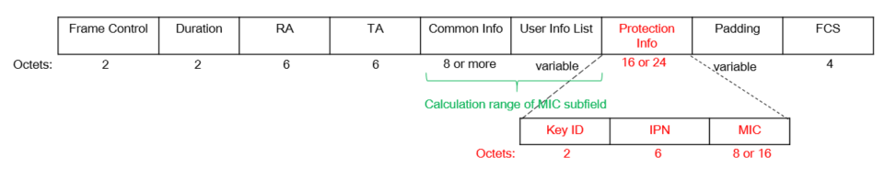
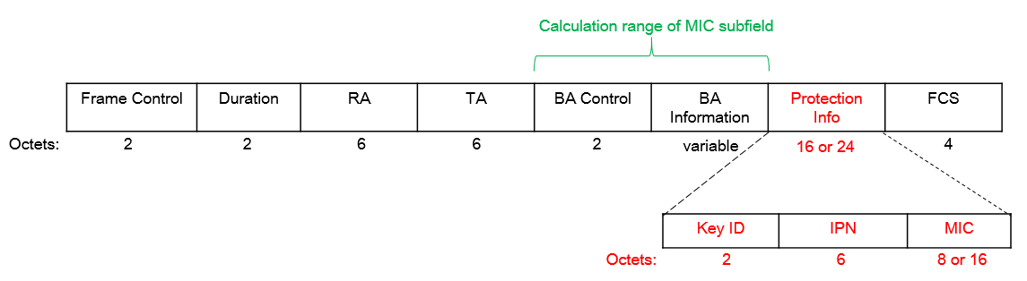
Integrity Check for Control frame
The Integrity Check method can detect attacks such as data value changes from a 3rd STA. When applying the Integrity Check method, the ways of constructing the control frame can be differed depending on the individually or group addressed RA.
  About individually addressed Control frame only for UHR STAs
    The UHR STA will receive a Control frame applied to the integrity check method(BIP), so check the integrity of the Control frame through (new) PTK.
      Maybe the length of Protection Info field, Key ID subfield, IPN(/BIPN) subfield, and MIC subfield can be changed.
    But, current BIP doesn’t support to use PTK to check the integrity of the transmitted/received frame. In 11bn, the definition of BIP can be extended to use PTK, or encryption/decryption methods can be used for individually addressed Control frame.
For example, the Trigger frame for UHR STA can include information for integrity check(e.g., Key ID, IPN, MIC) as a new field before padding field, and the MIC value can be calculated based on the Common Info field and/or User Info List field.
For example, the BlockAck frame for UHR STA can include information for integrity check(e.g., Key ID, IPN, MIC) as a new field before padding field, and the MIC value can be calculated based on the BA Control field and/or BA Information field.

Slide 5
Integrity Check for Control frame
About group addressed Control frame,
When a STA receives the group addressed Control frame applied to the Integrity Check method(BIP), there are two possible cases depending on how to consist of the control frame, whether received STAs are either only UHR STAs(Case 1) or pre-UHR STA and UHR STA(Case 2).
  ⇨ [Case 1] When only UHR STAs receive the control frame,
    The information for integrity check(e.g., Key ID, IPN, MIC) can be located as a new field in the control frame. For calculate the value of MIC, Key ID will be set (new) GTK for the group addressed Control frame.
      The format of Case 1’s Control frame can be same with the format of individually addressed Control frame in the previous slide.
  ⇨ [Case 2] When pre-UHR STAs and UHR STAs receive the control frame,
    All recipient STAs including pre-UHR STAs and UHR STAs must decode the frame body of the received control frame where the information for integrity check is located.
    In one way, the information for integrity check can be included in the User Info List field in the Trigger frame/BA Information field in the BlockAck frame for following the existing baseline.
      For example, the Special User Info subfield of Trigger frame defined in 11be(EHT) can be one of options to include the information for integrity check with a particular AID.
      For example, the AID TID Info subfield of Multi-STA BlockAck frame can be one of options to include the information for integrity check with a particular AID.

Slide 6
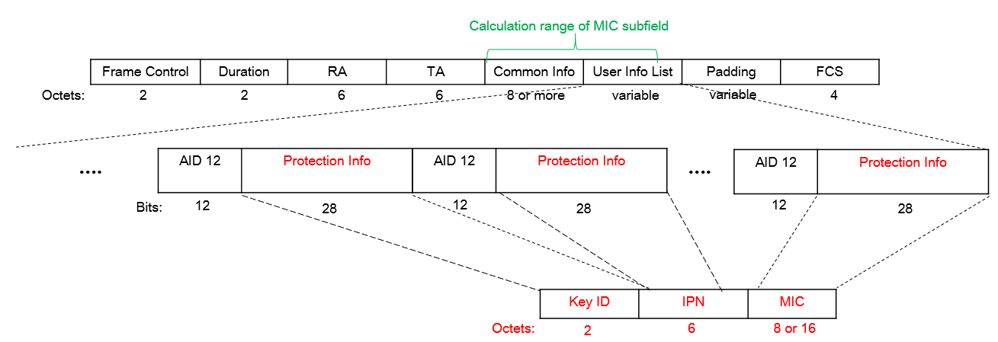
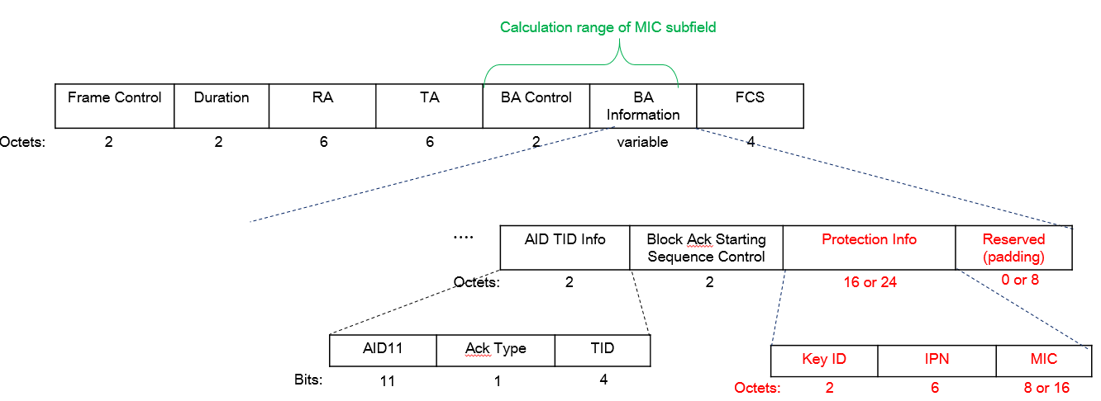
Integrity Check for Control frame
        * Maybe the length of Protection Info subfield, Key ID subfield, IPN(/BIPN) subfield, and MIC subfield can be changed.
The particular AID indicates only to UHR STA that the Special User Info subfield includes the information for integrity check. Pre-UHR STA will ignore the Special User Info subfields containing the Protection info subfield.
The particular AID indicates only to UHR STA that the Per AID TID Info subfield includes the information for integrity check. Pre-UHR STA will ignore the Per AID TID Info subfields containing the Protection info subfield.

Slide 7
Integrity Check mode indication for Control frame
About group addressed Control frame, two types of format for control frame are possible depending on combination of recipient STAs.
  The format for pre-UHR STA and UHR STA(Case 2) can support that pre-UHR STAs can receive its frame body from the Trigger frame or BlockAck frame without decoding error as well as UHR STAs.
  But when only UHR STAs receive it(Case 1), the format for pre-UHR STA and UHR STA(Case 2) can be unnecessary to use AID 12(11) subfield and divide the information for integrity check into different User Info fields of Trigger frame or BA Information fields of BlockAck frame.
  So, the two types of format for control frame are needed to guarantee that UHR STAs check the integrity of the received control frame under any circumstances.
If the format of control frame is different depending recipient STA(s), an indication needs which type of format for control frame is used.
  The mode indication distinguishes where the information for integrity check is included in the transmitted/received control frame.
    For example, whether the information is located after the User Info List field and before Padding field, or the information is located within the User Info List field in the Trigger frame.
    For example, whether the information is located after the BA Information field and before FCS field, or the information is located within the BA Information field in the BlockAck frame.
  The reserved bit in Common Info field of Trigger frame or BA Control field of BlockAck frame can be used to indicate the location of the information in the control frame and set by transmitter STA.

Slide 8
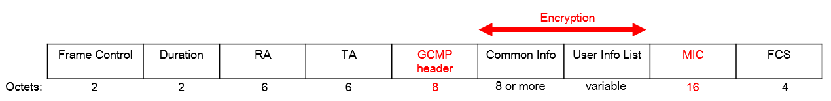
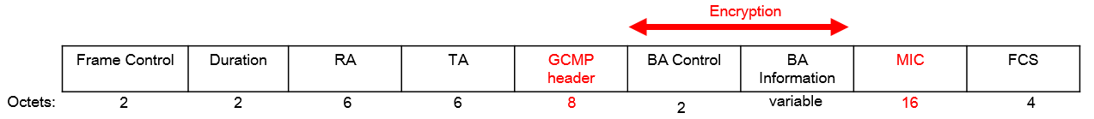
Encryption/Decryption for Control frame
Encryption/Decryption method is a method of shielding and protecting messages.
  If the control frame encrypts the frame body of the control frame, the Protected Frame subfield in Frame Control field will be set to 1.
    The STA supporting encryption/decryption(e.g., CCMP/GCMP) on control frame should announce its capabilities during an association.
  For example, if the Trigger frame and BlockAck frame are applied to GCMP, the frame body will be encrypted.
    In the case of the individually addressed RA, the encryption/decryption is performed based on (new) PTK with recipient STA. And in the case of the group addressed RA, the encryption/decryption is performed based on (new) GTK with recipient STAs.
      The keys(PTK and GTK) can be for encryption/decryption method of control frame(e.g., Trigger frame & BlockAck frame).

Slide 9
Encryption/Decryption for Control frame
Encryption/Decryption method is the most powerful protection method than the integrity check method of the baseline.
  Encryption/Decryption method can prevent from attacks to change/damage data values from a 3rd STA.
    If STA can decrypt the cipher message based on the value of the Key ID subfield in the CCMP/GCMP header, it can access/decode the plain message and check the integrity of the received frame based on PN and MIC.
    If a STA doesn’t recognize the key info based on the value of the Key ID subfield, the STA cannot access/decode the cipher message.
      So, the 3rd STA doesn’t have an opportunity to change/damage the cipher message at all.
  This method applies only to (beyond-)UHR STA supporting encryption/decryption for the control frame.
    If pre-UHR STAs receive the encrypted control frame, they cannot decode the frame body of the control frame.
      Also, unassociated STAs cannot decode the encrypted control frame.
Encryption/Decryption method can guarantee the confidentiality and integrity of the control frame between UHR STAs.

Slide 10
Further Issues
There are several topics to address to support the frames designed in this contribution.
  How to announce whether the control frame supports to apply a security method(s).
  Which cipher suites for the control frame are used.
  Which keys for the control frame are used depending on individually and group addressed Control frame.
  How to set/define the information related to check integrity/confidentiality of the control frame.
It is necessary to review whether protection is required for which types/variants of each of control frames.
  E.g, Trigger frame(Basic, etc), BlockAck frame(compressed/Multi-STA), etc.

Slide 11
Conclusion
In this contribution, we propose several protection methods for the control frame (e.g., Trigger frame & BlockAck frame).
    Only Integrity Check based on BIP,
      Individually addressed RA
      group addressed RA
    Encryption/Decryption based on CCMP/GCMP
To support that legacy STAs can receive/decode the control frame applied to the security mechanism, the integrity check method for the control frame is preferred.

Slide 12
Straw Poll 1
Do you support to define Trigger frame protection in 802.11bn?
  The detailed method is TBD.

Slide 13
Straw Poll 2
Do you support to define BlockAck frame protection in 802.11bn?
  The detailed method is TBD.
  The applied variant is TBD.

Slide 14
Straw Poll 3
Do you support to define BlockAckReq frame protection in 802.11bn?
  The detailed method is TBD.
  The applied variant is TBD.

Slide 15
Straw Poll 4
Do you agree to use Broadcast Integrity Protocol (BIP) for checking the integrity of the Trigger frame, BlockAck frame, and BlockAckReq frame?
  The detailed method is TBD.
  The applied variant of BA frame and BAR frame is TBD.
Notes:
BIP(Broadcast Integrity Protocol)

Slide 16
Straw Poll 5
Do you agree to define mechanism that a Trigger frame transmitted by an UHR AP carries the information for checking the integrity of the Trigger frame?
  The information is derived from BIP.
  The detailed information is TBD.

Slide 17
Straw Poll 6
Do you agree that when an UHR AP intends to transmit a Trigger frame for one or more UHR STA(s) as receivers to check the integrity of the Trigger frame, the Trigger frame carries the Key ID, PN, and MIC?
  NOTE: Receivers of Trigger frame can include pre-UHR STA(s).

Slide 18
Straw Poll 7
Do you agree to define mechanism that a BlockAck frame transmitted by an UHR STA carries the information for checking the integrity of the BlockAck frame?
  The information is derived from BIP
  The detailed information is TBD.
  The applied variant of BA frame is TBD.

Slide 19
Straw Poll 8
Do you agree that when an UHR STA intends to transmit a BlockAck frame for one or more UHR STA(s) as receivers to check the integrity of the BlockAck frame, the BlockAck frame carries the Key ID, PN, and MIC?
  The applied variant of BA frame is TBD.
  NOTE: Receivers of BlockAck frame can include pre-UHR STA(s).

Slide 20
Straw Poll 9
Do you agree to define mechanism that a BlockAckReq frame transmitted by an UHR STA carries the information for checking the integrity of the BlockAckReq frame?
  The information is derived from BIP
  The detailed information is TBD.
  The applied variant of BAR frame is TBD.

Slide 21
Straw Poll 10
Do you agree that when an UHR STA intends to transmit a BlockAckReq frame to an UHR STA as an receiver to check the integrity of the BlockAckReq frame, the BlockAcReq frame carries the Key ID, PN, and MIC?
  The applied variant of BAR frame is TBD.

Slide 22
Straw Poll 7
Do you agree to define the mechanism(s) for confidentiality and integrity protocol of the Trigger frame and BlockAck frame in 802.11bn?
  The detailed method is TBD.
  The applied variant is TBD.

Slide 23
References
[1] 23/0286 Trigger frame protection
[2] 23/0312 Thoughts on Secure control frames
[3] 23/0352 Enhanced Security Discussion

Slide 24
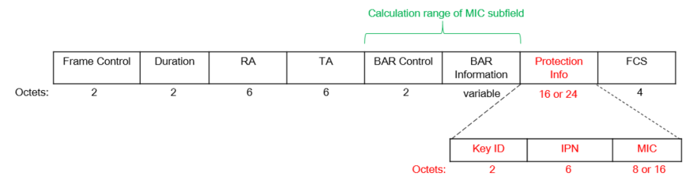
Appendix A. Integrity Check method for BlockAckReq frame
When applying the Integrity Check method, the ways of constructing the control frame can be defined to the new field for the information for checking integrity about individually address BlockAckReq frame only for UHR STA.
        Maybe the length of Protection Info subfield, Key ID subfield, IPN/BIPN subfield, and MIC subfield can be changed.

Slide 25
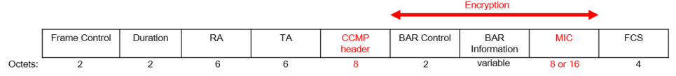
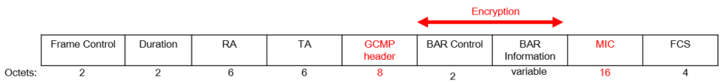
Appendix B. Encryption/Decryption method for BlockAckReq frame
Encryption/Decryption method is a method of shielding and protecting messages.
  For example, if BlockAckReq frame is applied to CCMP or GCMP, BAR Control field and BAR Information field will be encrypted.

