Slide 1
Coordinated TDMA Procedure
Date: 2023-11-13
Authors:
Name | Affiliation | Address | Phone | Email
Geonhwan Kim | LG Electronics | 19, Yangjae-daero 11gil, Seocho-gu, Seoul 137-130, Korea |  | geonhwan.kim@lge.com
Insun Jang |  |  |  | insun.jang@lge.com
Jinsoo Choi |  |  |  | js.choi@lge.com
Sunhee Baek |  |  |  | sunhee.baek@lge.com
Yelin Yoon |  |  |  | yl.yoon@lge.com
Dongju Cha |  |  |  | dongju.cha@lge.com
Eunsung Park |  |  |  | esung.park@lge.com
Dongguk Lim |  |  |  | dongguk.lim@lge.com
Jinyoung Chun |  |  |  | jiny.chun@lge.com
Insik Jung |  |  |  | insik0618.jung@lge.com
Hangyu Cho |  |  |  | hg.cho@lge.com
Sanggook Kim |  | 10225 Willow Creek Rd, San Diego, CA, USA |  | sanggook.kim@lge.com

Slide 2
Introduction
PAR for 11bn (UHR) [1] highlights the need for coordination to enhance WLAN reliability between neighboring APs and between P2P networks in isolated or overlapping BSS scenarios.
To this end, UHR SG has discussed various Multi-AP coordination schemes [2]-[6] and reviewed the feasibility of coordinated TDMA (C-TDMA), which cooperates based on time [7]-[10].
  C-TDMA can achieve coordination between neighboring APs based on the Triggered TXOP Sharing (TXS) protocol in 11be (EHT).
  Therefore, it can be considered a scheme that can be designed and applied as an initial step for Multi-AP coordination-based transmission.
In this contribution, we present our view on the procedures required for C-TDMA based transmission in a Multi-AP coordination scheme.

Slide 3






Assumptions for C-TDMA based Transmission
We consider the following assumptions for Multi-AP coordination in this contribution.
  AP which obtains a TXOP and initiates the Multi-AP coordination is a sharing AP.
  AP which is coordinated for the Multi-AP transmission initiated by the sharing AP is the shared AP.
  A Multi-AP set is a set of AP(s) that can initiate or participate in Multi-AP coordination.
  At least one AP in the Multi-AP set can be a sharing AP.
  Any AP that obtains TXOP can become a sharing AP.
  The shared APs exist within the range of a sharing AP, and shared APs may not hear each other.
  Some of the non-AP STAs associated with the shared AP may hear the sharing AP or the non-AP STA(s) associated with the sharing AP.
*At the point of winning the medium contention
Shared AP
Sharing AP
Shared AP
STA $a$
...
STA $n$
STA $a$
...
STA $n$
STA $a$
...
STA $n$

Slide 4
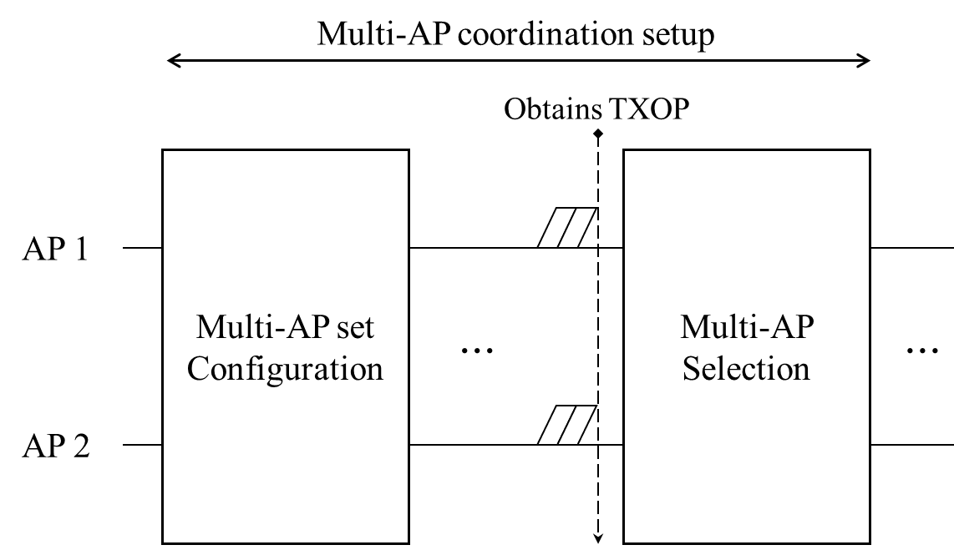
Expected C-TDMA Procedure in UHR (1/3)
Multi-AP coordination setup part
  Multi-AP set configuration
    To use the coordination scheme, a Multi-AP set should be configured in advance.
    In this procedure, each AP negotiates to group several candidate APs for Multi-AP operation.
    It can include a negotiation information for the C-TDMA based transmission.
  Multi-AP selection
    The sharing AP can select the shared AP(s) from the configured Multi-AP set.
    Also, this can be used as a short-term solicit method to request resources from a shared AP(s).
    That is, it may be used to update contents acquired during Multi-AP set configuration.

Slide 5
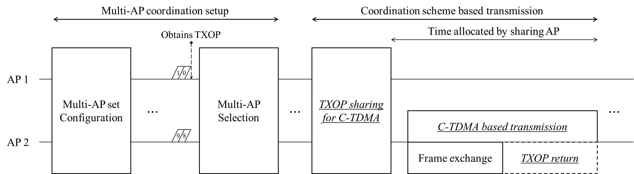
Expected C-TDMA Procedure in UHR (2/3)
Coordination scheme based transmission part
  [optional] Frame exchange within BSS of the sharing AP
    Basically, an AP that obtains TXOP and acts as a sharing AP can perform individual frame exchange.
  TXOP sharing for C-TDMA based transmission
    This procedure can allocate part of the TXOP to the shared AP(s).
    Several TXOP sharing methods can be considered to prevent protection issues [7],[8],[12].
  C-TDMA based transmission
    A shared AP(s) can transmit one or more PPDU(s) during the allocated time.
    For the remaining TXOP, the sharing AP may resume frame exchange within its BSS.

Slide 6
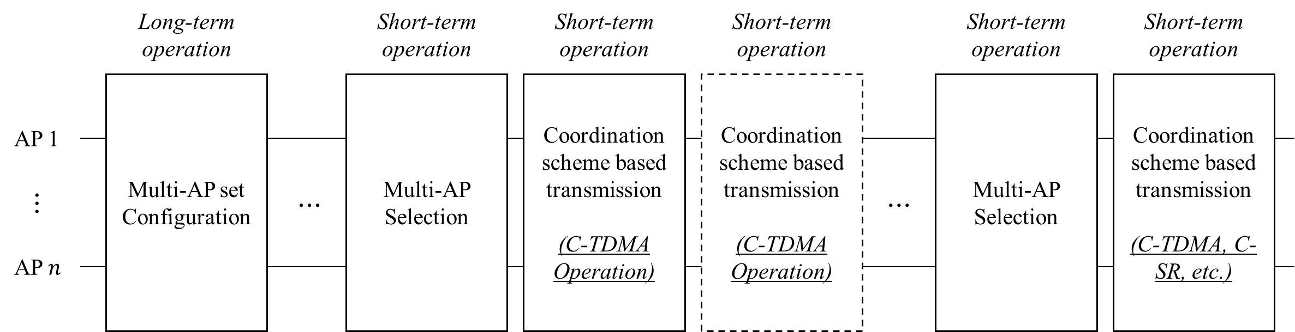
Expected C-TDMA Procedure in UHR (3/3)
C-TDMA procedures may involve both long-term and short-term (e.g., TXOP-level) operations [3][6].
Multi-AP set configuration procedure is necessary for long-term operation, and the negotiated information can be used and updated over a long period of time.
Also, Multi-AP selection and Coordination scheme based transmission operates in the short-term based on the configured Multi-AP set.
  Optionally, the C-TDMA operation may be repeated or another scheme may be performed.

Slide 7
Multi-AP Set Configuration
A Multi-AP set can be configured through the process below:
  Discovery of neighboring APs: APs can discover each other by receiving Beacon frame or Management frame sent by neighboring APs.
  Request/Response frame exchange: APs wishing to participate in C-TDMA (or otherwise) can perform a negotiation procedure to configure a Multi-AP set.
When configuring a Multi-AP set, the following information may be included for the C-TDMA negotiation procedure:
    Indications or parameters to identify multiple APs and manage Multi-AP set
    Capabilities for Multi-AP coordination schemes (e.g., C-TDMA, C-SR, etc.)
    Operating parameters (Common or specific parameters for each Multi-AP scheme)
    TBD
After the req./resp. frames are exchanged, a Multi-AP set is configured per AP.
  That is, each participating AP can create a Multi-AP coordination table including the successfully negotiated AP(s).

Slide 8
Multi-AP Selection (1/2)
If the sharing AP and the shared AP can recognize in advance whether or not TXOP sharing is required, it is useful in several aspects:
  If there is no response from the selected shared AP or it is reported that TXOP sharing is not necessary, the sharing AP can select another shared AP or not perform C-TDMA.
  The shared AP can report short-term/non-periodic information that can be helpful for C-TDMA operation.
During the Multi-AP selection procedure, the following information may be transmitted from the sharing AP:
  Multi-AP coordination schemes type (i.e., When a common frame is designed for Multi-AP coordination)
  Allocation duration (i.e., Indicates that the expected TXOP duration to be allocated)
  TBD
The shared AP that receives the request frame from the sharing AP can transmit a response frame containing the following information:
  Required TXOP duration (i.e., Indicates the TXOP duration required by the selected shared AP)
  LL traffic requirement (e.g., short-term/non-periodic/dynamic LL traffic)
  Status code (e.g., Accept or Reject based on whether TXOP sharing is currently required)
  TBD

Slide 9
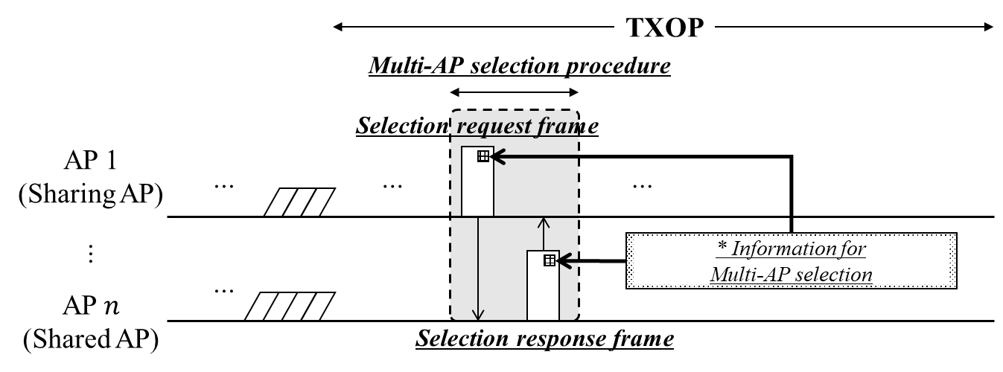
Multi-AP Selection (2/2)
Sharing AP can select one or more shared AP(s) from the configured Multi-AP set.
  Sharing AP may transmit a Trigger frame (TF), and the shared AP may transmit a TB PPDU in response.
    Multiple shared AP(s) can receive the TF and send feedback with updated information.
    However, TB PPDU transmission from the AP must be supported.
  Sharing AP may transmit a MU-RTS TF, and the shared AP may respond with a CTS frame.
    MU-RTS TXS TF (i.e., TXS mode) can be utilized and multiple shared APs can receive the TF.
    In this case, the CTS frame cannot contain information for Multi-AP coordination.
  Sharing AP may transmit a request frame (i.e., Mng.), and the shared AP may transmit a response frame.
    The shared AP can send a response frame with updated information instead of a TB PPDU or CTS.
    In this case, Multi-AP selection is only possible for a single shared AP.
Exceptionally, the Multi-AP selection procedure may be omitted for the following reasons:
  Perform TXOP sharing immediately upon obtaining TXOP, or
  Feedback from shared AP is not required or
  When there is only one negotiated AP.

Slide 10
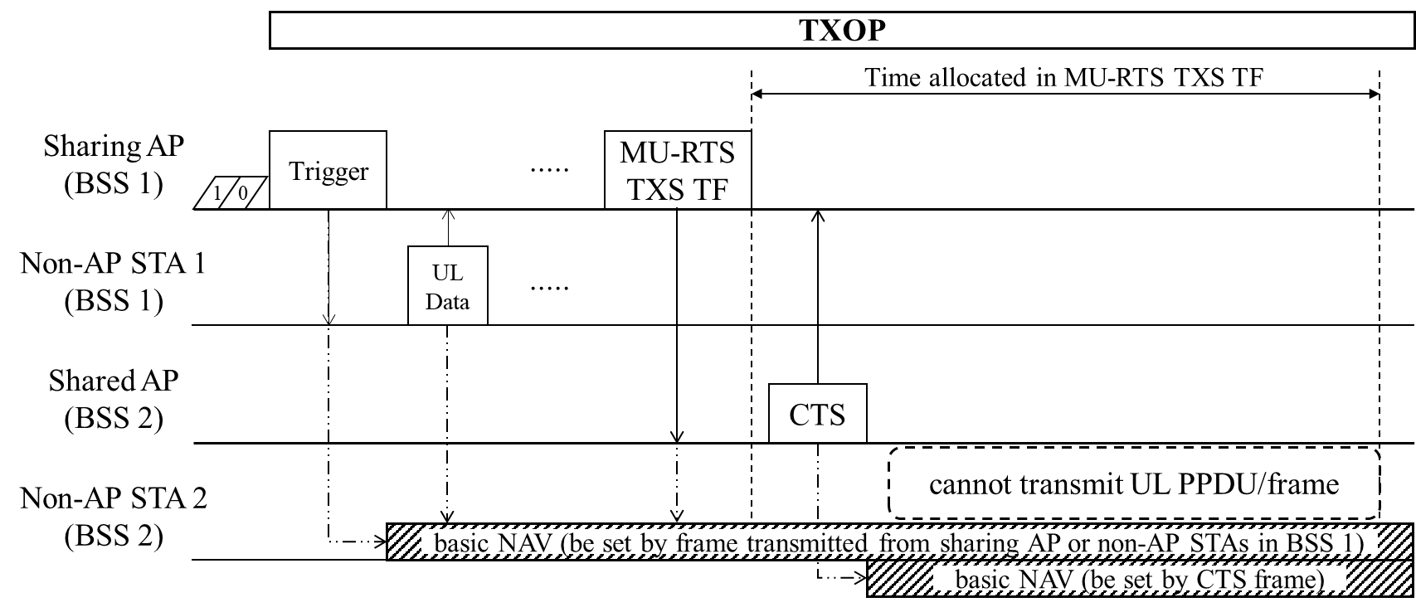
TXOP Sharing for C-TDMA
After selecting a shared AP, the sharing AP can optionally exchange frames within its BSS.
  The sharing AP can then use MU-RTS TXS TF (or Ctrl frame) to allocate time to the selected shared AP (i.e., TXOP sharing can be performed for C-TDMA based transmission).
In this situation, a non-AP STAs associated with the shared AP can set Basic NAV by:
  MU-RTS TXS TF sent by the sharing AP and/or CTS frame responded to by the shared AP
  Frames sent by the non-AP STAs associated with the sharing AP
As a result, UL PPDU(s) cannot be transmitted to the shared AP during the allocated time.
  Therefore, in order to perform C-TDMA based transmission, protection issue must be resolved.
There can be several ways to prevent protection issues [7],[8],[12].
  Specific ways to address protection issues require further discussion.

Slide 11
C-TDMA Transmission
The selected shared AP(s) that responds to the TXOP sharing initiated by the sharing AP can transmit one or more PPDU(s) during the allocated time.
  This requires the design of appropriate protocols that address or prevent protection issues that may occur with a non-AP STAs associated with the shared AP(s).
  Other cooperating APs not selected by the sharing AP can defer channel access for the time allocated to the selected shared AP(s).
The sharing AP may retrieve TXOP after the time allocated to the shared AP(s).
  A shared AP that completes a C-TDMA based transmission earlier than the allocated time must perform a TXOP return process.
  During the remaining TXOP duration, the sharing AP may exchange frames with non-AP STAs within the BSS or perform additional TXOP sharing (e.g., EHT TXS or C-TDMA).

Slide 12
Summary
In this contribution, we present our view on the procedures required for C-TDMA, one of the Multi-AP coordination-based transmission options.
In order to support C-TDMA based transmission in 11bn, the following procedures need to be defined and preceded:
  Multi-AP set configuration
  Multi-AP selection
  TXOP sharing for C-TDMA based transmission
Especially, for efficient C-TDMA operation, further discussion on Multi-AP selection and TXOP sharing procedures is necessary.
*Appendix #1 shows a detailed frame exchange diagram for the proposed C-TDMA procedure.

Slide 13
References
[1] 23/0480r3, “UHR proposed PAR”
[2] 22/1515r0, “A candidate feature: Multi-AP”
[3] 22/1895r0, “Thoughts on M-AP Coordination Principles”
[4] 23/767r0, “M-AP Coordination Agreement”
[5] 23/616r0, “Overhead Analysis of Coordinated Spatial Reuse”
[6] 23/1461r0, “Considerations on Multi-AP Operation”
[7] 23/0041r0, “Considerations on Coordinated TDMA (C-TDMA)”
[8] 23/0249r1, “Extended TXOP Sharing”
[9] 23/0261r0, “C-TDMA procedure in UHR”
[10] 23/0739r1, “Follow-up on Coordinated TDMA (C-TDMA)”
[11] 20/1935r66, “Compendium of straw polls and potential changes to the Specification Framework Document Part 2”
[12] 23/1910r1, “Coordinated TDMA (Follow up)”

Slide 14
Straw Poll 1
Do you agree to add the following text to the TGbn SFD?
    – An AP which obtains TXOP and initiates the Multi-AP coordination is the Sharing AP ^{[NOTE]}.
    – An AP which is coordinated for the Multi-AP transmission by the Sharing AP is the Shared AP ^{[NOTE]}.
  [NOTE]
  The names can be modified.
  This SP is “Motion 73, [30] and [288]” in the 11be SFD [11].

Slide 15
Straw Poll 2
Do you support defining a Coordinated TDMA (C-TDMA) mechanism that allows a sharing AP to transmit a control frame that allocates an AP a time to transmit one or more PPDU(s) within an obtained TXOP of the sharing AP?
    – It is TBD whether time will be allocated to more than one AP.
    – The subtype of control frame is TBD.

Slide 16
Straw Poll 3
TGbn shall define a mechanism by which an AP negotiates capabilities or operating parameters with one or more other AP(s) to participate in a Multi-AP coordination.
  – The details of capabilities and operating parameters are TBD.

Slide 17
Straw Poll 4
Do you agree that a Multi-AP set is a set of AP(s) that is configured through a negotiation mechanism between APs and can initiate or participate in a Multi-AP coordination?
  – AP(s) that coordinated for Multi-AP scheme(s) initiated by a sharing AP in the same Multi-AP set can participate as a shared AP ^{[NOTE]}.
  – At least one AP in the Multi-AP set shall be capable of being a sharing AP ^{[NOTE]}.
  [NOTE] These SPs are based on “Motion 124, #SP188, [1] and [294]” in the 11be SFD [11].

Slide 18
Straw Poll 5
Do you agree to define a mechanism for a sharing AP to request AP(s) in a Multi-AP set their intent to participate in Multi-AP scheme(s)?
  – Information that may be included in request and response frames is TBD.

Slide 19
Straw Poll 6
Do you agree that 11bn supports TB PPDU transmission between APs?

Slide 20
Straw Poll 7
Do you agree that in a C-TDMA mechanism, a sharing AP shall send a MU-RTS TXS Trigger frame as a control frame that allocates time to an AP to transmit one or more PPDU(s) within an obtained TXOP of the sharing AP?

Slide 21
Straw Poll 8
Do you support defining a triggered TXOP sharing mode for a C-TDMA mechanism?
  – The triggered TXOP sharing mode is carried in an MU-RTs TXS Trigger frame.
  – The mode’s description and frame exchange sequence are TBD.

Slide 22
Straw Poll 9
Do you agree that a sharing AP that allocates time to a single AP can set the RA field in the MU-RTS TXS TF to that AP’s MAC address?

Slide 23
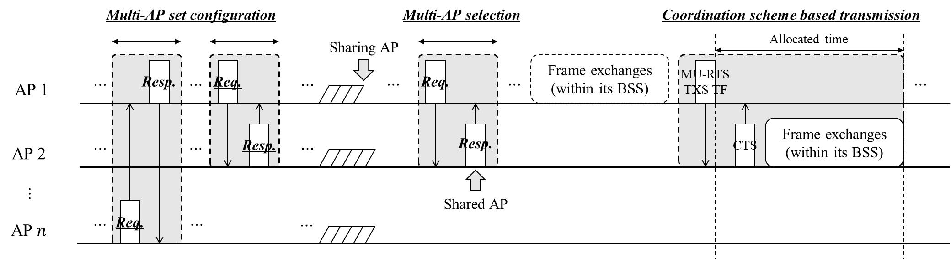
Appendix #1
Detailed frame exchange diagram for the proposed C-TDMA procedure:

