Slide 1
Seamless Roaming Procedure
Date: 2023-11-15
Authors:
Name | Affiliation | Address | Phone | Email
Yelin Yoon | LG Electronics | 19, Yangjae-daero 11gil, Seocho-gu, Seoul 137-130, Korea |  | yl.yoon@lge.com
Insun Jang
 |  |  |  | insun.jang@lge.com
Jinsoo Choi
 |  |  |  | js.choi@lge.com
Sunhee Baek |  |  |  | sunhee.baek@lge.com
Geonhwan Kim |  |  |  | geonhwan.kim@lge.com
Dongju Cha |  |  |  | dongju.cha@lge.com
Eunsung Park |  |  |  | esung.park@lge.com
Dongguk Lim |  |  |  | dongguk.lim@lge.com
Jinyoung Chun |  |  |  | jiny.chun@lge.com
Insik Jung |  |  |  | insik0618.jung@lge.com
HanGyu Cho |  |  |  | hg.cho@lge.com
Sanggook Kim |  | 10225 Willow Creek Rd, San Diego, CA, USA |  | sanggook.kim@lge.com

Slide 2
Abstract
Seamless mobility, a feature outlined in UHR PAR [1], requires a mechanism that ensures reliable connectivity and quality of experience for mobile users [1]
In this presentation, we introduce a seamless roaming procedure to enable seamless mobility

Slide 3
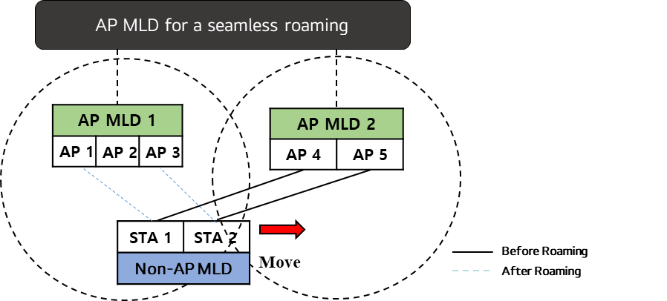
Re-cap
In the previous meeting, we deliberated on the features that may be required for achieving seamless roaming between non-collocated APs[3].
  We proposed an MLD based architecture where we have AP MLDs affiliated with the AP MLD for a seamless roaming
    We are going to name the “AP MLD for a seamless roaming” as the Ultra Fast BSS Transition (UFT) AP MLD in this contribution
  We want to maintain the Multi-Link setup utilizing the ML Reconfiguration
  We need a new method to identify the APs affiliated with the UFT AP MLD.

Slide 4
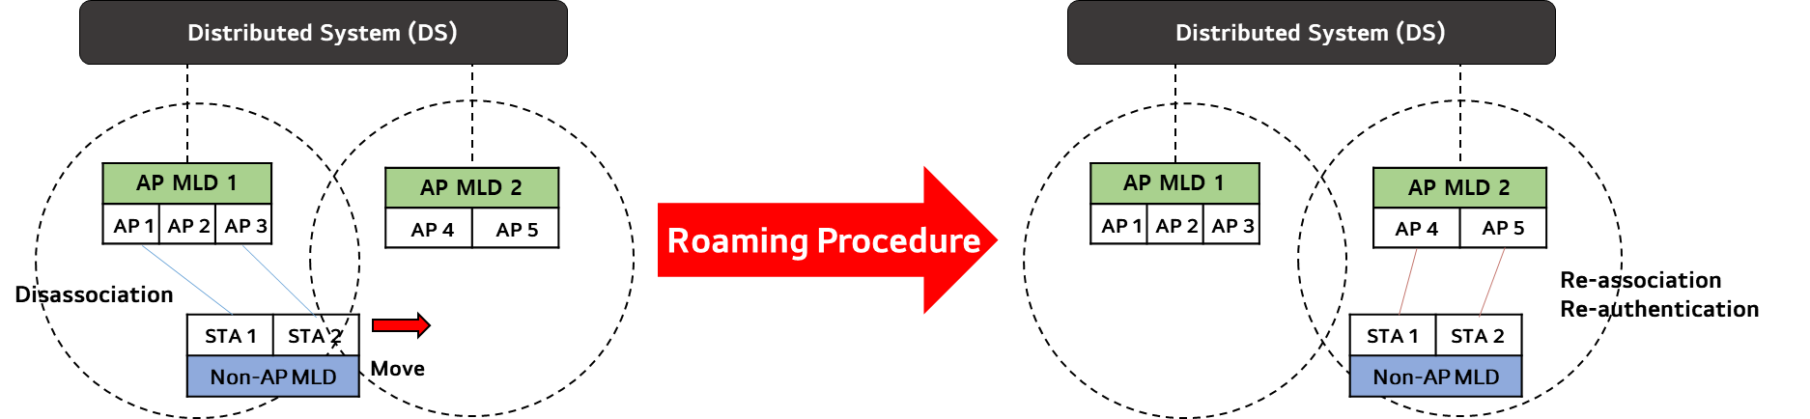
Motivation (1/2)
Current roaming mechanisms, including Fast BSS Transition, fall short in providing seamless roaming
  Despite its attempts to expedite the process, re-authentication and re-association processes lead to significant time delays which is taking too much time.
  Additionally, the data discontinuity experienced during disassociation and re-association with the target AP further aggravates these delays

Slide 5
Motivation (2/2)
We need a new framework to achieve “Ultra High Reliability (UHR)”. This framework should address the challenges posed by current methods and we can implement the following key features:
  Data Continuity: Ensures seamless data transfer and facilitates the exchange of data between the serving AP MLD and the target AP MLD
  Efficient Frame Exchanges: Minimizes the delays caused by frame exchanges during re-authentication and re-association processes
  Preserving the Multi-Link Setup

Slide 6
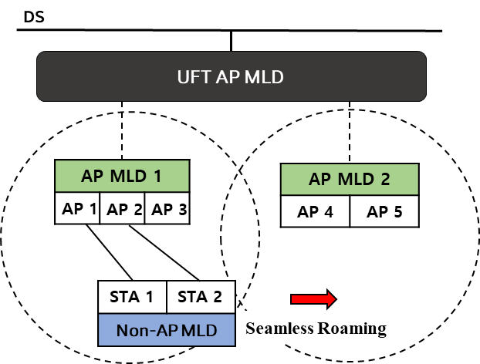
Roaming Procedure – Before Roaming
Before a non-AP MLD roams to another AP MLD, the UFT AP MLD needs to announce all its affiliated APs and some additional information, including:
  Seamless Roaming Support
    Whether the seamless roaming is supported by both AP MLD and non-AP MLD
  AP MLD recommendation list
    The non-AP MLD can ask for the recommended list of APs to the UFT AP MLD using a ML Probe Request frame. The UFT AP MLD may respond with the list using an ML Probe Response frame
    We can use a Reconfiguration Notify frame without any preceding requesting frame. Alternatively, the non-AP MLD can initiate by sending a request frame to solicit the Reconfiguration Notify frame.
      This list may also specify the order of the links based on preference or priority

Slide 7
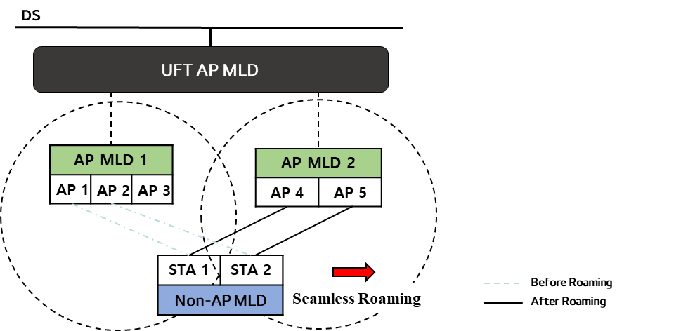
Roaming Procedure – During Roaming (1/3)
During roaming, an AP MLD and a non-AP MLD should maintain the Multi-Link Setup using a Reconfiguration process
The roaming process should be triggered first and this involves:
  The non-AP MLD or the UFT AP MLD selects the target AP MLD for roaming and sends a Reconfiguration Request frame
  Upon accepting the roaming request, the UFT AP MLD or the non-AP MLD responds with a Reconfiguration Response frame

Slide 8
Roaming Procedure – During Roaming (2/3)
While reconfiguring, we have three methods of link transition:
  Add then Delete: A *new link is added, and subsequently, the *old link is deleted
  Link Switch (Delete then add at once): The old link and the new link are deleted and added simultaneously
  Delete then Add: The old link is deleted first, followed by the addition of the new link
  With all these options, we need to ensure that at least one link must be maintained between the UFT AP MLD and the non-AP MLD
Link add then delete
  1. The non-AP MLD establishes a new link with the target AP MLD first
  2. Once the new data path is operational, data from the DS is transferred to the target AP MLD
  3. The link connected to the serving AP MLD is then deleted
  Requirement: This method requires a non-AP MLD to support for dual connectivity.
*New link: the link between the target AP MLD and the non-AP MLD
*Old link: The link between the serving AP MLD and the non-AP MLD

Slide 9
Roaming Procedure – During Roaming (3/3)
Link switch (Delete then add at once)
  1. The UFT AP MLD or the non-AP MLD announces the link it intends to delete and add in a single frame
  2. Once the request is sent, a timer is set for a link deletion and the data is shared via the newly added link
  3. Upon the timer expiration, roaming concludes
  Requirement: If the new link operates on a different channel, the AP MLD may need to notify the remaining time for the channel switch.
  NOTE - Data continuity cannot be guaranteed in single STA operation.
Link delete then add
  1. The link connected to the AP affiliated with the serving AP MLD is deleted
  2. Data is shared either by the remaining link or the previously added link
  3. A new link is added to the target AP MLD
  Requirement: To maintain data continuity, at least one link must remain connected to the AP affiliated with the serving AP MLD until the new link is added
  NOTE - Data continuity cannot be guaranteed in single STA operation.

Slide 10
Roaming Procedure – After Roaming
After the non-AP MLD has successfully roamed to the target AP MLD, several considerations come into play:
  Ensure that the Multi-Link Setup is preserved with the link that is newly added, ensuring network stability and reliability
  Following roaming, all links need to be reset to the TID default mode, and each link should undergo TID negotiation process after
  Once the link is added, the non-AP MLD and the AP MLD should be able to exchange frames right away, ensuring seamless data transmission and connectivity

Slide 11
Conclusion
In this contribution, we have outlined a roaming process utilizing the Reconfiguration. This process includes:
  The Transmission of a recommended AP list
  Roaming triggering using the Multi-Link Reconfiguration frames
  Three methods of link transition, ensuring efficient and seamless connectivity during roaming

Slide 12
Straw Poll #1
Do you support a transition mechanism of the non-AP MLD between AP MLDs that are within the same Extended Service Set (ESS) without re-authentication and re-association?
Notes:
Do you support to define a mechanism in 11bn that enables a non-AP MLD to roam from one AP MLD to another AP MLD and the non-AP MLD remains in state 4 (see 11.3) after successful roaming to the other AP MLD?

Slide 13
Straw Poll #1 (Edited)
Do you support to define a mechanism in 11bn that enables a non-AP MLD to roam from one AP MLD to another AP MLD and the non-AP MLD remains in state 4 (see 11.3) during and after roaming to the other AP MLD?

Slide 14
References
[1] 11-23/480r3 UHR draft proposed PAR
[2] 11-23/279r0 Considerations on Seamless Roaming
[3] 11-23/1090r0 Seamless Roaming Follow-up

Slide 15
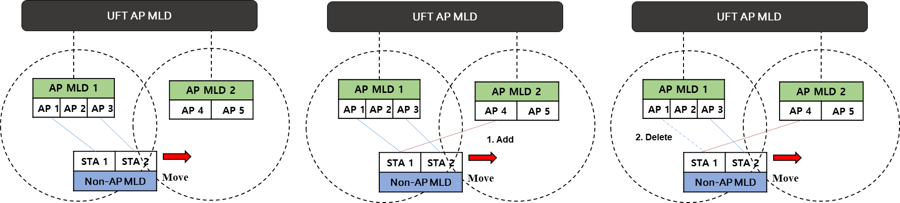
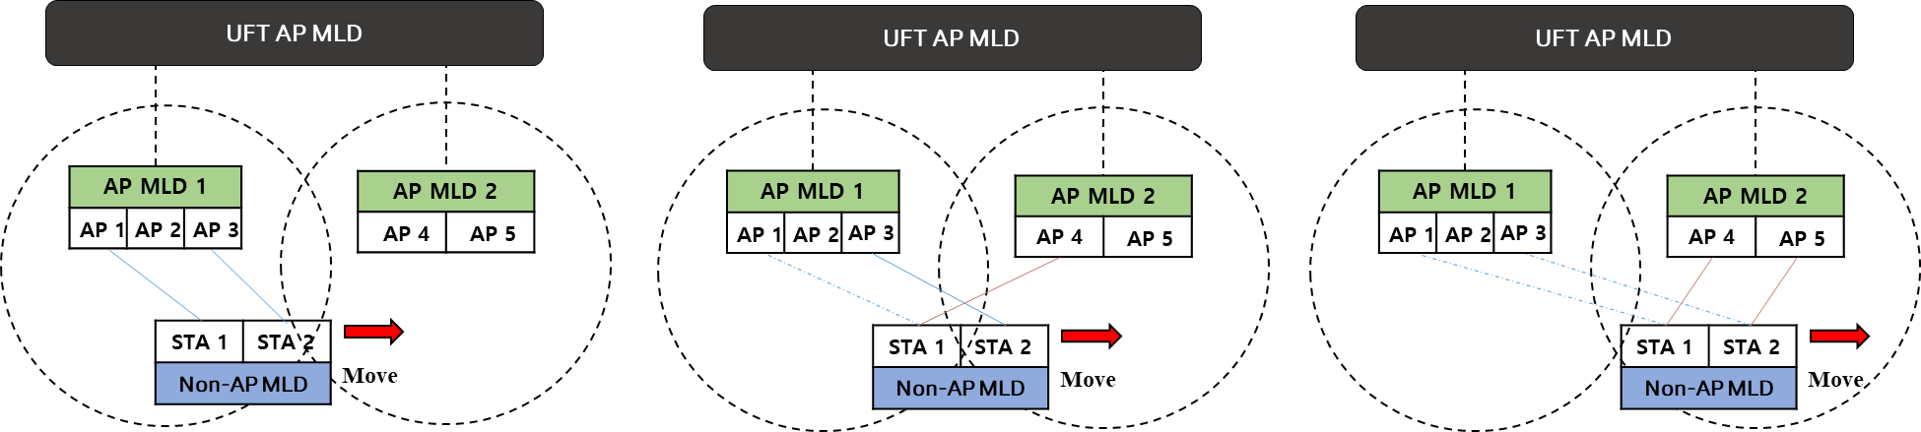
Appendix
Link Add then Delete
Link Switch

Slide 16
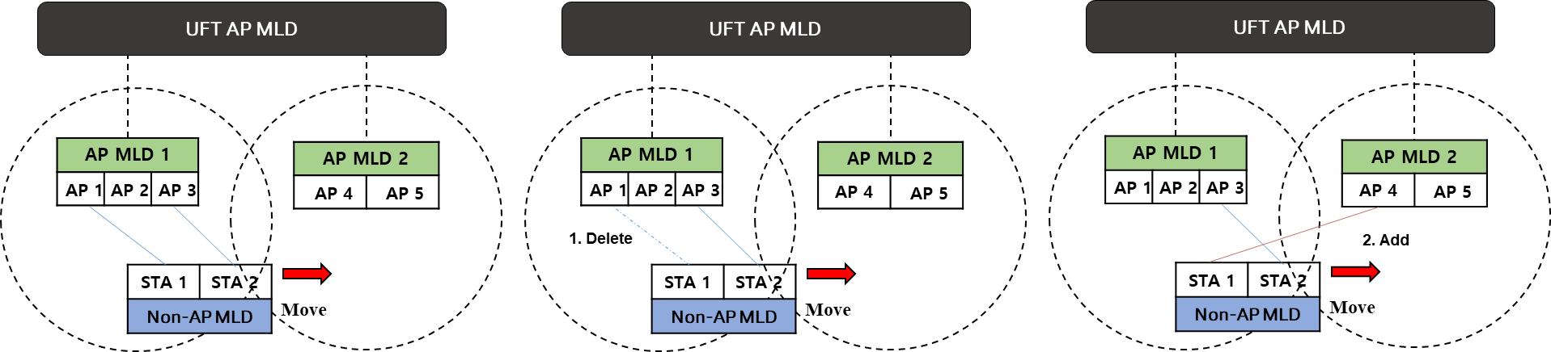
Appendix
Link Delete then Add

