Slide 1
Signaling Details for Non-colocated AP MLD
Date: 2023-10-20
Authors:
Name | Affiliations | Address | Phone | Email
Guogang Huang | Huawei |  |  | huangguogang1@huawei.com
Yuchen Guo
Yue Zhao
Maolin Zhang
Yunbo Li
Ming Gan
Notes:
September 2012

Slide 2
Introduction
Current UHR proposals [1-5] have discussed the following aspects
  The non-colocated AP MLD (or called roaming AP MLD) architecture for the seamless roaming should be an optional feature for 11bn.
  The UHR non-AP MLD can associate with an AP MLD or a non-colocated AP MLD. But the EHT non-AP MLD cannot associate with a non-colocated AP MLD.
  The AID space should be at the AP MLD level.
  The link of a non-colocated AP MLD can be identified by colocated set ID + Link ID
In this presentation, we will discuss the related signaling on the non-colocated AP MLD and the roaming procedure.
Non-colocated AP MLD
Non-colocated AP
MLD common MAC
MLD common MAC
MLD common MAC
AP 1
AP 2
AP 1
AP 2
Current AP MLD
Neighboring AP MLD
STA 1
STA 2
MLD common MAC
Non-AP MLD

Slide 3
Recap Non-colocated AP MLD
Each non-colocated AP MLD has a MAC SAP which is uniquely identified by a MAC address of the non-colocated AP MLD.
The DS will delivery the MSDU that are destined for a given UHR non-AP MLD which associates with the non-colocated AP MLD to the non-colocated AP MLD through the corresponding DS SAP and MAC SAP.
After the processing of the MLD upper MAC sublayer of the non-colocated AP MLD, the non-colocated AP MLD will delivery the encrypted MPDUs to one or more MLD lower MAC sublayers for transmission through the newly defined wired or wireless interface between the MLD upper MAC sublayer and the MLD lower MAC sublayer.
Note that the PTK cannot be distributed among AP MLDs which are affiliated with the same non-colocated AP MLD from the security point of view.
Non-colocated AP MLD
Non-colocated AP
MLD common MAC
MLD common MAC
MLD common MAC
AP 1
AP 2
AP 1
AP 2
Current AP MLD
Neighboring AP MLD
STA 1
STA 2
MLD common MAC
Non-AP MLD

Slide 4
How to identify a link
Generally, the link of the non-colocated AP MLD can be identified by using the following options
  Option 1. AP MLD MAC Address + Link ID
  Option 2. AP MLD ID + Link ID, wherein the AP MLD ID is assigned by the AP MLD.
  Option 3. Colocated set ID + Link ID, wherein the colocated ID is assigned by the non-colocated AP MLD. [1-2]
Comments
  Considering the AP MLD MAC Address is always present in the Basic Multi-link element and the Reconfiguration Multi-link element, option 1 can work very well.
  For option 2, since the AP MLD ID is assigned by the AP MLD, it shall be parsed from the corresponding AP MLD’s perspective.
  For option 3, considering we already had defined the AP MLD ID, there is no much need to define a colocated set ID which has a similar function.

Slide 5
Discovery of non-colocated AP MLD
Considering an AP MLD affiliated with a non-colocated AP MLD shall be visible for both the EHT non-AP MLD and the UHR non-AP MLD, the simplest way is to include a Non-colocated AP MLD MAC Address field and corresponding present bit within the Basic Multi-link element, as shown in the below Fig. 1.
  For the Beacon and Probe Response frames, if the AP MLD is affiliated with a non-colocated AP MLD, then the corresponding Non-colocated AP MLD MAC Address field is present. Otherwise, the Non-colocated AP MLD MAC Address field is not present.
  If the Non-colocated AP MLD MAC Address field is present in the Basic Multi-link element of Authentication and (Re)Association Request frames, it means the UHR non-AP MLD requests to associate with the indicated non-colocated AP MLD. Otherwise, the UHR non-AP MLD requests to associate with the current AP MLD.
    Meanwhile, the AP MLD ID is present to indicate which AP MLD of corresponding links are be requested.
Fig. 1 Basic Multi-link element

Slide 6
Discovery of non-colocated AP MLD (Cont.)
Since maybe there are multiple non-colocated AP MLDs with different SSIDs, a non-colocated AP MLD ID is defined to indicate which non-colocated AP MLD the corresponding AP MLD is affiliated with. Specifically,
  Define an Extend MLD Parameters subfield for the RNR element, as shown Fig. 2.
  A Non-colocated AP MLD ID subfield and the corresponding present bit is included within the Basic Multi-link element, as shown in Fig. 3.
Fig. 2 Extend MLD Parameters subfield
Fig. 3 Basic Multi-link element

Slide 7
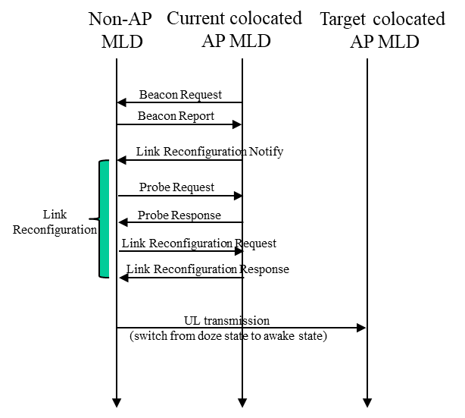
Roaming Procedure
In the non-colocated AP MLD, the non-AP MLD shall exchange Link Reconfiguration Request/Response frames with the current AP MLD to add links with neighboring AP MLDs.
It’s reasonable to allow that the non-AP MLD can exchange Probe Request/Response frames with the current AP MLD to get the info on neighboring AP MLDs affiliated with the same non-colocated AP MLD.
The link reconfiguration procedure is shown in the below Fig. 5.
Non-colocated AP MLD
Non-colocated AP
MLD common MAC
MLD common MAC
MLD common MAC
AP 1
AP 2
AP 1
AP 2
Current AP MLD
Neighboring AP MLD
STA 1
STA 2
MLD common MAC
Non-AP MLD
Fig. 5 Link reconfiguration procedure
Fig. 4 Non-colocated AP MLD architecture

Slide 8
Link Reconfiguration
Since the AID space is at the AP MLD level [4], a new AID will be assigned when adding links with an AP MLD which is affiliated with the same non-colocated AP MLD. Hence, an AID subfield and a corresponding present bit are included within the Basic Multi-link element.
If multiple serving AP MLD mode [4] is considered, the info on each AP MLD is signaled through a separate Basic Multi-link element. In other words, one or more Basic Multi-link elements are included within Link Reconfiguration Request/Response frames.
Fig. 6 Basic Multi-link element

Slide 9
Enhanced security
For the AAD construction of the individually addressed MMPDU in 11be, A1, A2 and A3 are the corresponding STA MAC address of the link on which the corresponding MMPDU is sent, respectively.
  This manner requires the re-encryption of the individually addressed MMPDU when it is retransmitted through another link. This will increase the retransmission delay especially under the non-collocated MLD architecture.
Hence, we propose to define a new mode for the AAD construction of the individually addressed MMPDU, i.e. A1, A2 and A3 are the corresponding MLD MAC address, respectively. Furthermore, for a link-specific individually addressed MMPDU, an MLO Link Information element shall be included within the frame body.
  This new mode can be enabled during the (Re)association Request/Response frame exchange. For example, an Management Frame Protection Enhanced Mode Enabled bit within the RSN Capabilities field of the RSNE or within the Extended RSN Capabilities field of the RSNXE.

Slide 10
References
[1] 11-22-1910-03-0uhr-seamless-roaming-for-uhr
[2] 11-23-0170-01-0uhr-smooth-roaming-discussion
[3] 11-23-0231-00-0uhr-thoughts-on-seamless-roaming-under-the-non-collocated-ap-mld-architecture
[4] 11-23-0632-00-0uhr-smooth-roaming-follow-up
[5] 11-23-1416-00-0uhr-seamless-roaming-follow-up

Slide 11
SP 1
Do you support to use the link ID plus the AP MLD MAC address to identify a link under the roaming AP MLD architecture?
  Yes:
  No:
  Abstain:

Slide 12
SP 2
Do you support to reuse the current Basic Multi-link element to signal the info (e.g. roaming AP MLD MAC address) on the roaming AP MLD?
  Yes:
  No:
  Abstain:

Slide 13
SP 3
Do you support to define a new mode for the AAD construction of the individually addressed MMPDU, i.e. A1, A2 and A3 are the corresponding MLD MAC address, respectively?
  Yes:
  No:
  Abstain:

