Slide 1
Support of Sensing using Legacy STAs in 11bf
Date: 2023-10-31
Authors:

Slide 2
CID 3523
CID | Clause | PP.LL | Comment | Proposed Change
3523 | 11.55.1.2 | 135.16 | Support of legacy STAs would set the ground for wider and faster adoption of WiFi sensing. In fact, most of the proprietary Wi-Fi sensing solutions make use of legacy STAs. Add support for legacy STAs in 11bf and consider the corresponding procedures. | I will bring a contribution to add the support of legacy STAs to 11bf.

Slide 3
Background
In [1,2] , the authors provided the reasons why the support of legacy devices would provide much benefit to the market adoption of 11bf amendment
  802.11ax is expected to have the dominant market share for sub-7 GHz Wi-Fi Chipsets
  802.11ax has similar PHY to 11az which forms a baseline for 11bf
In [3], the authors suggested to complement the TB and SBP sensing by supporting opportunistic sensing with associated legacy STAs
  Discussions have yielded several challenges to include support of sensing using legacy STAs in 11bf
In fact, all proprietary Wi-Fi sensing solutions make use of legacy STAs [4]
In this contribution, we discuss the challenges to include support of sensing using legacy STAs in 11bf and provide potential solutions

Slide 4
Challenges
Manageability
  There is no way to negotiate the sensing parameters with the legacy STAs which are not sensing-capable
Controllability
  The sensing initiator has no mechanisms to control the sensing measurement exchanges with a legacy device
Predictability
  It is not predictable when a legacy STA would send an uplink PPDU such that the sensing initiator can perform sensing measurements
Privacy
  The legacy STAs did not consent to provide sensing measurements or get involved in a sensing measurement exchange

Slide 5
Support of Sensing in Legacy STAs using RTS/CTS
Sensing Initiator
(AP)
RTS 1
RTS 2
MU - RTS
Measure Channel
Measure Channel
Measure Channel
PPDU Carrying CTS 1
Sensing Responder
non-AP STA 1
PPDU Carrying CTS 2
Sensing Responder
non-AP STA 2
TB-PPDU Carrying CTS 3
Sensing Responder
non-AP STA 3

Slide 6
How RTS/CTS Mechanism Helps
Controllability
  Sensing initiator (AP) controls when the RTS/CTS exchanges may take place
    This may take place during the sensing availability window
  Sensing initiator (AP) identifies the non-AP STAs involved in the exchange
    Allowing the sensing initiator to control who are the responders participating in the sensing measurement
Predictability
  Sensing initiator (AP) have full predictability of the responses since it controls when they are sent
    RTS/CTS exchange is initiated by the AP and the non-AP STA sending the PPDU carrying the CTS is predictable as a response to receiving the RTS.

Slide 7
How RTS/CTS Mechanism Helps
Manageability
  There is no negotiation for the sensing parameters in RTS/CTS mechanism
  Legacy RTS an be used to control the bandwidth of the CTS by using different bandwidth of non-HT duplicated PPDU
  MU-RTS allows for using the primary channel to send the CTS using TB-PPDU
    MU-RTS can be used to trigger one non-AP STA to send the CTS
    The bandwidth used to send the CTS can be configured in the MU-RTS allowing for larger sensing bandwidth
Privacy
  Legacy STAs must transmit CTS when receiving RTS during normal operations; any device can use the frames for channel measurement and no privacy loss is expected compared to legacy operations.
  There is no restrictions or limitations for what can be done by the PPDU carrying the CTS including measuring the channel for any purpose, sensing included.

Slide 8
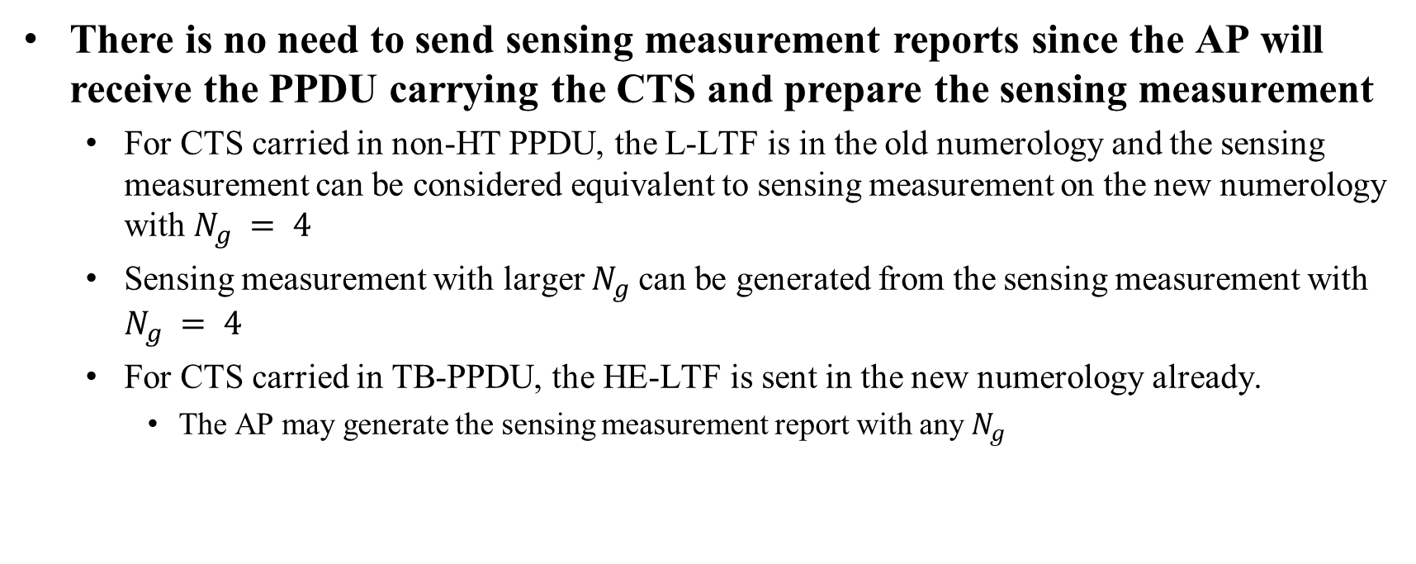
Sensing Measurement Report
There is no need to send sensing measurement reports since the AP will receive the PPDU carrying the CTS and prepare the sensing measurement
  For CTS carried in non-HT PPDU, the L-LTF is in the old numerology and the sensing measurement can be considered equivalent to sensing measurement on the new numerology with $N_{g} = 4$
  Sensing measurement with larger $N_{g}$can be generated from the sensing measurement with $N_{g} = 4$
  For CTS carried in TB-PPDU, the HE-LTF is sent in the new numerology already.
    The AP may generate the sensing measurement report with any $N_{g}$

Slide 9
Changes to the specs
To enable the support of sensing using the legacy STAs, the changes required to the 11bf specs are minimal
  The sensing initiator needs to set the Duration field in the MAC header of the RTS frame or the MU-RTS frame to the time needed to receive the CTS back.

Slide 10
Conclusions
Support of sensing using legacy STAs would set the ground for wider and faster adoption of Wi-Fi sensing in the market.
There are several challenges to support sensing using legacy STAs this includes manageability, controllability, predictability, and privacy.
CTS/RTS mechanism provides potential solutions to these challenges and enables the sensing functionality using legacy STAs.

Slide 11
References
[1] 11-21/1047r1, Legacy Support in 11bf
[2] 11-21/1754r2, Legacy Support in 11bf - Next Steps
[3] 11-21/1218r0, LB 272 CID 1673 Utilizing Legacy STA
[4] 11-19/1164r0, Wi-Fi Sensing

