Slide 1
Thoughts on Dynamic Subchannel Operation
Date: 2023-12-12
Authors:

Slide 2
Introduction
Many Wi-Fi clients do not support the full bandwidth option supported by the AP
  While APs may support up to 320 MHz, client may support only 80 MHz, or 160 MHz
When the AP has traffic for multiple STAs, if at least one client is wideband, Multi-User OFDMA can be used to schedule Resource Units (RUs) to the wideband STA in S80 or S160
  If no such client exists, large portions of the operational bandwidth go underutilized, leading to poor spectral efficiency
  802.11bn must address such underutilization by allowing narrowband devices to use different portions of the operational bandwidth
Frequency
S80
Unutilized resource
In-BSS Transmission to 160 MHz STA
WIFI 7
S40
S20
In-BSS Transmission to 40 MHz STA
P20
subchannels
Time

Slide 3
Background & Objective
Communicating with narrowband STAs on a nonprimary subchannel is possible in 802.11
  Using the Subchannel Selective Transmission (SST) feature defined in 802.11ah and 802.11ax
  However, SST uses individual TWT to negotiate semi-static Service Periods during which narrowband STAs switch to nonprimary subchannels.
Objective of Dynamic Subchannel Operation: Maximize spectral efficiency by allowing dynamic switching to secondary subchannels
Frequency
S80
In-BSS Transmission to 80 MHz STA3
In-BSS Transmission to 160 MHz STA
WIFI 8
S40
In-BSS Transmission to 40 MHz STA2
S20
In-BSS Transmission to 40 MHz STA1
P20
subchannels
Time

Slide 4
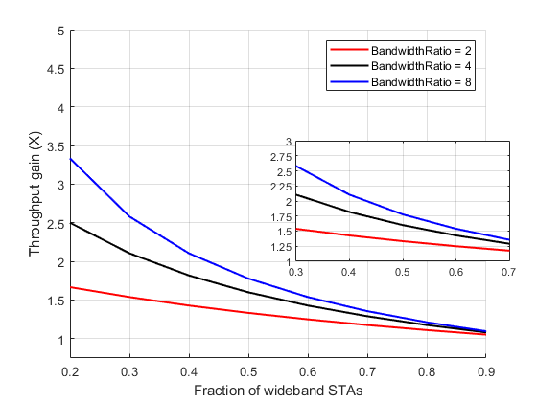
Theoretical Gains Analysis
Scenario
  Single BSS
  M + N associated STAs, where
    M = # of STAs that support entire BW
    N = # of narrowband STAs
  BW configuration
    Total BW = W
    BW of narrowband STAs = W₁
    BandwidthRatio = W/W₁
Frequency
Wideband TX
Narrowband TX enabled by DSO
Wideband TX
Narrowband TX enabled by DSO
W
Narrowband TX
Narrowband TX
W₁
Time

Slide 5
Design Considerations
Capabilities and requirements for enabling Dynamic Subchannel Operation
  The narrowband STAs must be capable of switching their radios dynamically from primary subchannel to a secondary subchannel and vice versa. These switches may incur delays.
  The narrowband STA must be capable of receiving frames on secondary subchannels that are sent in a single PPDU that spans the primary and secondary subchannels
  Set of secondary subchannels is determined based on the STA’s BW and “anchor” channels announced by the AP
  The narrowband STA must be able to select the anchor channels it is willing to switch to for DSO
Switching back & forth
  The non-AP STA keeps its radio parked on the primary (e.g., P20) channel
  The non-AP STA switches to the secondary subchannel when the AP instructs it to do so
    The AP performs an initial frame exchange to signal the secondary subchannel
    Uplink transmissions on the secondary subchannels are Trigger-based only
  The non-AP STA switches back to the primary subchannel when it detects no frame addressed to it within a timeout interval that starts at the trailing edge of the last PPDU sent/received by the STA
    Similar to EMLSR frame exchange sequence rules

Slide 6
Basic Frame Exchange Sequence
AP announces two anchor channels (A-1 and A-2)
  STA1 (80 MHz) may be legacy and need not support DSO; STA2 (80 MHz) supports DSO and picks A-2 as the anchor channel
  In the initial frame exchange, the AP assigns RUs to STA2 only in the 80 MHz subchannel associated with A-2
    STA2 may only monitor A-2 (e.g., for preambles of incoming PPDUs)
Frequency
After STA2 sends the ACK, it waits on S80 for an additional timeout interval of aSIFSTime + aSlotTime + aRxPhyStartDelay
BSRP Trigger frame
non-HT dup PPDU
(DL)
BSR
STA1
(UL)
In-BSS Transmission to 80 MHz STA2
(DL)
Ack
(UL)
When no frame is addressed to STA2 during the timeout interval, it initiates switch back to P20
BSS bandwidth
A-2
BSR
STA2
(UL)
In-BSS Transmission to 80 MHz STA1
(DL)
Ack
(UL)
At the end of the DSO transition delay, STA2 has parked its radio back on P20
A-1
P20
Time
STA1 parked on P20
Communicate with STA2 to indicate the start of DSO frame exchange
AP and STAs exchange frames on the designated subchannels in an OFDMA PPDU. More than one SIFS-separated PPDUs may be exchanged
DSO Transition Delay

Slide 7
Signaling Considerations
The AP must indicate the following
  Whether it supports DSO mode
  Location of anchor channels
The STA must indicate the following
  Whether it supports DSO mode
  Delays associated with switching
  Anchor channels it is willing to use
Signaling is also required to enable/disable the DSO mode

Slide 8
Conclusions
In this presentation, we present our views on Dynamic Subchannel Operation with focus on:
  Capabilities and requirements
  Mechanism for switching across subchannels and frame exchange sequence
  Signaling considerations

Slide 9
SP
Do you agree that TGbn will define a Dynamic Subchannel Operation (DSO) mode of operation where non-AP STAs can be allocated resources dynamically (i.e., on a per-TXOP basis) outside of their current operating bandwidth within the associated AP’s operating bandwidth?

