Slide 1
Considerations for Relay Operation in Next Generation Wi-Fi Networks
Date: 11-03-2023
Authors:

Slide 2
Abstract
In this presentation we provide some thoughts on design aspects for relay feature development.

Slide 3
Introduction
To improve reliability and throughput, the UHR PAR document considers Rate-vs-Range (RvR) throughput improvement as one of the main objectives.
Several contributions have considered relay as a candidate solution for range extension and discussed different aspects that need to be considered for relay feature development [1]-[5]
In this contribution, we provide our views on relay feature and discuss some high level technical directions that can be considered for the relay feature development.

Slide 4
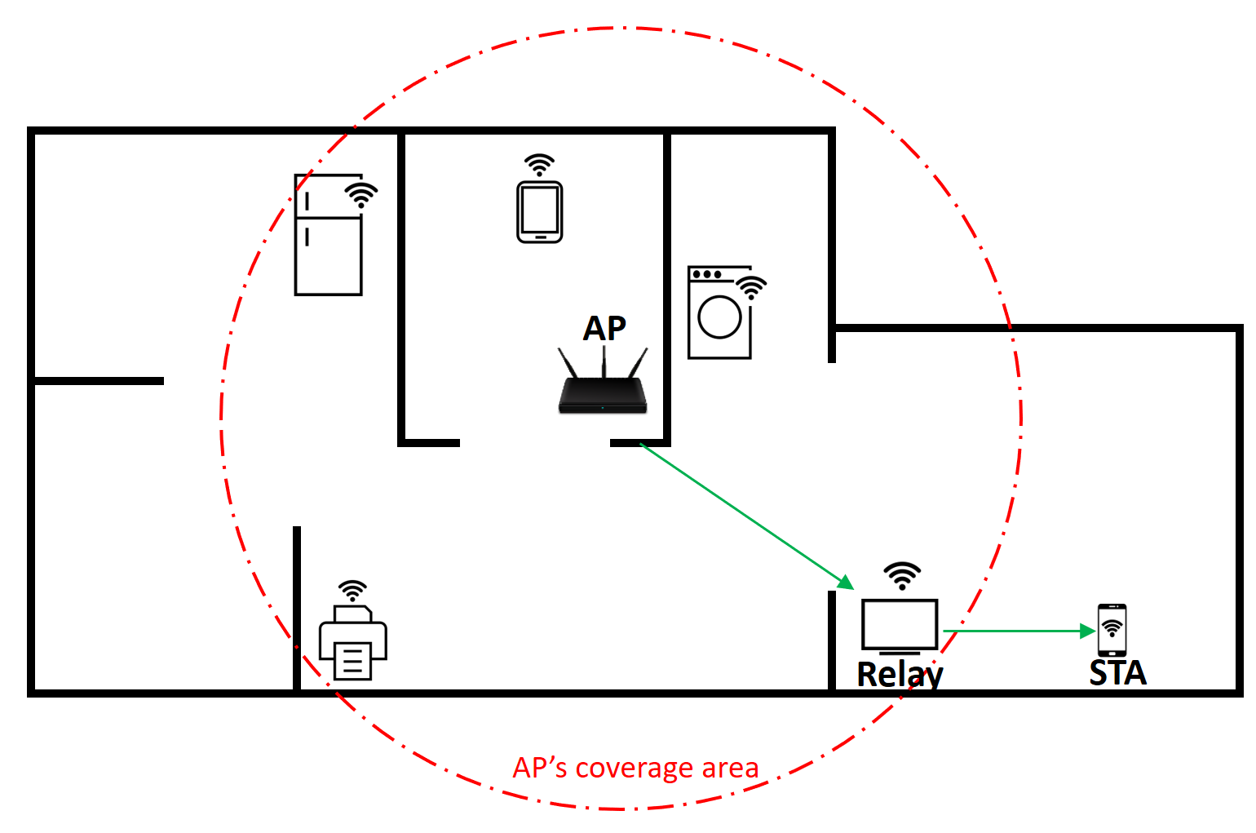
Relay Use Case
An indoor Wi-Fi network today can have areas with weak connections and in some cases even dead zones
  If a user walks in and out of these areas, the application performance and user experience can degrade.
In such scenarios, a relay can enable the device to maintain good connection and avoid degradation in user experience.
  The home network can have a number of smart home devices that can support Wi-Fi and can act as a relay to enhance AP coverage in weak areas/dead zones.
Other use cases for relay have been discussed in prior work. E.g., Automotive use case involving rear side device to dashboard communication[1]

Slide 5
Relay Operation
A number of aspects of relay operation have been discussed in UHR SG:
  Relay architecture [4]
  Features to consider for relay operation [3]
  Simulation results to show benefits of relay operation [1], etc.
In this contribution, we present some of our high level thoughts and directions that can be considered for relay feature development.

Slide 6
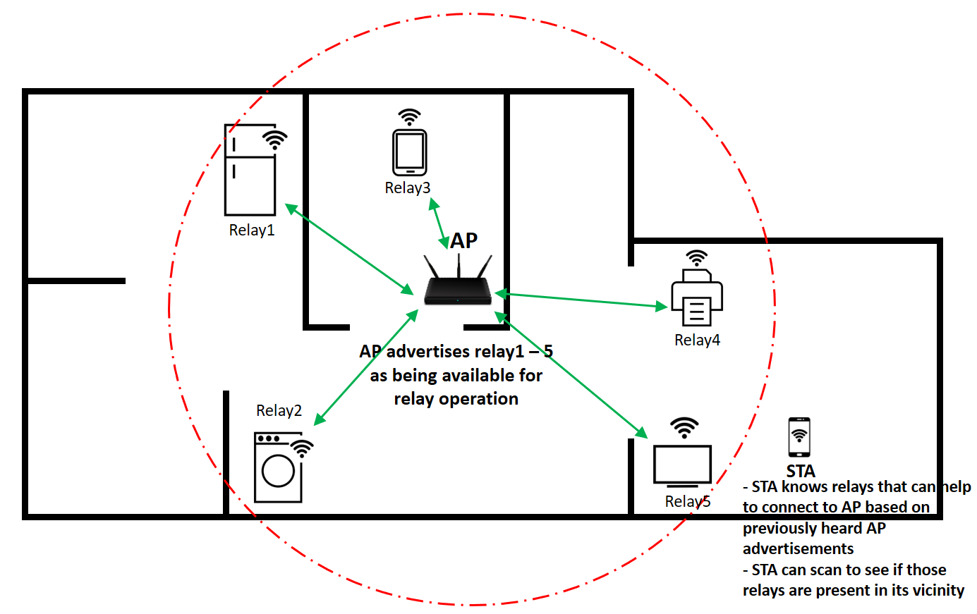
Discovery of Relay
For a STA to be able to leverage relay operation:
  The STA should be able to discover relays in its vicinity
  The STA should be able to identify which of these relays can help to communicate with the AP that it is connected to.
Advertisement of relays can be helpful
  AP side advertisement of relay devices that its associated STAs can connect to can be helpful. This can create an awareness amongst its associated STAs about the support and in STA-side decision making.
  Relay side advertisement can also be useful. This can enable STAs to search for relays in its vicinity and connect to them when necessary.

Slide 7



Temporary Unavailability Handling Procedures
Relay may not be available to serve STA’s traffic due to a number of factors.
  One possibility is when the relay faces an overload condition:
    Handling of relay’s own traffic along with those of the STAs that the relay is serving. E.g., a smart home device that can have its own traffic to perform its smart home related operations.
    Increase in load of the STAs that a relay is currently serving or addition of new STAs that have high load traffic.
    If relay has AP functionalities (e.g., something similar to a hotspot today), the relay can have traffic of its own BSS that needs to be handled.
  Another possibility could be due to power save. E.g., when relay is a battery powered device.
Since there is a possibility of a relay encountering such a situation, procedures to avoid/handle such situations can be beneficial:
  Procedure to advertise the relay’s capability and constraints in advance
  Procedure to temporarily pause relay operation/addition of new STAs and resume at a later point when conditions are favorable
AP
Relay
STA
Relay’s BSS
AP
Relay
STA
Relay’s traffic

Slide 8
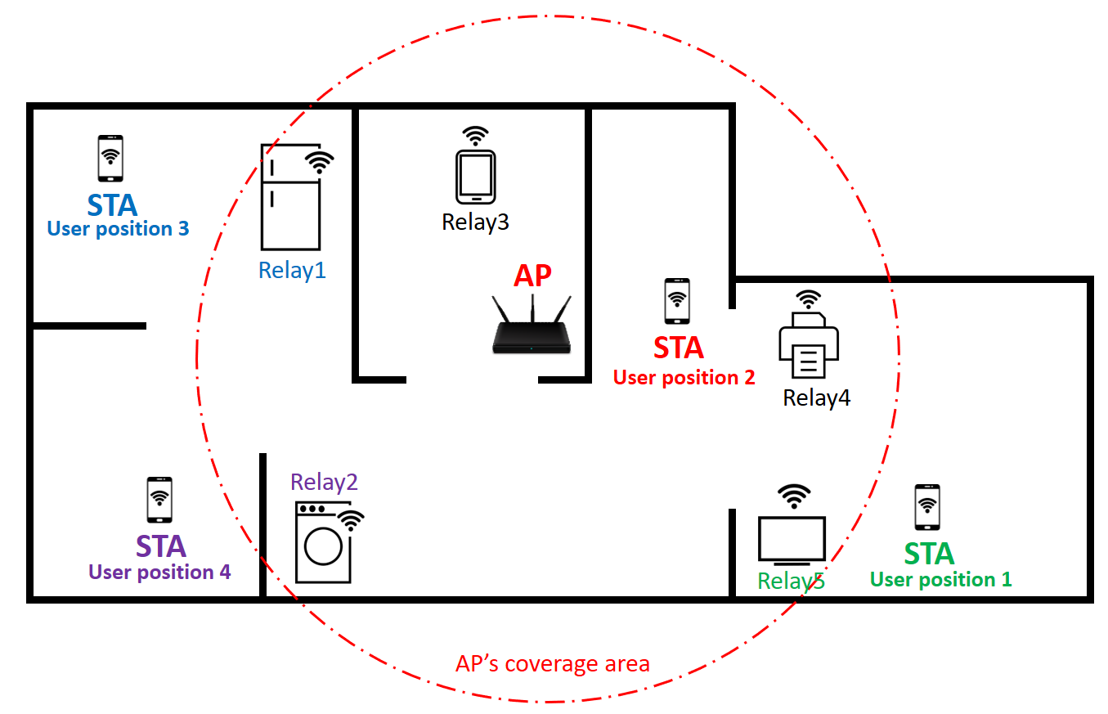
Mobility Management in Relay Operation
STA’s transition from AP to relay:
  As a user walks into an area with weak connection/dead zone from the AP’s coverage point of view, the STA may want to transition from AP to relay for maintaining its connection.
  As the user walks out of the area, the STA may want to switch back.
  Design of a low overhead procedure to enable transition from AP to relay and back can be useful.
STA’s transition from one relay to another relay:
  There can be more than one relay available for an STA. As the user moves around, the optimal relay can change over time.
  Design of a low overhead procedure to transition from the current relay to a new relay can be beneficial.

Slide 9
Low Latency Application Support in Relay Operation
With relay operation, STA’s traffic now faces a multi-hop transmission to the AP compared to the single hop transmission prior to switching to a relay.
This can cause some additional delay for low latency traffic (e.g., due to additional channel access delays for the relay to access the medium).
Procedures that can enable support for an STA’s low latency traffic after it switches to a relay are important.
  E.g., enhanced channel access mechanism if relay is expected to contend for the medium

Slide 10
Conclusion
In this contribution, we discuss some design aspects that can be considered for relay feature development in 802.11bn:
  Relay discovery
  Temporary unavailability Handling
  Mobility management procedures for relay operation
  Low latency application support in relay operation

Slide 11
References
[1] UHR Rate-vs-Range Enhancement with Relay, IEEE 802.11-22/1908r1
[2] Thought for Range Extension in UHR, IEEE 802.11-23/0042r0
[3] Features to consider for efficient Relay operation, IEEE 802.11-23/1138r1
[4] Consideration on UHR Relay Architecture, IEEE 802.11-23/1450r1
[5] UHR Relay Follow-up, IEEE 802.11-23/1175r0

