Slide 1
MAP group set-up operation discussion

Slide 2
Background
UHR PAR intends to improve the Reliability via multi-AP coordination scheme
A batch of multi-AP coordination features have been discussed in UHR group
Reference [2] and [3] propose to have a candidate AP group where the APs participate MAP coordination scheme.
Reference [4] indicates that any AP in the MAP group can be shared or sharing AP in different coordination time slot.
In some of MAP coordination proposals, like C-OFDMA, MAP sounding, AP ID should be defined to identify each shared AP(may including sharing AP) in Trigger frame, NDPA frame.

Slide 3
Limitation & Motivation
  Limitation
    It will be more flexible if multi APs can form an MAP group dynamically.
    The master AP(AP1) in MAP group may can’t exchange frame with a far away AP(AP2) that intends to join a current AP group.e.g. AP1 need to allocate AP-ID to the new member.
  In this contribution, we propose more discussion on the MAP group set-up procedure
  MAP group information shall be broadcast in a MGMT. frame, so that a new AP can discover and join an existed MAP group.
  Some notification procedure should be defined for which one AP in the MAP group can leave/join a MAP group
  One AP may relay other two APs information exchange if they are hidden node/BSS in a MAP group

Slide 4
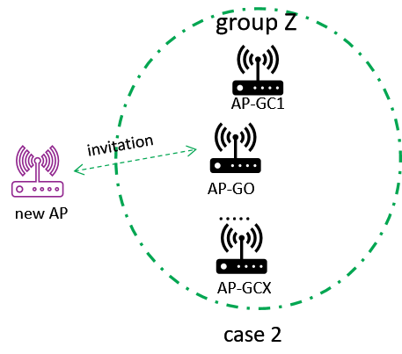
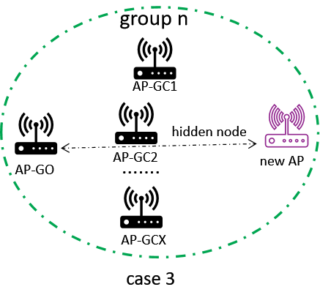
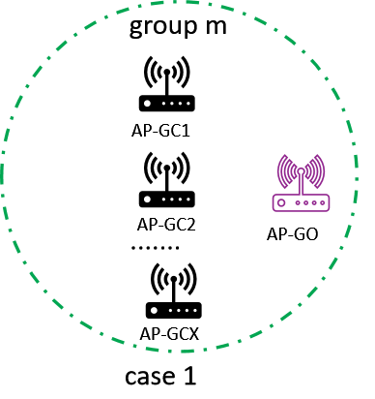
MAP group set-up procedure
Two or more APs form a MAP group via a negotiation procedure:
  One AP becomes the group owner(AP-GO) for assigning, maintaining and recycling AP ID.
  AP-GO may maintain group key, group identifier,etc.
  Other APs in the same group are called group client(AP-GC).
  AP-GO/GC can invite a 3rd AP to join an existed MAP group via a MGMT. frame
  AP-GC may relay the frame exchange between AP-GO and new joined AP if they are hidden nodes.

Slide 5
MAP group discovery procedure
  Each AP in an MAP group should broadcast the group identifier in Beacon or other MGMT. frame
    Each AP may broadcast neighbour AP’s group identifier in RNR,ML,MBSSID etc.
    A new AP may discover an existed MAP group after receiving the Beacon or via other MGMT. frame.

Slide 6
Join and leave an existed MAP group
    A new AP may request to join an existed MAP group via a MGMT. frame exchange with an AP-GO or AP-GC
AP-GO will recycle the AP ID if one AP-GC leaves the AP group
AP-GO may broadcast AP ID assignment(AP ID mapping to AP MAC address) to all AP-GCs if an AP join or leave the current group
The AP group should be torn down if AP-GO leaves the current AP group
  AP-GO may broadcast AP group torn down message to all AP-GCs

Slide 7
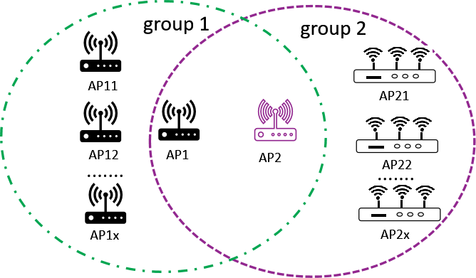
One AP may participate in different MAP groups
MAP may form different AP groups based on certain capability or features.
  One AP in the MAP overlap area may join the different MAP groups if it meets their requirements.
  The AP in multiple MAP groups should broadcast all the MAP group’s information

Slide 8
Summary
This contribution discusses the following procedures in MAP set-up scheme.
  MAP group discovery
  Join or leave one or more existed MAP groups
  AP ID granted and recycle procedure
  AP-GO and AP-GC role in an MAP group
  Relay hidden node information in an MAP group

Slide 9
THANK YOU ☺

Slide 10
reference
[1] 11-23-0480-00-uhr-uhr-proposed-par.pdf
[2] 11-23-1461-01- Considerations on Multi-AP Operation
[3]11-23-Proposed Amendments for Multi-AP Coordination Language in EHT SFD
[4] 11-23-1066-M-AP Coordination Agreement – follow up

Slide 11
Straw Poll #1
Do you agree that AP ID in TBD field of MAP coodination Trigger frame is used to identify each participator AP?

Slide 12
Straw Poll #2
Do you support to consider to define the MAP group discovery, set-up, tear- down procedure?

