Slide 1
The security consideration in MAP scheme

Slide 2
Background
UHR PAR:
  THE UHR SG focuses on the WLAN connectivity improvement, e.g. higher reliability, lower latency and manageability improvement.
  The connectivity improvement is not on the single infrastructure network, but also in multiple infrastructure networks
With the following common procedures, a batch of features are discussed on how to improve the WLAN connectivity in MAP scheme,like co-OFDMA,co-SR,co-beamforming, etc.
  The sharing AP competes the channel resource, and grants the channel resource to the shared AP via a Trigger frame
  The sharing AP may have extra information exchange with the shared AP via MGMT frames,like BQR,BSR,etc.
  Two APs may have some information exchange to decide the sharing AP/shared AP role via MGMT frames, see reference [4]

Slide 3
Several security concerns in MAP coordination scheme
Injection(middle man) attack
  The 3rd party may capture the frame exchange between two APs, and injects a certain attack information in the frame and then sends it to the receiver AP, How the receiver dertermine the frame from the legitimate transmitter or from the 3rd party?
Malicious AP attack--Can I mimic you?
    A malicious AP may mimic as a legitimate AP and join the MAP co-ordination procedure, to attack the whole network.
  Replay attack
    Case 1: The 3rd party may replay a certain frame,e.g.Trigger frame or initial frame to wake up the APs in low power mode, which causes a high power consumption on AP side.
    Other Cases.
    Deny of service(DoS) attack--Do you believe a “tore down” frame?
    In reference[4], the shared AP may drop the granted AP ID if the sharing AP sends a tore down frame. The 3rd party may send a tore down frame to the shared AP after the MAP set-up procedure, which may result in the shared AP never be scheduled.

Slide 4
High level security proposal in MAP scheme
  Before any MAP coordination scheme, two APs should authentication each other
    Consider to reuse current authentication procedure.
    No need to define the association procedure--The association procedure between two APs may cause some ambiguity.
  Verify a certain frame integrity via MIC
    Reuse BIP machansim,e.g.MIC may be used in certain Trigger frame, initial frame with PN information
    Both unicast and group addressed control frame should be taken into account.
  Frame protection will be involved if the frame contains some sensitive information
    Reuse PMF mechansim to protect a certain MGMT. frame.
    Also, consider both unicast and group addressed MGMT. frame

Slide 5
Propose to reuse the PASN protocol in MAP scheme
  PASN has been used in 11az and 11bk draft to protect FTM frame.
  PASN is also extended by 11bh draft to deliver the encrypted 11bh identifier.
  PASN supports no-authentication, SAE, FILS and FT mode, and it can meet all kinds of AP authentication requirement.
  PASN protocol allows the two entities authenticate each other during 3-way handshake.

Slide 6
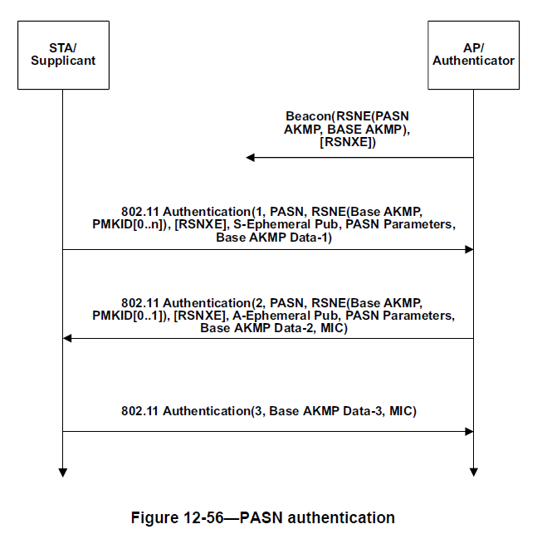
Recap the PASN protocol
PTK is derived from PMK and Diffie-Hellman shared secret protocol with a simple formula as bellow.
PTK = KDF-HASH-NNN (PMK, “PASN PTK Derivation”, SPA || BSSID || DHss)

Slide 7
The consideration of extension on PASN in MAP scheme
TCK is derived from PTK to protect individual control frame
Group keys are delivered from master AP to protect group addressed control and MGMT. frame
Following the extension in 11bh draft, Group key is delivered to slave AP via 2-PASN/3-PASN authentication frame.
Need to define an extra signaling exchange procedure to decide which side becomes the master AP to generate and maintain the group keys.
RSNE to indicate the selected cipher-suite and AKM.

Slide 8
THANK YOU ☺

Slide 9
reference
[1] 11-23-0480-00-0uhr-uhr-proposed-par.pdf
[2] 11-23-0352-01-0uhr-enhanced-security-discussion.pptx
[3] 11-23-0286-00-0uhr-trigger-frame-protection.pptx
[4] 11-23-1868-01-Coordinated-Spatial-Reuse-Design.pptx

Slide 10
Straw Poll #1
Do you support to define a mechanism to protect the frames exchange between APs in M-AP Coordination agreement procedure?

