Slide 1
DPWiFi: A Proposed IEEE802.11bn PHY
Date: 2024-01-26
Authors:

Slide 2
Abstract
Breakthrough Dynamic Polarization Multiplexing and Beamforming (“DPWiFi”) multi-signal processing combines unrestricted order RF stream MIMO Multiplexing with steerable high directivity Tx/Rx Beamforming to yield EHT-based P2P radios transporting 92 Gbps beyond 28 km and PMP radios distributing 27 GbE across 79 km²

Slide 3
What’s new this time around
At the September 802.11WNG session TWI unveiled DPWiFi, a proposed PHY for the nascent TGbn, that employs patented digital polarization modulation to MIMO-multiplex up to 32 EHT streams within a single 320 MHz channel
The DPWiFi tutorial presented in September has been affixed hereto as Appendix A
A manual closed form analysis of a 4-stream DPWiFi Tx-Rx has been added as Appendix B
Also, at that last session’s end an esteemed colleague raised a truly existential question: “Wouldn’t the so-claimed 92 Gbps information transport within only 320 MHz completely violate Shannon’s Theorem?” Appendix C, also attached hereto, explains why not
The following slides expand/refine upon two previously identified key DPWiFi Use Cases, and incorporate a call for TGbn to also develop certain DP-complementary PHY/ MAC extensions arguably essential to ultimately successful IEEE802.11bn products and services

Slide 4
Proposed IEEE802.11bn PHY
32 IEEE802.11be concurrent, cochannel RF streams
32x32 MIMO Dynamic Polarization Multiplexing (“DP-32”)
32x32 MIMO Tx/Rx DLOS/ nLOS/ NLOS Beamforming/Beamsteering
AP MU-MIMO Tx Multi-beaming
Client MU-MIMO Rx Interference Cancellation
Client MU-MIMO Rx NLOS Multipath Recombination
5-7 GHz UNII Operation
4096 QAM 5/6
320 MHz BW
92.2 Gbps Peak Data Rate
80 GbE P2P Throughput over 28 km Free-Space Range
27 GbE PMP Throughput across 79 km² Foliage-obstructed Region

Slide 5
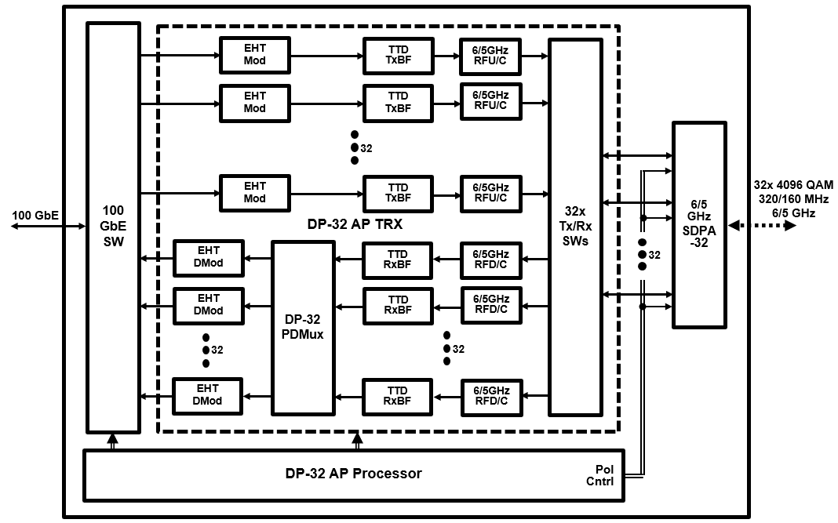
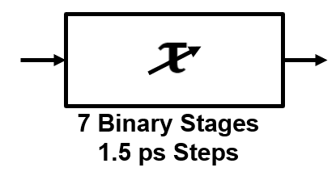
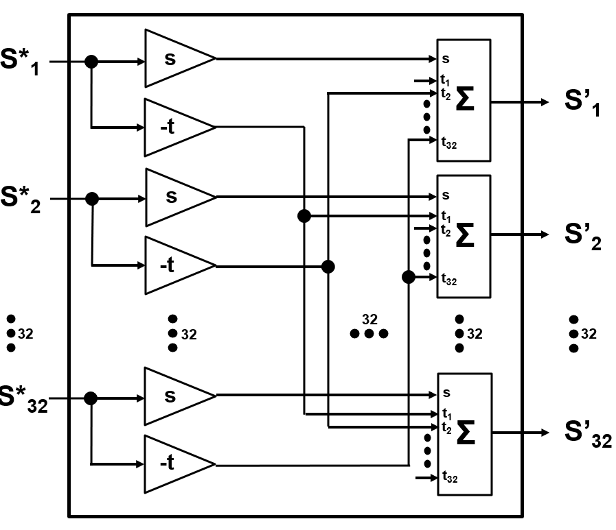
Contemplated 92.2 Gbps DPWiFi Access Point (32 Polarization-Multiplexed and Transceived EHT RF Streams)
92/46 Gbps 320/160 MHz 6/5 GHz DP-32 AP/MeshNode
TTD xBF
DP-32 PDMux

Slide 6
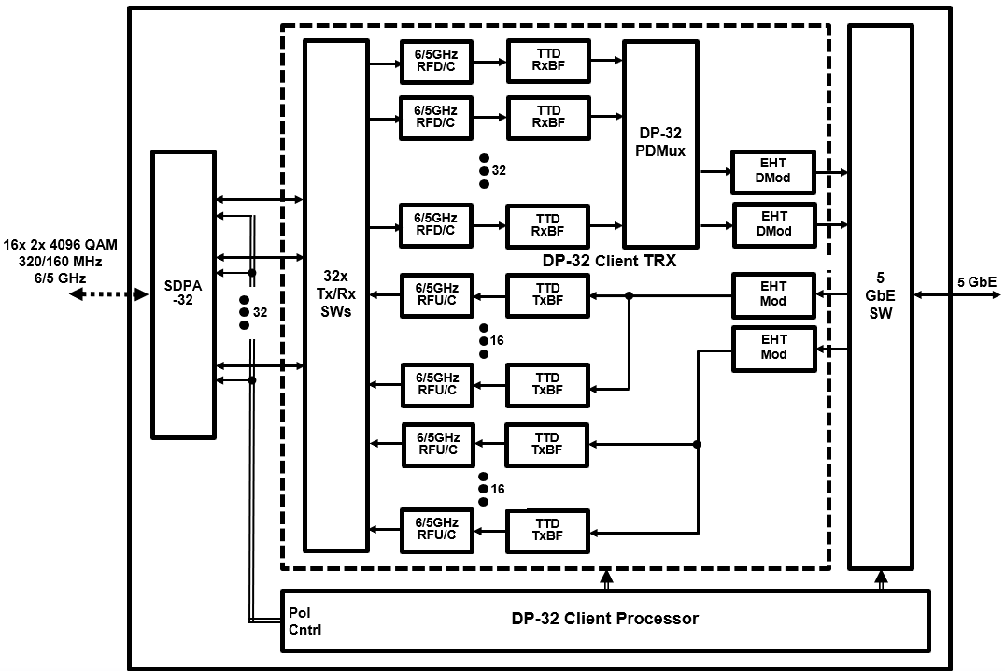
Contemplated 5.8 Gbps DPWiFi Client (32 Polarization Multiplexed/ 2 Transceived EHT RF Streams )
5.8/2.9 Gbps 320/160 MHz 6/5 GHz DP-32 Client
TTD xBF
DP-32 PDMux

Slide 7
Point to Point DPWiFi Terrestrial Internet Backhaul Application
P2P DPWiFi AP Configuration
Modulation/Coding | MCS13 (4096Q5/6)
Bandwidth (B) | 320 MHz
TRX Frequency (fc) | 6705 MHz (6 GHz Ch 151)
Tx Power (P_{Tx}) | +36 dBm (Regulatory Maximum)
SDPA Element Gain (G_{Element}) | 19 dBi (30º Beamwidth)
SDPA Array Gain (G_{Array}) | 16 dBi (6Hx6W-2Hx2W Boresight)
Ambient Temperature T | 25º C
Noise Figure (F) | 2.2 dB
P2P DPWiFi AP-AP Link Configuration
Signal/Noise Ratio (SNR) | 55 dB (1e-6 PER)
SDPA Gain (G_{Tx} = G_{Rx}) | 35 dBi (G_{Element} + G_{Array})
Noise Power (kTBF) | -87 dBm
By Regulatory Fiat, the above P2P DPWiFi link’s Free Space Path Loss works out to
DPWiFi FSPL|_{MCS13} = P_{Tx} + G_{Tx} + G_{Rx} – kTBF - SNR = 138 dB
And the corresponding P2P DPWiFi 92 Gbps Free-Space Range to
R = SQRT(FSPL)c/4πf_{c} = 28.2 km

Slide 8
Point to Multipoint DPWiFi Terrestrial Internet Distribution Application
PMP DPWiFi AP/ Client Configuration
Modulation/Coding | MCS13 (4096Q5/6) to MCS0 (B1/2)
Bandwidth (B) | 320 MHz
TRX Frequency (fc) | 6705 MHz (6 GHz Ch 151)
AP EIRP (EIRP_{Tx}) | +36 dBm (Regulatory Maximum)
Client SDPA Element Gain (G_{RxElement}) | 16 dBi (45º Beamwidth)
Client SDPA Array Gain (G_{RxArray}) | 16 dBi (6Hx6W-2Hx2W Boresight)
Ambient Temperature T | 25º C
Noise Figure (F) | 2.2 dB
PMP DPWiFi Peak Data Rate at Free Space Range:
Mod/Cod | BDR (Mbps) | XDR (Gbps) | SNR (dB) | FSPL (dB) | FSR (km)
MCS13 4096Q5/6 | 2882 | 92.2 | 55 | 100 | 0.36
MCS12 4096Q3/4 | 2594 | 83.0 | 53 | 102 | 0.45
MCS11 1024Q5/6 | 2402 | 76.9 | 49 | 106 | 0.71
MCS10 1024Q3/4 | 2162 | 69.2 | 47 | 108 | 0.90
MCS9 256Q5/6 | 1922 | 61.5 | 43 | 112 | 1.4
MCS8 256Q3/4 | 1799 | 55.3 | 41 | 114 | 1.8
MCS7 64Q5/6 | 1441 | 46.1 | 36 | 119 | 3.1
MCS6 64Q3/4 | 1297 | 41.5 | 34 | 121 | 4.0
MCS5 64Q2/3 | 1153 | 36.9 | 30 | 125 | 6.3
MCS4 16Q3/4 | 865 | 27.7 | 27 | 128 | 9.0
MCS3 16Q1/2 | 577 | 18.5 | 23 | 132 | 14.1
MCS2 4Q3/4 | 432 | 13.8 | 21 | 134 | 17.9
MCS1 4Q1/2 | 288 | 9.2 | 17 | 138 | 28.2
MCS0 B1/2 | 144 | 4.6 | 14 | 141 | 38.2
PMP DPWiFi Link Configuration
G_{Rx} | 32 dBi (G_{RxElement} + G_{RxArray})
kTBF | -87 dBm
PMP DPWiFi Link Obstruction RF Attenuation
Outdoor Foliage | 1 dB/ meter
Indoor Drywall | 2 dB/ Wall
Exterior Stucco | 6 dB/ Wall
Exterior Masonry | 15 dB/ Wall
PMP DPWiFi Average Data Rate across Obstructed Range:
ObsR* (km) | Eq FSR (km) | FSPL (dB) | SNR (dB) | MCS Range | Tpt (Gbps)
1.0 | 2.0 | 115 | 40 | MCS13-MCS7 | 59.7
2.5 | 5.0 | 123 | 32 | MCS13-MCS5 | 43.8
5.0 | 10.0 | 129 | 26 | MCS13-MCS3 | 31.3
10.0 | 20.0 | 135 | 20 | MCS13-MCS1 | 18.4
PMP DPWiFi Data Rate vs Range: FSPL = EIRP_{Tx} + G_{Rx} – kTBF – SNR FSPL = 155 - SNR
*- 6m Outdoor Foliage

Slide 9
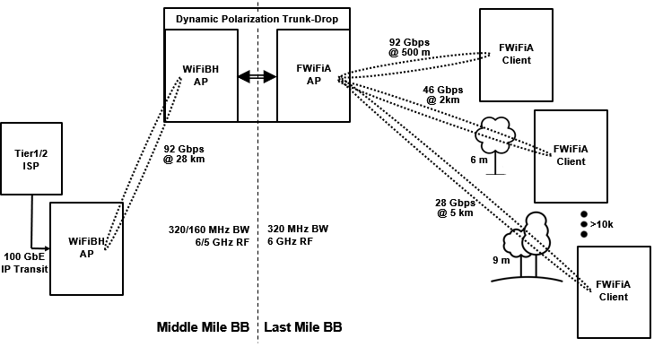
Key DPWiFi Use Cases
Point to Multipoint Ultra-High-Capacity Fixed WiFi Access (“FWiFiA”) Last Mile Broadband BBDP (i.e., a “Dynamic Polarization Trunk-Drop”) to Broadband CPE connectivity
Point to Point Ultra-High-Capacity FWiFiA Backhaul (“WiFiBH”) Middle Mile Broadband Internet Exchange Point (Broadband Source) to Broadband Distribution Point connectivity

Slide 10
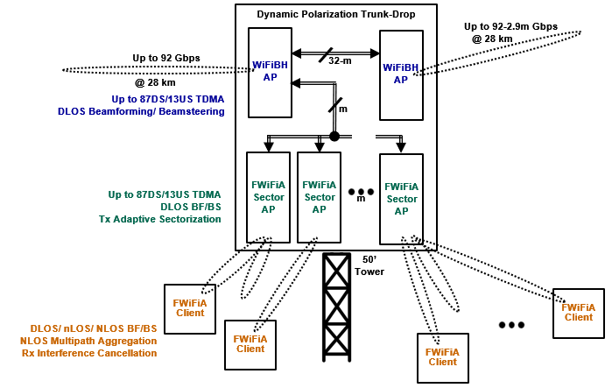
Dynamic Polarization Trunk-Drop Architecture

Slide 11
Proposed Dynamic Polarization-complementary TGbn Tasks
Although possessed of the world’s fastest Physical Layer, the proposed DPWiFi constructs need further associated PHY/MAC extensions to yield truly compelling products and services:
Link Throughput Maximization TDMA MAC (Let’s max out the already massive pipe)
AP up to 90%/ 10% Downstream/ Upstream traffic split
AP up to 32k Client Access List
Direct-/ near-/ Non-Line-of-Sight Link Optimization PHY (Gotta deal with those pesky almost universally obstructed Base Station-Subscriber links)
MIMO AP Tx DLOS Beamforming/ Beamsteering
MU-MIMO AP Tx Adaptive Sectorization
MIMO Client Rx DLOS/ nLOS/ NLOS Beamforming/ Beamsteering
MU-MIMO Client Rx AP Beamsplit Multipath Aggregation/ Diversity Combining
Resilient Unlicensed Band Operations PHY (Just like at 2.4 and 5, it’s ultimately gonna be a jungle at 6 GHz)
MU-MIMO Client Rx Interference Cancellation
This is a call for any and all interested doteleveners to collaborate with TWI in developing these mission-critical DPWiFi capabilities

Slide 12
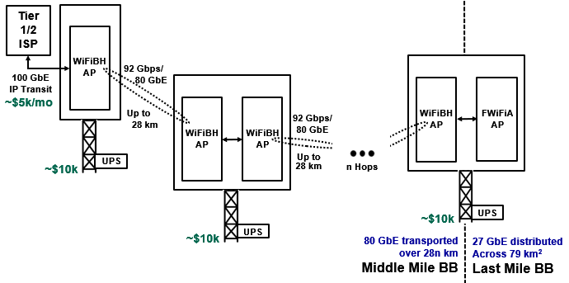
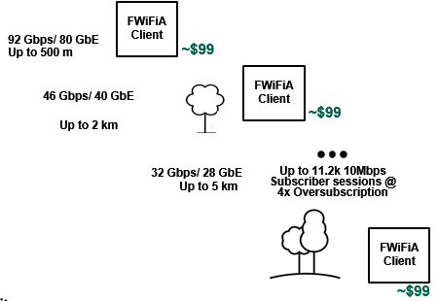
Representative “Municipal Fixed WiFi Access” Network
Link Type | Data Rate | Range | Network Capacity
WiFiBH AP-AP | 92.2 Gbps | 28.0 km/ Free Space | 80 GbE @ 87/13 TS
FWiFiA AP - Client | 92.2 Gbps 46.1 Gbps 36.9 Gbps 18.5 Gbps 13.8 Gbps | 300 m/ Free Space 1 km/ 6m Foliage 2.5 km/ 6m Foliage 5km/ 6m Foliage 10 km/ 6m Foliage | 80 GbE/ 32.0k Subs 52 GbE/ 20.8k Subs 38 GbE/ 15.2k Subs 27 GbE/ 10.8k Subs 16 GbE/ 6.4k Subs
Subscriber-Allocated Muni FWiFiA Costs | 6 GHz RF Attn
DPWiFi Infrastructure | <$10
DPWiFi CPE | $99
60/60/24/7 10Mbps BB | <$1/ mo
A single “Muni FWiFiA” DPWiFi AP distributes <$20/mo 60/60/24/7 10 Mbps to over 10k Subscribers

Slide 13
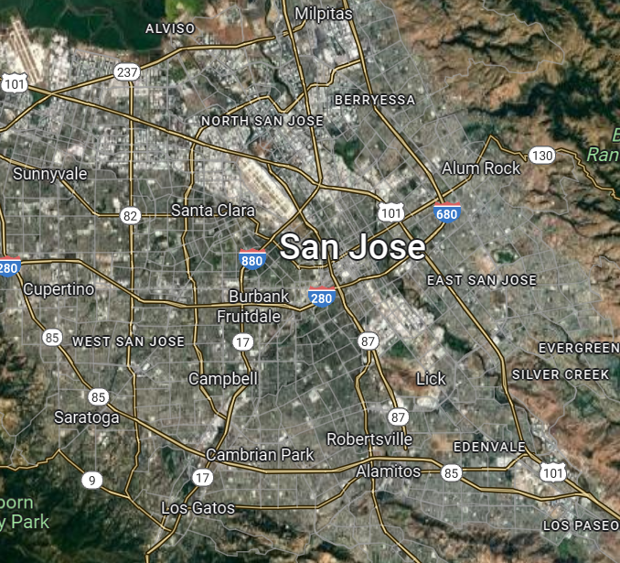
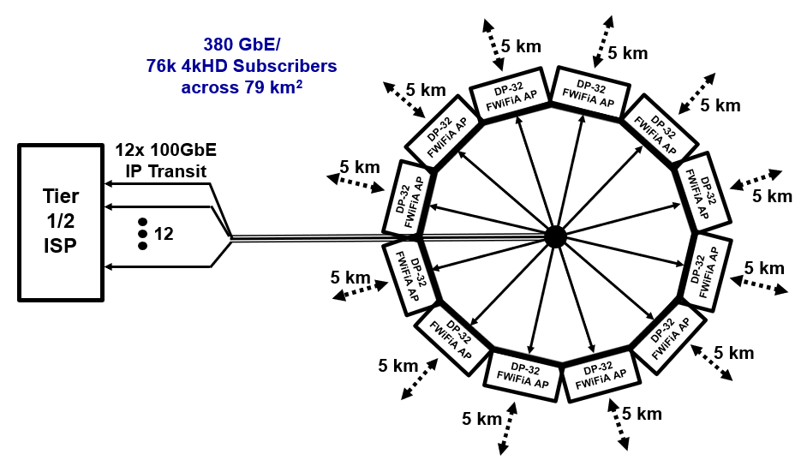
Representative “Metropolitan Fixed WiFi Access” Network
~$60k/mo
~$250k
Link Type | Data Rate | Range | Network Capacity
12x FWiFiA AP - Client | 1.11 Tbps 553 Gbps 443 Gbps 222 Gbps 166 Gbps | 300 m/ Free Space 1 km/ 6m Foliage 2.5 km/ 6m Foliage 5km/ 6m Foliage 10 km/ 6m Foliage | 960 GbE/ 384k Subs 624 GbE/ 250k Subs 456 GbE/ 182k Subs 324 GbE/ 130k Subs 192 GbE/ 77k Subs
User-Allocated Metro FWiFiA Costs | 6 GHz RF Attn
DPWiFi Infrastructure | <$2
DPWiFi CPE | $99
60/60/24/7 10Mbps BB | <$1/ mo
A dozen “Metro FWiFiA” DPWiFi APs distribute <$20/mo 60/60/24/7 10 Mbps to over 125k Subscribers

Slide 14
What Does All This Mean to Us 802.11 folk? (One Guy’s Idle Musings, Analyses and Conclusions )
Musing 1: DPWiFi FWiFiA will promptly obsolete all other WAN Broadband connectivity technologies Analysis 1: DPWiFi can deliver Any Time, All the Time 4kHD Home BB for, what, ~$15/mo? $10? $5? Cable delivers Sometimes 4kHD Home BB for ~$60/mo 5G does NOT deliver Any 4kHD Home BB, at any price FTTP and LEOSat BB aren’t even in the conversation Conclusion 1: Most of the world’s 1.4B fixed Broadband connections will rapidly migrate to DPWiFi once WiFiBH and FWiFiA equipment become widely available
Musing 2: There will be enormous, immediate and lasting demand for DPWiFi Analysis 2: Assuming just 1.2B DPWiFi BB migrations means ~400M new DPWiFi subs/yr for 3 years, or 400M (3-yr life) DPWiFi Clients sell annually for the foreseeable future Given 1 FWiFiA AP per 2000 Clients, 2 WiFiBH APs per FWiFiA AP and a systemic 3x network overbuild means (4e8/2e3 x 3 x 3 =) 1.8M DPWiFi APs sell yearly, also ftff Conclusion 2: WiFi chip/radiomakers will sell as much DPWiFi as they can build, as fast as they can build it
Musing 3: DPWiFi equipment could come available much faster than many would expect Analysis 3: As the DPWiFi PHY comprises a trivial WiFi-7 spin, DP-32 SoC platforms could arrive by 2025 100k’s of WiFiBH/FWiFiA APs and 10M’s of FWiFiA Clients then should come available by 2026 Conclusion 3: To much popular acclaim, IEEE802.11bn-compatible APs and Clients, as well as thereby-enabled breakthrough Internet services, could long precede formal TGbn standardization

Slide 15
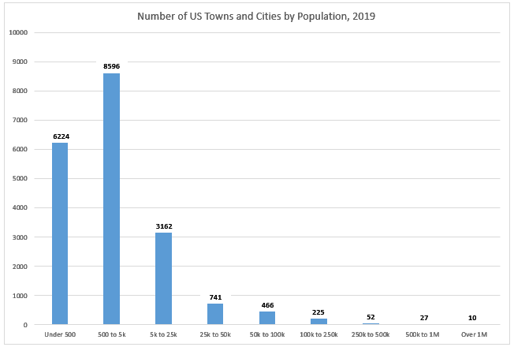
A Substantiating Concrete, Imminent Example (One Guy’s Not so Idle MA&C)
NsI Musing 1: Per the graph, ~12.5k towns in the USA boast between 500 and 50k residents NsI Analysis 1: Those towns comprise ~75M (generally Broadband-underserved) households
Represent the entire (overwhelmingly untapped) market for ~1k US WISPs
Just 1-2 TownWiFi buildouts each would well-BB-serve ALL those towns Those 1k WISPs are ready, willing and able to build out the instant DPWiFi arrives!
NsI Conclusion 1: The USA market demand for DPWiFi APs and Clients on Day 1 of availability:
70M FWiFiA Clients + 70k WiFiBH/ FWiFiA APs

Slide 16
Proposed Dynamic Polarization PHY Summary
The novel DPWiFi PHY presented here, a way-out-of-left-field MIMO Multiplexing re-think, would launch 802.11 into the rarefied 100GbE-over-kilometers realm long dominated exclusively by fiber
Further PHY and MAC extensions deliver the ultra-high reliability performance required by carrier class PMP and P2P DPWiFi
Dynamic Polarization and recommended extensions deserve serious consideration for adoption by the new IEEE802.11bn standard

Slide 17
One Final Thought
Having studiously avoided those trite 4 little words until now:
IEEE802.11bn Dynamic Polarization WILL finally, uniquely, definitively and irreversibly BtDD for anyone and everyone, anytime and all the time, anywhere and everywhere on the planet

Slide 18
Appendix A
DPWiFi Analysis

Slide 19
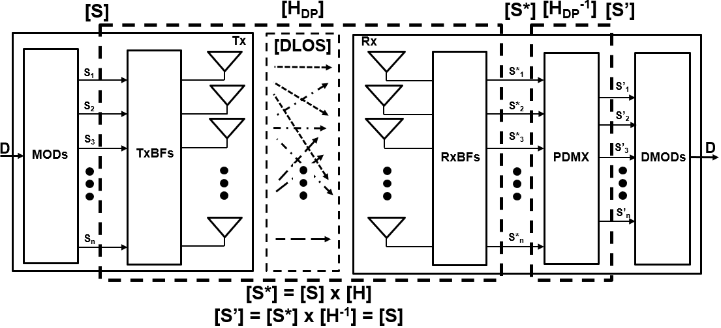
Reciprocally Interference-Free Cochannel Propagation of Unrestricted Count RF Spatial Streams in DLOS Channels
MIMO Dynamic Polarization Multiplexing and Beamforming
DPWiFi Propagation Channel Model
[H_{DP}] represents the DPWiFi medium transfer function as well as the TRX Polarization Multiplexer
If [H_{DP}] is non-singular, it has an inverse [H_{DP}]⁻¹ representing the TRX Polarization Demultiplexer
The analysis following will verify [H_{DP}] non-singularity and gauge its computational tractability

Slide 20
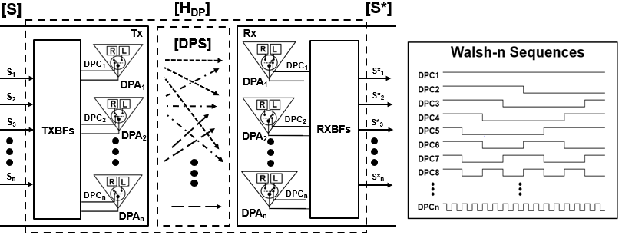
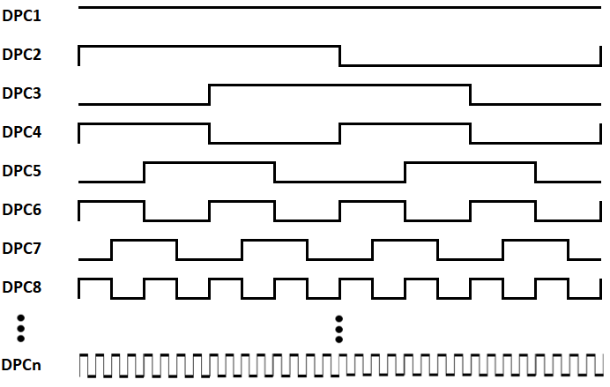
[H_{DP}] Characterization
“n” selectable Dual-Pol Tx Antennas (“DPAs”) distinctly Polarize n RF Spatial Streams [S] (S_{i}, i = 1, 2 … n) with n respective Walsh-m (m>n) binary orthogonal codes [DPC] to yield the polarization-decorrelated [DPS]
Transmit Beamforming (TxBF) aggregates all the DPS_{i} for high directivity transmission toward n Rx DPAs
n Rx DPA “matched polarization filters” De-polarize [DPS] using the same Tx Walsh sequences prior to high directivity RxBF detection, thereby yielding the (DPWiFi) polarization-multiplexed [S*] (S*_{ij}, i, j = 1, 2 … n)

Slide 21
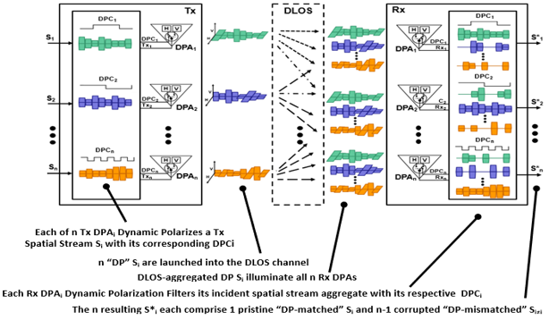
[H_{DP}] Operation
As the DPC_{i} all comprise Walsh binary orthogonal sequences,
ALL S*_{i=j} = 1 and ALL S*_{i≠j} = r, where r (in theory) equals 0.5

Slide 22
[H_{DP}] Dynamic Polarization Multiplexer Representation
In practice, however, the [H_{DP}] DPWiFi Propagation Channel correlation index r corresponds to the cross-pol isolation measured between a realizable Rx DPA’s selectable orthogonally polarized elements
For example, commercially available X-band Dual-Pol antennas spec xpol iso at -25dBc typical
Therefore, [H_{DP}] can be expressed as
[H_{DP}] is non-singular (as well as deterministic, time-invariant and uniform), meaning there exists an [H_{DP}]⁻¹ DPWiFi Polarization Demultiplexer that is also deterministic, time-invariant and uniform (!)

Slide 23
[H_{DP}]⁻¹ Dynamic Polarization Demultiplexer Representation
So, given the DP Propagation Channel/Polarization Multiplexer represented by
There exists a DPWiFi Polarization Demultiplexer (“PDMX”)represented by

Slide 24
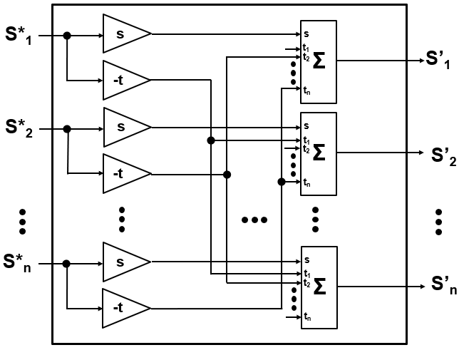
Dynamic Polarization Demultiplexer Implementation
The DPWiFi Polarization Demultiplexer operation [S’] = [S*] x [H_{DP}]⁻¹ (= [S]) may be equivalently expressed computationally and by hardware (i.e., the physical TRX PDMX) by:
and
The Dynamic Polarization Demultiplexer comprises trivial hardware

Slide 25
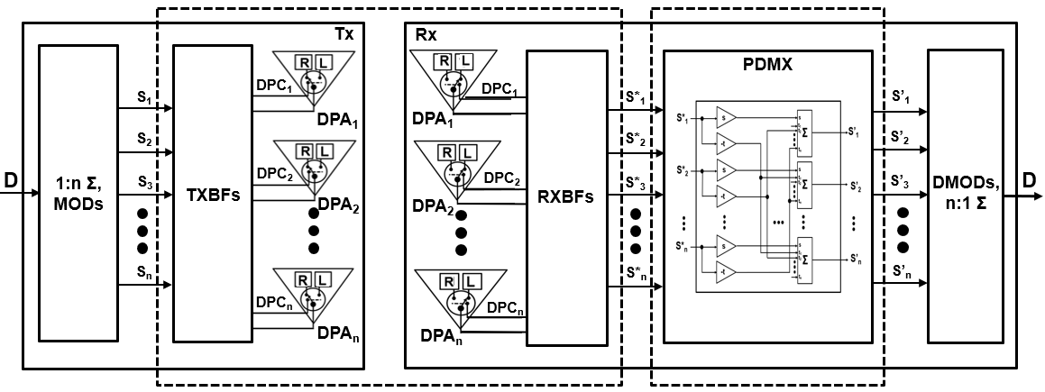
DPWiFi TRX Model
[H_{DP}] DPWiFi Propagation Channel
[H_{DP}⁻¹] DPWiFi PDMX

Slide 26
Appendix B
Illustrative Dynamic Polarization Example:
Closed Form Analysis of a DPWiFi Tx-Rx Link featuring n = 4, r = 0.505

Slide 27
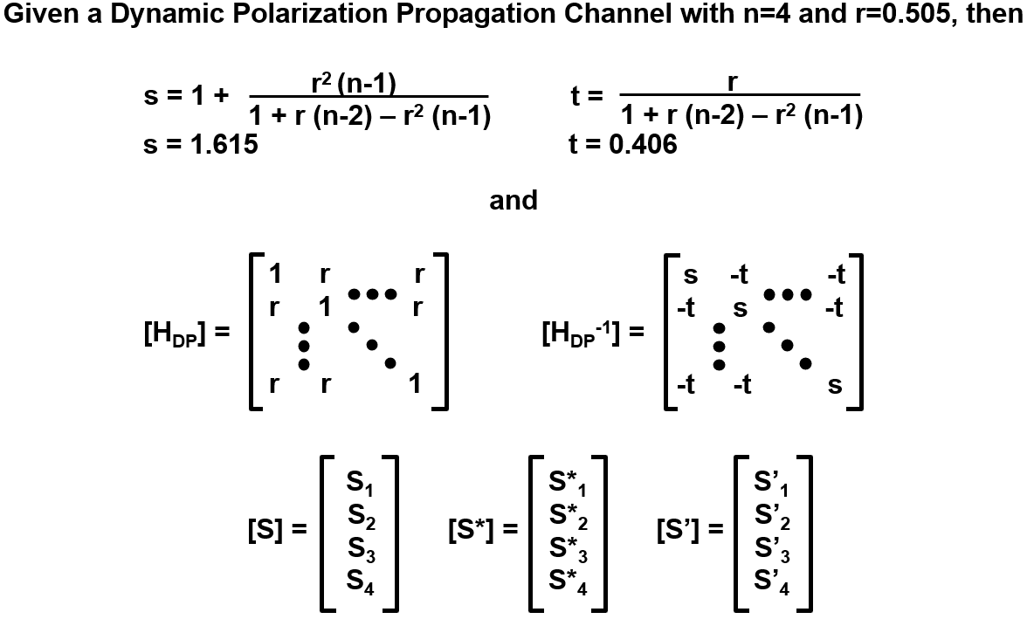
DPWiFi TRX Analysis Part 1

Slide 28
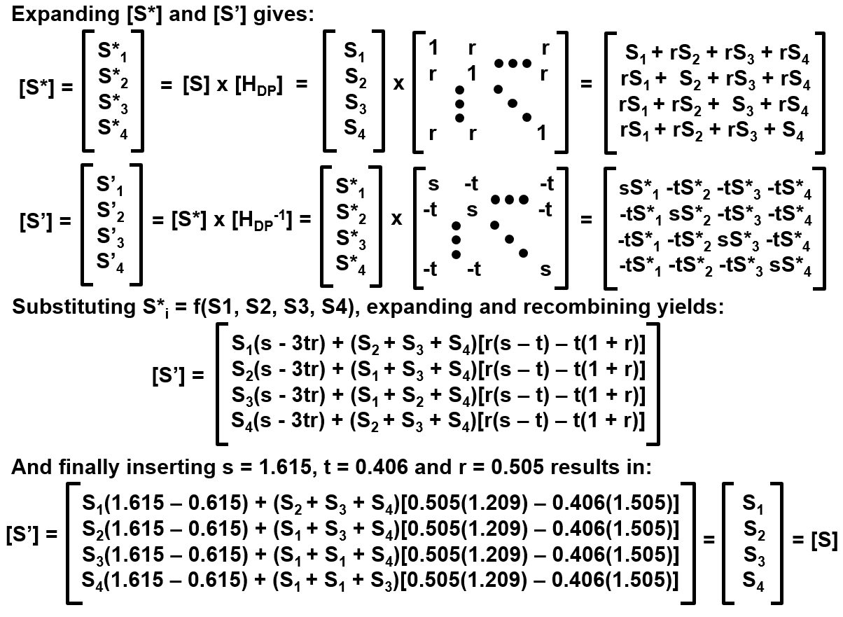
DPWiFi TRX Analysis Part 2

Slide 29
Appendix C
DPWiFi and the Shannon Limit

Slide 30
Dynamic Polarization and the Shannon Limit, Part 1 How does DP-n NOT exceed Shannon’s maximum channel capacity law?
Consider the canonical Shannon Tx-Rx Channel of Figure A, below A signal S₀ of bandwidth BW transmitted through a directional antenna of gain G_{TX} at power level EIRP₀ , detected through another antenna of gain G_{RX} and ultimately received as S’₀ with a S/N ratio SNR₀ propagates across the transmission channel of Shannon capacity C₀ = BW log2 (1 + SNR₀) shown
Consider now a perfectly equivalent Tx-Rx channel in Figure B Directional antennas G_{RX} and G_{TX} replaced by perfectly equivalent phased arrays G_{RX} and G_{TX}

Slide 31
Dynamic Polarization and the Shannon Limit Part 2
And yet another perfect equivalent Tx-Rx in Figure C:
S₀ and S’₀ 1:n splits replaced by equivalent n x S₀ and S’₀ replicas, all traversing distinct C₀ capacity channels
And finally, consider the not-really-sleight-of-hand of Figure D:
n S0 and S’0 replaced by perfectly equivalent distinct Si, i = 1, 2 … n, the phased array antennas by SDPAs and the Rx n:1-1:n splitter combiner by a Pol- Demux, all traversing distinct C₀ capacity channels
An n^{th} order DPWiFi link comprises n Shannon channels, not just one
PDMX

