Slide 1
1st Vice Chair Report - 2023 Nov - Plenary Honolulu
Date: 2023-11-13
Authors:
Notes:
.

Slide 2
Abstract
Agenda Items for 1st Vice Chair –
Monday November 13:
M3.3 II Session Information
M3.4 II Meeting room locations
M3.5 II Meeting registration
M3.6 II Recording attendance
M3.7 II Local File Server Access
M3.8 II Breakfast, breaks, Social logistics
Friday November 17:
F3.1.2 DT WG Straw Poll
F3.1.3 DT Future venues Insight

Slide 3
Monday, November 13, 2023 802.11 WG Opening Plenary
M3.3 II Session Information
M3.4 II Meeting room locations
M3.5 II Meeting registration
M3.6 II Recording attendance
M3.7 II Local File Server Access
M3.8 II Breakfast, breaks, Social logistics

Slide 4
Successful Mixed-mode Meeting Protocol
In-room Attendees:
In Webex choose connect without audio before you join
Use the Webex queue to indicate you want to speak
Wait to be called on while standing/holding a microphone to make a comment
Repeat any questions that are inadvertently asked away from the microphone
Remote Attendees:
Join Webex and set Webex audio as ‘music’
Use the Webex chat window to indicate you want to speak (“q”)
Wait to be called on to speak

Slide 5
November 2023 IEEE 802 Plenary Session
Event Summary and Important Information
Prepared By: Face to Face Events and Jon Rosdahl, November 12, 2023

Slide 6
IEEE 802 Newcomer Orientation
Monday November 13th at 9:00 AM
WHO: IEEE 802 Newcomers (and all others!)
WHAT: IEEE 802 Orientation Program, Details at <https://t.ly/pdtku>
WHEN: Monday 13 November, 9-10 HST
WHERE: IEEE 802 Calendar https://ieee802.org/802tele_calendar.html
HOW TO PREPARE: Please take an hour and get to up speed with a high-level view of IEEE 802 and how it works before you plunge into the session. IEEE 802.15 First Vice Chair Phil Beecher will lead the program. Your questions will be answered.
REGISTRATION FEE: Registration for the IEEE 802 Plenary Session (with fee) is required, whether attending in-person or remotely.

Slide 7
In Person Registration Times and Location
Sunday
Registration Counter, Coral Lounge in Mid Pacific Conference Center
5:00 PM - 7:30 PM
Monday - Wednesday
Registration Counter, Coral Lounge in Mid Pacific Conference Center
7:30 AM - 5:00 PM
Thursday
Event Office, Tiare at Kalia Executive Conference Center
8:00 AM - 5:00 PM

Slide 8
Meeting Planner Contact Information
Dawn Slykhouse, Face to Face Events
Mobile: +1 (408) 594-1342
Email: dawns@facetoface-events.com
Lisa Ronmark, Face to Face Events
Mobile: +1 (604) 316-4947
Email: lisa@facetoface-events.com
Stephanie Williams, Face to Face Events
Mobile: +1 (408) 497-9613
Email: stephanie@facetoface-events.com
Meeting Planner Office: Kalia Executive Conference Center, Tiare
Registration: Mid Pacific Conference Center, Coral Lounge

Slide 9
Network Access Information
SSID: IEEE802
Password: ieeeieee
Encryption Type: WPA2/WPA3
SSID: IEEE802-6G
Password: ieeeieee
Encryption Type: WPA3
Support for 6GHz WiFi
Local Document Server for IEEE 802 Documents: http://ieee802.linespeed.com/
Network Provider and Onsite Network Support
The November 2023 IEEE 802 Plenary Session Network Provider is Linespeed Events.
Richard Alfvin
Mobile: +1 (585) 781-0952
Email: rick@linespeed.com
Members of the Linespeed team can be dispatched by contacting the Meeting Planner directly or by placing a request at the event registration desk.

Slide 10
Schedule of Sessions and Attendance
SCHEDULE OF SESSIONS
In Person Room Assignments: Schedule QR codes posted outside each meeting room and on your badge hand out. http://schedule.802world.com/schedule/schedule/show
Virtual Participation: https://ieee802.org/802tele_calendar.html
ATTENDANCE TOOL (IMAT) : https://imat.ieee.org/
REGISTRATION FEE REQUIREMENT REMINDER
Payment of the session registration fee is required for all individuals who participate in any session associated with the November 2023 IEEE 802 Plenary Session. Registration: https://cvent.me/nwK28E

Slide 11
Audio Visual Support - In Person Sessions
WHO TO CONTACT IF AUDIO VISUAL EQUIPMENT ISN’T WORKING IN YOUR ONSITE MEETING ROOM
Please contact the Meeting Planner directly if you have any issues with the audio visual equipment in your meeting room. The Meeting Planner will contact support and the appropriate technician will be sent to assist as soon as possible.
Meeting Planner can be reached at:
Registration and Information Desk: Coral Lounge
Event Office: Tiare
Via Text or Call: Lisa Ronmark: +1 (604) 316-4947, Stephanie Williams +1 (408) 497-9613
WEBEX AUDIO IN THE ONSITE MEETING ROOM
If you are a local participant, PLEASE, select “Don’t connect to audio” when joining the WebEx session. Connecting to the audio, November cause an audio feedback loop that prevents the meeting from proceeding

Slide 12
Food and Beverage Breaks
FOR REGISTERED ATTENDEES ONLY
Light Breakfast
Coral Lounge, 2nd Floor
Monday - Friday
7:15 AM - 8:15 AM
Morning Coffee & Tea Break
Coral Lounge, 2nd Floor
Monday - Thursday
9:50 AM - 10:35 AM
Lunch
Coral III, 2nd Floor
Monday - Thursday
12:00 PM - 1:30 PM
Afternoon Break
Coral Lounge, 2nd Floor
Monday - Thursday
3:00 PM - 4:00 PM

Slide 13
Request for information on F&B Friday needs
During WG Opening Meetings
1. If you will attend one of the three meetings on Friday, November 17, 2023 ( 802 EC Closing Plenary, the 802.11 Closing Plenary or the 802.1 " IEC/IEEE 60802" meeting ) will you participate (eat/drink) :
With breakfast? -
with the AM Break? -
With lunch? -
With PM Break
Due end by end of Monday (Today)

Slide 14
IEEE 802 Networking Social
Wednesday November 15th at 6:30 PM
WHO: All registered attendees and their guests.
WHAT: Casual Networking Reception with refreshments, bar service and musical entertainment.
WHERE: Great Lawn
PARTICIPATION WRISTBANDS
All individuals (including children over the age 8) attending the Social event must wear a wrist band. Wrist Bands and drink ticket shall be distributed with Name Badges at the Plenary Session registration desk. If you plan to have guests attend please pick up their wrist bands by this time. Late requests may not be accommodated.
Please contact the Meeting Planner if have any questions.

Slide 15
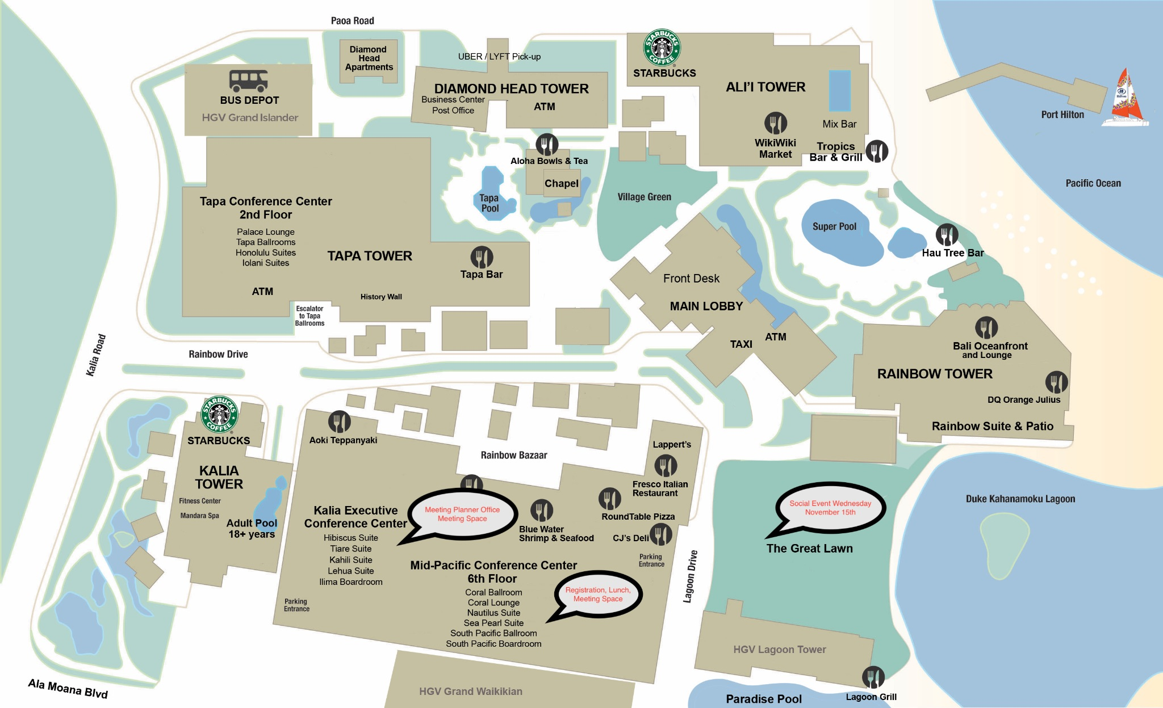
Resort Map - Meeting Space, Lunches, Social Locations Highlighted

Slide 16
Next IEEE 802 Plenary Session – March 2024
The next IEEE 802 Plenary Session will be March 10-15, 2024. The session will be a Mixed Mode with In-Person participation at the Hyatt Regency Denver. If you have any questions please email: 802info@facetoface-events.com
Information and Registration
IEEE 802 Session Registration opens Dec 1, 2023
Early Registration Deadline : Friday January 12, 2024
Group Hotel Reservations: Hyatt Regency Denver at Colorado Convention Center
Available Soon
Hotel Reservation Booking Cut Off Date: February 16, 2024
Future Plenary Sessions (802world.org)

Slide 17
M3.6 Recording attendance
It is a requirement that attendees record their participation at an 802.11 session and declare their affiliation. This record is usually made using the IMAT attendance system.
If you wish to participate without recording attendance, send an email per session to the WG 2nd vice chair declaring your participation and affiliation. You cannot gain or maintain 802.11 voting membership using this method.
You must record 75% attendance of required 802.11 slots in a session for that session to count towards gaining or maintaining 802.11 voting membership
You need a single IEEE-SA web account
The IEEE SA web account requires a working email address
do not remove your email address from the account
Use the email address associated with that web account when registering attendance
If you change email addresses, update the web account, don’t create a new web account, or your membership status may not be calculated properly
Record attendance using this URL: IMAT.IEEE.ORG/

Slide 18
Registration Report Nov 12, 2023
As of Nov 12, 2023 | Column Labels
Nov Registration | In-Person Attendee | Virtual Attendee | Student | Grand Total
Accepted | 478 | 416 | 7 | 901
802.1 | 43 | 24 |  | 67
802.3 | 125 | 127 |  | 252
802.11 | 261 | 234 | 6 | 501
802.15 | 42 | 28 | 1 | 71
802.18 | 3 | 2 |  | 5
802.19 | 1 | 1 |  | 2
802.24 | 3 |  |  | 3
Cancelled | 3 | 1 |  | 4
(blank) | 3 | 1 |  | 4
Grand Total | 481 | 417 | 7 | 905

Slide 19
Friday, November 17, 2023 802.11 WG Closing Plenary
Agenda Items:
3.1.2 DT Straw Poll regarding meetings
3.1.3 DT Future venues status and discussion

Slide 20
Straw Poll: Return to This Venue: (Hilton Hawaiian Village, Honolulu)
1. How many people would like to come back to this venue?
Yes –
No –
2. Did you go to the social?
Yes –
No –
3. If you attended the Social, did you like the social?
Yes –
No –
Notes:
Show of Hands of those in the room.

Slide 21
Straw Poll: January 2024 – Panama Interim
1.If the 2024 January 802 Wireless Interim Session were held at the Hilton Panama, Panama City, Panama as an in-person only session, would you attend?
Yes –
No –
Abstain -
2. If the 2024 January 802 Wireless Interim Session were held at the Hilton Panama, Panama City, Panama as mixed-mode session, will you attend:
Attend In-person --
Attend Virtually (remotely) -
Will not attend plenary -

Slide 22
Straw Poll: 2024 March - Denver Plenary
1.If the 2024 March 802 Plenary Session were held at the Hyatt Regency Denver at Colorado Convention Center, Denver, CO, as an in-person only session, would you attend?
Yes –
No –
Abstain -
2. If the 2024 March 802 Plenary Session were held at the Hyatt Regency Denver at Colorado Convention Center, Denver, CO as mixed-mode session, will you attend:
Attend In-person --
Attend Virtually (remotely) -
Will not attend plenary -

Slide 23
Future Interim Venue Status
As of Nov 13, 2023
2024-01 (14-19) Panama (Rebooked from Jan 2022)
2024-05 (12-17) Warsaw, Poland – (Rebook from May 2022)
2024-09 (8-13) Waikoloa, HI
2025-01 (12-17) Kobe, Japan – TBC (Moved from May 2023)
2025-05 (11-16) – RFP - Europe
2025-09 (14-19) Waikoloa, HI
2026-01 (11-16) - RFP
2026-05 (10-15) – RFP - Europe
2026-09 (13-18) Waikoloa, HI
2027-01 (10-15) - RFP
2027-05 (9-14) – RFP Asia (could rotate J-M-S)
2027-09 (12-17) - RFP
Meeting Planner:
Starred Venues :MTG Events Dotted Venues: Face to Face Events
Notes:
Future Wireless Interim Meetings: review and status Sept 1, 2023
In General, Each year one Session must be Non-NA/US – Odd years Asia – Even Years Europe
2024 January 14-19 – Hilton Panama, Panama – Contract executed (802WFIN-21/31r0)
2024 May 12-17 - Warsaw Marriott, Warsaw, Poland– Contract signed by hotel in IEEE legal processing
2024 Sept 8-13 - Hilton Waikoloa Village – Contract executed (802WFIN-20/12r0)
2025 Jan 12-17 – Kobe, Japan – in negotiations
2025 May 11-16 – Open – Target Europe - RFP
2025 Sept 9-14 - Hilton Waikoloa Village, Waikoloa, HI – Contract executed (802WFIN-22-0007r0)
2026 Jan 11-16 – RFP – Open (NA/Asia)
2026 May 10-15– RFP – Open (Asia/NA)
2026 Sept 13-18 Hilton Waikoloa Village, Waikoloa, HI – Contract executed (802WFIN-22-0008r0)
2027 Jan 10-15 – RFP – Open (NA/Asia)
2027 May 9-14 – RFP – Open (Asia/NA)
2027 Sept 12-17 – RFP – Open (NA/Asia)

Slide 24
Future Venue Contract Status
2024 March 10-15 – Hyatt Regency Denver at Colorado Convention Center, Denver, CO, (March 2021)
2024 July 14-19 – Sheraton Le Centre Montreal, Montreal, Quebec, Canada (July 2020)
2024 Nov 10-15 –Hyatt Regency Vancouver, Vancouver, Canada (Nov 2021)
2025 March 9-14 –Hilton Atlanta, Atlanta, GA, United States (2 of 2 – March 2020).
2025 July 13-18 –Melia Castilla, Madrid Spain
Was Marriott Madrid Auditorium (July 2021) – Changed to co-locate with IETF the week after.
2025 Nov 9-14 – Open –RFP NA
2026 March 8-13 -, Hyatt Regency Vancuver
Was Hyatt Regency Chicago (March 2024) changed due to cancel of Hyatt Regency Chicago
2026 July 13-18 – Le Centre Sheraton Montreal, Montreal (July 2022 attrition offset)
2026 Nov 8-13 - Open – RFP Asia
2027 March –Hilton Atlanta, Atlanta, GA, United States ( offset potential shortfall 2023/2025)
2027 July 11-16 - Open –RFP Europe
2027 Nov 14-19 – Hawaiian Village, Oahu, Hawaii, United States
802 EC Approved – Contract is being Negotiated.
Nov 13, 2023
Notes:
As of 11-13-2023
Yellow Highlight – Was replaced – circumstances cause another change.
Blue Highlight – replacement dates for venues deferred.
Light Green highlight – potential targets for possible deferrals or offset penalties.
Dark Green Highlight – rebooked due to COVID
Red – Cancelled – Electronic Plenary
No highlight – pre Covid assigned dates/venues. Note: 2026 March - RFP -2019 - Hyatt Regency Chicago selected for March 2023, Contract not signed due to PSAV - Moved to 2024 March - then moved to 2026 due to agreement with rebooking Denver 2024.
Executed Contract
items are Venues approved by IEEE 802 EC, but Contract not complete.
These are open Calendar items I am working with potential venues.
Calendar open
https://mentor.ieee.org/802-ec/dcn/20/ec-20-0001-05-00EC-802-plenary-future-venue-contract-status.xlsx

Slide 25
References
1. Plenary Meeting Status File: 802 EC-22/0003r0
https://mentor.ieee.org/802-ec/dcn/22/ec-22-0003-00-00EC-future-802-plenary-venue-contract-status.xlsx
2. IEEE 802WCSC Meeting Venue Manager Report: 802 EC-23/0001r05
https://mentor.ieee.org/802-ec/dcn/23/ec-23-0001-05-WCSG-ieee-802wcsc-meeting-venue-manager-report-2023.pptx

