Slide 1
Roaming Consideration in UHR SG
Date: 2023-XX-XX
Authors:
Name | Affiliations | Address | Phone | Email
Yue Xu | Huawei | Huawei Nanjing R&D Institute, Nanjing, Jiangsu, China, 210012 |  | xuyue57@Huawei.com
Chenhe Ji
Chun Pan
Xiaofei Bai

Slide 2
Introduction
Roaming is one of the criteria that needs to be continuously considered and improved throughout the development of WLAN. The UHR SG also sets the KPI requirements for roaming.
So far, almost all roaming-related proposals have ‘seamless’ or ‘smooth’ as a highlight or key point to show their contributions (high-level or specific). However, few proposals address specific roaming metrics or attainable performance. They are ambiguous.
In this contribution, we do a quick survey of current roaming-related contributions and provide some workable details to make statements of the roaming and future roaming-related recommendations clearer.

Slide 3
Background (Roaming related)
Scope:
Need:
Roaming-related contents are relatively ‘simple’ in the UHR SG official document [1]. But, so far, roaming-related proposals and contributions are relatively clear and unified, ‘seamless’ or ‘smooth’ , in terms of KPI.

Slide 4
Survey of current contributions
DCN | Title | Briefs
0231 | thoughts-on-seamless-roaming-under-the-non-collocated-ap-mld-architecture [3] | Roaming in MLO MAC-layer logic sorting and operation design
1910 | seamless-roaming-for-uhr [4] | Roaming in MLO ‘No limitations but ideally short (10s of ms)’
0170 | smooth-roaming-discussion [5] | Roaming in MLO
0279 | considerations-on-seamless-roaming [6] | Roaming in MLO
0332 | improve-roaming-between-mlds [7] | Roaming in MLO Reduce latency
0324 | roaming-requirements [8] | Roaming in MLO 4 optional roam goal
1131 | thoughts-on-seamless-roaming [9] | Roaming in MLO
0632 | smooth-roaming-follow-up [10] | Roaming in MLO
1090 | seamless-roaming-follow-up [11] | Roaming in MLO

Slide 5
Example of Roaming Requirements (1/2)
Besides the quick survey, we also list several general scenarios to illustrate the need for high roaming performance in WLAN. And the underlined terms explain why we need ‘seamless’ (or ‘smooth’) roaming.
AGV (Automated Ground Vehicle) / AMR (Autonomous Mobile Robot) [2] | Involving communication, including guidance control, process data exchange, video/image, and emergency stop, between robots and a control system,
Mobile UAV Sensors [2] | Mobile to different working zone and periodical report of information to the control system. High-density deployment environment.
Online Conference | The key frames (such as P frames) of the video have to ensure smooth conference performance without frame freezing.
In the following slide, we provide one real AGV example to represent how ‘high’ the roaming performance is required in industrial WLAN scenarios.

Slide 6
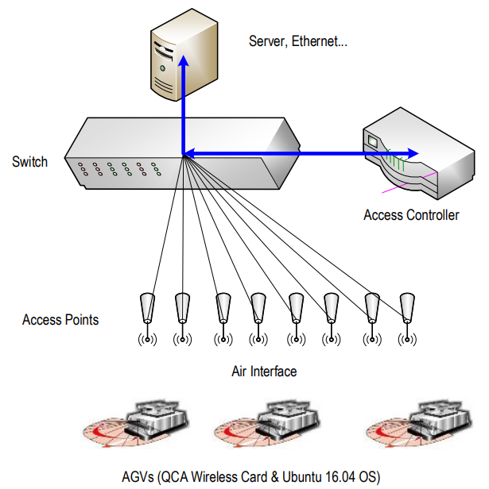
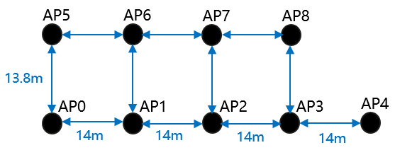
Example of Roaming Requirements (2/2)
The real AVG requirements of Roaming are (Acceptance Criteria):
Criteria | Value | Briefs
Roaming Latency | <= 100ms | The Latency includes data transmission latency and BA negotiation The combination of the two parameters indicates that services are seamless in industrial scenarios. For example, if STAs roam 2000 times a day, the system allows only one offline per week.
Roaming Successful Rate | >= 99.99%
 |  | Emphasize that the roaming delay on MLD should be less than 100ms (complete the connection on the data plane) and the reliability (the probability of no timeout) should be 99. 99%.
Response Latency | <= 100ms@99.99%
continuous packet loss rate | <= 0.01% | Probability of two consecutive packet losses (For example, if STAs roam 2000 times a day, the system allows only one offline per week.)
Illustration of AGV Environment
Compared to the roaming related content in the UHR SG, there is a gap between real scenarios’ requirements.
Deployment of APs

Slide 7
Target Consideration for Roaming
According to the survey, all roaming-related proposals (both title and content) emphasize seamless roaming or smooth roaming (The term is relatively mildly, but it's actually a seamless way around).
However, there is a huge gap between this feature and the roaming performance proposed in the UHR SG, which has caused the roaming-related content to become ‘outdated’ and inaccurate.
Understanding that the PAR has already been submitted to IEEE SASB for approval that any update may be challenging, the UHG SG (and the future TGbn) may consider the following roaming requirement during the development of functional requirements and specification framework (for example):
- WLAN devices need to meet efficient roaming requirements in feature scenarios, especially in industrial scenarios. Thus, the roaming requirement should ensure that the roaming latency is no more than 100ms, the roaming success rate is greater than 99.99% (service level), the response latency is no more than 100ms with 99.99% reliability, and the continuous packet loss rate is no more than 0.01%.

Slide 8
Summary
We compared roaming performance in the UHR SG official document (e.g., PAR) , the proposals related to roaming in the SG, and real needs, and found performance gaps among them. Such gaps have made the criteria of roaming somewhat outdated and ambiguous. A way forward option to update the roaming requirement is proposed if the SG agrees with the performance gaps.

Slide 9
References
[1] UHR proposed PAR, IEEE 802.11-23/480
[2] “Wi-Fi 6/6E for Industrial IoT,” WBA (Wireless Broadband Alliance), May 2018.
[3] Thoughts-on-seamless-roaming-under-the-non-collocated-ap-mld-architecture, IEEE 802.11-23/0231r0
[4] Seamless-roaming-for-uhr, IEEE 802.11-22/1910r3
[5] Smooth-roaming-discussion, IEEE 802.11-23/0170r1
[6] Considerations-on-seamless-roaming, IEEE 802.11-23/0279r0
[7] Improve-roaming-between-mlds, IEEE 802.11-23/0322r0
[8] Roaming-requirements, IEEE 802.11-23/0324r1
[9] Thoughts-on-seamless-roaming, IEEE 802.11-23/1131r0
[10] Smooth-roaming-follow-up, IEEE 802.11-23/0632r1
[11] Seamless-roaming-follow-up, IEEE 802.11-23/1090r0

