Slide 1
Use case for distributed RUs in Downlink
Date: 10-Sep-23
Authors:

Slide 2
Introduction
OFDMA uses Resource Units (RU) to assign distinct parts of the bandwidth to different users
In 802.11ax, 802.11be, RUs are contiguous (apart from puncturing)
i.e., consisting of consecutive, adjacent tones
In [1], the concept of “distributed RU” (dRU) was introduced
Tones assigned to a user are spread across the bandwidth
Mostly for UL OFDMA to overcome the regulatory PSD limits
In [2], the performance of dRU under residual CFO is investigated

Slide 3
dRU in downlink
Both [1] and [2] explicitly consider dRU in the uplink direction
Use of dRU in downlink does not provide the ability to boost power as proposed in [1] for uplink OFDMA
Are there other possible benefits from using dRU in downlink?
In this submission, we investigate a possible use case for dRU in the downlink direction

Slide 4
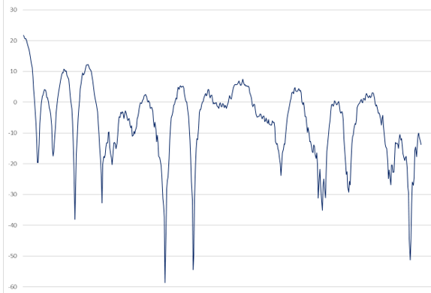
Disadvantage of “regular” RU
The wireless channel may exhibit strong frequency selectivity
The optimal MCS for an RU could vary significantly depending on its position within the total bandwidth
Separate RUs may require separate rate adaptation
SU rate adaptation is different from OFDMA rate adaptation

Slide 5
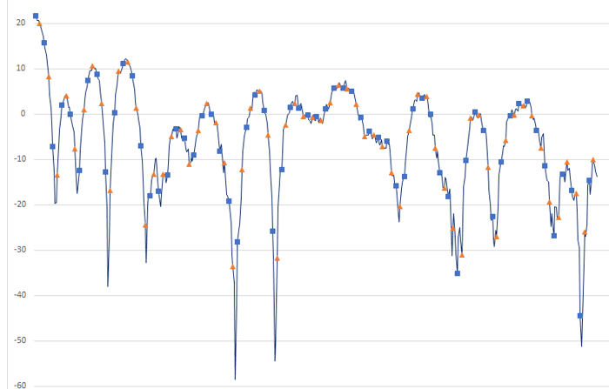
Distributed RU in downlink
For a dRU, the tones can be effectively spread across the whole spectrum
“sampling” the entire bandwidth
For instance:
distributed RUs exhibits very similar channel conditions
Essentially the same as SU channel

Slide 6
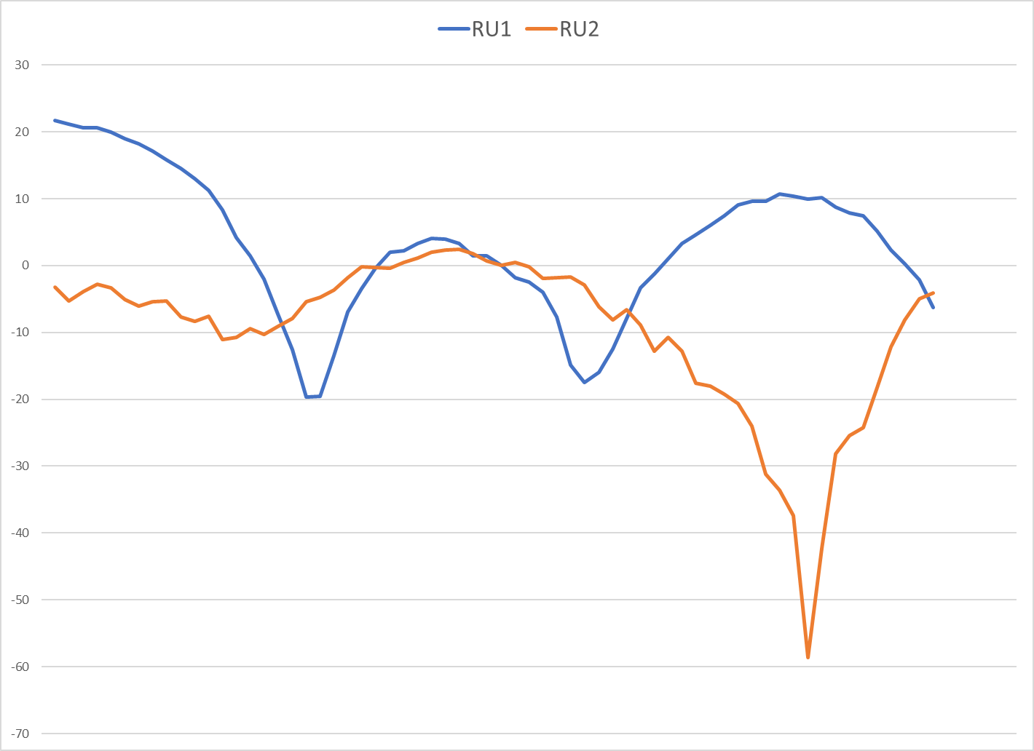
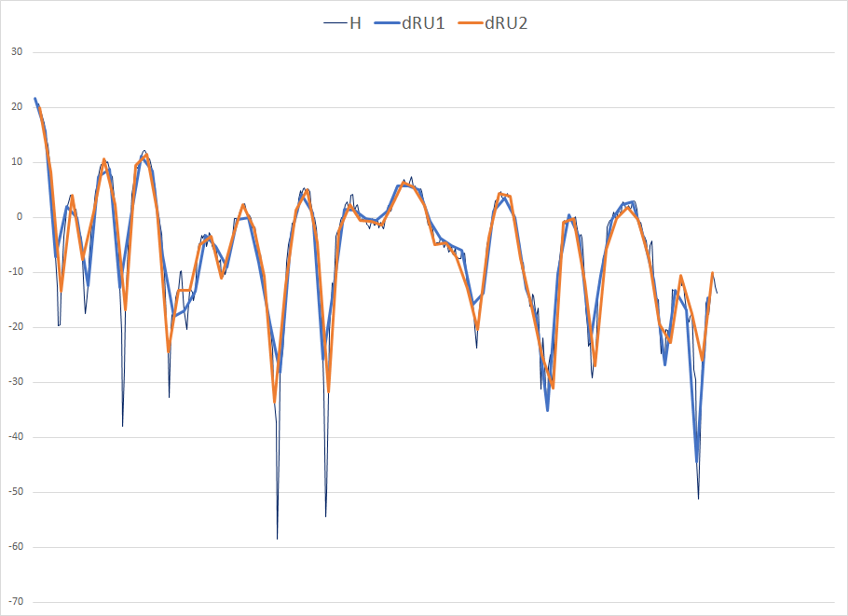
Example: channel conditions for different RUs
“regular” RU | Distributed RU

Slide 7
Rate adaptation with dRU
Intuitively, optimal MCS values for different distributed RUs should be very similar, if not identical
Also identical to SU rate adaptation
Rate adaptation could effectively be performed independently of the “location” of the RU – or even the size of the RU
Eliminate the need for separate rate adaptation for (potentially) each RU location
Or, conversely, no need to restrict non-AP STA to single RU
Only a single rate adaptation training is needed
Covering both OFDMA and SU
The MCS value for a given RU does not risk getting “out of date” because the specific RU hasn’t been used for a while

Slide 8
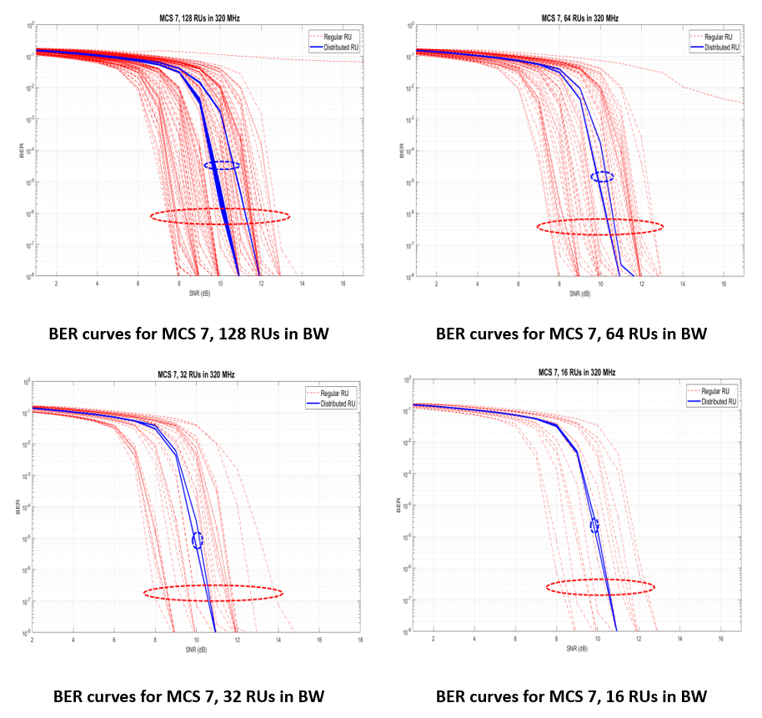
BER curves of all possible RUs and dRUs

Slide 9
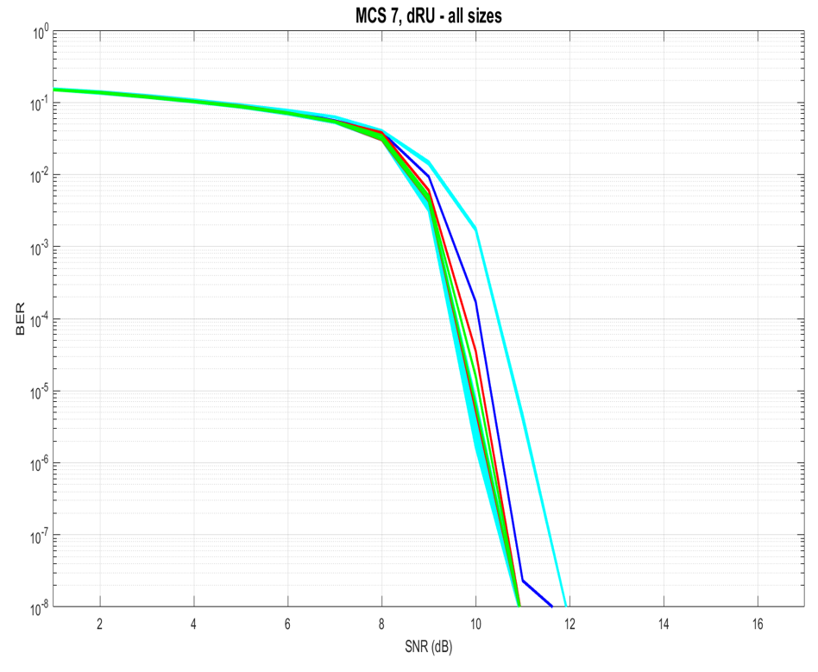
BER curves for dRUs of different size

Slide 10
Observations
There is a significant spread in the BER curves of “regular” RUs
BER curves of distributed RUs (locations and sizes) are very close together
Rate adaptation could be performed independently of the location or size of the RU
Identical for SU and OFDMA
Note: Rx smoothing could be impacted
STA could still estimate full channel

Slide 11
Pilot Tones for dRU
Each “regular” RU has a number of pilot tones within its frequency boundaries
spaced relatively closely together, especially for smaller RUs
Each distributed RU is spread across the full bandwidth
We could define a single set of pilot tones (e.g., 16 tones for 80 MHz), that can be used/shared by all of the distributed RUs
Better tracking for “smaller” RUs
Better frequency separation of pilot tones
Single tracking algorithm for all RU sizes and locations

Slide 12
Conclusions
Distributed RUs have been mostly considered for UL transmissions
There is a use case for distributed RUs in downlink
Unified and convenient rate adaptation
Common set of pilot tones for all RUs

Slide 13
References
[1] 11/23-0037 UHR Feature to Overcome PSD Limitations Distributed-Tone Resource Units, https://mentor.ieee.org/802.11/dcn/23/11-23-0037-00-0uhr-uhr-feature-to-overcome-psd-limitations-distributed-tone-resource-units.pptx
[2] 11/23-1115 CFO Impact and Pilot Design for dRU, https://mentor.ieee.org/802.11/dcn/23/11-23-1115-00-0uhr-cfo-impact-and-pilot-design-for-dru.pptx

