Slide 1
Dynamic Polarization Spatial Multiplexing and Beamforming WLANs:
A Sneak Preview
Date: 2023-09-11
Authors:

Slide 2
Abstract
A radically new “Dynamic Polarization Spatial Multiplexing and Beamforming” candidate 802.11 PHY (to be unveiled at tomorrow’s WNG session) is summarized herein. Capable of wireless backhauling up to 92 Gbps within 320 MHz at 6 GHz beyond 18 km, “DPSMXBF” merits serious consideration as an integral PHY for the nascent TGbn.

Slide 3
Dynamic Polarization WLANs
Proposed “DPSMXBF” 802.11 PHY
32 IEEE802.11be RF spatial streams
  32x32 MIMO Spatial Multiplexing
  32x32 MIMO Beamforming
  5-7 GHz UNII Operation
  4096 QAM
  320 MHz BW
  92,224 Mbps peak Data Rate
  > 550 m WLAN Free Space Range
  > 2.8 km Fixed Wireless Access FS Range
  > 18 km Fiber Replacement Backhaul FS Range

Slide 4
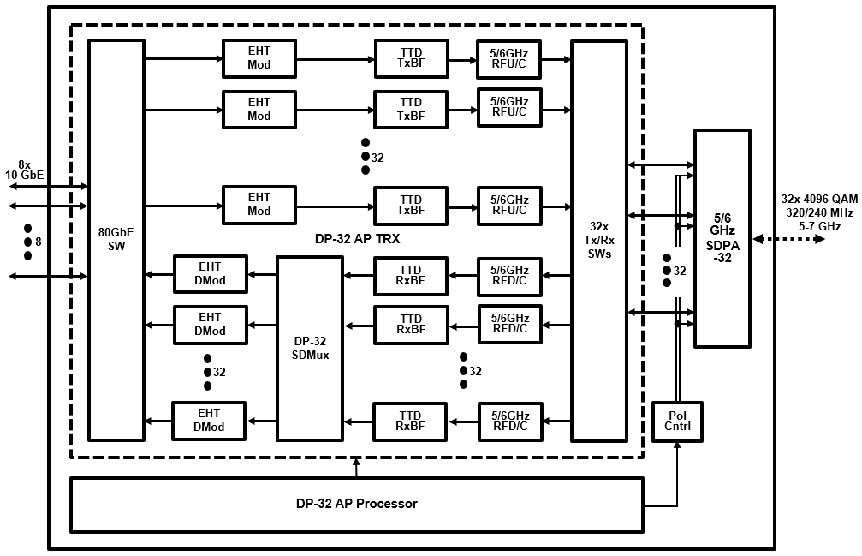
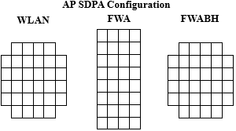
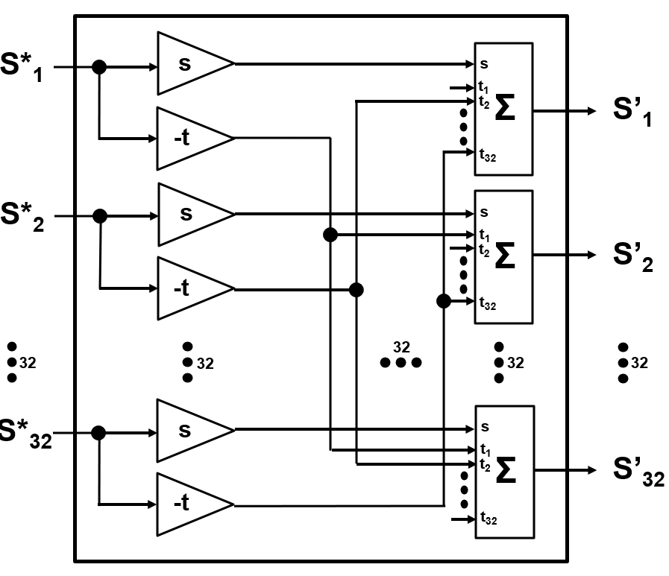
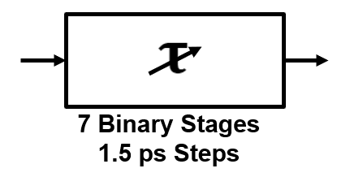
Contemplated 92 Gbps “DP-32” WLAN Access Point/ Meshnode
(32 EHT Spatial Streams)
92/69 Gbps 6/5 GHz DP-32 AP/MN
DP-32 AP/Meshnode SDPA-32 Phased Array
Node Type | Element Directivity | SDPA Gain
WLAN AP/MN | 180º | 20.5 dBi
FWA AP | 60º | 30.5 dBi
FRBH Node | 30º | 36.5 dBi
SDPA Beamwidth (WxH): 16.9º x 16.9º
DP-32 SDMux
TTD xBF

Slide 5
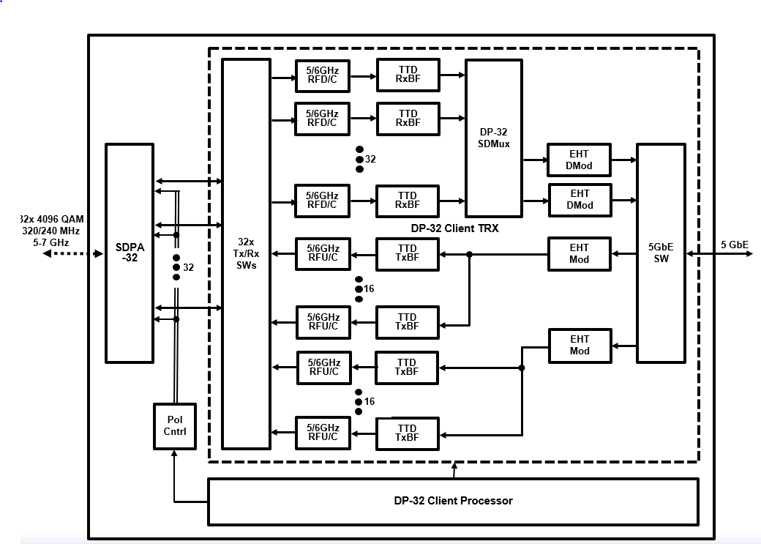
Contemplated 5.8 Gbps DP-32 WLAN Client
(2 EHT Spatial Streams)
5.8/4.3 Gbps 6/5 GHz DP-32 Client
DP-32 Client SDPA-32 Phased Array
Node Type | Element Directivity | SDPA Gain
WLAN Client | 180º | 20.5 dBi
FWA Client | 90º | 26.5 dBi
SDPA Beamwidth (WxH): 16.9º x 16.9º
TTD xBF
DP-32 SDMux

Slide 6
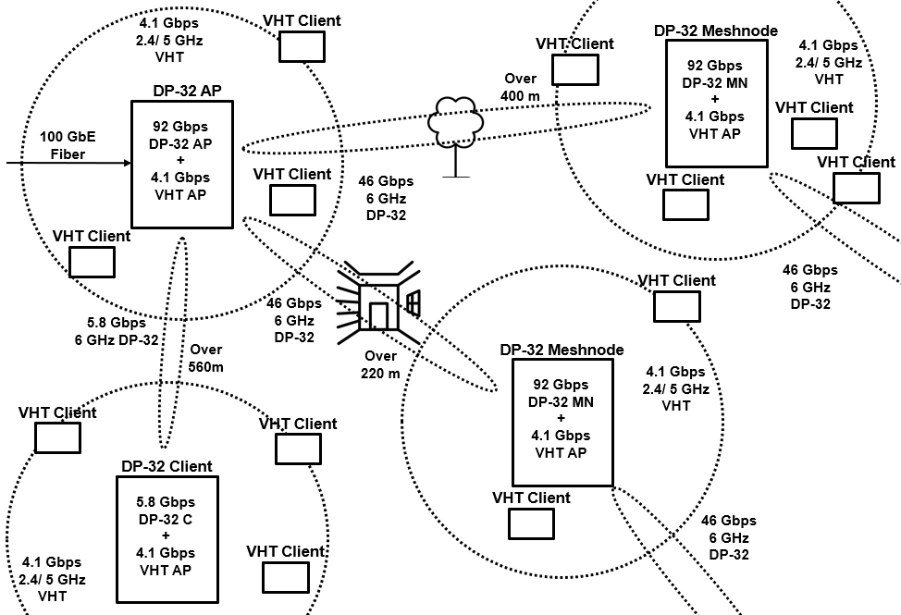
Contemplated Dynamic Polarization WLAN Mesh Network
Link Obstruction | 6 GHz RF Attenuation
Outdoor Foliage | 1 dB/ meter
Indoor Drywall | 2 dB/ Wall
Exterior Stucco | 6 dB/ Wall
Exterior Masonry | 15 dB/ Wall
Link Type | Data Rate | Range | NW Capacity
AP – MN MN - MN AP/MN - C | 92.2 Gbps 46.1 Gbps 5.8 Gbps | 565 m/ Free Space 422 m/ 3 m Foliage 222 m/ 1 ID + 1 ES | >40k concurrent Users

Slide 7
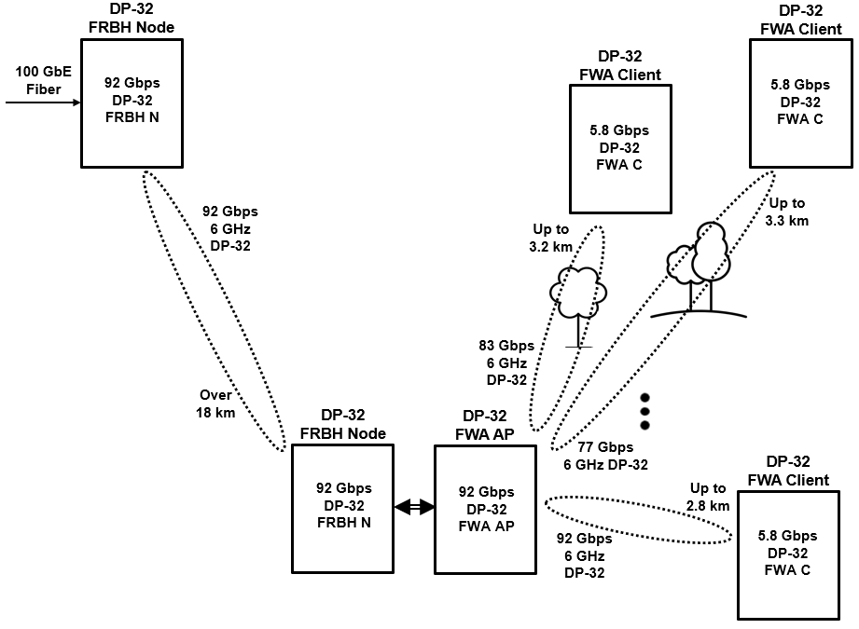
Contemplated Dynamic Polarization FRBH + FWA Network
Link Obstruction | 6 GHz RF Attenuation
Outdoor Foliage | 1 dB/ meter
Link Type | Data Rate | Range | NW Capacity
FRBH N - N | 92.2 Gbps | 18.0 km/ Free Space
FWA AP – C | 92.2 Gbps 83.0 Gbps 76.9 Gbps | 2.8 km/ Free Space 3.2 km/ 3m Foliage 3.3 km/ 5m Foliage | >40k Subscribers provided 5x Oversubscription

Slide 8
DPSMXBF WLANs
    Tune in Tomorrow in WNG!

