Slide 1
Dynamic Polarization Spatial Multiplexing and Beamforming WLANs:
A Sneak Preview
Date: 2023-09-11
Authors:

Slide 2
Abstract
A radically new “Dynamic Polarization Spatial Multiplexing and Beamforming” candidate 802.11 PHY (to be unveiled at tomorrow’s WNG session) is summarized herein. Capable of FWA-transporting up to 92 Gbps within 320 MHz at 6 GHz beyond 3.5 km, “DPSMXBF” merits serious consideration as an integral PHY for the nascent TGbn.

Slide 3
Dynamic Polarization WLANs
Proposed “DPSMXBF” 802.11 PHY
32 IEEE802.11be RF spatial streams
  32x32 MIMO Spatial Multiplexing
  32x32 MIMO Beamforming
  5-7 GHz UNII Operation
  4096 QAM
  320 MHz BW
  92,224 Mbps peak Data Rate
  > 550 m WLAN Free Space Range
  > 2.8 km Fixed Wireless Access FS Range
  > 18 km Fiber Replacement Backhaul FS Range

Slide 4
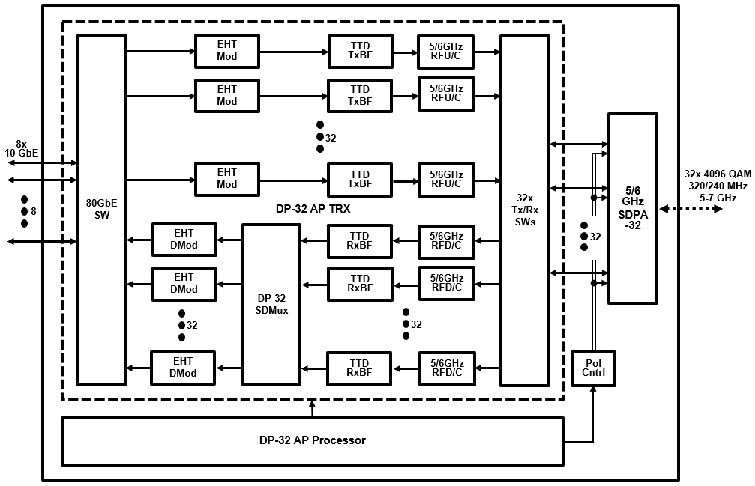
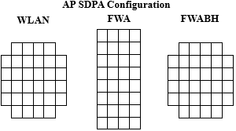
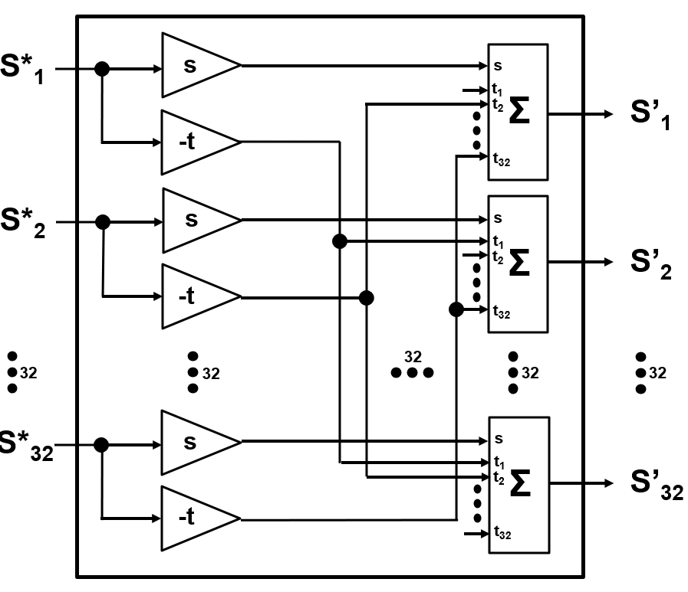
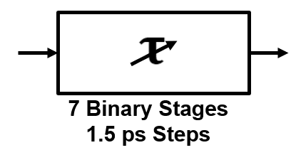
Contemplated 92 Gbps “DP-32” WLAN Access Point/ Meshnode
(32 EHT Spatial Streams)
92/69 Gbps 6/5 GHz DP-32 AP/MN
DP-32 AP/Meshnode SDPA-32 Phased Array
Node Type | Element Directivity | SDPA Gain
WLAN AP/MN | 180º | 20.5 dBi
FWA AP | 60º | 30.5 dBi
FRBH Node | 30º | 36.5 dBi
SDPA Beamwidth (WxH): 16.9º x 16.9º
DP-32 SDMux
TTD xBF

Slide 5
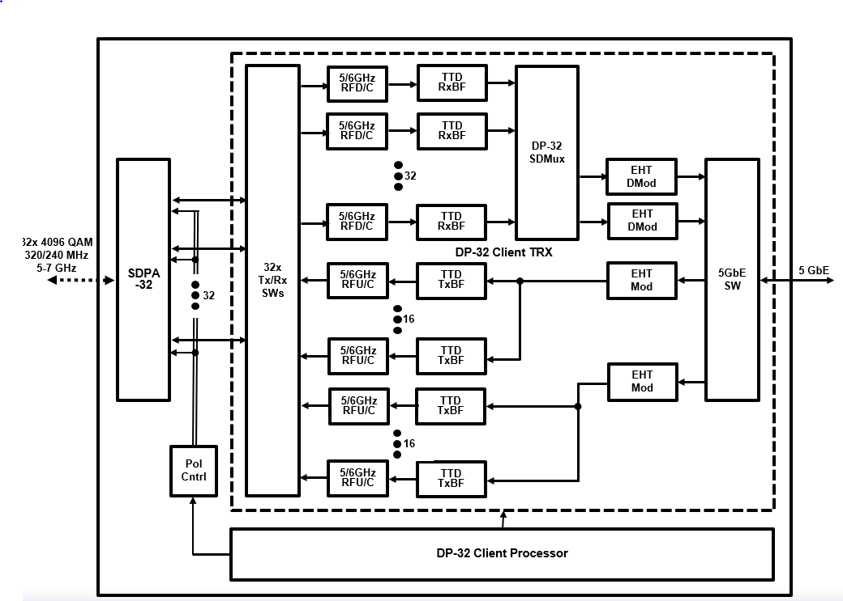
Contemplated 5.8 Gbps DP-32 WLAN Client
(2 EHT Spatial Streams)
5.8/4.3 Gbps 6/5 GHz DP-32 Client
DP-32 Client SDPA-32 Phased Array
Node Type | Element Directivity | SDPA Gain
WLAN Client | 180º | 20.5 dBi
FWA Client | 90º | 26.5 dBi
SDPA Beamwidth (WxH): 16.9º x 16.9º
TTD xBF
DP-32 SDMux

Slide 6
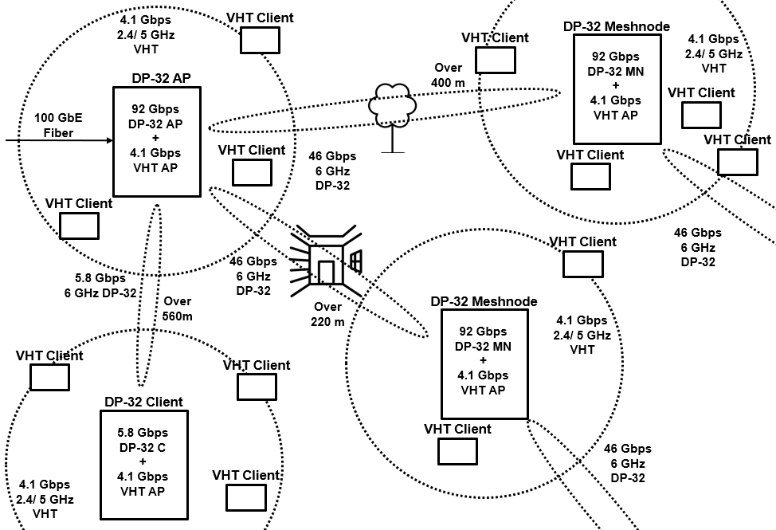
Contemplated Dynamic Polarization WLAN Mesh Network
Link Obstruction | 6 GHz RF Attenuation
Outdoor Foliage | 1 dB/ meter
Indoor Drywall | 2 dB/ Wall
Exterior Stucco | 6 dB/ Wall
Exterior Masonry | 15 dB/ Wall
Link Type | Data Rate | Range | NW Capacity
AP – MN MN - MN AP/MN - C | 92.2 Gbps 46.1 Gbps 5.8 Gbps | 565 m/ Free Space 422 m/ 3 m Foliage 222 m/ 1 ID + 1 ES | >40k concurrent Users

Slide 7
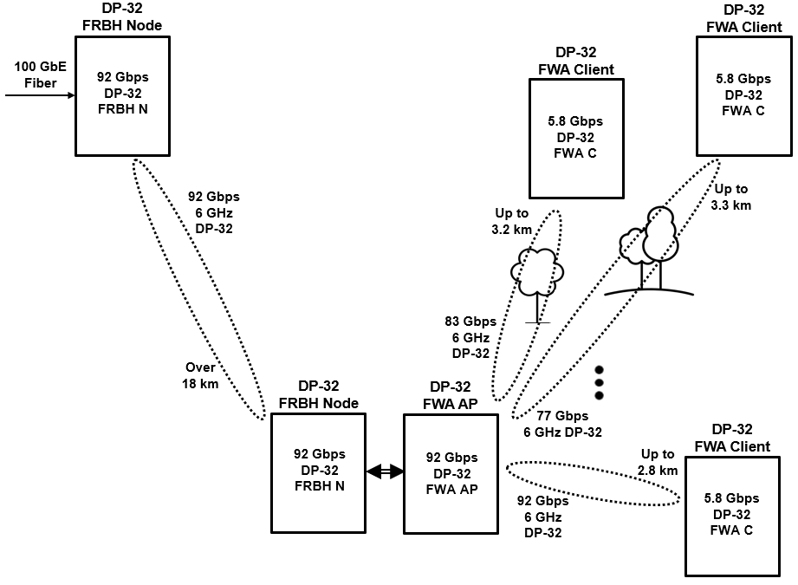
Contemplated Dynamic Polarization FRBH + FWA Network
Link Obstruction | 6 GHz RF Attenuation
Outdoor Foliage | 1 dB/ meter
Link Type | Data Rate | Range | NW Capacity
FRBH N - N | 92.2 Gbps | 18.0 km/ Free Space
FWA AP – C | 92.2 Gbps 83.0 Gbps 76.9 Gbps | 2.8 km/ Free Space 3.2 km/ 3m Foliage 3.3 km/ 5m Foliage | >40k Subscribers provided 5x Oversubscription

Slide 8
DPSMXBF WLANs
    Tune in Tomorrow in WNG!

