Slide 1
Cross Interference During
Coordinated Spatial Reuse
Date: 2023-09-11
Authors:

Slide 2
Abstract
Coordinated Spatial Reuse (C-SR) is one of the Multi-AP transmission techniques that is being considered for UHR.
C-SR only requires RSSI or pathloss feedback as opposed to complete CSI between all APs and STAs.
Based on the RSSI or pathloss feedback, a sharing AP decides the transmit powers and MCSs of all shared APs during the C-SR transmission phase.
In this contribution, we talk about considerations regarding cross interference during the C-SR transmission phase.

Slide 3
General Procedure for C-SR
AP1
(sharing AP)
AP2
(shared AP)
Interference Measurement
Phase
Transmission Phase
STA1
(Associated with AP1)
STA2
(Associated with AP2)
Interference measurement phase
  The sharing/shared APs measure interference or pathloss to each other’s target STA.
Transmission phase
  Initiated by the sharing AP. The sharing AP controls the transmit power and MCS of the shared APs.

Slide 4
Interference Measurement Phase
An interference measurement phase can be one of the following.
  General Multi-AP channel sounding [1],[2]
  Active RSSI measurement procedure [3]
  Opportunistic RSSI measurements [4]
Regardless of the interference measurement phase, a sharing AP obtains an estimate of cross interference of all APs and STAs participating in the C-SR transmission phase. It uses these estimates to determine the transmit powers and MCS of the shared APs.

Slide 5
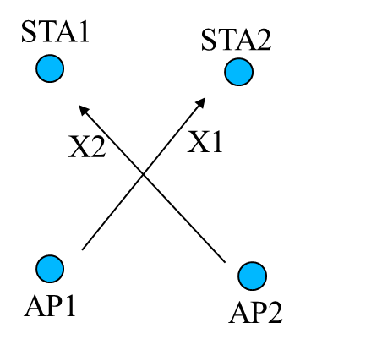
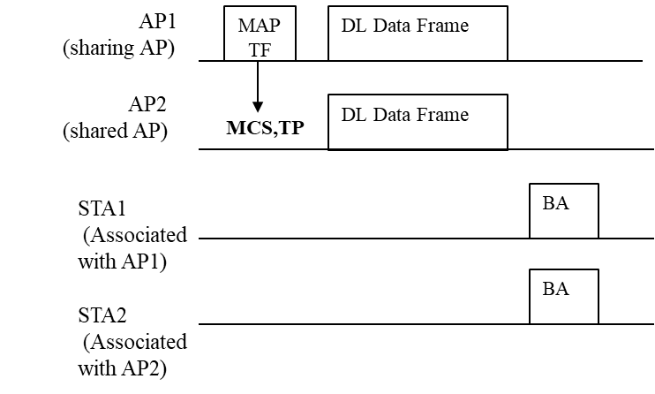
Shared AP Transmit Power and MCS
During the transmission phase, we assume that AP1 first decides its own transmit power and MCS. Based on these decisions, it computes the transmit power and MCS of the shared AP.
Transmit power of AP2 - AP2 transmit power depends on the interference from AP2 to STA1 (X2) and MCS to be used by AP1.
MCS of AP2 - The sharing AP (AP1) may indicate a maximum MCS of the shared AP. AP2 MCS may depend on the interference from AP1 to STA2 (X1) and transmit power of AP1.

Slide 6
Cross Interference during C-SR Transmission Phase
Additional restrictions may be necessary to prevent unexpectedly large cross interference during the C-SR transmission phase.
For example, the following may be disallowed (or allowed with explicit signaling) for the shared APs in order for the sharing AP to accurately decide the C-SR transmit parameters.
  Beamforming restrictions
  Bandwidth/RU size restrictions
  PPDU alignment restrictions

Slide 7
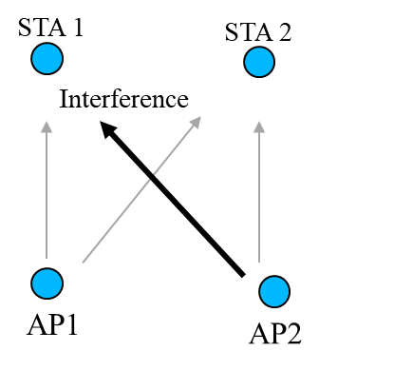
Shared AP Beamforming (1/2)
AP1
(sharing AP)
MAP
TF
DL Data Frame
AP2
(shared AP)
DL Data Frame
(Beamformed)
MCS,TP
STA1
(Associated with AP1)
Beamformed
Interference
STA2
(Associated with AP2)
BA
A Shared AP may perform beamforming (non-coordinated) to STA2 to increase its own transmission’s reliability under the TP and MCS limitation set by the sharing AP.
A beamformed PPDU may cause a higher interference to the Sharing AP’s transmission than a non-beamformed PPDU.

Slide 8
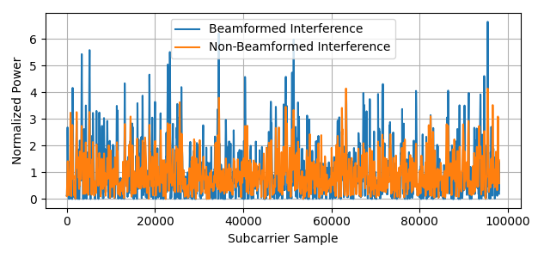
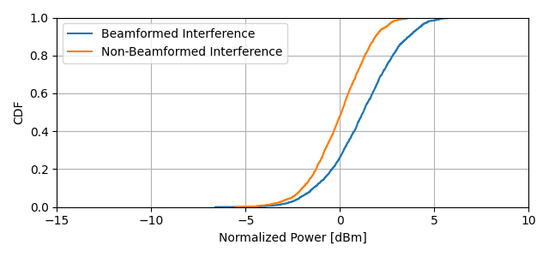
Shared AP Beamforming (2/2)
Simulation Parameters
AP1 – 2 Antennas
AP2 – 2 Antennas
PPDU Format: SU PPDU/80 MHz
Channel Model: TGn Channel B
AP2 Beamforming: Strongest beam/eigenvector.
1000 Iterations
PPDU1
PPDU2
PPDU 100
1000 Iterations
Interference amplification
As seen in the figure, the interference of AP2 may experience amplification on some subcarriers due to beamforming. The AP1 must account for this effect when deciding the transmit power of AP2.
Note: x-axis is concatenated PPDU subcarrier samples (980) of all PPDUs

Slide 9
Use of smaller BW/RU
STA 1
STA 2
AP1
(sharing AP)
MAP
TF
DL Data Frame
80 MHz
Interference
AP2
(shared AP)
DL Data Frame
(20MHz)
MCS,TP
STA1
(Associated with AP1)
Narrower band PPDU
Interference
AP1
AP2
STA2
(Associated with AP2)
BA
AP2’s transmission may also result in a higher interference than AP1 may expect if AP2 uses a smaller BW or RU than AP1 expects. AP1 must account for this possibility when deciding the transmit power of AP2.

Slide 10
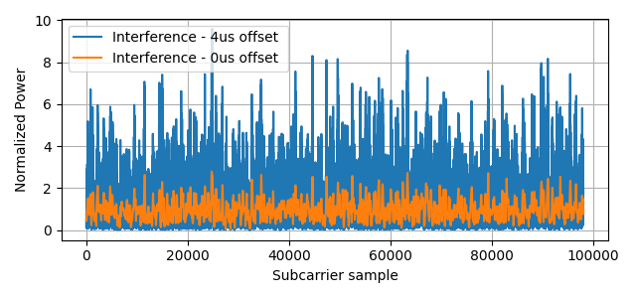
Synchronized vs Non-Synchronized C-SR
Simulation Parameters
AP1 – 2 Antennas
AP2 – 2 Antennas
PPDU Format: SU PPDU/80 MHz
Channel Model: TGn Channel B
AP2 transmission offset: 4 us
AP1
(sharing AP)
MAP
TF
Pre-UHR
UHR
offset
AP2
(shared AP)
UHR portion
unsynchronized
MCS,TP
Pre-UHR
PPDU1
PPDU2
1000 Iterations
PPDU 100
AP2 may also introduce unexpectedy high interference to the Sharing AP when it transmits a PPDU that is not fully aligned with the PPDU of the Sharing AP.
Note: x-axis is concatenated PPDU subcarrier samples (980) of all PPDUs

Slide 11
Proposed Solution
Restrict the following during C-SR
  Non-coordinated beamforming
  Bandwidth/RU size changes for range extension
  Unsynchronized PPDU transmissions
Option 1 – Disallow
Option 2 – Explicit Allowance/Disallowance

Slide 12
Conclusion
We presented considerations regarding cross interference during the C-SR transmission phase.
We showed through simulation results how some transmission parameter choices by the shared AP may result in higher interference to the sharing AP’s transmission when left unrestricted.

Slide 13
References
[1] https://mentor.ieee.org/802.11/dcn/19/11-19-1097-00-00be-sounding-procedure-in-ap-collaboration.pptx
[2] https://mentor.ieee.org/802.11/dcn/19/11-19-1134-01-00be-consideration-of-multi-ap-sounding.pptx
[3] https://mentor.ieee.org/802.11/dcn/23/11-23-0668-02-0uhr-coordinated-measurement.pptx
[4] https://mentor.ieee.org/802.11/dcn/20/11-20-0576-00-00be-coordinated-spatial-reuse-protocol.pptx

