Slide 1
[CID18 and CID111 Resolution for LB274]
Date: 2023-08-27
Authors:

Slide 2
Abstract
This document proposes a solution to address CID18 and CID111, which are about non-AP STA to non-AP STA identification.
Rev.0 – initial version
Rev.1 – device ID removed, only IRM left, special action frame usage rather than TDLS action frame usage.

Slide 3
CID18 and CID111
Two CIDs about communication between non-AP STAs
CID | Comment | Proposed Change
18 | two non-AP STA commnucation is improtant, and widely used in Wi-Fi industry, like Wi-Fi Mirocast . But one STA to identify another STA with RCM via IRM is missing,11bh SPEC should add this part support. | add non-AP STAs' identification with RCM
111 | D1.0 does not address some of the scenarios such as TDLS. | If applicable, add support for IRM and/or device ID in TDLS.

Slide 4
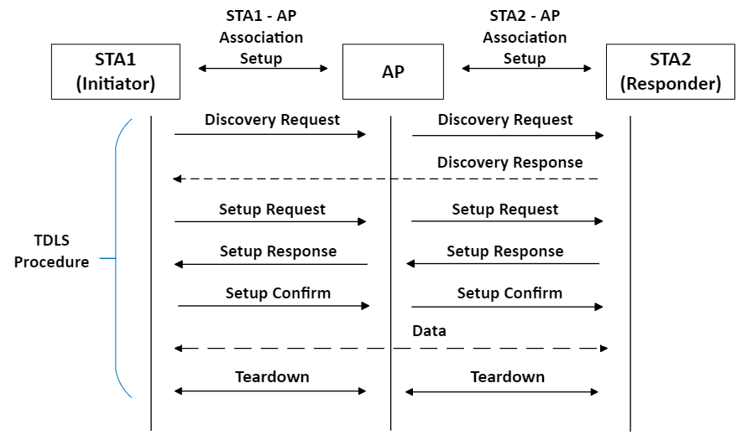
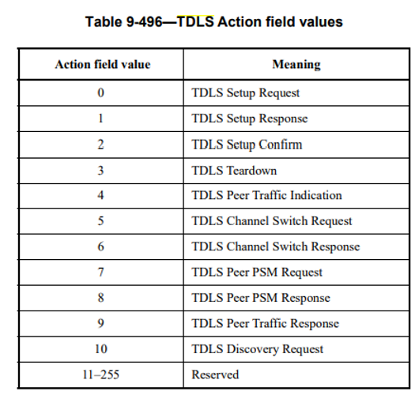
Recap: TDLS
TDLS (Tunnel Direct Link Setup) enables at least two non-AP STAs to communicate with each other (while they are associated) to the same AP (ESS)

Slide 5
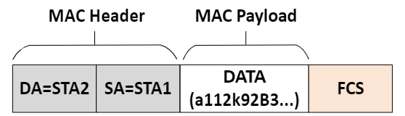

Recap: TDLS
TDLS uses action frames (called TDLS Action frames).
These frames are encapsulated in data frames so they are protected, such as:
This is seen in the air (Encrypted Data Frame)
This is the real content in the encrypted Data Frame

Slide 6
What CID18 and CID111 want?
The current 802.11bh D1.0 only addresses AP (ESS) to identify the non-AP STA. It does not address a (non-AP) STA identifying the other (non-AP) STA in the same ESS for TDLS. Example:
STA1 (e.g., phone)
AP
STA2 (e.g., TV)
Association
Association
Initial Connection
(device ID/IRM allocation)
(device ID/IRM allocation)
TDLS connection
TDLS connection
Association
Association
AP identifies STA1 and STA2
Next Connection
(device ID/IRM usage)
(device ID/IRM usage)
TDLS connection
TDLS connection
STA1 and STA2 don’t identify each other

Slide 7
Proposal to address CID18 and CID111
Each STA provides IRM to the other STA in IRM Action Frame.
In the initial connection,
  STA1 and STA 2 associate with AP (IRM allocation for AP)
  TDLS initiator (e.g. STA1) sends its IRM to TDLS responder (e.g. STA2) in IRM Action Frame.
  TDLS responder (e.g. STA2) sends its IRM to TDLS initiator (e.g. STA1) in IRM Action Frame.
In the next connection,
  STA1 and STA 2 associate with AP (IRM usage so that AP identifies them)
  STA1 and STA2 identify each other in TDLS based on IRM provided in the initial connection.

Slide 8
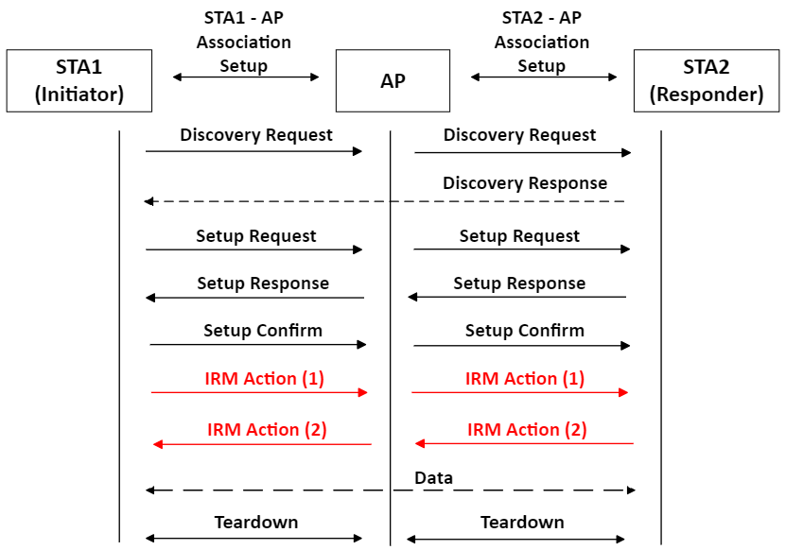
STA1 has IRM1
STA2 has IRM2
STA1 provides IRM1 to STA2 via AP
STA2 provides IRM2 to STA1 via AP

Slide 9
Further Consideration
[1392r5] already defines IRM Action Frame. It might be better to add another action value for TDLS connection.
Action field value | Meaning
0 | Duplicate IRM
1 | New IRM
2 | IRM for TDLS
3-255 | Reserved
Category | IRM Action | IRM
IRM for TDLS

Slide 10
SP1
Q: Do you think 802.11bh should address identification between two non-AP STA’s?
Yes, No, Don’t care, Abstain

Slide 11
SP2
Q: Do you think the proposal in this document (IRM exchange with IRM Action Frame for TDLS connection) is a good way to address STA to STA identification for TDLS ?
Yes, No, Don’t care, Abstain

