Slide 1
AMP Interference Example
Date: 2023-09-11
Authors:

Slide 2
Abstract
Providing some examples to better understand possible impact of AMP deployments on existing deployments

Slide 3
802.11AMP-STA Impact on Legacy Deployments
During last meeting, some concerns were raised regarding the possible impact of deploying multiple AMP STAs, working with legacy 802.11 modes, on the legacy 2.4GHz deployment
We present two detailed use case of AMP-STAs
For these use case, we demonstrate the impact of the legacy mode AMP-STA on the legacy 2.4GHz deployment

Slide 4

Supermarket Aisle Example
Use of 802.11AMP-STAs on the supermarket
shelves
  Adds control over the stocking process
  Add control on inventory and refilment
  Monitors shelf placements to maintain profitability
The sequence of AMP-STAs are located 40cm
apart on each shelf.
Each AMP-STA transmits -25dBm
A legacy 802.11g AP is positioned on the ceiling for coverage service to the customers and the workers

Slide 5


Supermarket Aisle Example [cont.]
A person walking trough
802.11 AP.
Shelves
Within the aisle, the AMP-STAs signal level is 35dB weaker compared with the legacy depolyment
Dipole
Antennas
644 AMP STAs.

Slide 6
Traffic Details
644 AMP-STAs within the aisle shelves
For this example:
  Each AMP-STA transmits 200 bits
  Minimum data rate is a readout once per 15 minutes
  Peak data rate is a readout once per 1 sec
  Total minimum traffic: 143bps, total peak traffic: 129kbps
  Assuming 20Mbps for legacy approach over 2.4GHz, we get a minimum of 7.2x10⁻⁴ % of usage for adding the AMP-STAs to the 802.11 network
  Assuming 20Mbps for legacy approach over 2.4GHz, we get a peak of 0.64 % of usage for adding the AMP-STAs to the 802.11 network

Slide 7
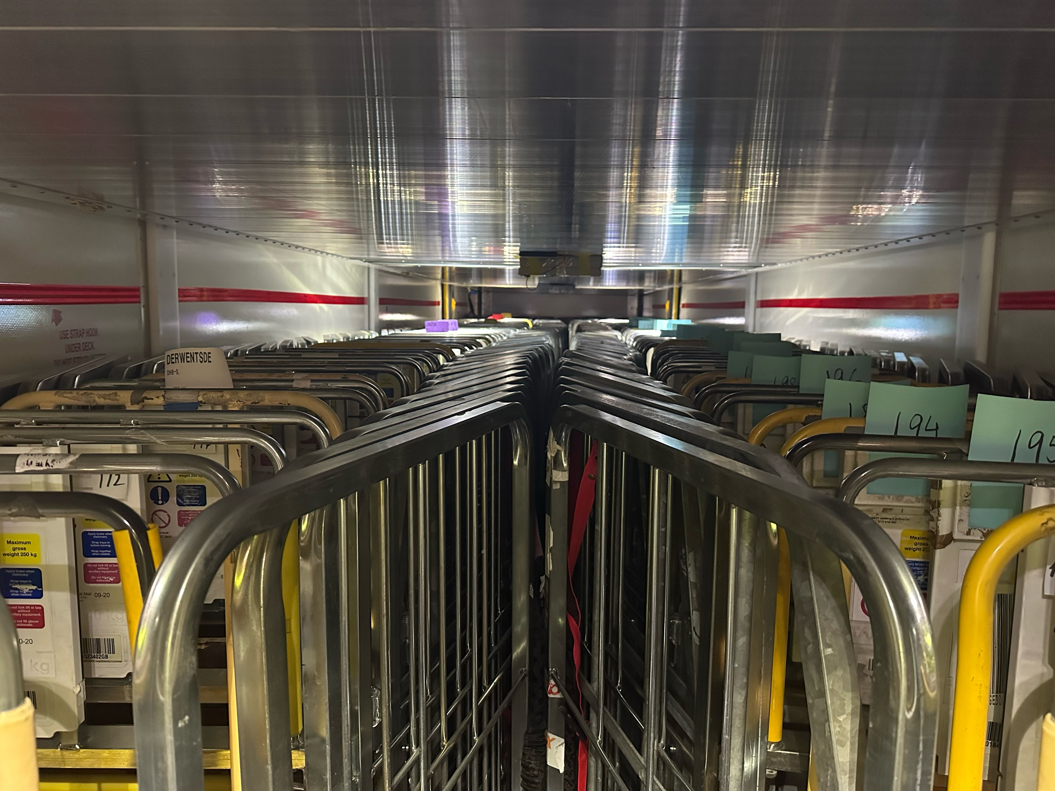
Logistic Example
Within the logistic use case, often there is a need to transport carts from location to location
In order to maintain efficiency, most transports are denser when compared to the warehouse locations
The truck carrying the carts is travelling near
802.11 legacy deployments
Carts transported
inside the truck

Slide 8
Logistic Example [cont.]
A person walking by
802.11 AP.
Truck
Trailer
Within the sidewalk, the AMP-STAs signal level is also 35dB weaker compared with the legacy depolyment
154 AMP STAs.

Slide 9
Traffic Details
154 AMP-STAs within the truck trailer in this example
For this example:
  Each AMP-STA transmits 200 bits
  Minimum data rate is a readout once per 20 minutes
  Peak data rate is a readout once per 1 minute
  Total Minimum traffic: 25bps, total peak traffic: 513bps
  Assuming 20Mbps for legacy approach over 2.4GHz, we get a minimum of 1.3x10⁻⁴ % of usage for adding the AMP-STAs to the 802.11 network
  Assuming 20Mbps for legacy approach over 2.4GHz, we get a peak of 25x10⁻⁴ % of usage for adding the AMP-STAs to the 802.11 network

Slide 10
Summary
From the analysis of the impact of legacy mode AMP-STAs on existing deployments it appears that no actual impact is seen in the presented use cases
Even though the number of devices is large, the amount of information within each is very small - making the total negligible when compared with existing 802.11 devices that are operating over 2.4GHz

