Slide 1
Preemption for Low Latency Application (follow up)
Date: 2023-08-10
Authors:

Slide 2
Introduction
Preemption was discussed in [1] as a general solution to support low latency application in different scenarios [2].
In this document, we will discuss some open questions in more detail with simulation results.

Slide 3

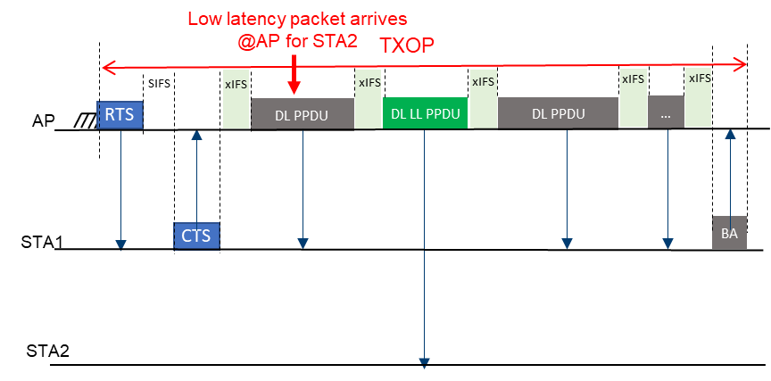
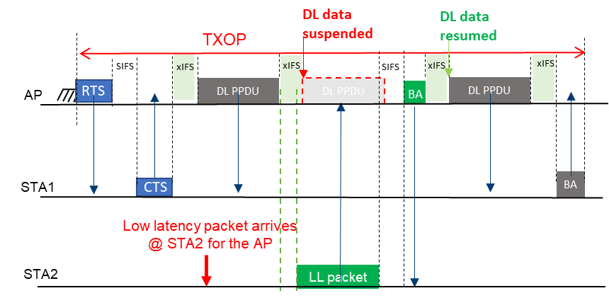
Recap - General solution for case A and case B
(Event-based or periodic LL traffic with jitters)
Divide the large PPDU into small PPDUs with maximum length limitation and xIFS ( ) gaps to provide preemption opportunity for the LL transmitter
Case A: TXOP holder can insert DL LL packet within the TXOP
Case B: LL transmitter can preempt the on-going transmissions in a TXOP during a xIFS time
  Further considerations: xIFS length; collisions and hidden node problem between multiple LL STAs
Case A: LL transmitter is the TXOP holder
Case B: LL transmitter is not the TXOP holder

Slide 4
Main Challenging
Which STA has LL data
When the STA has LL data
Multiple STAs have LL data
Power saving

Slide 5
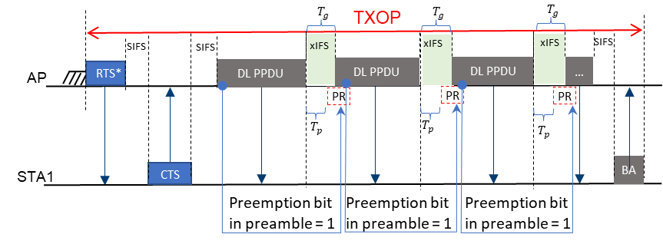
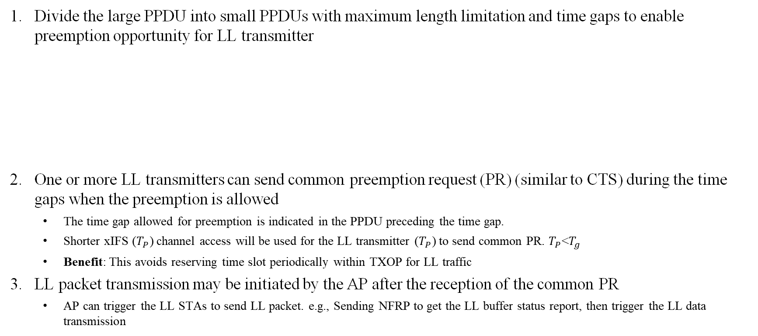
General solution for case A and case B [1]
(Event-based or periodic LL traffic with jitters)
Divide the large PPDU into small PPDUs with maximum length limitation and time gaps to enable preemption opportunity for LL transmitter
One or more LL transmitters can send common preemption request (PR) (similar to CTS) during the time gaps when the preemption is allowed
  The time gap allowed for preemption is indicated in the PPDU preceding the time gap.
  Shorter xIFS ($T_{P}$) channel access will be used for the LL transmitter ($T_{P}$) to send common PR. $T_{P}$<$T_{g}$
  Benefit: This avoids reserving time slot periodically within TXOP for LL traffic
  3. LL packet transmission may be initiated by the AP after the reception of the common PR
  AP can trigger the LL STAs to send LL packet. e.g., Sending NFRP to get the LL buffer status report, then trigger the LL data transmission

Slide 6
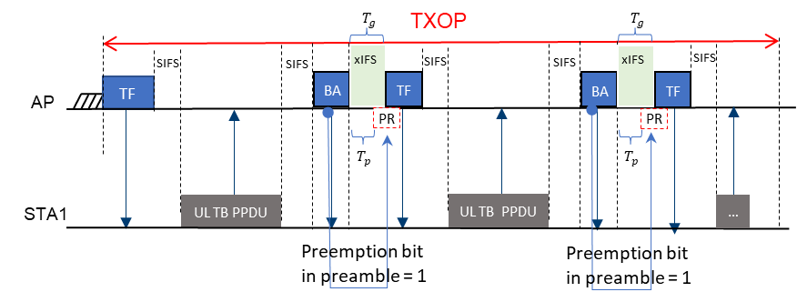

Preemption indication
TXOP preemption indication: Signaling in the first control frame of the TXOP to indicate whether preemption is allowed or not within the TXOP
Time gap preemption indication: One bit in U-SIG or UHR-SIG of the current PPDU to indicate whether preemption is allowed or not $T_{p}$ after the end of the current PPDU.

Slide 7
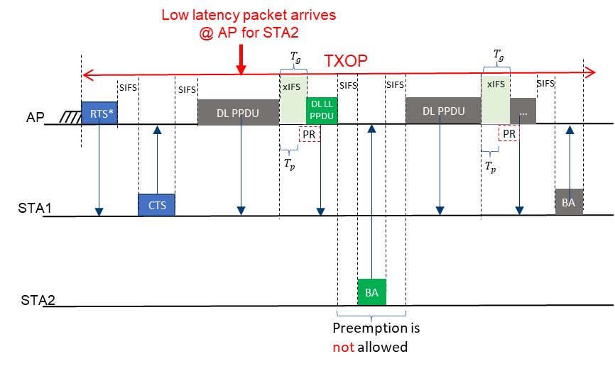
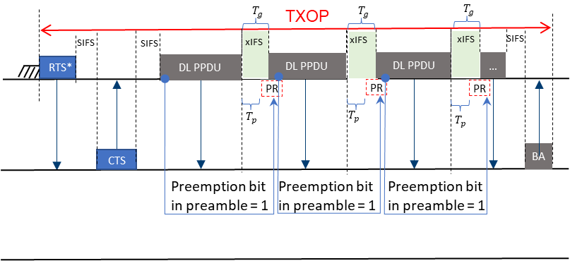
Preemption within TXOP (DL) → possible cases
DL TXOP without preemption
DL TXOP with DL LL packet

Slide 8
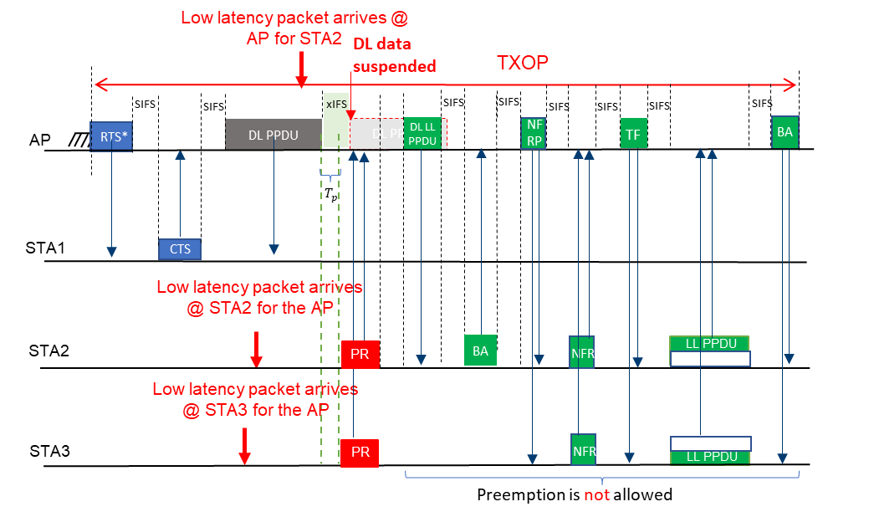
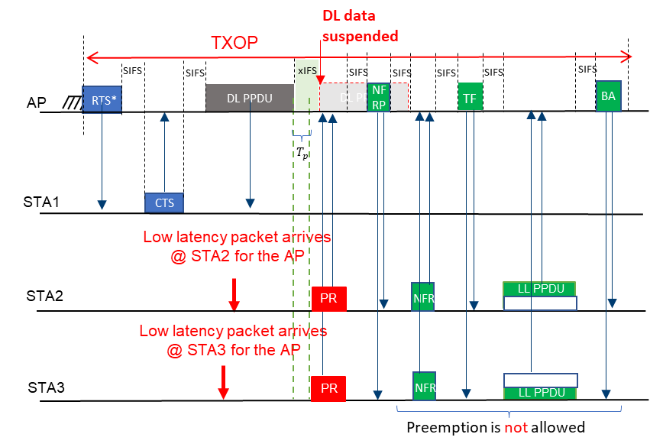
Preemption within TXOP (DL) → possible cases
DL TXOP with multiple UL LL packets
DL TXOP with both DL LL and multiple UL LL packets
It’s AP’s decision to order the DL LL + BA and the NFRP+NFR+TF+UL LL +BA

Slide 9
Simulation scenario
1 AP; 10 STAs = 8 legacy + 2 LL;
2x2x40MHz
Non-LL STAs traffic: Full buffer (DL) between AP and Legacy clients; AC_BE
LL STAs traffic: 160 bytes every 3 or 30ms; AC_VO
  LL traffic start uniformly randomized within interarrival interval
  LL traffic stream arrival pattern re-started with new random start time every 1 second
Preemption mode with xIFS = PIFS, AP TXOP limit = 5ms with PPDU limit = 1ms
Legacy non-Preemption modes
  AP TXOP limit = 5ms as baseline
  AP TXOP limit = 1ms as comparison with Preemption mode;
Evaluation cases for LL latency and total BSS throughput
  Case 1: LL in DL only
  Case 2: LL in UL only
  Case 3: LL in both DL and UL
No hidden nodes

Slide 10
Simulation Results → DL LL
Note: Shows the fixed throughput loss due to the PIFS gap and preamble before each DL PPDU per 1ms, which is around 7.5% with preamble = 50.4usec
Notes:
20+4+4*2+4+2*(2*3.2+0.8)=50.4

Slide 11
Simulation Results → UL LL
Note: Shows the fixed throughput loss due to the PIFS gap and preamble before each DL PPDU per 1ms, which is around 7.5% with preamble = 50.4usec

Slide 12
Simulation Results → DL+UL LL
Note: Shows the fixed throughput loss due to the PIFS gap and preamble before each DL PPDU per 1ms, which is around 7.5% with preamble = 50.4usec

Slide 13
Summary
Preemption can provide bounded latency while keeping low performance impact to the high throughput traffic.
Further consideration:
  UL SU TXOP
  xIFS time
  Preemption Request frame
  Further overhead reduction

Slide 14
References
[1] 11-23-0092r0, “Preemption”
[2] 11-23-0018r1, “Low latency support in UHR”

