Slide 1
COST Action INTERACT: Intelligence-Enabling Radio Communications for Seamless Inclusive Interactions
Date: 2023-07-11
Authors:
Name | Affiliations | Address | Phone | email
Periklis Chatzimisios | International Hellenic University & University of New Mexico | P.O. Box 141 Sindos 57400 Thessaloniki (Greece) |  | pchatzimisios@ihu.gr
Daniele Medda | International Hellenic University
Athanasios Iossifides | International Hellenic University

Slide 2
Outline
What is a COST Action?
Status of the INTERACT COST Action.
Objectives and Transversal Issues.
Working Groups.
Vertical Teams.
Horizontal Activities.
Deliverables.
References.

Slide 3
What is a COST Action (objectives & organization)?
The general framework of a COST action (4 years) is built mainly around networking. It supports some meetings (but not for all), Training schools (TS), Short Terme Scientific Missions (STSM).
Objective: Building collaboration between searchers across Europe and beyond.
Participants: Mainly from Europe but also from all over the world. Anybody can join.
3 meetings per year: 500+ Working Group members; Every meeting is about 80 to 100 persons, 70 technical documents presented, a lot of discussions….

Slide 4





What is a COST Action?
Memorandum of Understanding
4 years (11/2021-10/2025)
Network
Research coordination
&
Capacity building
500 000 euros
(indicative)

Slide 5
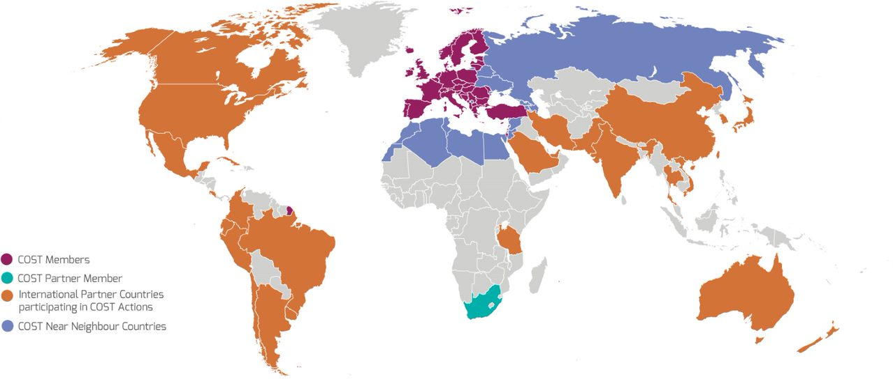
What does “anywhere in the world” mean?
COST Full/Cooperating Member
COST Partner Member
Near Neighbour Countries (list to be confirmed)
Third States
currently participating

Slide 6
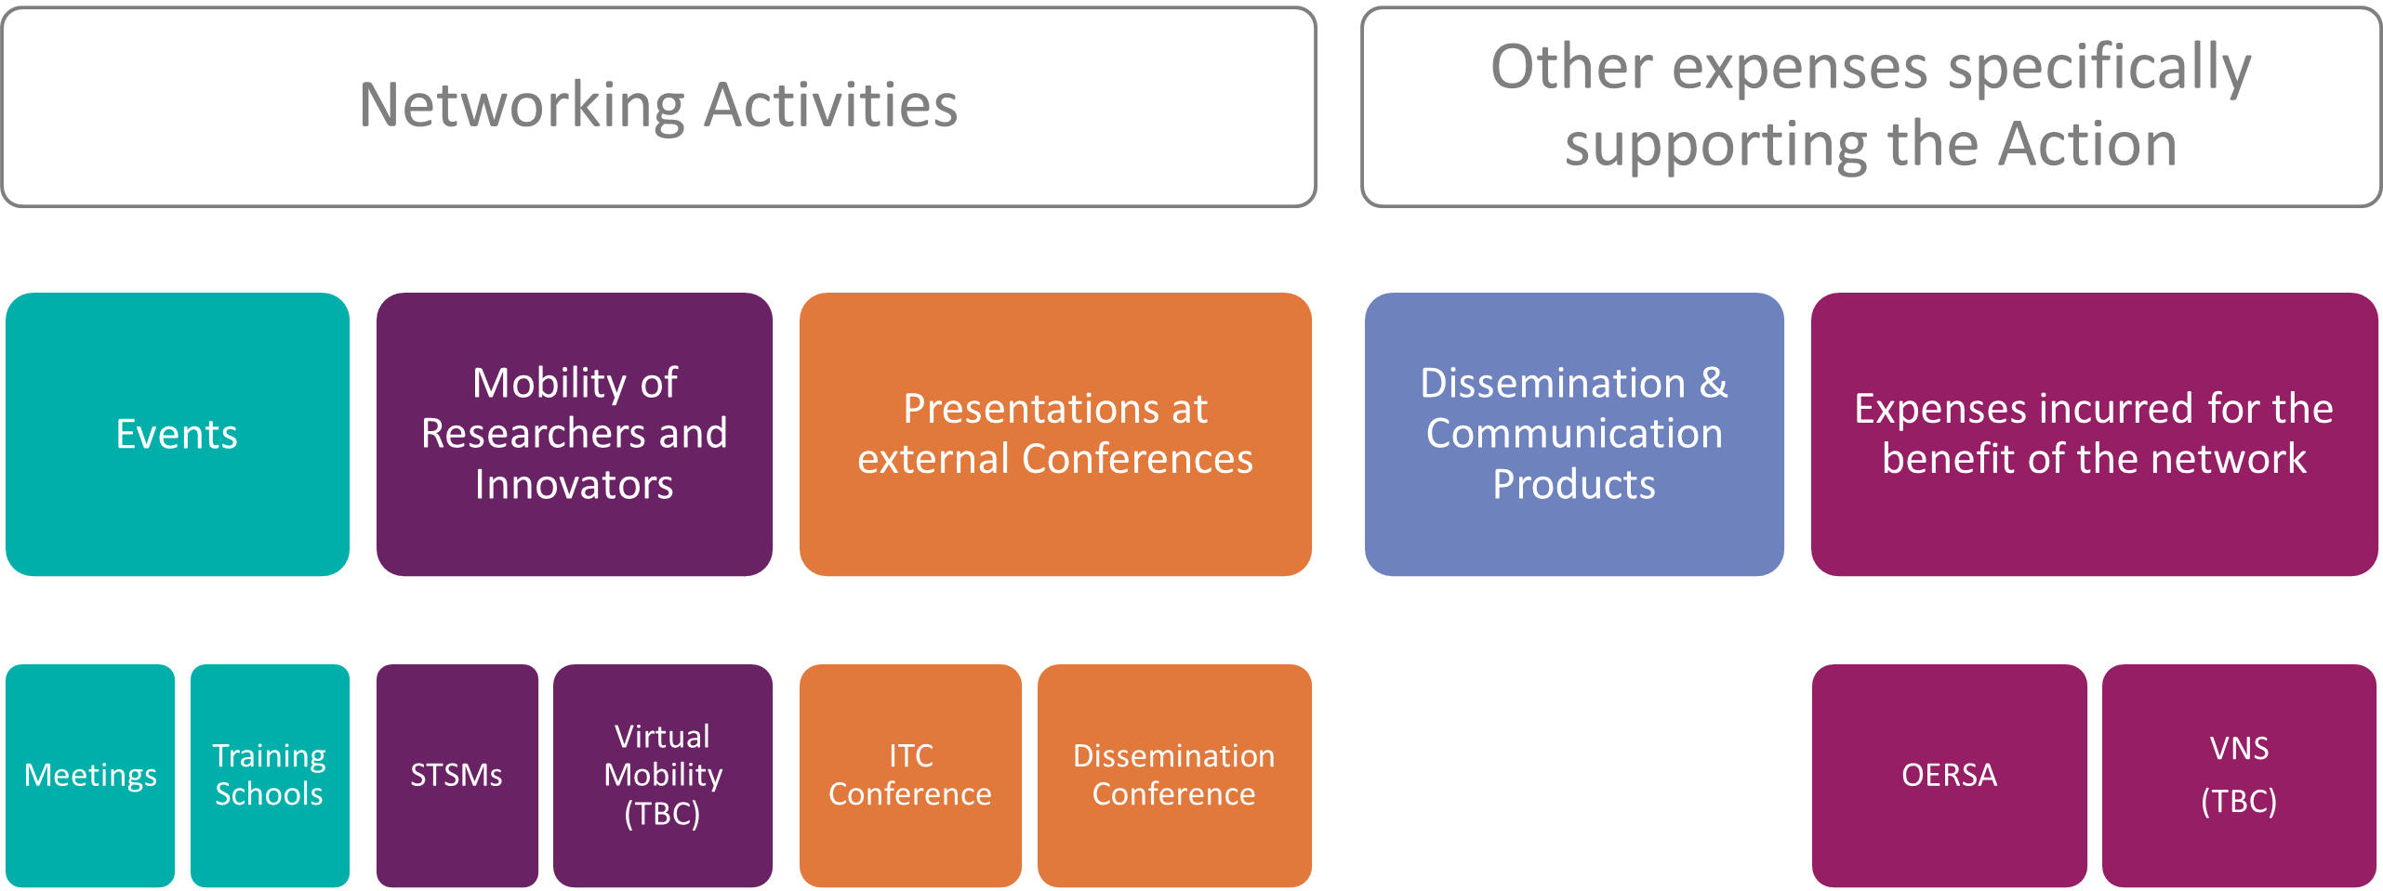
What can be funded by COST?

Slide 7
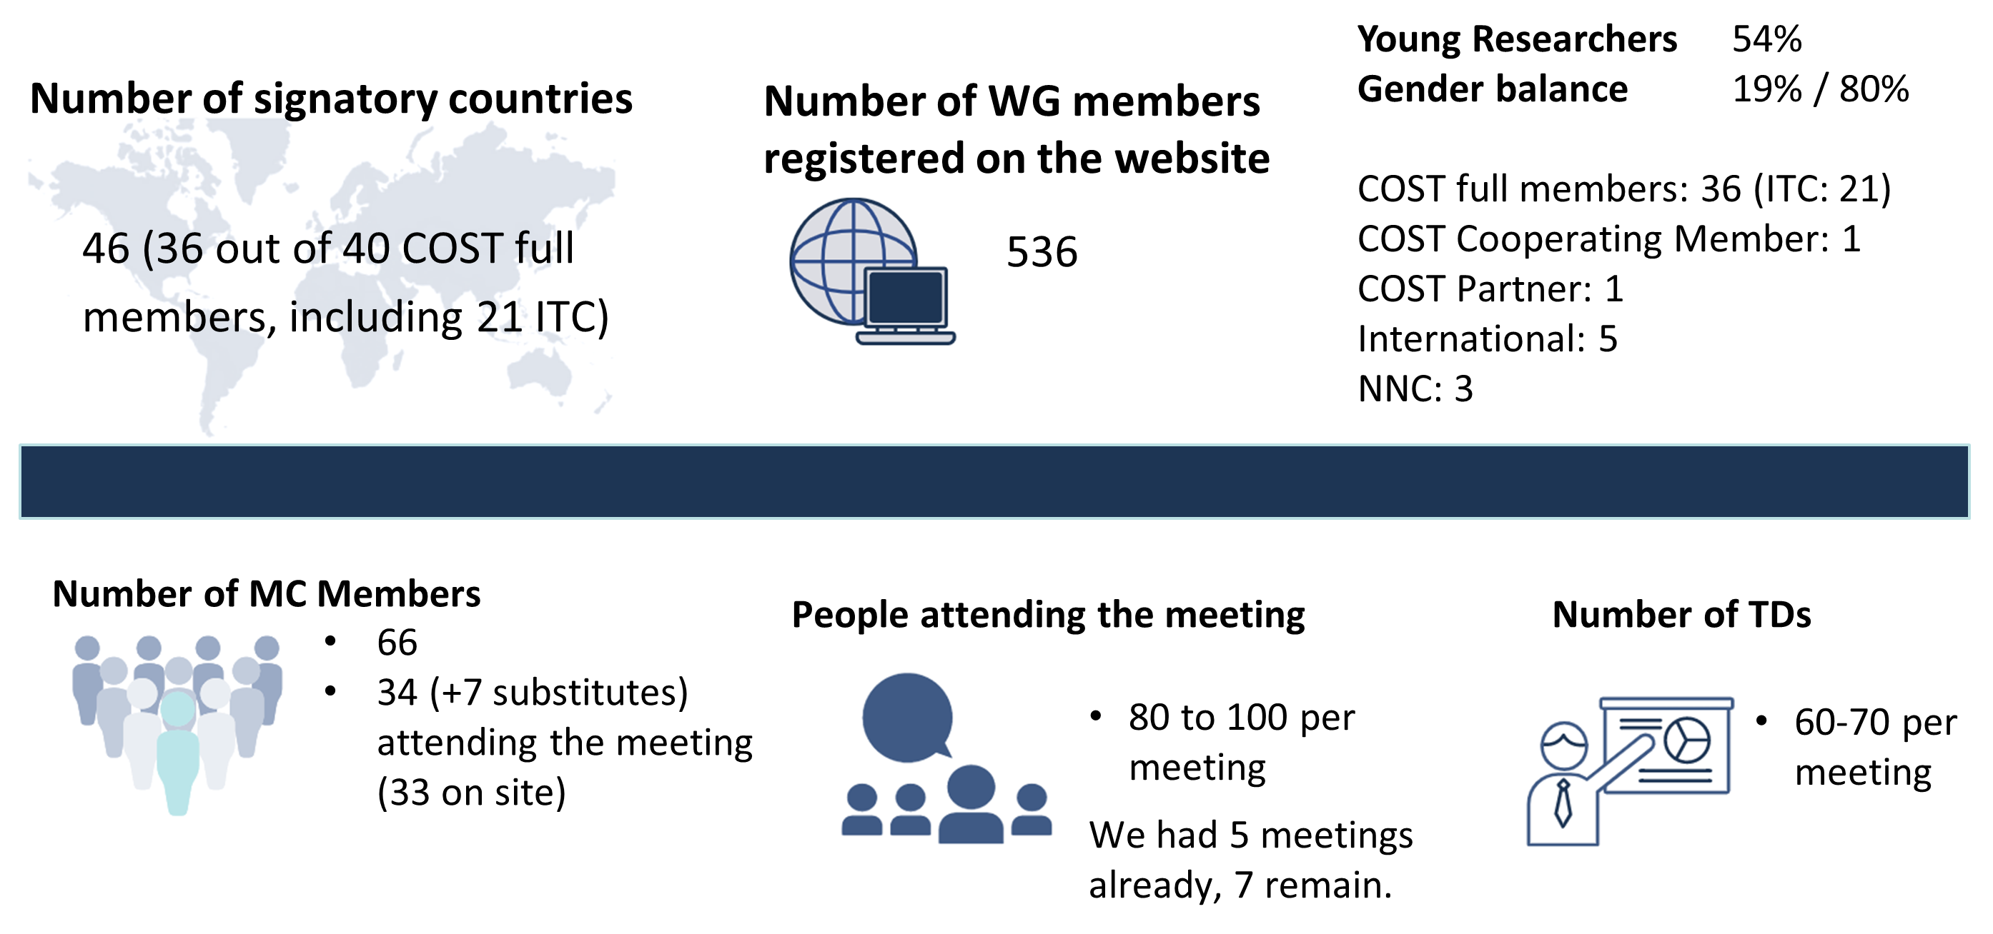
Status of the COST Action INTERACT [1]

Slide 8
Objectives
O1: Fundamental research in the fields of
  Antennas and Propagation,
  Signal processing and Localisation,
  Network Architectures and Protocols
O2: To make the Wireless Network Intelligent – aware, adaptive and parsimonious
O3: To contribute to the creation of Intelligent Environments
  Health
  Transportation
  Industry
  Buildings and Cities

Slide 9



Transversal Issues
Achieve trade-offs in model-driven versus data-driven communication engineering
To support the research by making available datasets on real world scenarios

Slide 10
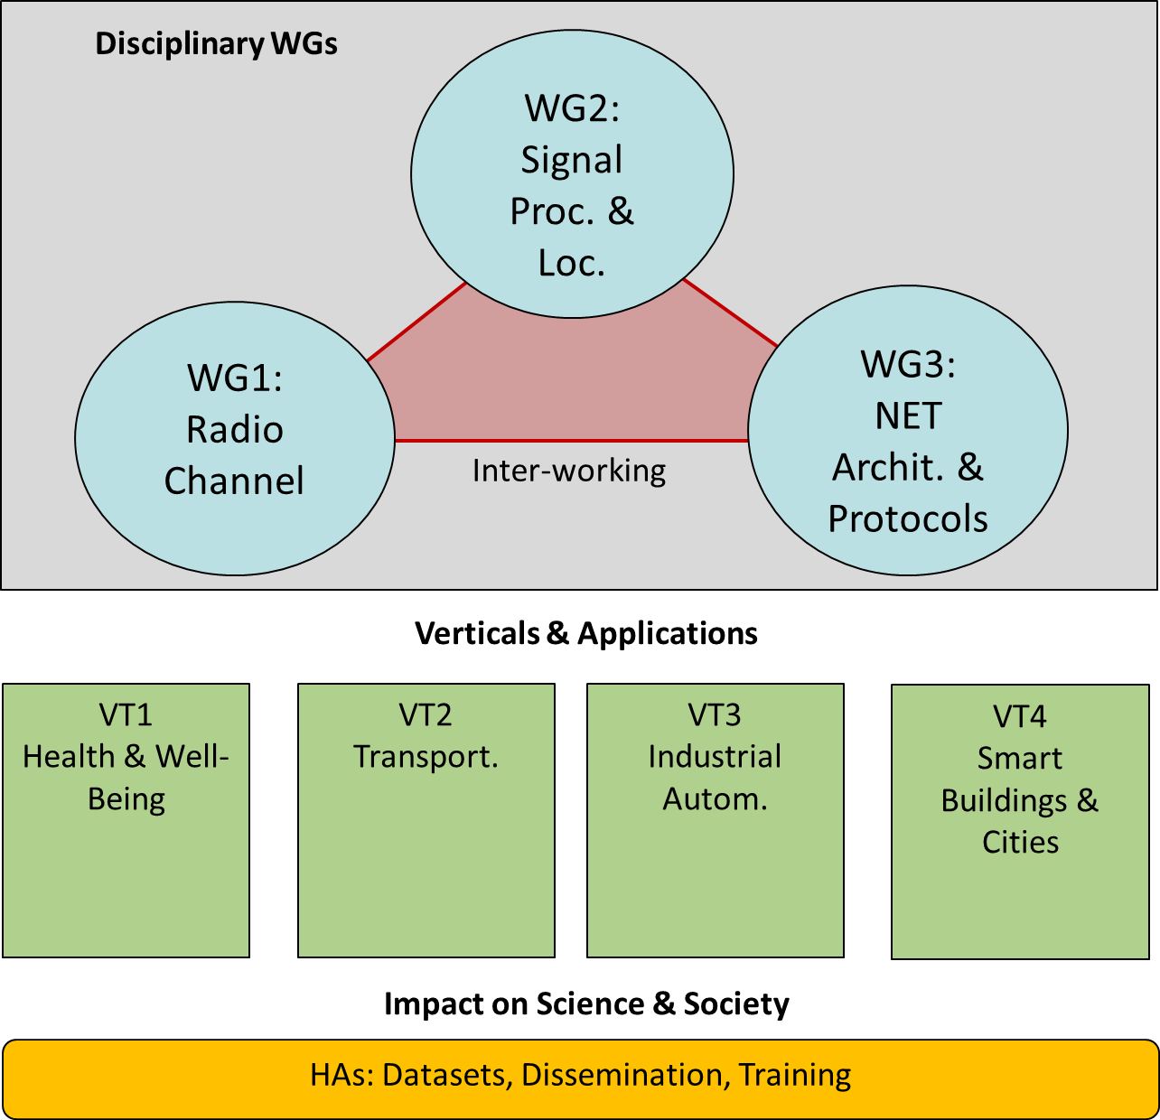
Implementation

Slide 11
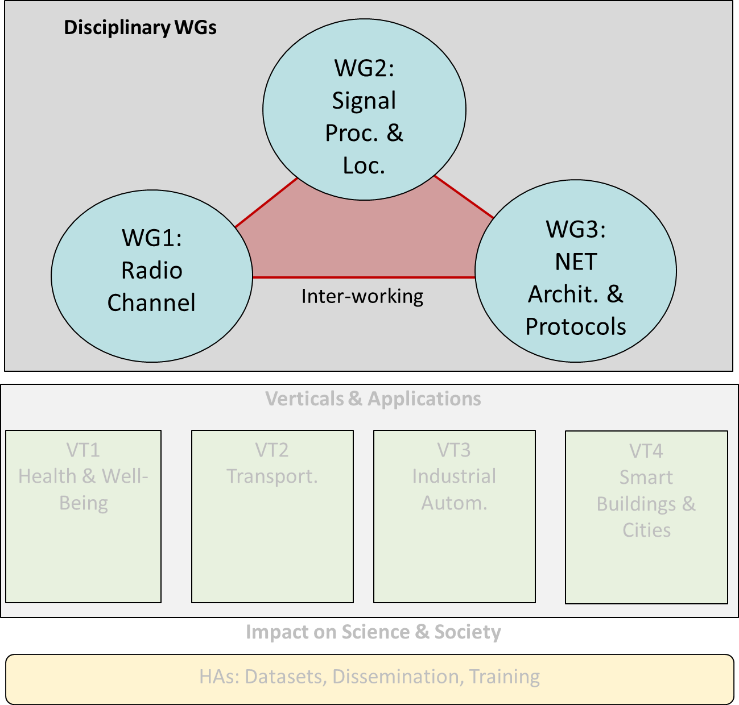
Working Groups
WG1: Radio channel
  Radio channel modelling
  ML-based propagation modelling
  Shape the radio channel through RIS
WG2: Signal Processing and Localisation
  Novel PHY layer technologies
  ML-based positioning
WG3: Network Architectures and Protocols
  ML-Based network management and orchestration
  Dynamic networks
  Novel network paradigms for full interactive experience

Slide 12
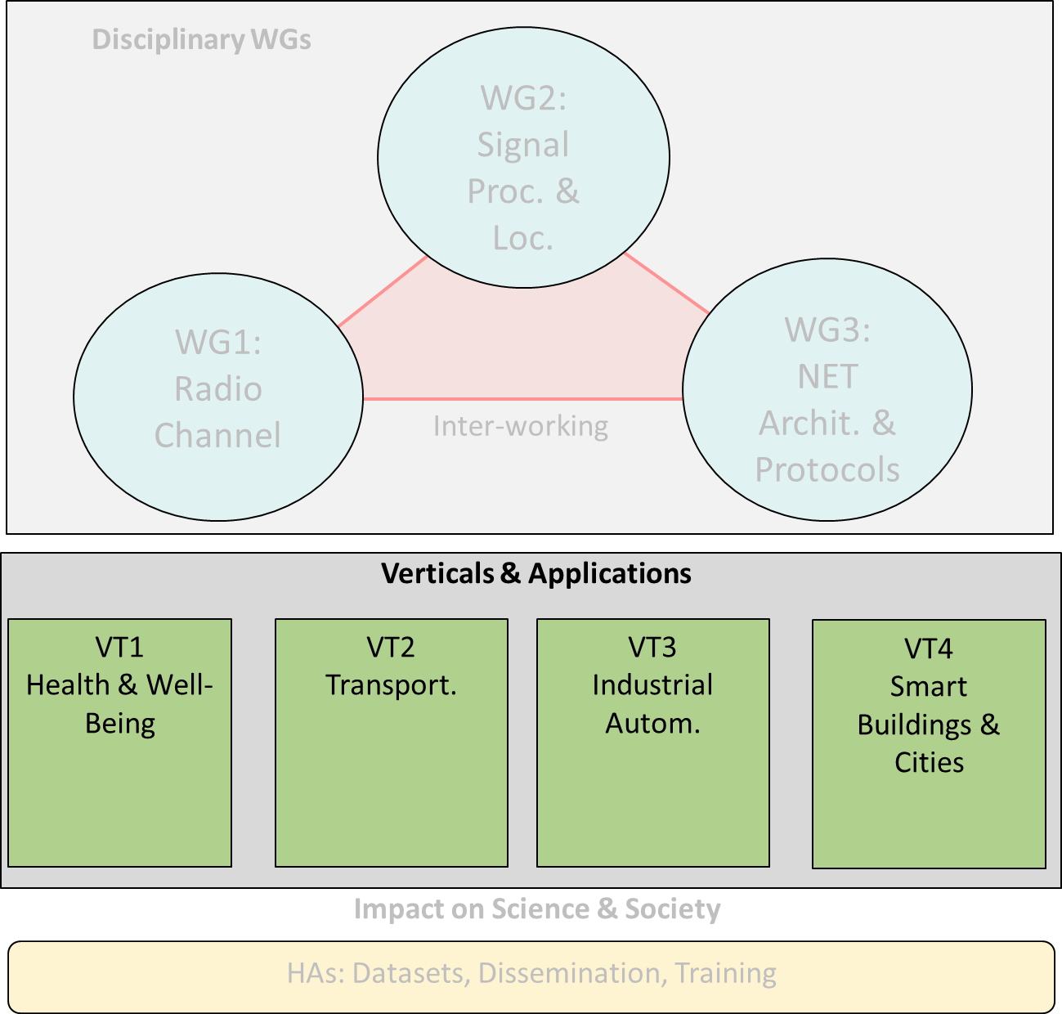
Vertical Teams
VT1: Health and Well-Being
  Mission-critical body-centric communications
  Novel human-to-machine interaction applications
VT2: Transportation
  High-mobility scenarios, including cars, trains and UAVs (3D)
VT3: Industrial Automation
  Critical communication (Ultra reliable, guaranteed latency)
VT4: Smart Buildings and Cities
  Ultra-dense, low rate and low energy scenarios

Slide 13
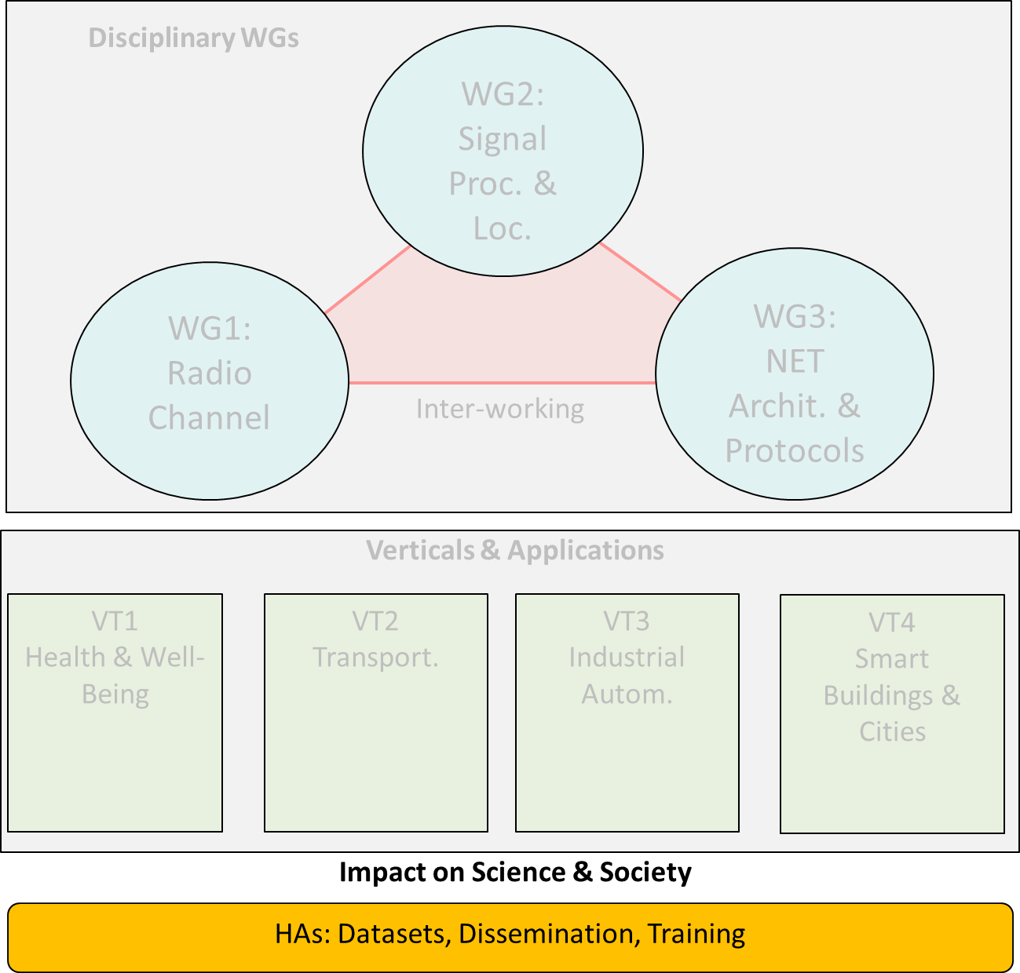
Horizontal Activities
HA1: Datasets
  Set-up and maintenance of datasets, including measurement results, simulation scenarios and models, etc.
HA2: Dissemination
  Organisation of workshops, special sessions
  Setup and maintenance of website, social media, newsletters
HA3: Training
  Organisation of training schools, tutorials in conferences, etc.
  Organisation of training sessions of soft-skills

Slide 14
Deliverables (1)
Month 12 Deliverable 1 (HA1) - H1: Database structure and content requirements.
Deliverable 2 (All) - D1: State-of-the-art and key challenges
Month 16 Deliverable 3 (WG1) - White paper on radio channel modelling and prediction to support environment-aware communications
Month 32 Deliverable 4 (WG2) - White paper on novel physical layer technologies and localization algorithms for future wireless networks

Slide 15
Deliverables (2)
Month 36 Deliverable 5 (All WGs and verticals) - Disciplinary solutions to the research challenges (preliminary draft of the final report)
Month 48 Deliverable 6 (HA1) - H2: Database with data sets available.
Deliverable 7 (WG3) - White paper on novel network architectures and protocols for future wireless networks
Deliverable 8 (All) - FR: Final report (open-access book) including all research outcomes of the different disciplinary and interdisciplinary work.

Slide 16
Working Groups
WG1 Radio Channels (Vittorio Degli Esposti, UNIBO, Italy; Mate Boban, HUAWEI, Germany)
  Increase the theoretical and experimental understanding and modelling of radio channels
SWG mmWave and THz sounding (Diego Dupleich, TUIL, Germany; Wei Fan, AAU, Denmark)
  Concentrate the expertise on radio channel measurements and analysis
SWG on Reconfigurable Intelligent Surfaces (Marco Di Renzo, CNRS & CentraleSupélec, Paris-Saclay University, Paris, France; Joonas Kokkoniemi Centre for Wireless Communications, University of Oulu, Oulu, Finland)
  Develop electromagnetically consistent analytical, numerical, and experimental models for RIS and RIS-aided radio channels

Slide 17
Working Groups
WG2 Signal Processing and Localisation (Alister Burr, UOY, United Kingdom; Ana Garcia Armada, UC3M, Spain)
  Design new positioning and localization techniques
SWG Integrated Sensing and Communication (Yang Miao, University of Twente, Netherlands; Carsten Smeenk IIS Fraunhofer, Germany)
  Develop transceivers and information retrieve approaches that simultaneously sense and communicate
WG3 Network Architectures and Protocols (Hamed Hamadi, UOY, United Kingdom; Konstantin Mikhaylov, OULU, Finland)
  Propose new networking paradigms to perform human-to-thing communication

Slide 18
Vertical Teams
VT1 Health and Well-Being (Kamran Sayrafian, NIST, United States; Slawomir Ambroziak, PG, Poland)
    ...scientific challenges dealing with communications around or inside the human body,..
SWG Exposure to Electromagnetic Fields (Joseph Wout, UGENT, Belgium; Conchi Garcia-Pardo, Spain)
    ..contribute to measurement analysis for the assessment of human exposure to electromagnetic fields.
VT2 Transportation (Thomas Blazek, SAL, Austria; Adrian Kliks, PUT, Poland)
    ...challenges related to high mobility, requesting precise knowledge of the radio channel
VT3 Industrial Automation (Golsa Ghiaasi, SAL, Austria; Raheeb Muzaffar, SAL, Austria)
    ... calling for the design of novel transmission techniques, considering mmWave and THz bands…
VT4 Smart Buildings and Cities (Periklis Chatzimisios, IHU, Greece; Fernando José Velez, UBI, Portugal)
    ...will emphasise both very high-rate communications and/or ultra-dense networks. ...

Slide 19
Cooperation and opportunities
(a) Invited Speech by IEEE 802.11 WGs to take place at the next INTERACT meeting (September 2023, Poland)
    There are research teams @INTERACT that are interested!
    (b) There are some other COST Actions that will be interested in IEEE 802.11 standards!
    (c) IEEE Conference on Standards for Communications and Networking (CSCN 2023)
    http://cscn2023.ieee-cscn.org/ (it will come alive in a few days) (November 6-8, Munich)
    A Panel on IEEE 802.11 standards! (it happened last year“25 Years of IEEE 802.11 Standards”)
    (https://cscn2022.ieee-cscn.org/program/panels)
    Training Session for Young Professionals and Students on IEEE 802.11 standards! (happened @CSCN 2022)

Slide 20
References
[1] https://interactca20120.org/ (COST CA20120 INTERACT website)

