Slide 1
Distributed Microphone Smart Home Application for AMP IoT devices
Date: 2023-07-10
Authors:
Patricia Bower/Vytas Kezys , HaiLa Technologies Inc.

Slide 2
Abstract
The purpose of this presentation is to outline distributed microphones for smart homes as a key use case driving specific requirements for AMP IoT devices in future. Use cases in smart manufacturing may also drive similar requirements
Patricia Bower/Vytas Kezys , HaiLa Technologies Inc.

Slide 3
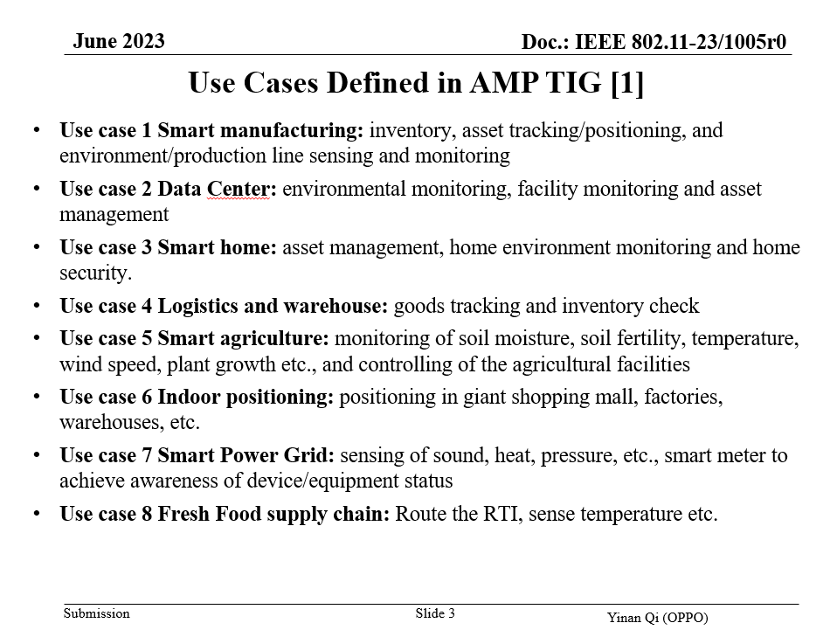
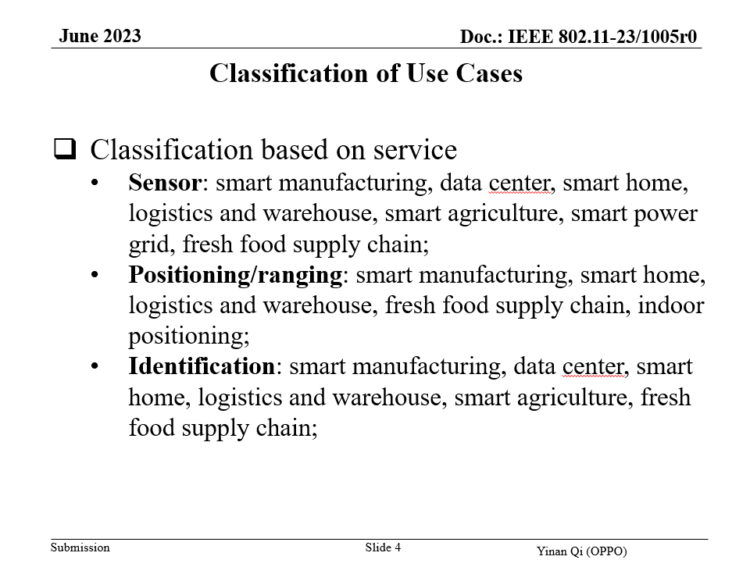
AMP SG focus review:
Use case summary (802.11-23/1005r0)
Use Case 3: Smart Home
  Asset management, environment monitoring, and home security
In addition to the above, it is expected that smart homes with home hub/gateway devices will support distributed microphones in future to support continuous natural language interaction and to move beyond wake-word model

Slide 4

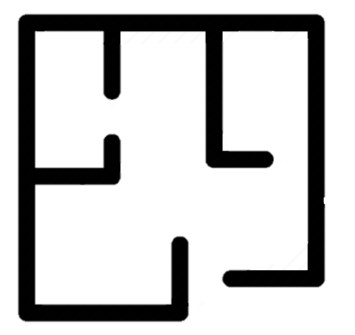
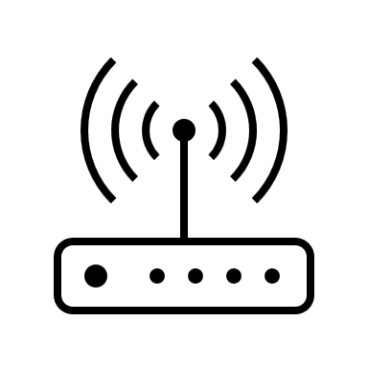

Smart Home: Distributed microphone
Microphone
(AMP device)
Home hub
(AMP-supporting STA)
Second floor
AMP-supporting AP/STA
(potential joint transmission)
First floor
Patricia Bower/Vytas Kezys, HaiLa Technologies Inc

Slide 5
Distributed microphone use case (1/2)
Description
  Smart home hub STAs will migrate towards use of distributed microphones to enable hub/gateway voice-activation from anywhere in the home
  AMP use case classification is Sensor
  Expected to be a high-volume AMP device application
Features
  Extremely low power, ambient microphone (= AMP IoT device)
  Voice detection at AMP microphone
  Supporting compressed voice data (very low bit rate)
  Processing at home hub/gateway and beyond
  Bursty data
  Leverages fixed AMP-supporting STA infrastructure (e.g., smart light bulbs)
  May allow for locating user acoustically for context
  Can allow for noise cancellation

Slide 6
Distributed microphone use case (2/2)
Requirements
  Product-life battery or battery-free (energy harvesting)
  Density of distribution: up to 1/m²
  Infrastructure: fixed AMP-supporting STAs
  Type 1 AMP STA
  Latency: <100ms
  Payload: 4kbps (cumulative higher over longer voice detection cycles, e.g., 100msec)
  Bursts of high duty cycle of transmit for longer periods of voice

Slide 7
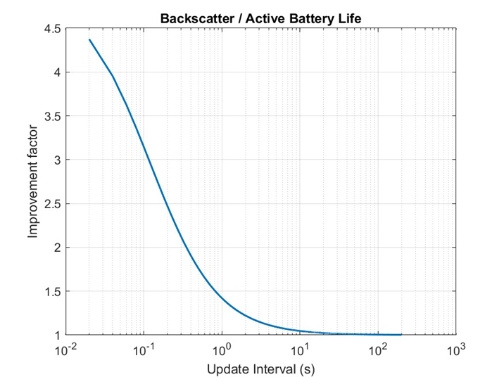
Addressing distributed microphone
AMP device constraints
Problem statement
  The smart home distributed microphone use case places additional constraints on AMP device specifications namely a combination of high data rates (burst), high transmit duty cycle, and extreme longevity
AMP device enabling technologies
  Comparative battery life modelling of both active transmit and passive backscatter of 1Mbps DSSS uplink against different sensor update intervals was performed
  At sensor sampling rate of >3/sec, passive backscatter uplink is shown to support both high duty cycle and significantly extended battery life
AMP device battery life modelling relative to sensor sample interval: Backscatter vs Active Transmit

Slide 8
Summary
Future Smart Home application for distributed microphone requires both extreme longevity (low power) and high duty cycle AMP device
  This application may drive a requirement for energy harvested power source in the AMP IoT devices
  Propose to include these requirements as part of (or a subset of) UC3 Smart Home
Use cases that would be part of UC1 Smart Manufacturing may also have similar constraints for combined high data rate, high duty cycle, and extreme longevity

Slide 9
References
1. IEEE 802.11-23/1005r0, Discussion on Requirements for AMP Use Cases

