Slide 1
Discussion on AMP Security
May 2023
Doc.: IEEE 802.11-23/1189r1
Date: 2023-03-13
Authors:
Name | Affiliation | Address | Phone | Email
Weijie Xu | OPPO |  |  | xuweijie@oppo.com
Yinan Qi |  |  |  | v-qiyinan@oppo.com
Hao Min | Quanray |  |  | hmin@fudan.edu.cn

Slide 2
Abstract
Doc.: IEEE 802.11-23/1189r1
It is proposed during the TIG phase[1][2] to review the security mechanism for AMP and check whether the existing WiFi security can be reused for AMP.
In this submission, the power consumption of encryption algorithm AES 128 is tested.

Slide 3
Background
Doc.: IEEE 802.11-23/1189r1
User privacy and data security needs to be protected in many of the use cases identified for AMP IoT[3].
  e.g. the information wrote into and read from the AMP tag used in logistics use cases
  e.g. in the use case of finding home belongings, the location information of personal belongings shall not be exposed to the unauthorised devices
On the other hand, there is strict constraint of device complexity and power consumption for AMP devices, it needs to check whether the existing security can be reused when supporting AMP IoT in 802.11.
AES 128 is the main encryption/decryption algorithm used in WiFi.

Slide 4
Baseband Architecture
Doc.: IEEE 802.11-23/1189r1
In order to measure the power consumption of AES128, the following baseband architecture is designed.
Figure 1 Baseband Architecture

Slide 5
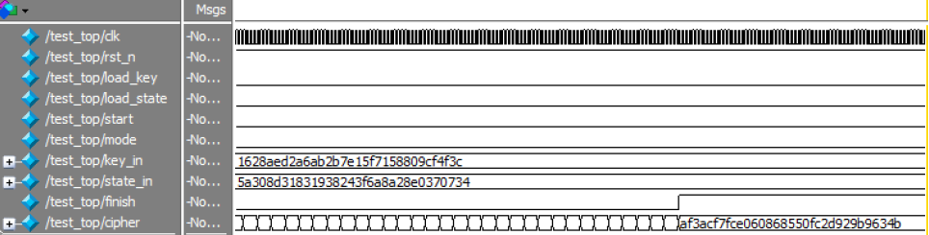
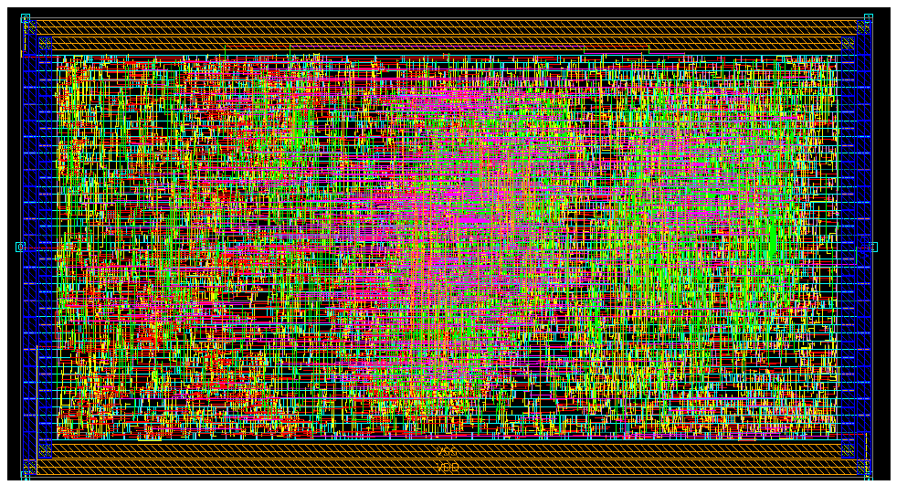
Testing of AES128
Doc.: IEEE 802.11-23/1189r1
Chip process: 65nm.
Packet length:128bits(cleartext or ciphertext)
Figure 2 Testing of encryption using AES 128 Figure 3: Baseband layout
Power consumption test result: 3.8 uW/6.5uW for AES module/whole chip.

Slide 6
Summary
Doc.: IEEE 802.11-23/1189r1
In this submission, the power consumption of AES 128 in an ultra-low power consumption baseband platform is tested.
It can be seen very low power consumption (i.e. several uW) can be achieved for encryption/decryption using AES 128 hardware accelerator.
It is proposed to use the exiting WiFi security as the starting point for AMP IoT device.

Slide 7
Reference
May 2023
Doc.: IEEE 802.11-23/1189r1
IEEE 802.11-23/0063r4, Proposal for consensus straw poll
IEEE 802.11-23/0406r0 Proposal for consensus straw poll and motion
IEEE 802.11-23/0436r0 Technical Report on support of AMP IoT devices in WLAN

