Slide 1
Follow-up Discussions on Neural Network Model Sharing for WLAN
Date: 2023-07
Authors:
Name | Affiliations | Address | Phone | Email
Ziyang Guo | Huawei | Huawei Base, Bantian, Longgang, Shenzhen, Guangdong, China, 518129 |  | guoziyang@huawei.com
Peng Liu
Ross Jian Yu

Slide 2
Introduction
In [1], we revisited the use cases in the previous submission and observed that most of them can be regarded as transmission scheme optimization. Then, we investigated the neural network model architecture on transmission scheme optimization, which consists of inputs, pre-processing, core neural network and post-processing, and discussed the functions and possible standardization impacts/ways for each part.
In this submission, we take channel access and rate adaptation as example. We study the technical feasibility of model reuse, i.e., a model with the same architecture is able to perform well on both tasks.

Slide 3
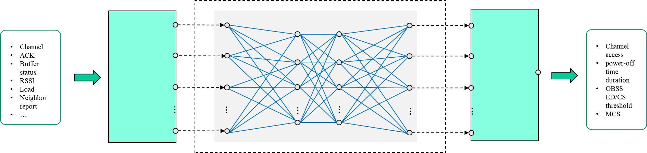
Recap: Neural Network Model Architecture[1]
Train@AP
Components | Descriptions | Thoughts on Standardization
Input | local radio measurements at PHY/MAC layer, defined in Sec.4.3.11 of 802.11-2020 or customized A sequence of historical observations | Standardize some basic and common inputs for a variety of use cases
Pre-processing | Format conversion (e.g., normalization) to NN friendly format Feature extraction or augmentation Could be NN or other algorithms | If Pre-processing is left for implementation, the output of Pre-processing (i.e., the input of core NN) shall be standardized
Core Neural Network | Structure, e.g., DNN or CNN Layer types, number of layers, number of neurons per layer, activation function | Standardize several basic and mandatory model structure such as DNN and CNN Alternatively, consider ONNX[6] or NNEF[7] on top of the 802.11 Explore model reuse
Post-processing | Map neural network output to specific transmission scheme Probability distribution or ArgMax | Both types can be considered to be standardized
Training data report
AP
Model deployment/sharing
Non-AP 3
Non-AP 1
Inference@non-AP STA
Non-AP 2
Input/
measurements
Pre-processing
Core Neural Network
Post-processing
Output/decision

Slide 4

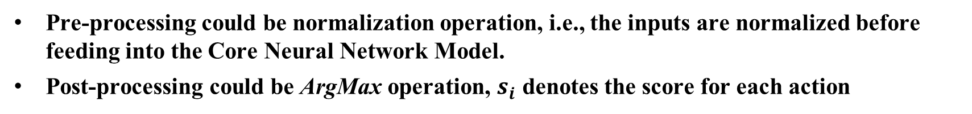


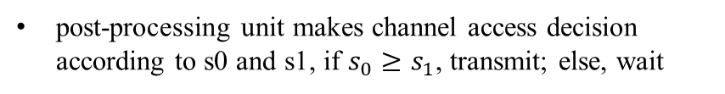

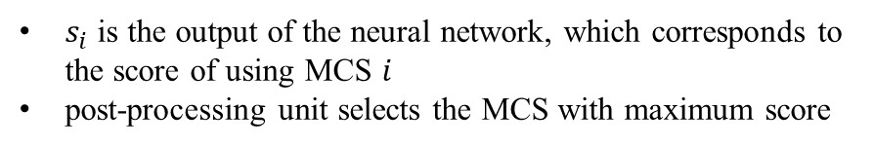


Pre- and Post- Processing for Channel Access and Rate Adaptation
Pre-processing could be normalization operation, i.e., the inputs are normalized before feeding into the Core Neural Network Model.
Post-processing could be ArgMax operation, $s_{i}$ denotes the score for each action
Channel Access
Rate Adaptation
$$s_{0}$$
$$s_{0}$$
$$s_{1}$$
post-processing
post-processing
$$s_{1}$$
Channel access decision
MCS decision
$$⋮$$
$$s_{N−1}$$
post-processing unit makes channel access decision according to s0 and s1, if $s_{0}≥s_{1}$, transmit; else, wait
$s_{i}$ is the output of the neural network, which corresponds to the score of using MCS $i$
post-processing unit selects the MCS with maximum score

Slide 5








Core Neural Network Model for Channel Access and Rate Adaptation
$$m_{0}$$
$$s_{0}$$
$$m_{1}$$
$$s_{1}$$
$$⋮$$
$$⋮$$
$$⋮$$
$$s_{N−1}$$
$$m_{M−1}$$
$$⋮$$
$$⋮$$
$$⋮$$
$$⋮$$
Input
layer
Output
layer
Hidden layer
Given pre- and post- processing, the whole architecture can be simplified as a core neural network.
The core neural network consists of input layer, hidden layer and output layer.
The M-dimensional input layer is the a combination of input measurements after pre-processing and the N-dimensional output layer is score for each transmission scheme.

Slide 6

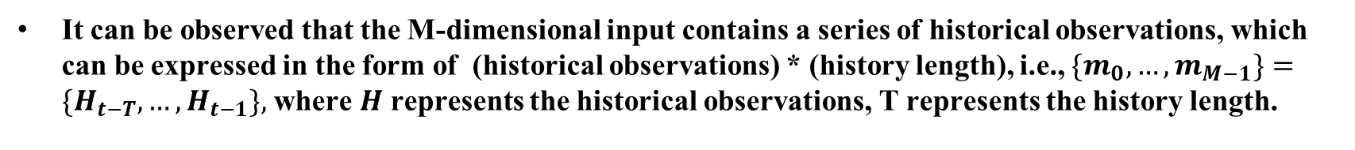



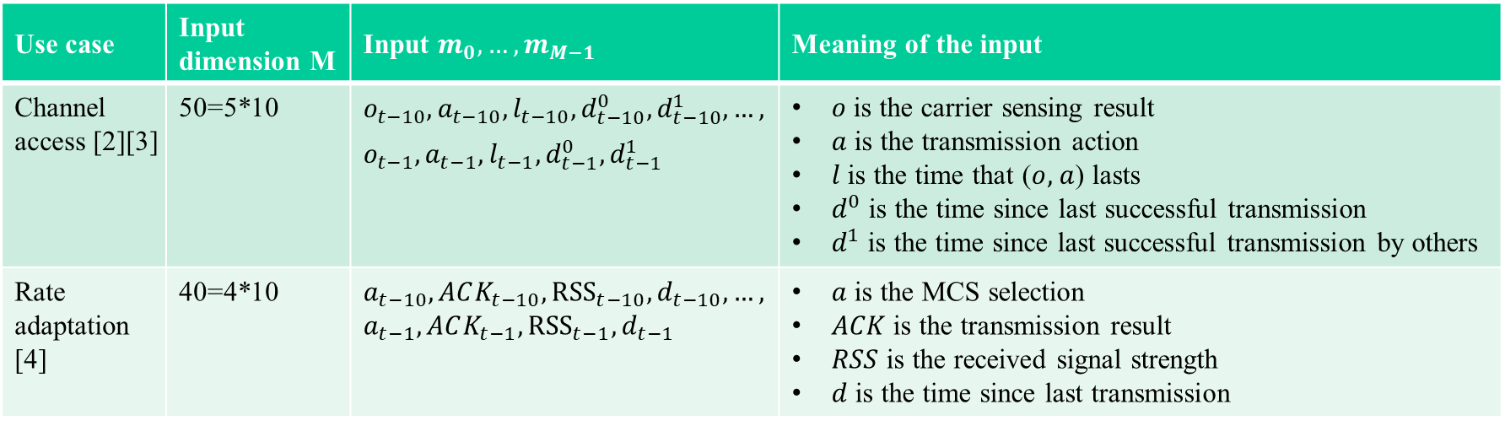
Inputs for Channel Access and Rate Adaptation
Use case | Input dimension M | Input $m_{0},…,m_{M−1}$ | Meaning of the input
Channel access [2][3] | 50=5*10 | $$o_{t−10},a_{t−10},l_{t−10},d_{t−10}^{0},d_{t−10}^{1},…,$$ $$o_{t−1},a_{t−1},l_{t−1},d_{t−1}^{0},d_{t−1}^{1}$$ | $o$ is the carrier sensing result $a$ is the transmission action $l$ is the time that ($o,$ $a$) lasts $d^{0}$ is the time since last successful transmission $d^{1}$ is the time since last successful transmission by others
Rate adaptation [4] | 40=4*10 | $a_{t−10},ACK_{t−10},{RSS}_{t−10},d_{t−10},…,$ $a_{t−1},ACK_{t−1},{RSS}_{t−1},d_{t−1}$ | $a$ is the MCS selection $ACK$ is the transmission result $RSS$ is the received signal strength $d$ is the time since last transmission
$$H_{t−T}$$
$$H_{t−1}$$
$$H_{t−T}$$
$$H_{t−1}$$
It can be observed that the M-dimensional input contains a series of historical observations, which can be expressed in the form of (historical observations) * (history length), i.e., $\{m_{0}, …, m_{M−1}\}=\{H_{t−T}, …,H_{t−1}\},$ where $H$ represents the historical observations, T represents the history length.

Slide 7
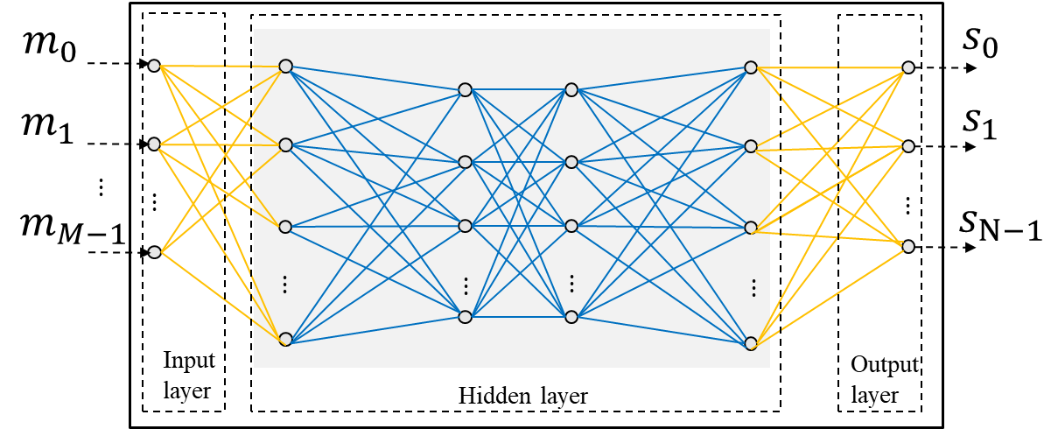
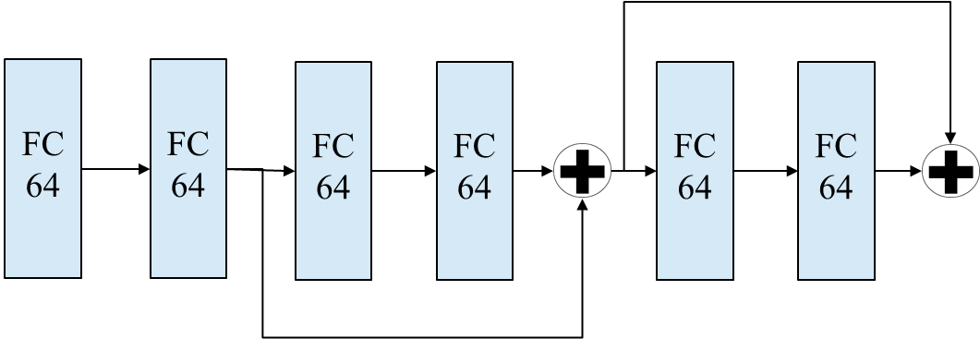
Model Reuse for Channel Access and Rate Adaptation
We found that [5], which also focus on AI-aided channel access as [2][3], adopts the same hidden layer as [4].
We replace the hidden layer used in [2][3] by that in [4], and investigate the feasibility of model reuse for channel access and rate adaptation.
Use DNN-based hidden layer structure for both channel access and rate adaptation use cases

Slide 8
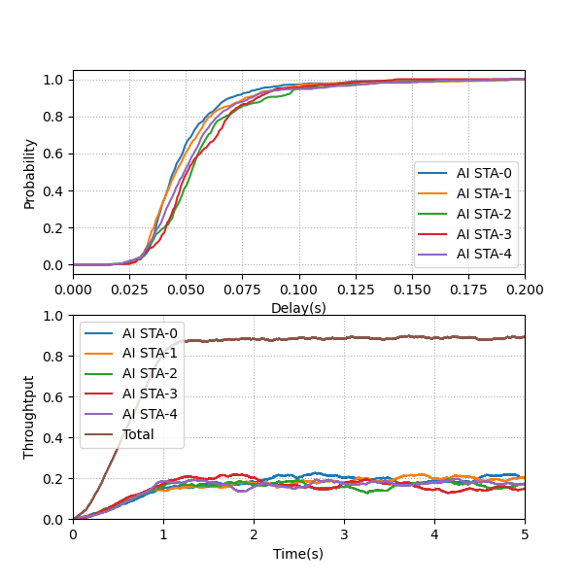
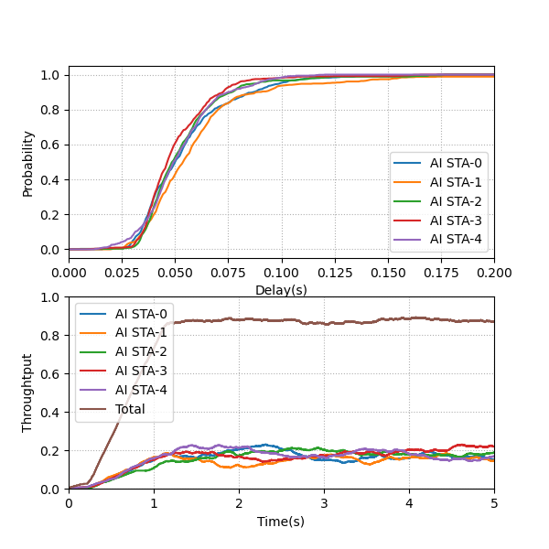
Model Reuse for Channel Access and Rate Adaptation
The simulation results show that similar throughput and delay performance can be achieved by replacing hidden layer structure of channel access [2][3] by that of rate adaptation [4].
The same core neural network can be used for different transmission scheme optimizations.
Original structure
Model reuse

Slide 9
Discussions on Benefits of Model Reuse
Reduce implementation complexity
  Avoid model compilation at the STA side
  Reduce developing effort and cost, e.g., memory for model storage
Facilitate standardization
  Simplify the signaling of model alignment
  Easy for model management compared with one model for one feature
AP
STA
Training
Model (weight/bias, function ID, input/output indications)
  Taking channel access and rate adaptation as example:
    AP trains the model;
    Sends the model parameters (weight/bias) and other parameters (function ID, input/output indications) over the air. Function ID is used to indicate which transmission scheme (channel access or rate adaptation) the model parameters is associated with.
    STA updates the model accordingly.
Update model accordingly

Slide 10
Summary
In this contribution, we take channel access and rate adaptation as example to further discuss the neural network model architecture, including
  Pre- and post- processing
  Inputs and reference format
  Technical feasibility of model reuse and corresponding benefits

Slide 11
Reference
[1] 11-23-0750-00-aiml-discussions-on-neural-network-model-sharing-for-wlan
[2] 11-22-1522-01-aiml-drl-based-channel-access
[3] Z. Guo, Z. Chen, P. Liu, J. Luo, X. Yang and X. Sun, "Multi-Agent Reinforcement Learning-Based Distributed Channel Access for Next Generation Wireless Networks," in IEEE Journal on Selected Areas in Communications, vol. 40, no. 5, pp. 1587-1599, May 2022, doi: 10.1109/JSAC.2022.3143251.
[4] W. Lin, Z. Guo, P. Liu, M. Du, X. Sun and X. Yang, "Deep Reinforcement Learning based Rate Adaptation for Wi-Fi Networks," 2022 IEEE 96th Vehicular Technology Conference (VTC2022-Fall), London, United Kingdom, 2022, pp. 1-5, doi: 10.1109/VTC2022-Fall57202.2022.10012797.
[5] L. Zhang, H. Yin, Z. Zhou, S. Roy and Y. Sun, "Enhancing WiFi Multiple Access Performance with Federated Deep Reinforcement Learning," 2020 IEEE 92nd Vehicular Technology Conference (VTC2020-Fall), Victoria, BC, Canada, 2020, pp. 1-6, doi: 10.1109/VTC2020-Fall49728.2020.9348485.
[6] Open Neural Network Exchange (ONNX), https://onnx.ai
[7] The Khronos NNEF Working Group, “Neural Network Exchange Format”, https://www.khronos.org/registry/NNEF/specs/1.0/nnef-1.0.5.html

